Slide 1
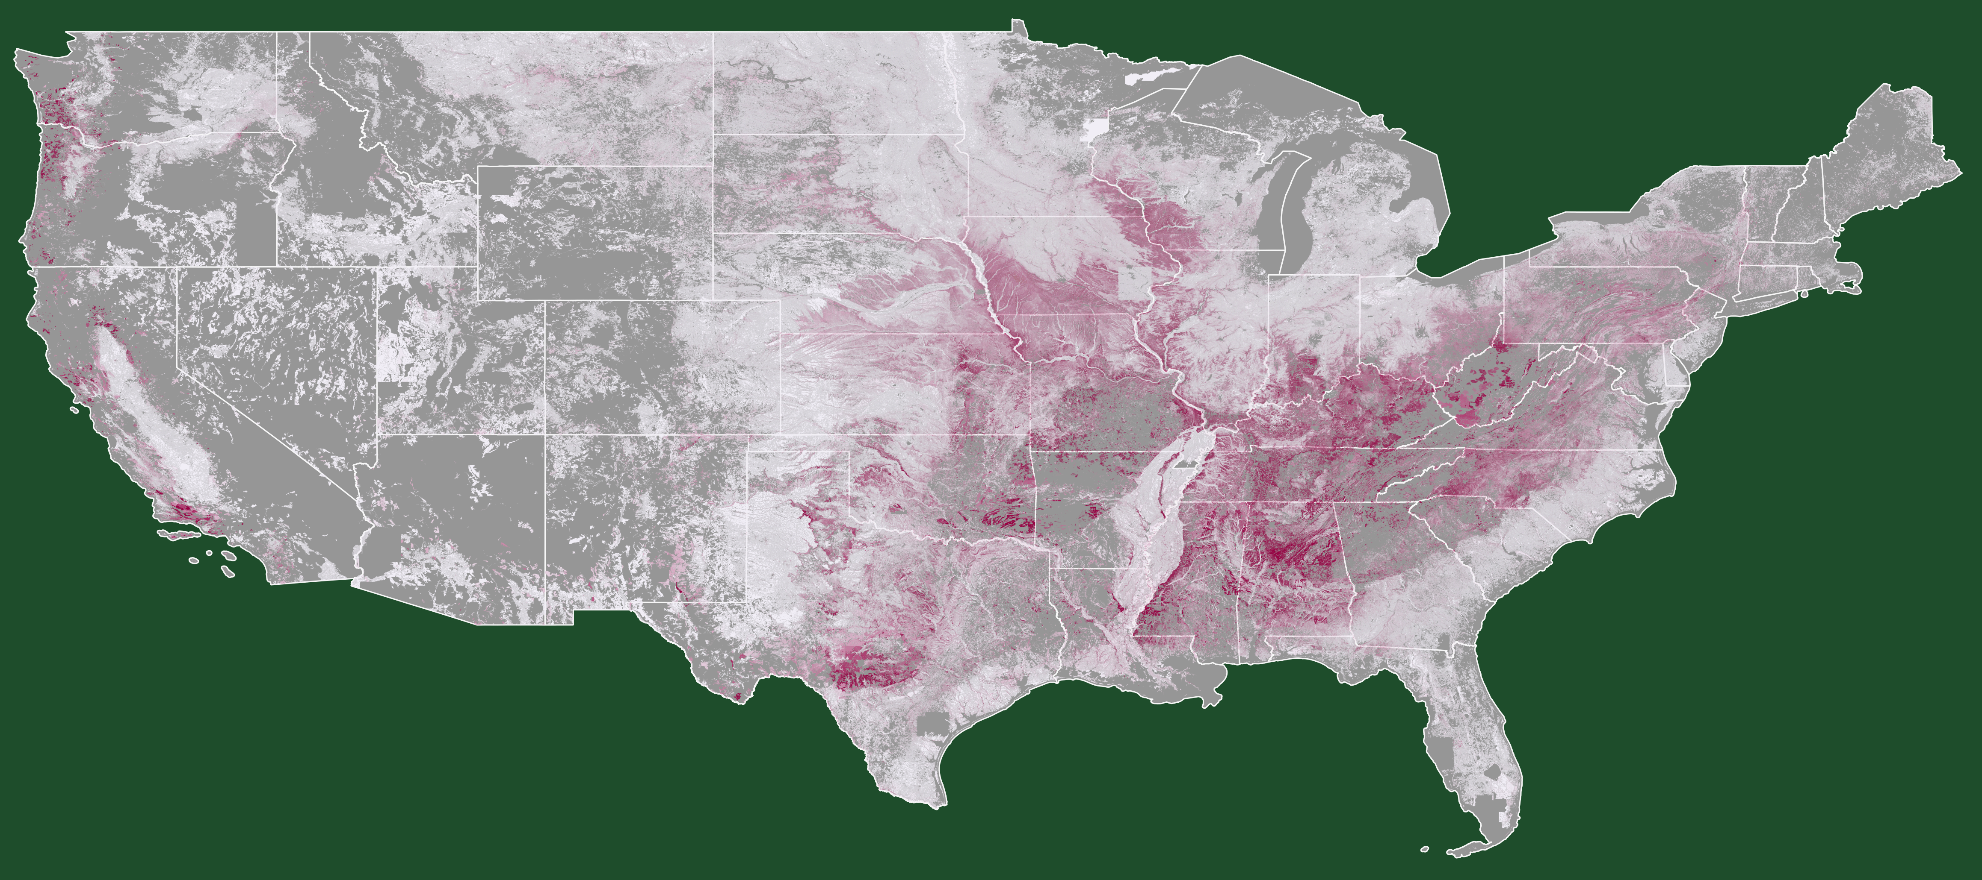
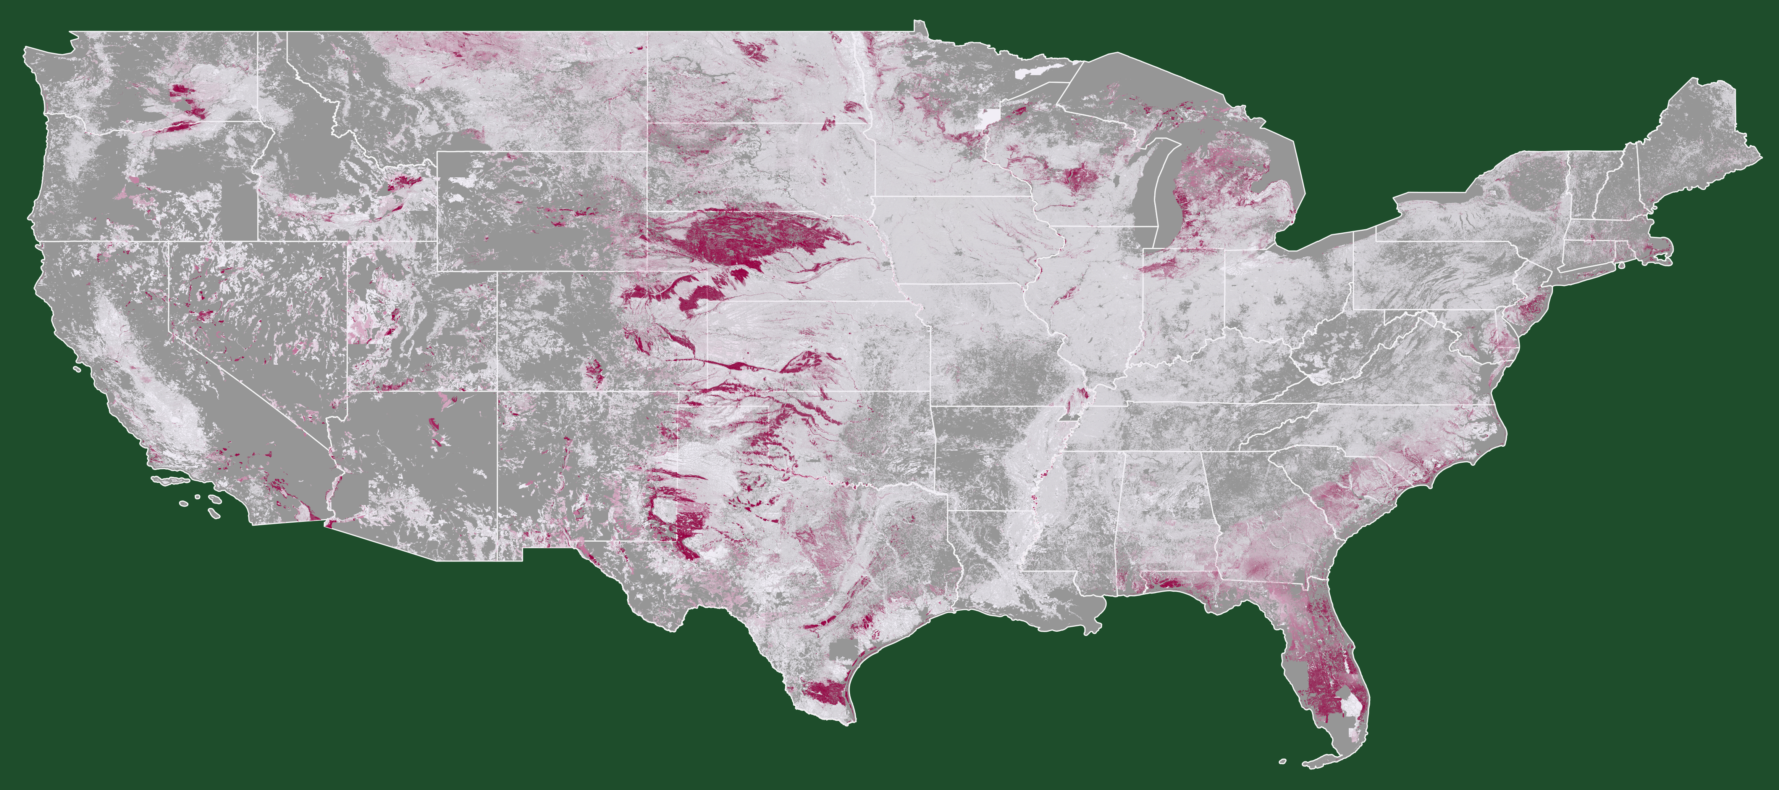
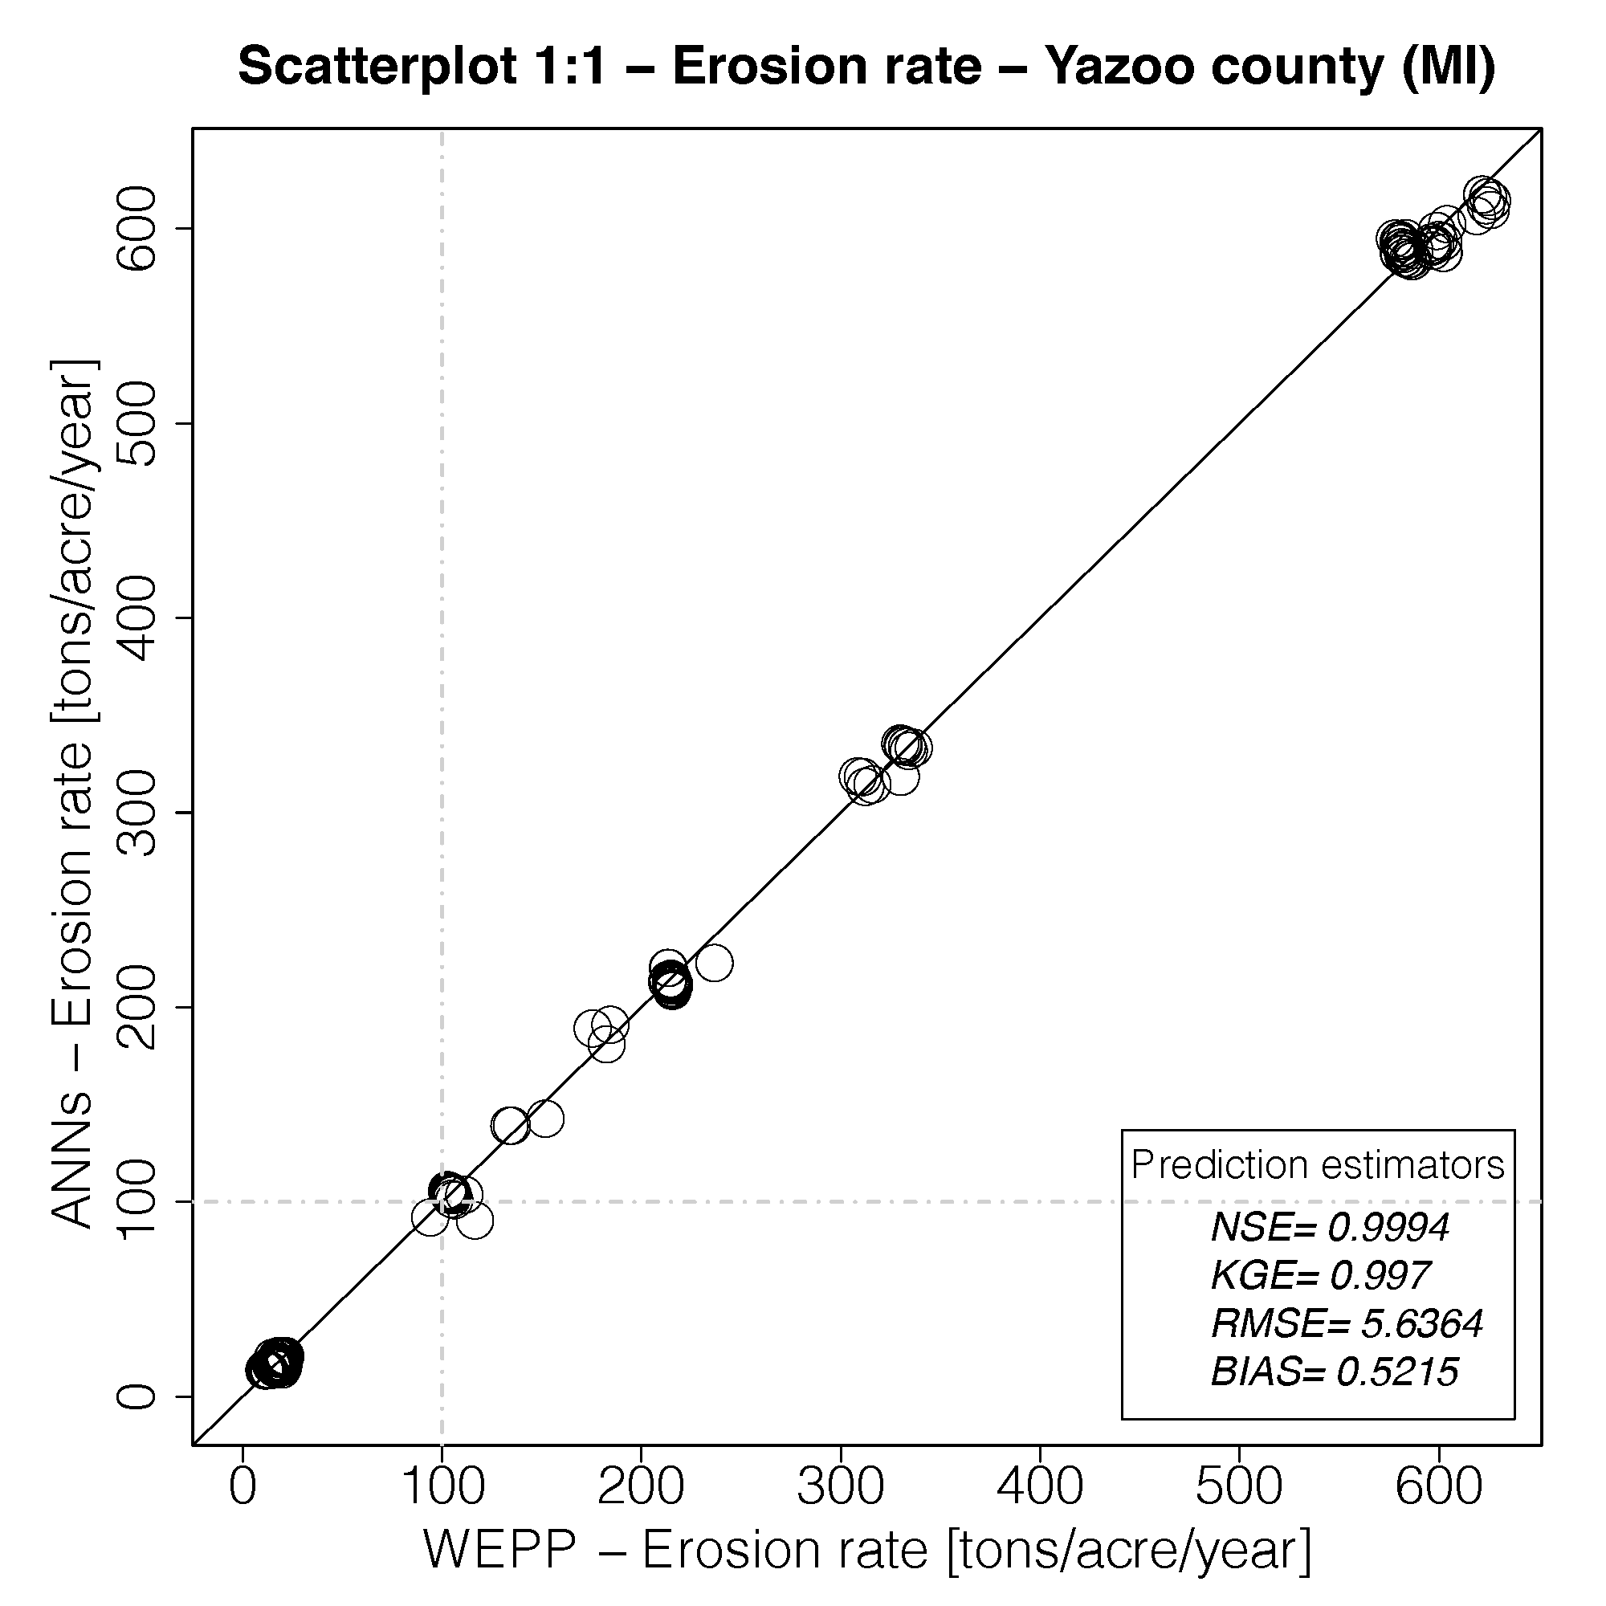
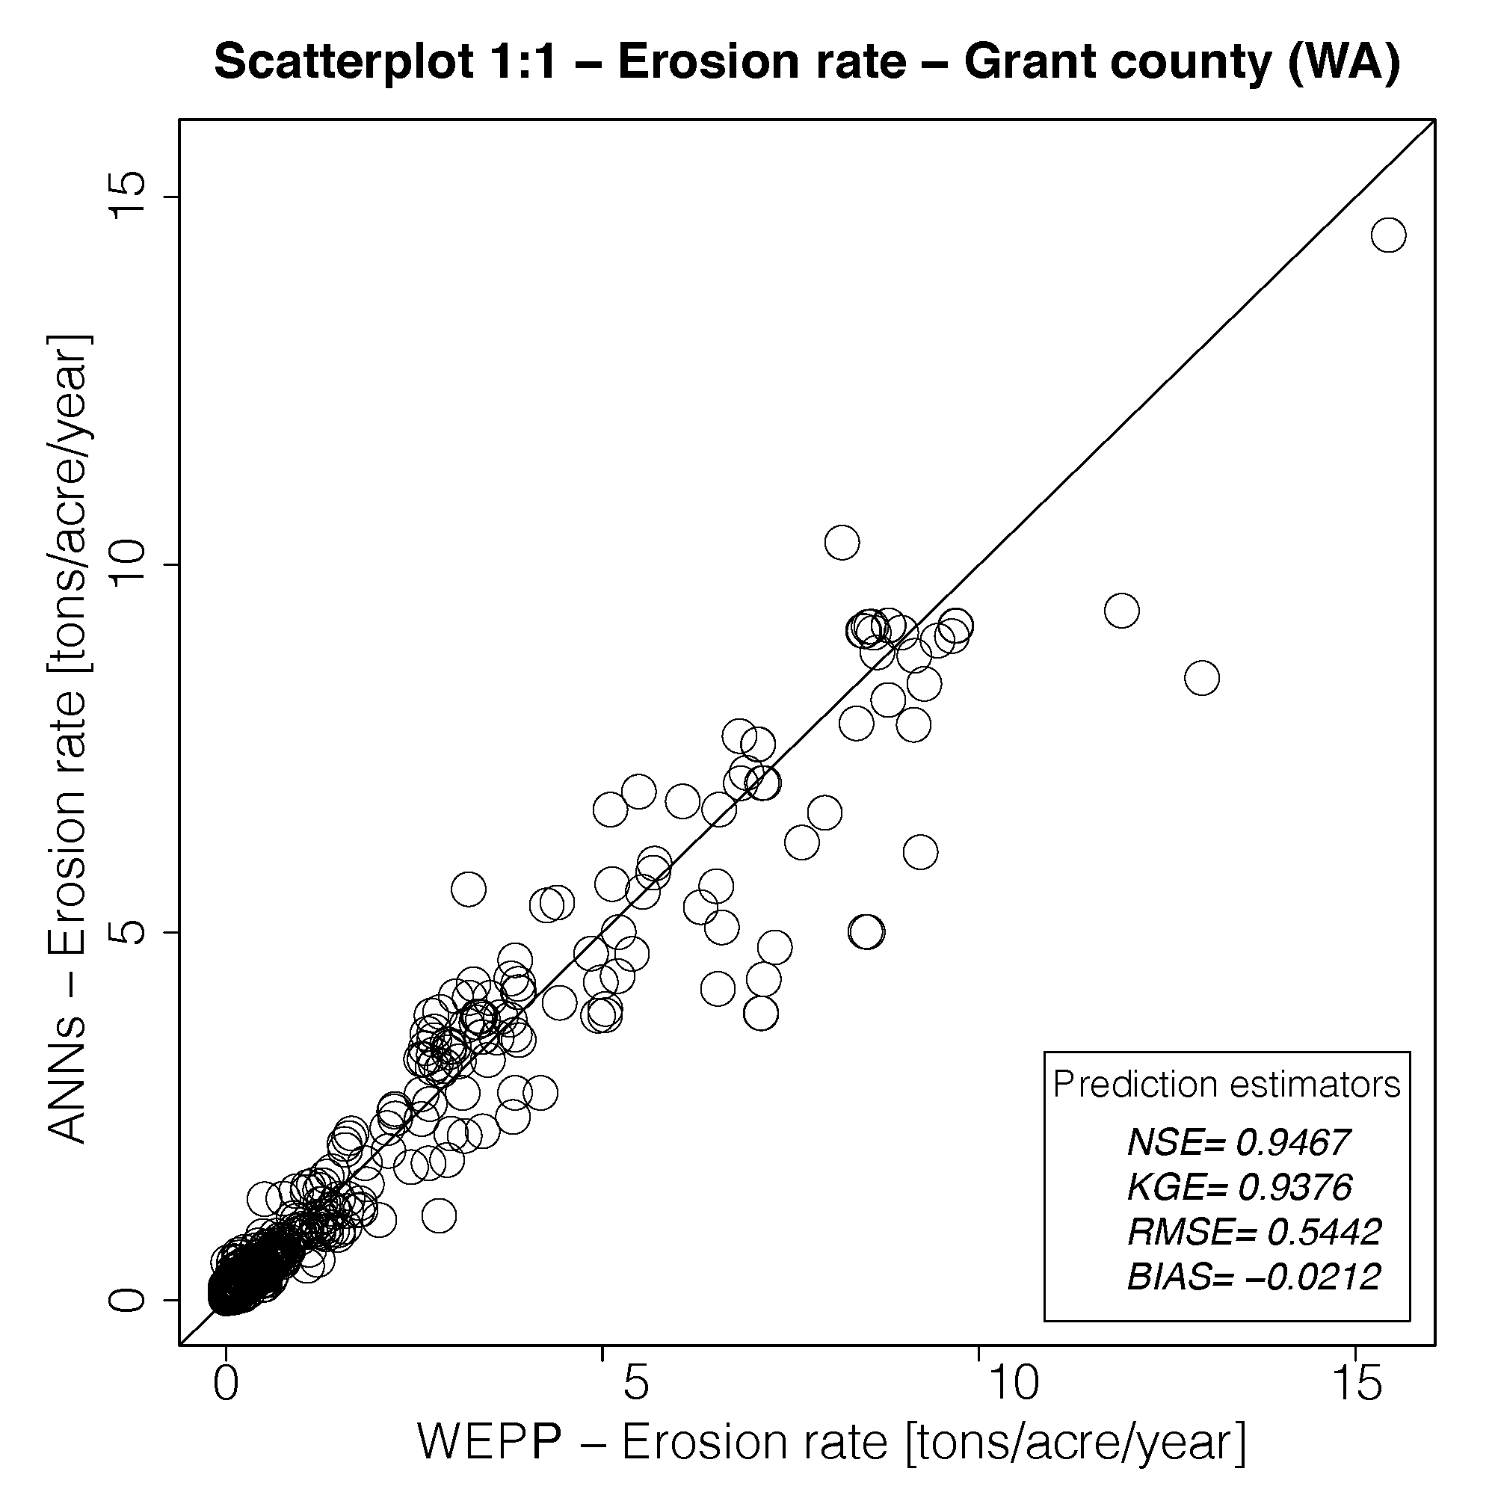
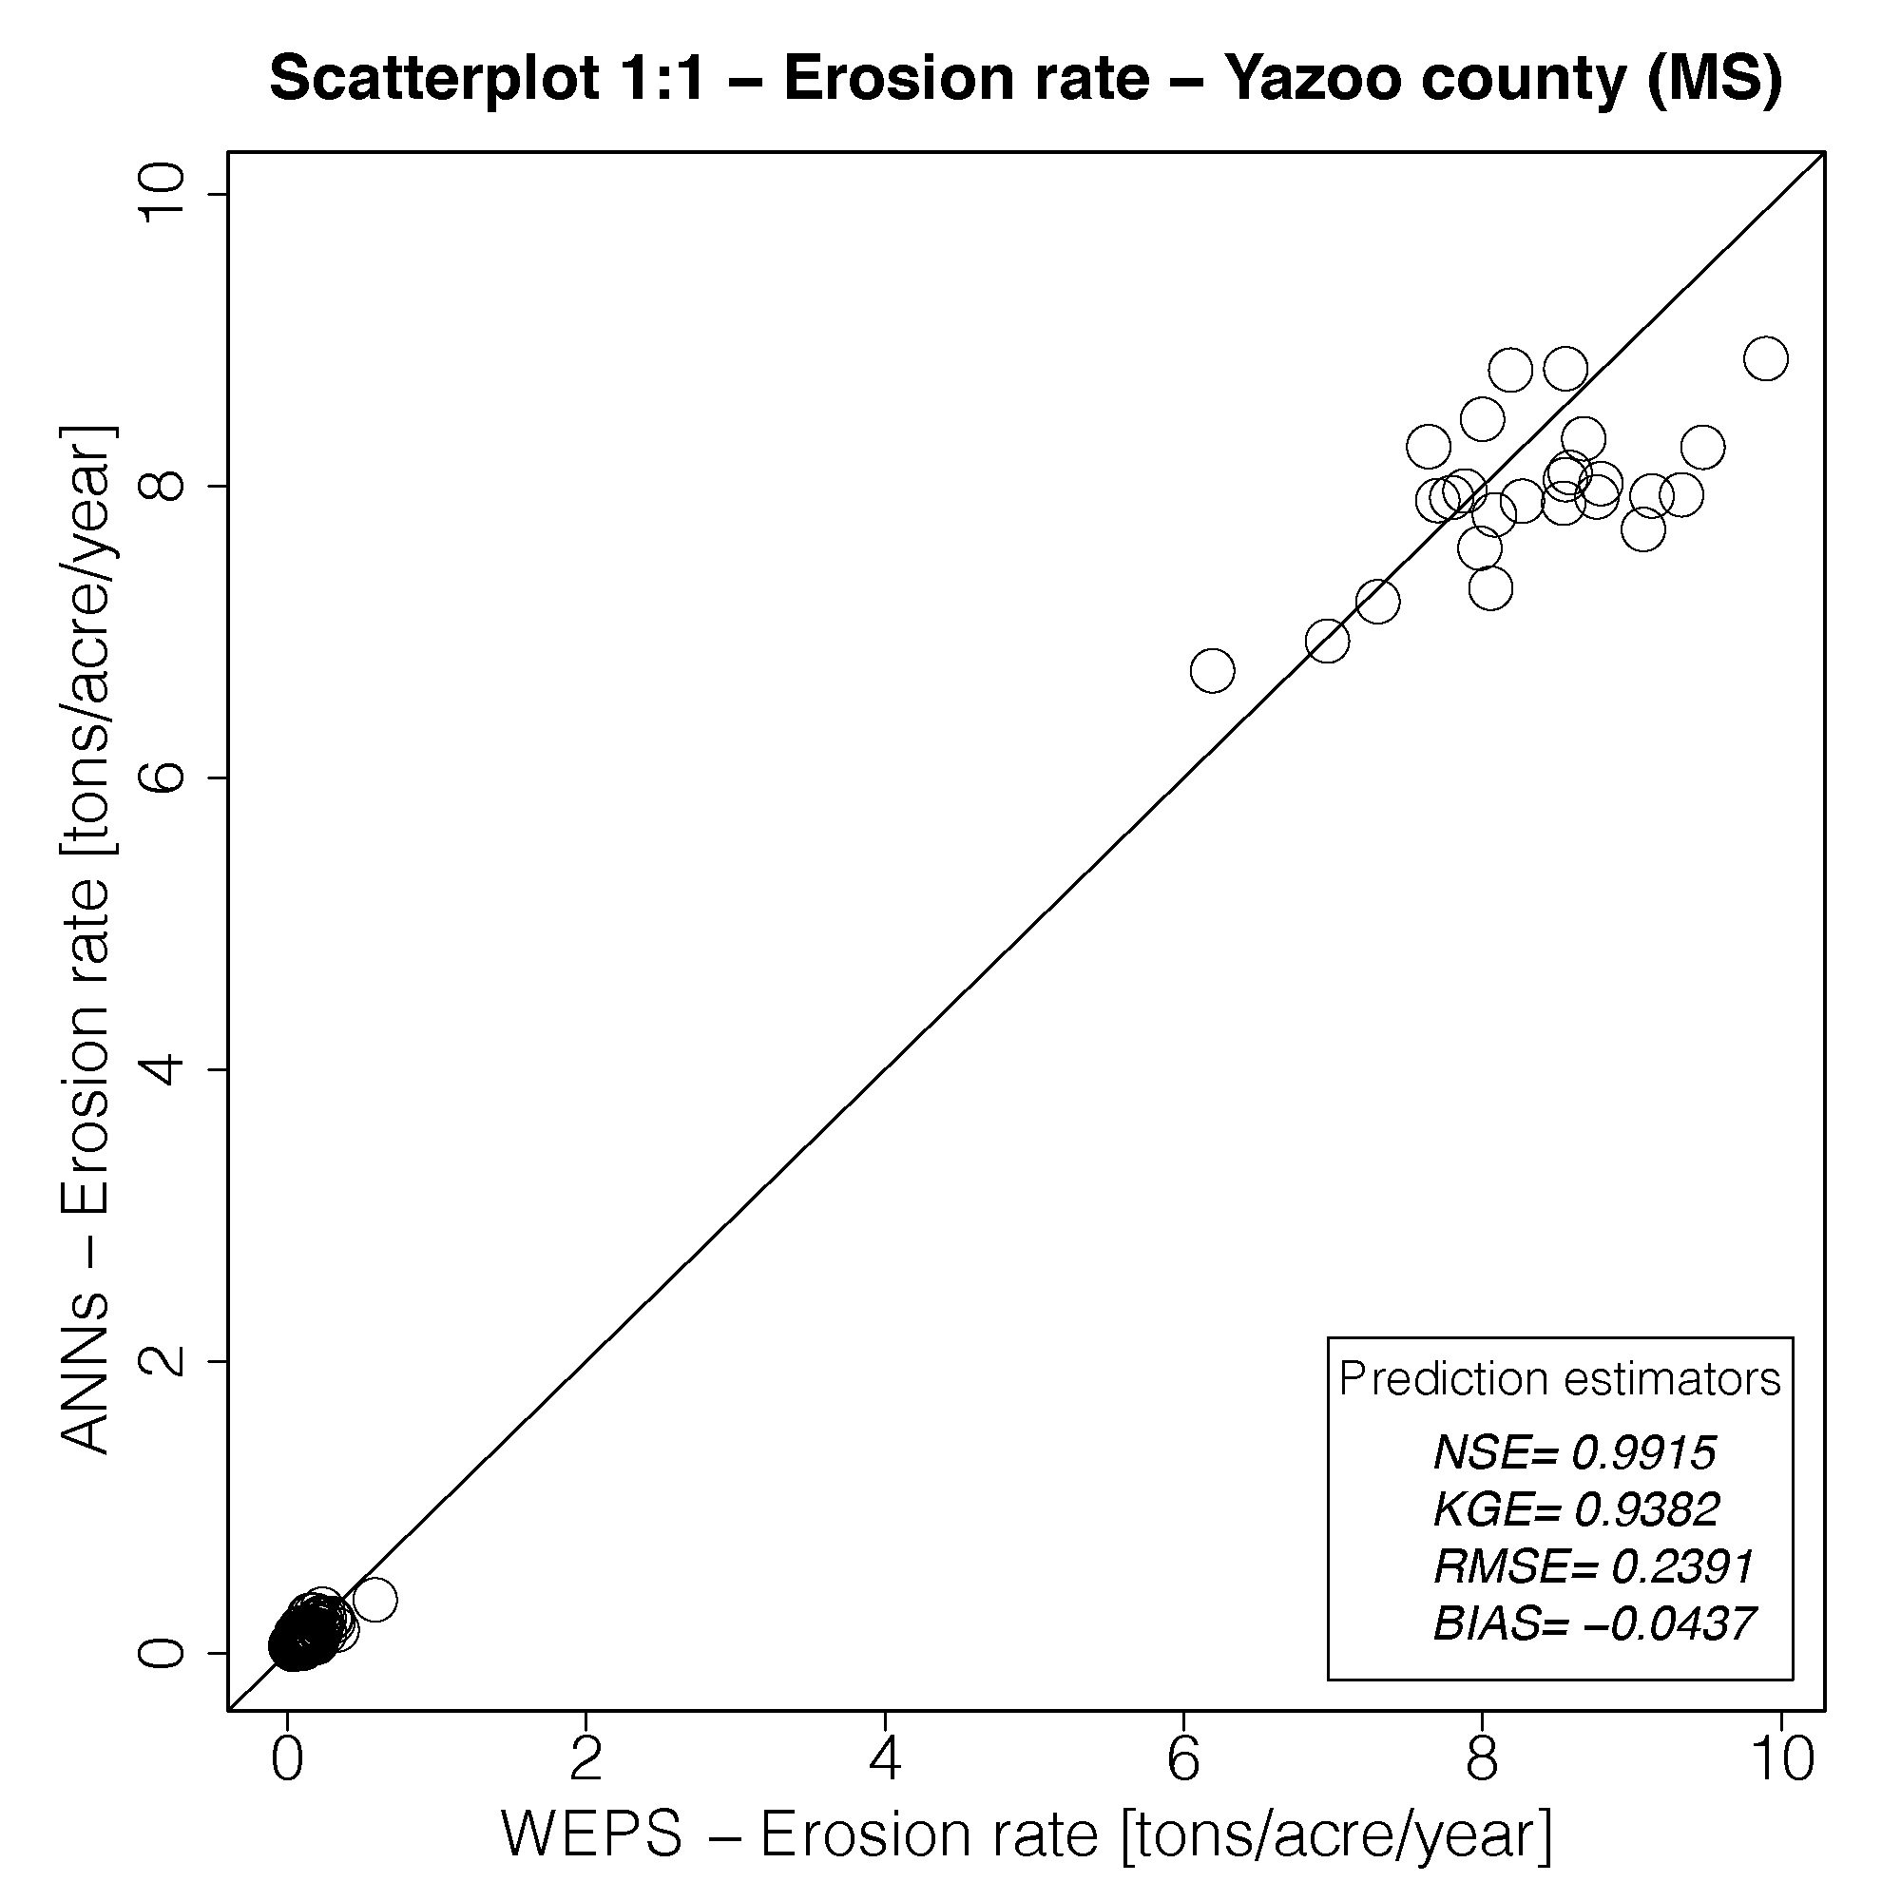
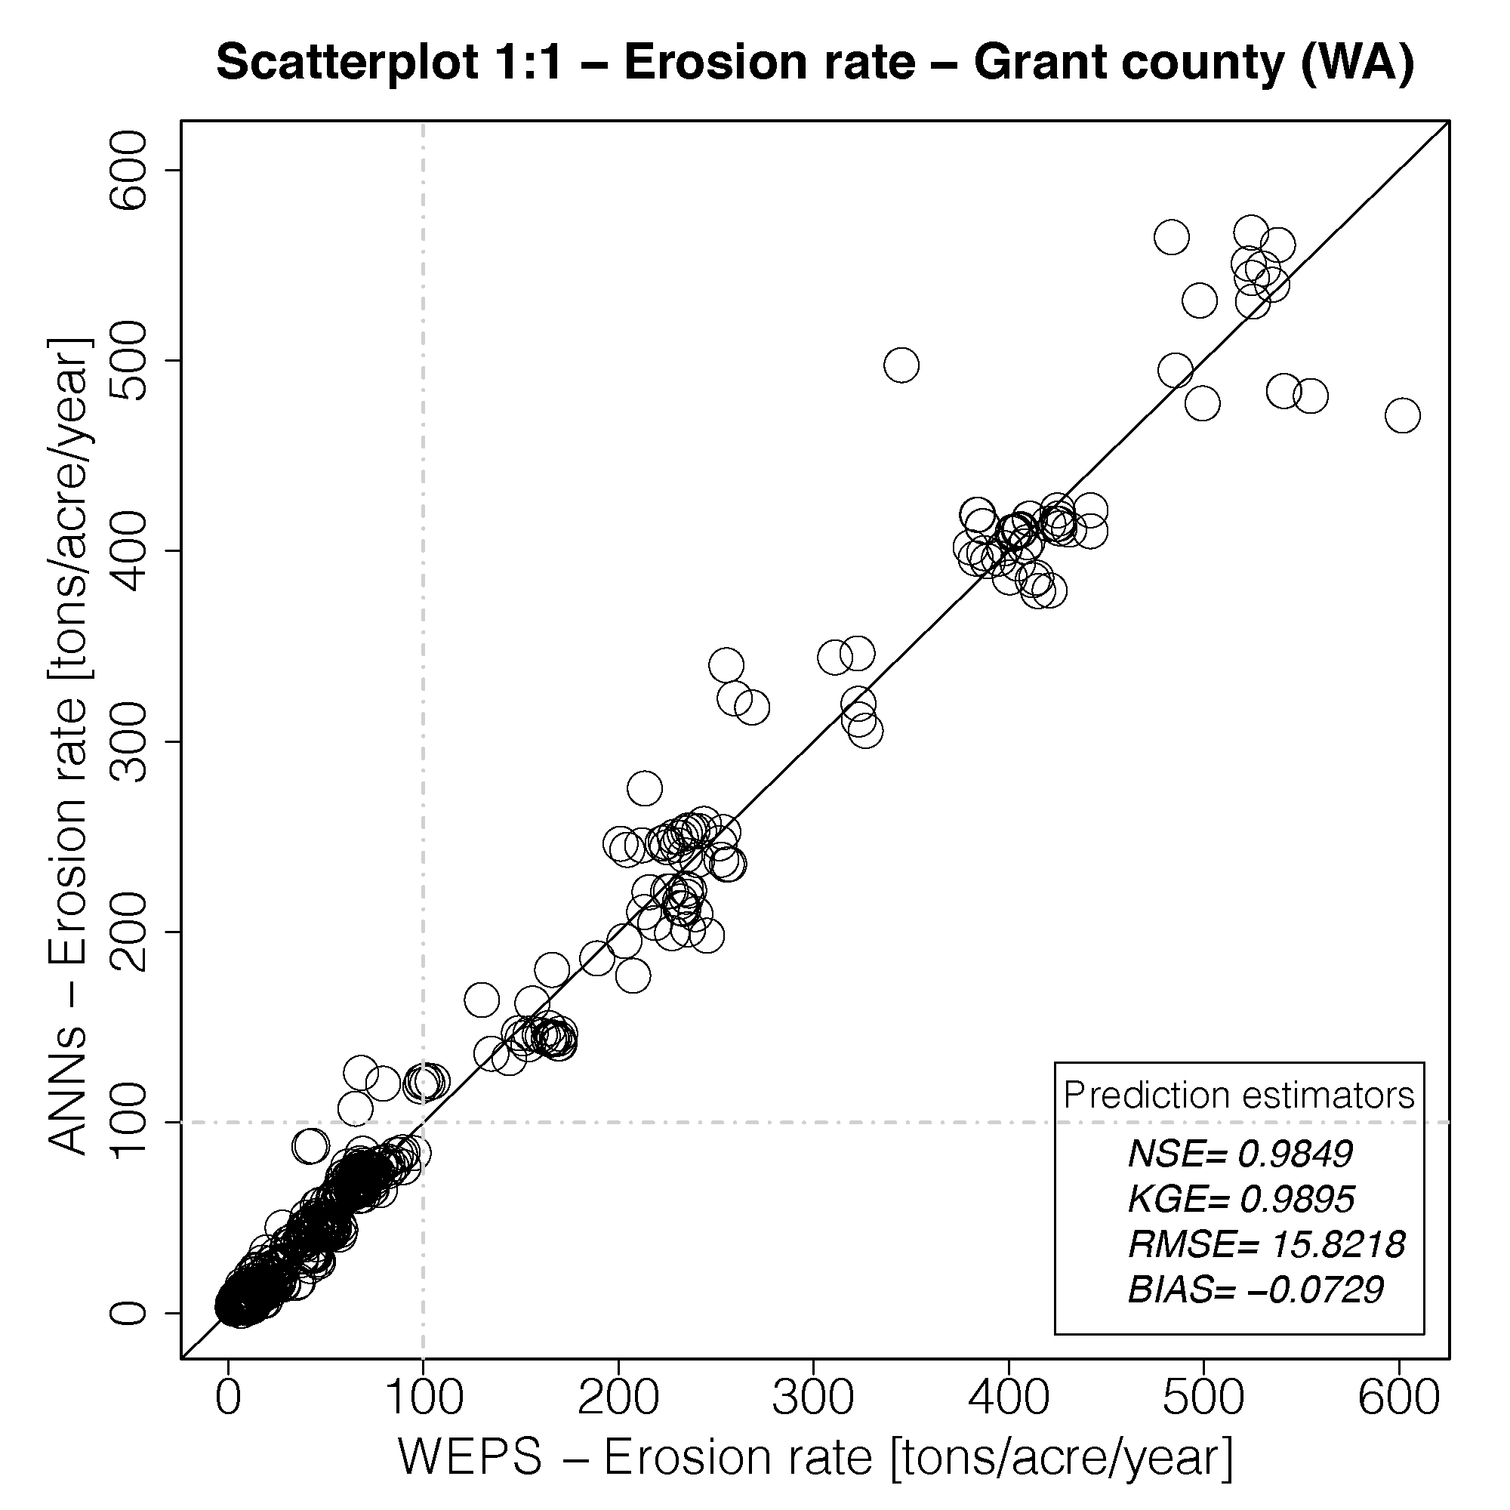

Three options to update water and wind erodibility in environmental benefit assessments for ranking Conservation Reserve Program (CRP) offers
Comparing Surrogate to Full Water and Wind Erosion Model Simulations for Ranking Conservation Reserve Program (CRP) Offers
Jack Carlson¹, Rich Iovanna², Olaf David¹, Francesco Serafin¹, Shaun Case¹
¹Colorado State University, Dept. of Civil and Environ. Engr., Object Modeling System Laboratory
²USDA Farm Production and Conservation Business Center, Economic and Policy Analysis Division
Options Comparison
Option 1 - Real-Time Full Water and Wind Erosion Model Simulations
The crpassessment service returns water and wind erosion rate results for a CRP offer area in 10-20 seconds
  Advantages: Provides the most site-specific results within the CRP offer area; TauDEM result reflects slope steepness within CRP offer area
  Disadvantages: Longest time to return results
Option 2 - Real-time Water and Wind Erosion Surrogate Model Runs
  Separate pilot surrogate models evolved for Yazoo County, MS (high intense rainfall) and Grant County, WA (dry, windy) pilot tests. The smcrpassessment service running surrogate models returns results in 5-7 seconds.
    Advantages: Second shortest time to return results, at upper end of acceptable range; fewer moving parts.
    Caveats: Although high model efficiencies (predictive power) in pilot tests, needs refinement to resolve edge cases; currently focused on improved sampling and clustering to reduce error; need to better represent soil surface wetness input for WEPS surrogate; expanding beyond pilots will adopt zonal approach; not yet ready to recommend.
Option 3 - CRP Erosion Database
The crperosion service returns results in less than 1 second.
  Advantages: Shortest time to return results; provides sufficiently site-specific results; fewer moving parts; current recommended option.
  Disadvantages: Average slope results reflect steepness of soil mapunit polygon usually spanning the CRP offer area; therefore erosion rate somewhat less site-specific; annual soil data refresh triggers decision whether/when to re-run simulations to update the CRP_Erosion database.
Motivation
Current water and wind erodibility indices use factors from older Universal Soil Loss Equation (USLE) and deprecated Wind Erosion Equation (WEQ) models. C (wind) factor and R (rainfall) factor data are not up to date; slope data is not site specific, and indices are less intuitive than actual erosion rates (e.g. ton is ~cubic yard of soil loss).
Advances in Erosion Science, Modeling Methods, Processing Power
WEQ has been replaced by the process-based Wind Erosion Prediction System (WEPS) model from the USDA Agricultural Research Service (Wagner 2013). The Water Erosion Prediction Project (WEPP) model has a common pedigree with WEPS and represents the latest water erosion science from the USDA-ARS National Soil Erosion Laboratory (Flanagan 2007) .
TauDEM (Terrain Analysis Using Digital Elevation Models) (https://hydrology.usu.edu/taudem/ taudem5/) and other raster processing tools provide a rapid method for computing average slope steepness. For this project, the tools computed slope steepness from 10m DEM intersecting CRP offer area soil polygons
Parameter-elevation Regressions on Independent Slopes Model (PRISM) raster data (https://prism.oregonstate.edu) enables adjustment of climate station input parameters to the CLIGEN weather generator for more accurate representation of precipitation and temperature. All weather inputs for model simulations were PRISM adjusted.
Both WEPP and WEPS have been deployed as web services on a Cloud Services Integration Platform (CSIP) (https://alm.engr/colostate.edu/cb/project/csip), integrated with the USDA Natural Resources Conservation Service (NRCS) Soil Data Mart and Conservation Resources domain database containing climate and land management data.
Using tight CSIP model-data integration, Docker/Kubernetes orchestration (https:// kubernetes.io), and a publish/subscribe messaging pattern, a crpassessment web service runs WEPP and WEPS simulations for a tilled-fallow management simultaneously for a location, service calls scaling to capacity, for this project averaging 800,000 requests per day.
Artificial Neural Networks (ANNs) used to create surrogate models can reduce computational load associated with full process model simulations. For this project, the NeuralEvolution of Augmenting Topologies (NEAT) genetic algorithm (https://www.cs.ucf.edu/~kstanley/neat.html) was applied to WEPP and WEPS simulation training datasets to evolve surrogate models.
New Approach for Representing Water and Wind Erodibility
Run WEPP and WEPS model simulations to compute water and wind erosion rates for a tilled-fallow management having 12 monthly rotary harrow operations, 123 soil tillage intensity rating (STIR), and no contouring adjustment. Starting condition is bare soil and no wind barriers at edge of field. Erosion rates reflect conditions if the area were stripped of vegetative cover and kept lightly disturbed, thus reflecting vulnerability to erosion due to soil and climate factors.
Options for Computing Water and Wind Erodibility for CRP Offer Areas
Option 1 - Real-Time Full Water and Wind Erosion Model Simulations
Weighted average water and wind erosion rates for tilled-fallow management on the three most prevalent soil mapunits in a CRP offer area, using a crpassessment web service generating results from running the Water Erosion Prediction Project (WEPP) and Wind Erosion Prediction System (WEPS) models in real-time.
Option 3 - Real-time Water and Wind Erosion Surrogate Model Runs
Weighted average water and wind erosion rates for tilled fallow management on the three most prevalent soil mapunits in a CRP offer area, using a smcrpassment web service generating results from running WEPP and WEPS artificial neural network (ANN) surrogate models previously trained from datasets compiled through large volume WEPP and WEPS model simulations.
Option 3 - CRP Erosion Database (Map)
Weighted average water and wind erosion rates for tilled fallow management on the three most prevalent soil mapunits in a CRP offer area, computed using a crperosion web service fetching results from a CRP_Erosion database previously compiled from running WEPP and WEPS model simulations on 17.3 million soil mapunit polygons intersecting cultivated cropland polygons from the USDA National Agricultural Statistics Service (NASS).
CRP_Erosion: Water
Dark red denotes soil mapunit polygons more vulnerable to water erosion
CRP_Erosion: Wind
Dark red denotes soil mapunit polygons more vulnerable to wind erosion
Computing Load – Option 2
  17,334,000 CSIP web service calls via publish/subscribe
  34.6 million WEPP and WEPS simulations
  10 GB of json requests (17.3 M at 625 byte per request)
  82 GB of json responses (17.3 M at 5 KB per request)
  200 million internal service calls (soils, crlmod, slope, climate, ...)
  Total accumulated service execution time: 7.95 years
Supporting Infrastructure
  16 Kubernetes nodes with CephFS
  103 docker containers for wepp, weps, soils, climate, slope, crp, pub/sub
  400 cores, GB network; 4 webhooks
  Throughput 800,000 - 1 million CSIP runs per day.
Response data flows for web services and data supporting three new options for water and wind erodibility

