Slide 1
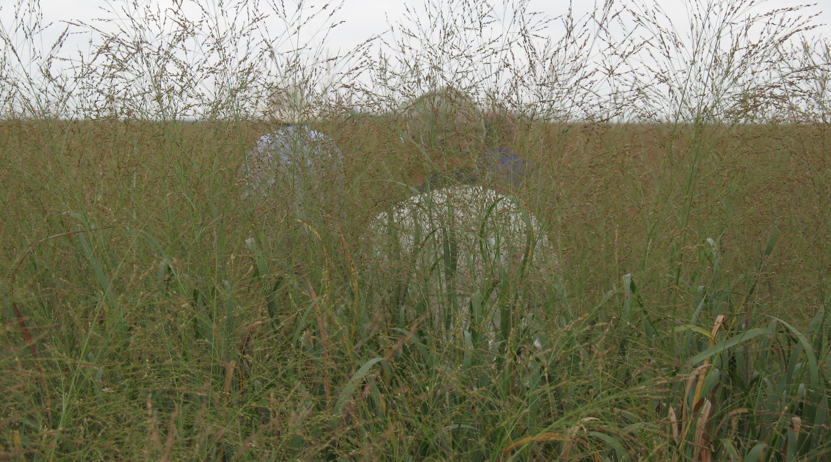

Updated Water and Wind Erodibility for Environmental Benefits Assessment in
Program Ranking
Olaf David, CSU
Rich Iovanna, FPAC
Dan Janes, FSA
Francesco Serafin, CSU
Shaun Case, CSU
Jack Carlson, CSU

Slide 2
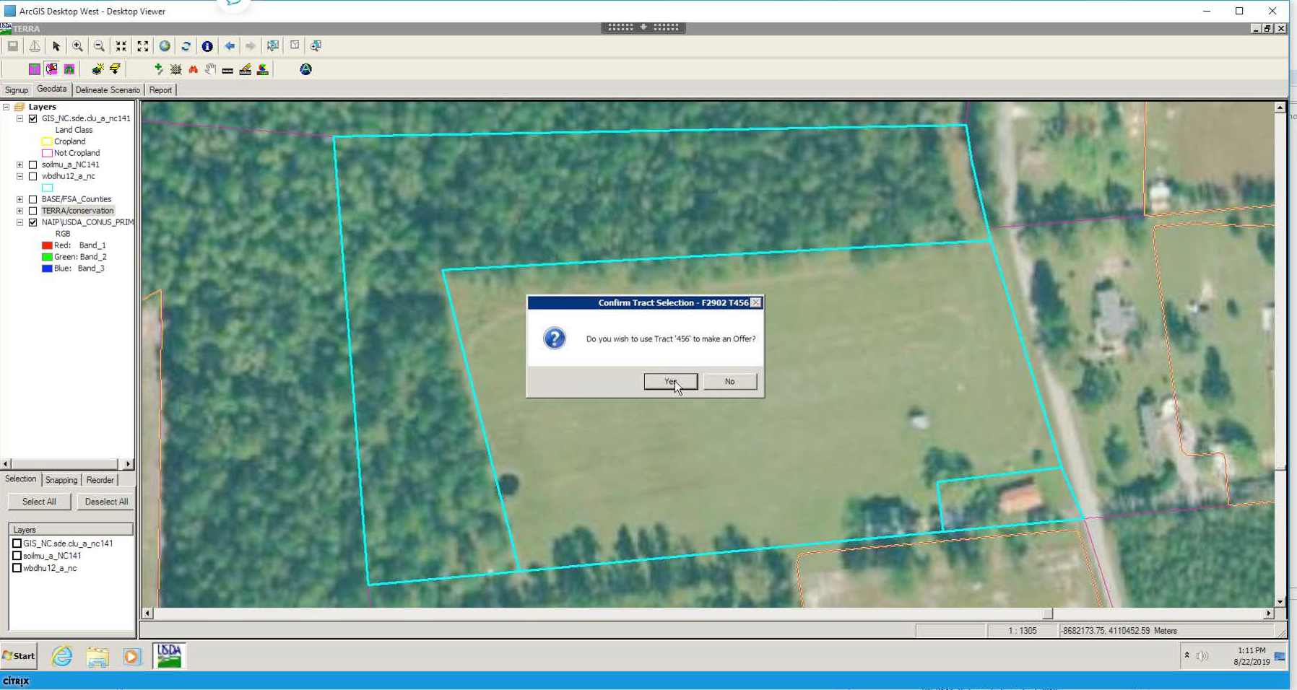
TERRA Application for Computing Erodibility/EBI

Slide 3
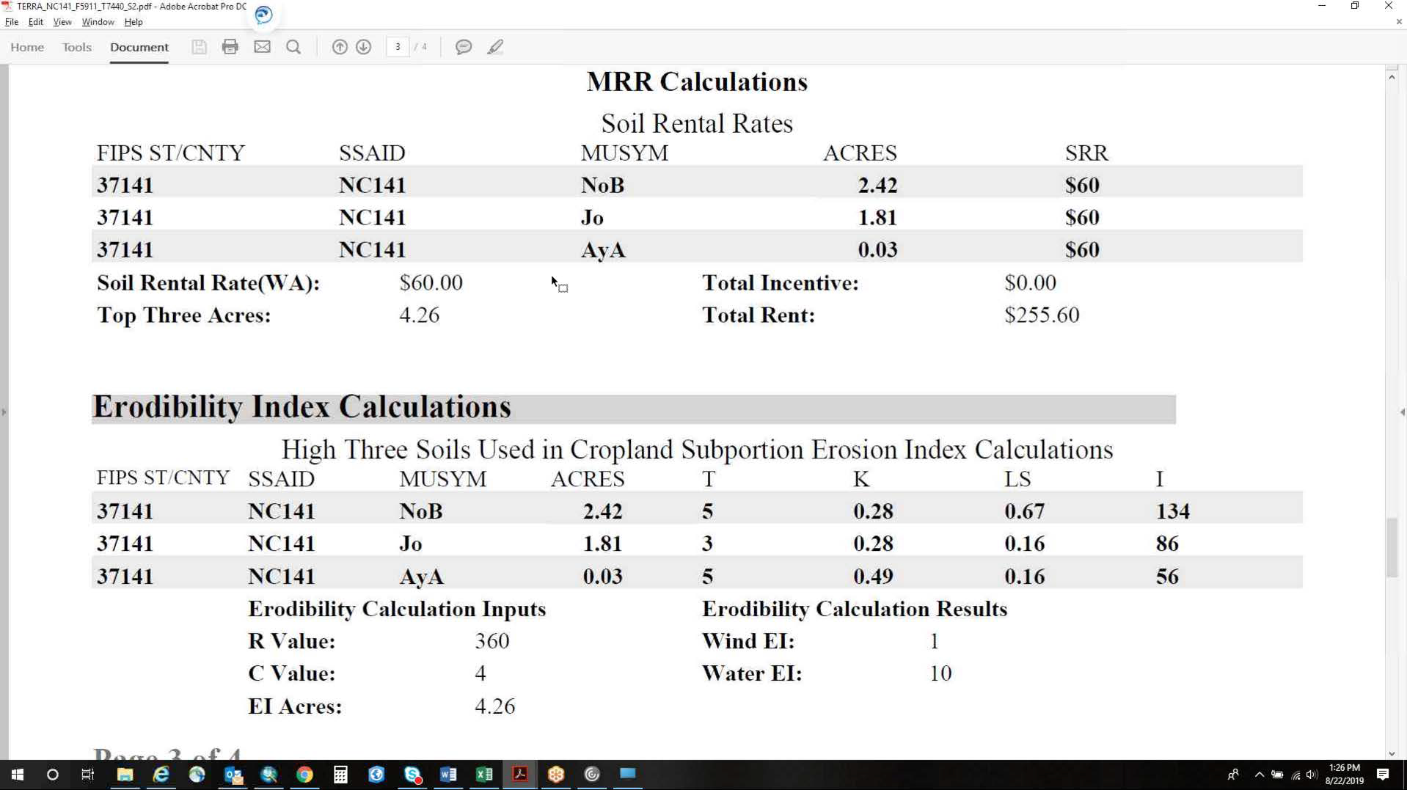
TERRA Application for Computing Erodibility/EBI

Slide 4
Legacy to Current Erosion Technology
Process-Based Erosion Models (became possible with increasing computing power)
WEPP (Cropland Water)
Supported
WEPS (Cropland Wind)
Supported
RHEM (Rangelands Water)
Supported
Empirical Erosion Models (began when computing power was limited)
WEQ (Cropland Wind)
RWEQ
Discontinued
USLE (Cropland Water)
RUSLE
RUSLE2
?
1950 1960 1970 1980 1990 2000 2010 2020 2040 2050

Slide 5
Major Reasons for Update
  - Erodibility values more localized to CRP offer area
    Mapunit polygon vs. county extent mapunit
    10m DEM-based slope steepness vs. county extent mapunit steepness
    4K PRISM pixel adjusted climate input vs. county climate
  - More recent climate station data
  - WEQ technology no longer supported
  - WEPP and WEPS models cut from the same cloth
    Share common contemporary processes/methods
    Greater data commonality and compatibility
    Better integration with SWAT/APEX/EPIC water quality degradation vulnerabilities going forward

Slide 6
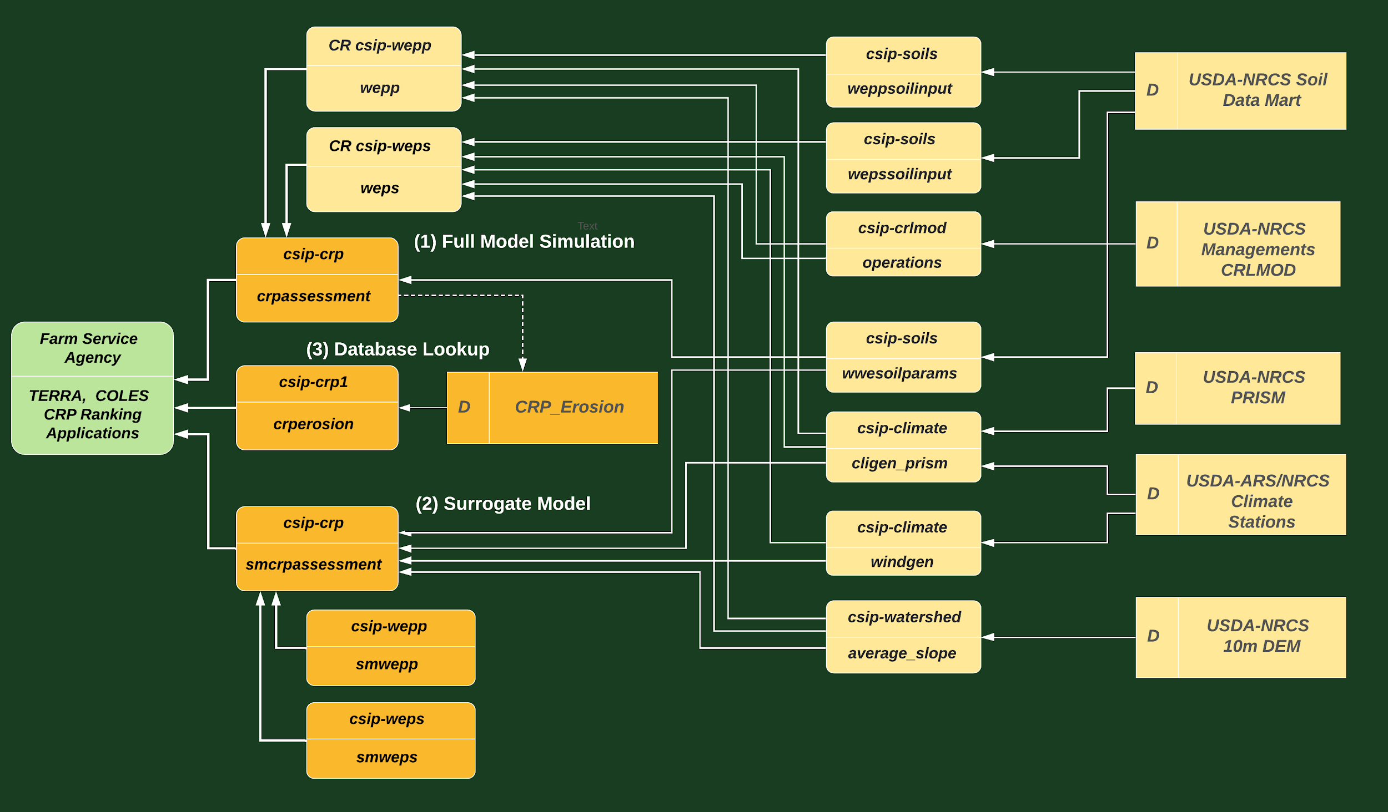
Three WEPP/WEPS-Based Options for Erodibility Calculations
Response data flows for web services and data supporting three new options for water and wind erodibility

Slide 7
Methods
Tilled fallow rotation object: 12 monthly rotary harrow operations, STIR 123
WEPP model service
  Calls wwesoilparams service to fetch soil mapunit/component list for area to be simulated
  Calls weppsoilinput service which fetches data from Soil Data Mart, processes and returns .sol input file
  Calls cligen_prism service which runs CLIGEN and returns PRISM adjusted .cli input file
  Calls operations service to fetch input parameters from CRLMOD for .man input file
  Calls average_slope service which returns average slope steepness for area to be simulated.
WEPS model service
  Calls wwesoilparams service to fetch soil mapunit/component list for area to be simulated
  Calls wepssoilinput service which fetches data from Soil Data Mart, processes and returns .ifc input file
  Calls cligen_prism service which runs CLIGEN and returns PRISM adjusted .cli input file
  Calls windgen service which runs WINDGEN and returns .win input file.
  Calls operations service to fetch input parameters from CRLMOD for .man input file
  Uses a 200x200 feet WEPS region

Slide 8
Computing Load – CRP Erosion Database/Map (Option 3)
  17,334,000 CSIP crpassessment web service calls via publish/subscribe
  22 million WEPP and WEPS simulations (each)
  10 GB of json requests (17.3 M at 625 byte per request)
  82 GB of json responses (17.3 M at 5 KB per request)
  200 million internal service calls (soils, crlmod, slope, climate, ...)
  Total accumulated service execution time: 7.95 years
Supporting Infrastructure
  16 Kubernetes nodes with CephFS
  103 docker containers for wepp, weps, soils, climate, slope, crp, pub/sub
  400 cores, GB network; 4 webhooks
  Throughput 800,000 - 1 million CSIP runs per day

Slide 9
Advantages/Disadvantages
(1) Full Model Simulation
Advantage: CRP offer area specific result; site-specific climate and slope steepness
Disadvantage: Takes 10-20 seconds to return result; more moving parts
(2) Surrogate Model
Advantage: CRP offer area specific result; site-specific climate and slope steepness; surrogate model takes less than 1 second to return result; fewer moving parts
Disadvantage: Takes ~5 seconds to fetch input data to surrogate model; surrogate model accuracy may not achieve NSE > 95% and RRMSE <10% in some areas.
(3) Database Lookup
Advantage: More site specific than legacy method; takes less than 1 second return result; fewest moving parts
Disadvantage: Not as site specific as options 1 and 2 (mupolygon-based); database requires update after annual July Soil Data Mart refresh

Slide 10
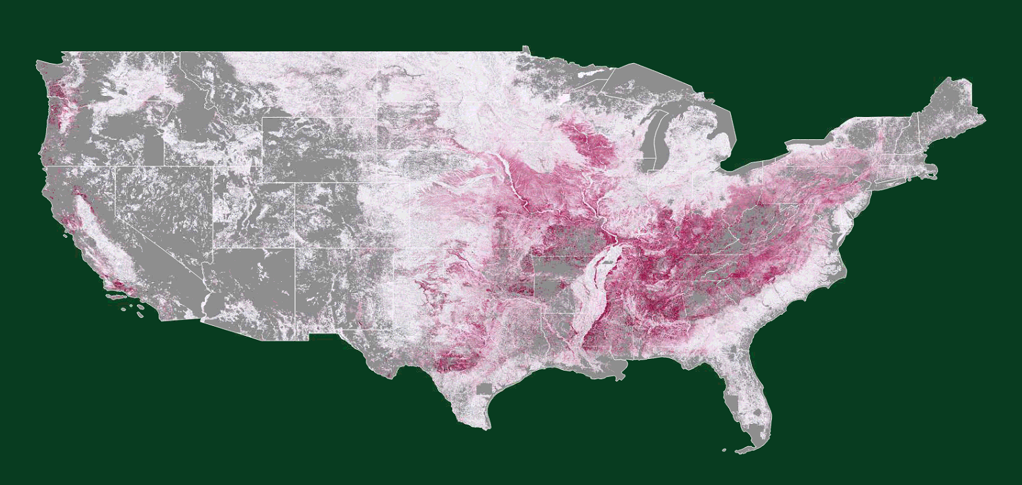
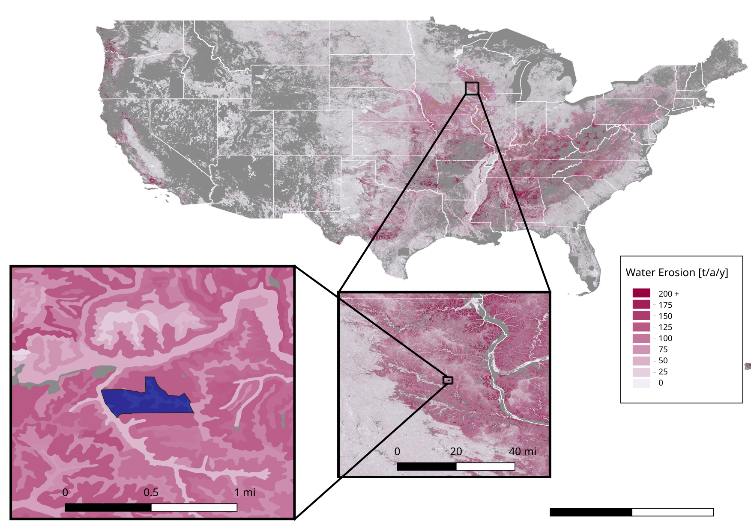
CRP Tilled Fallow Erosion Map - Water
51 shape files, total size of 35 GB
17M polygons

Slide 11
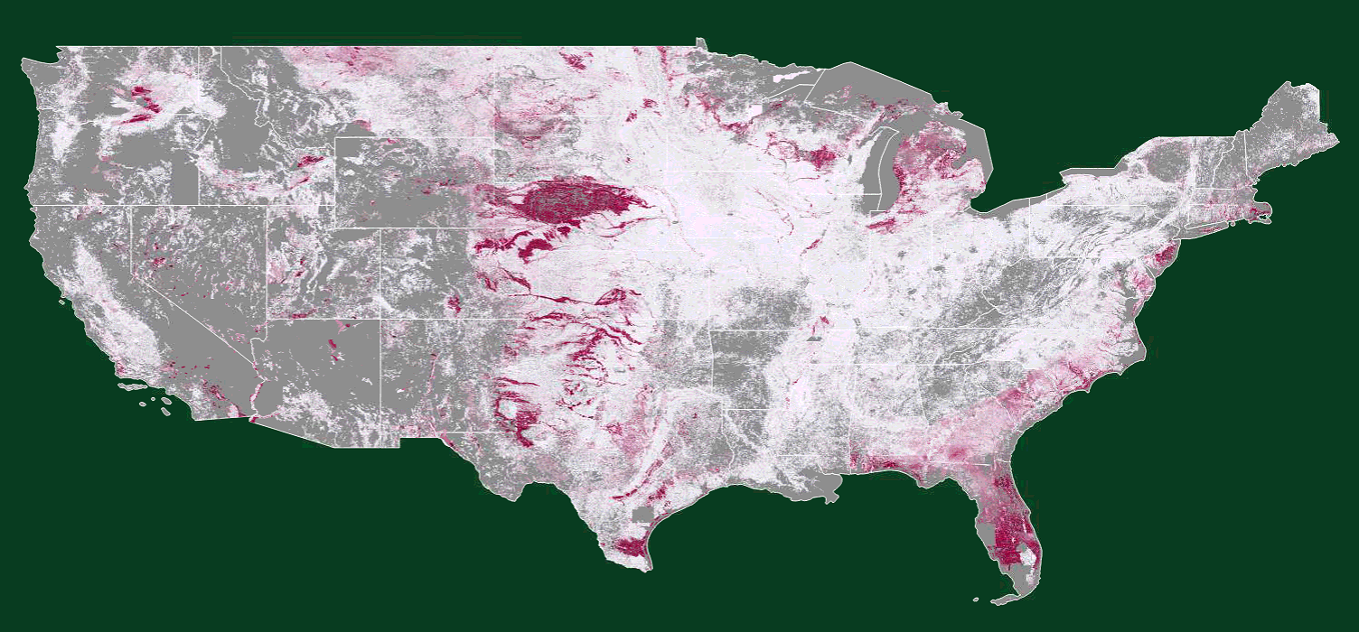
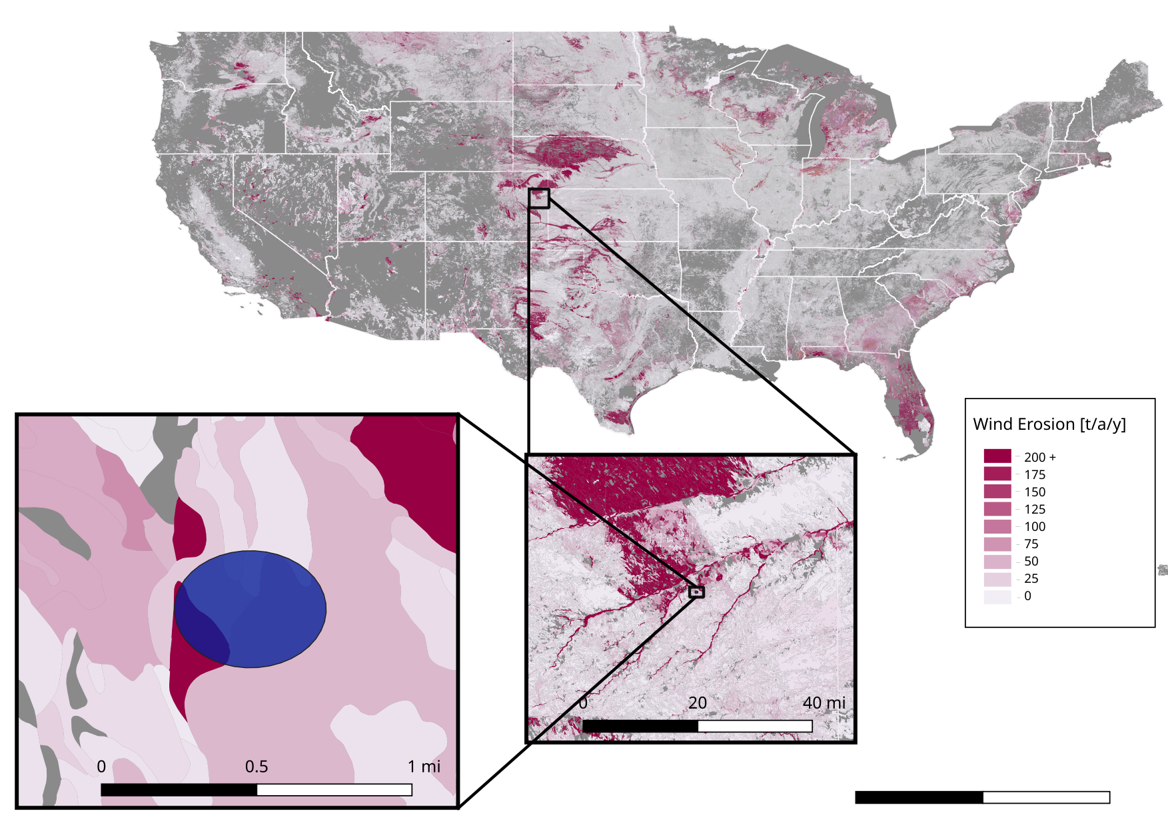
CRP Tilled Fallow Erosion Map - Wind

Slide 12
CRP Tilled Fallow Erosion Map - Water

Slide 13
CRP Tilled Fallow Erosion Map - Wind

Slide 14
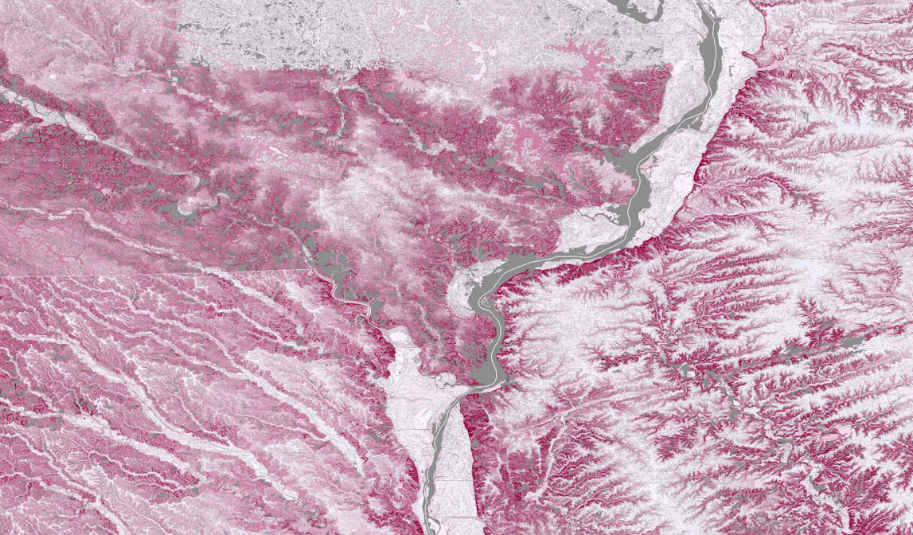
QA/QC – Iowa Example

Slide 15
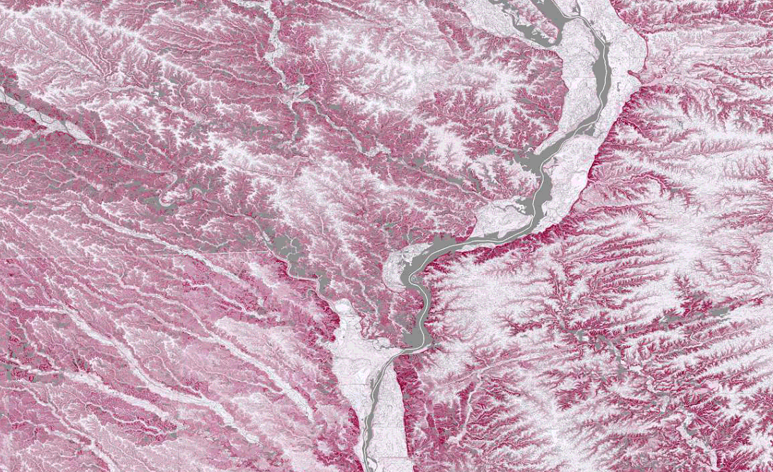
QA/QC – Iowa Example

Slide 16
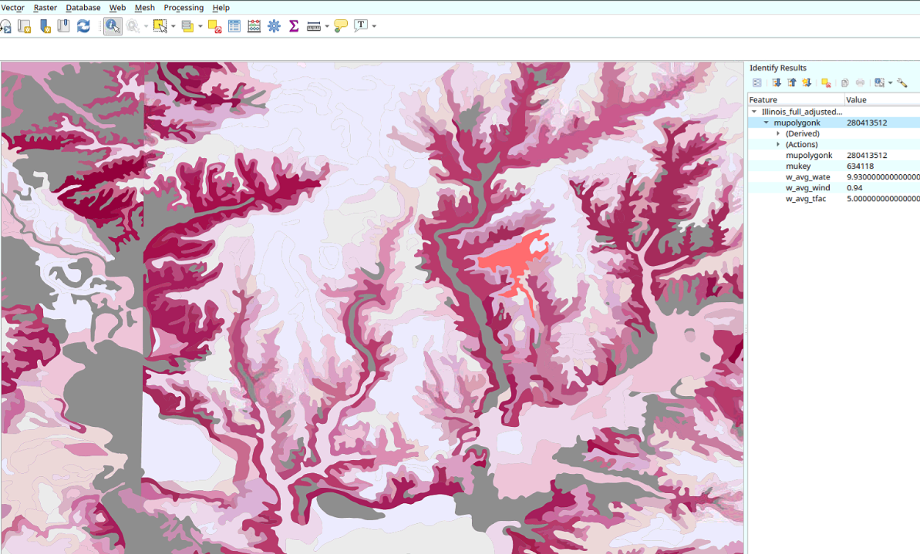
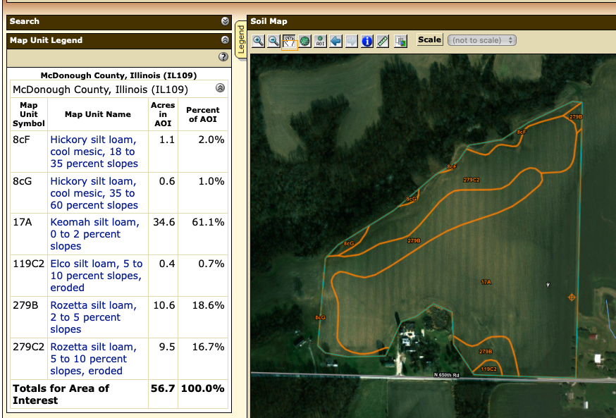
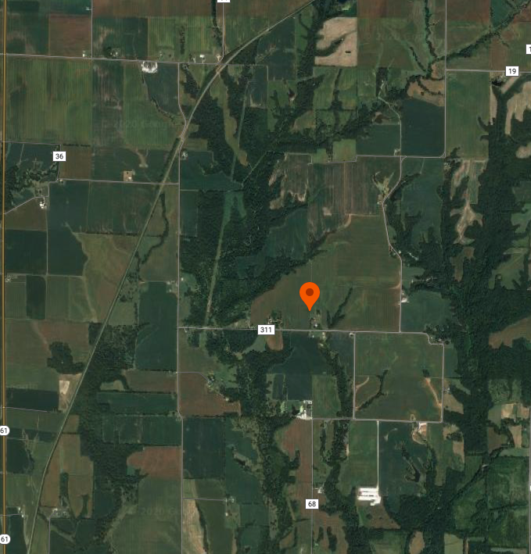
Erodibility = weighted average for 3 most prevalent mapunits in CRP offer area.

Slide 17
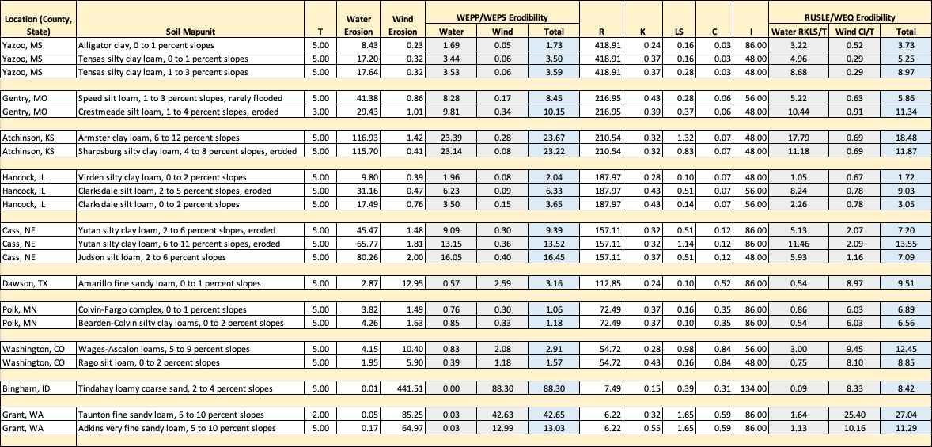
Water and Wind Erodibility Comparisons

Slide 18
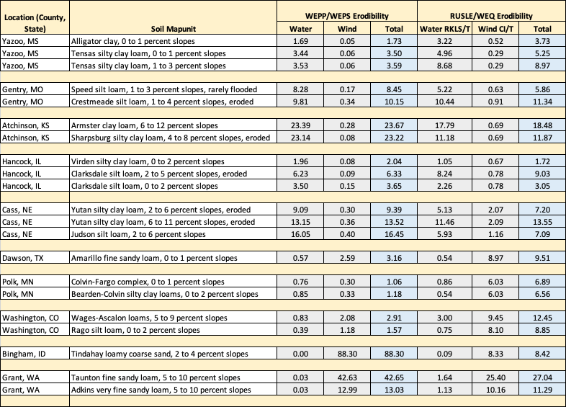
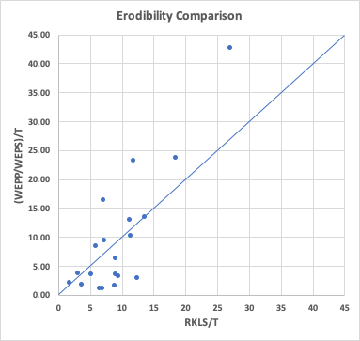
Water and Wind Erodibility Comparisons

Slide 19
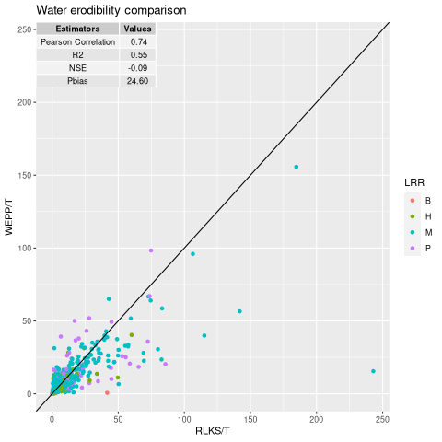
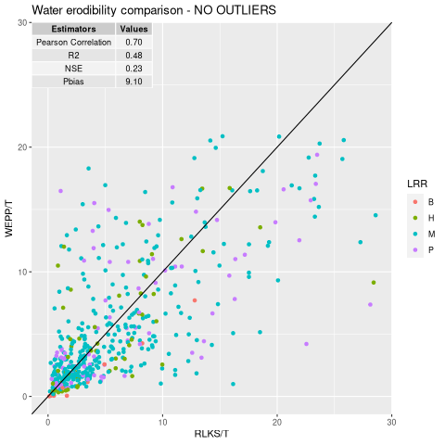
Water Erodibility Comparison
Comparing 577 samples between 4 LRR

Slide 20
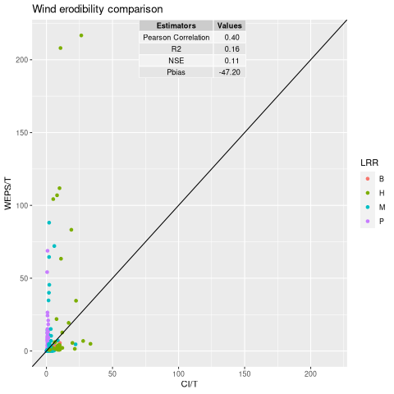
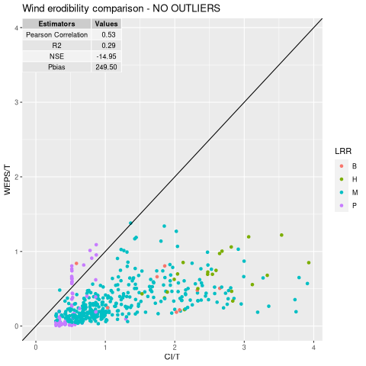
Wind Erodibility Comparison

Slide 21
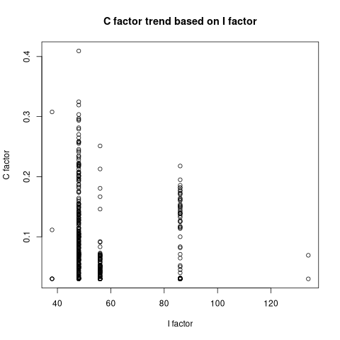
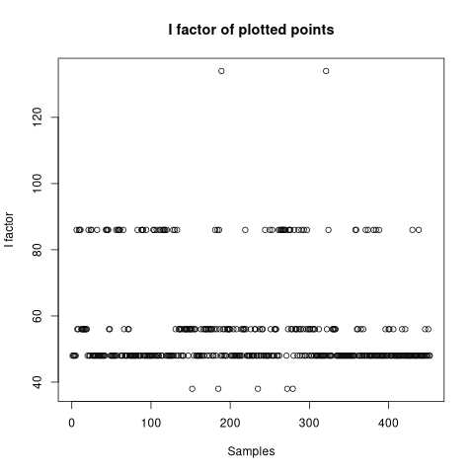
Wind Erodibility: C and I factor analysis

Slide 22
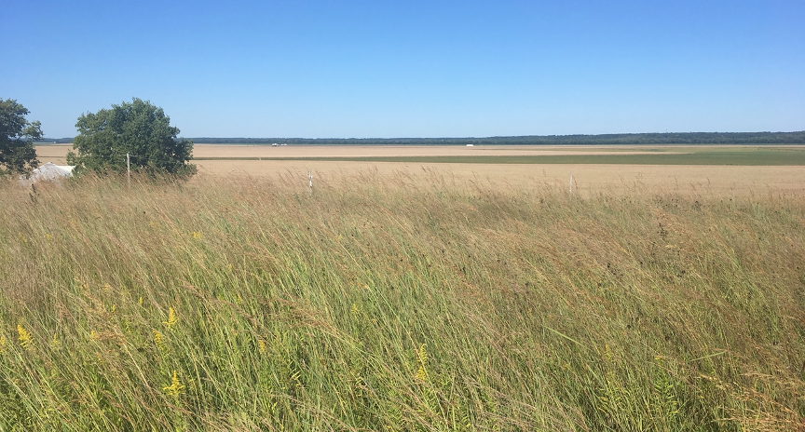
Discussion

Slide 23
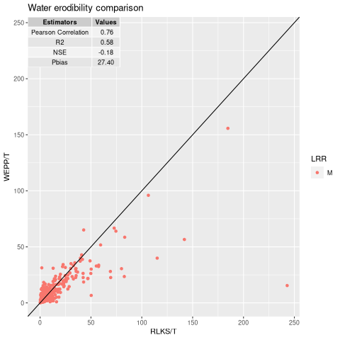
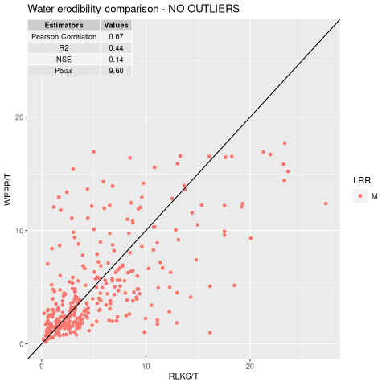
Water Erodibility Comparison - LRR M

Slide 24
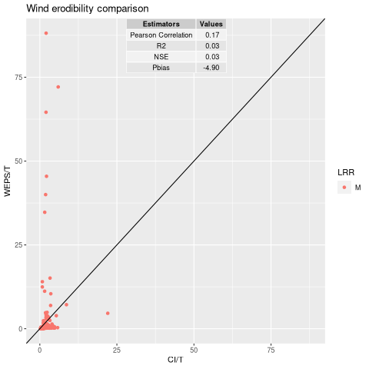
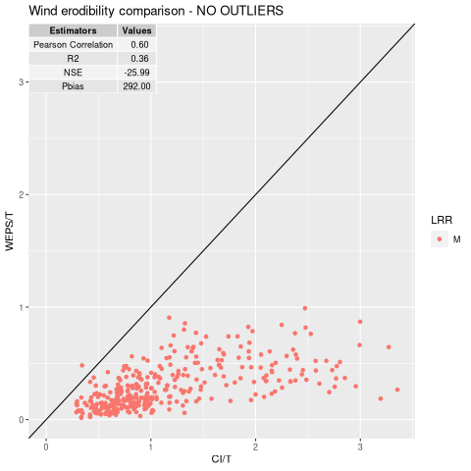
Wind Erodibility Comparison - LRR M

Slide 25
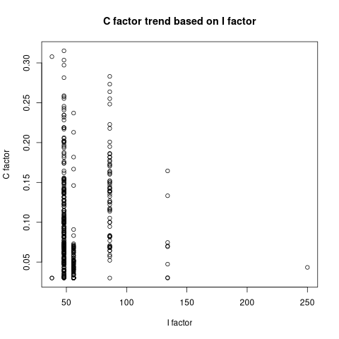
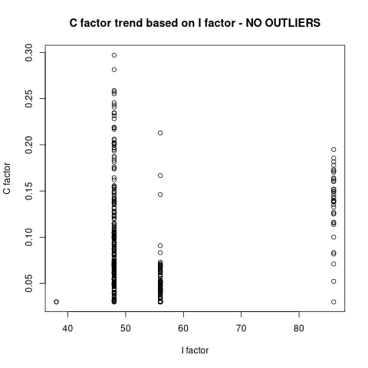
Wind Erodibility C factor, I factor - LRR M

Slide 26
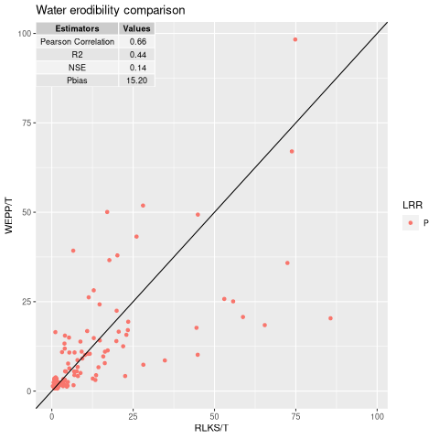
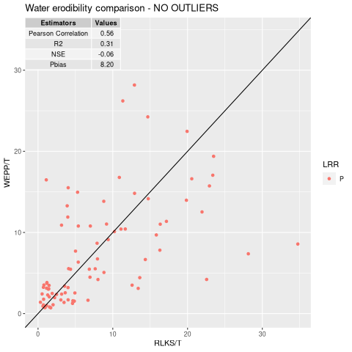
Water Erodibility Comparison - LRR P

Slide 27
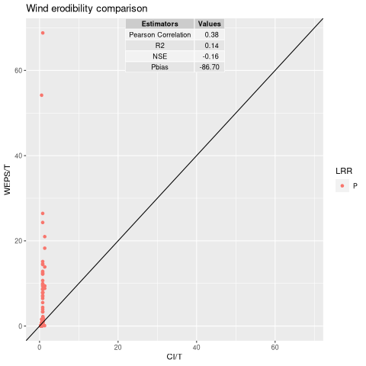
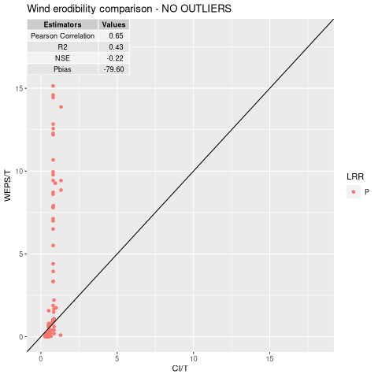
Wind Erodibility Comparison - LRR P

Slide 28
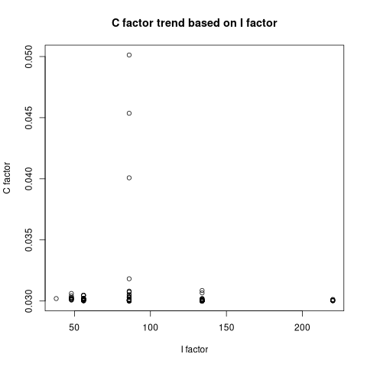
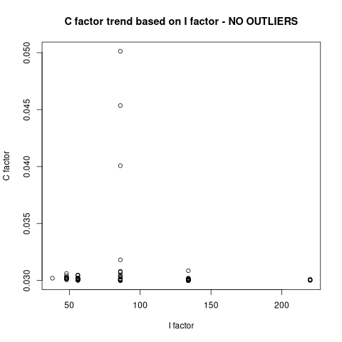
Wind Erodibility C factor, I factor - LRR P

Slide 29
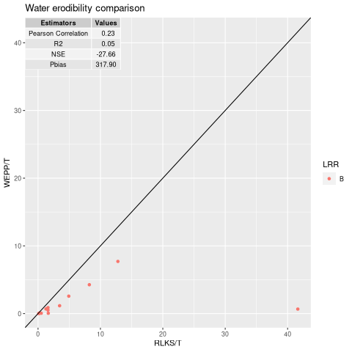
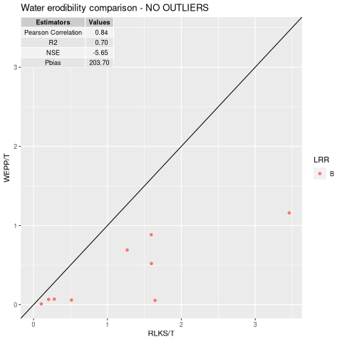
Water Erodibility Comparison - LRR B

Slide 30
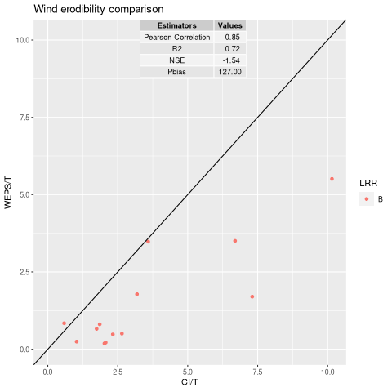
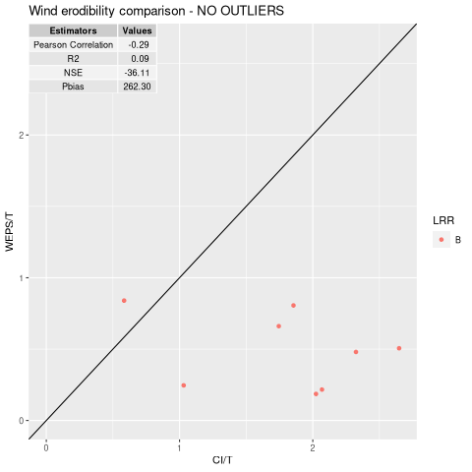
Wind Erodibility Comparison - LRR B

Slide 31
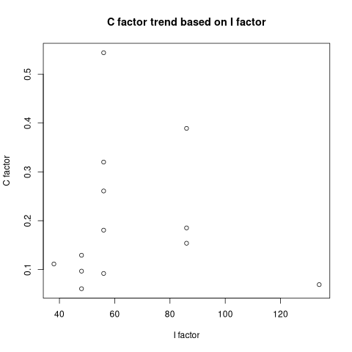
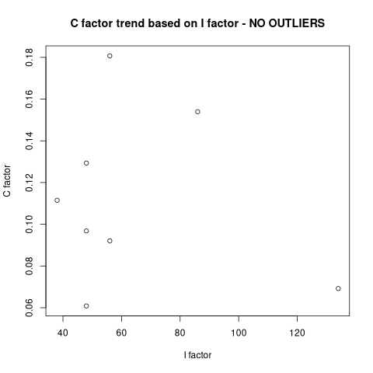
Wind Erodibility C factor, I factor - LRR B

Slide 32
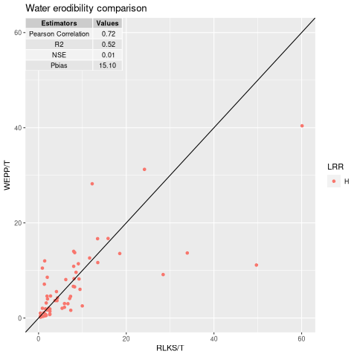
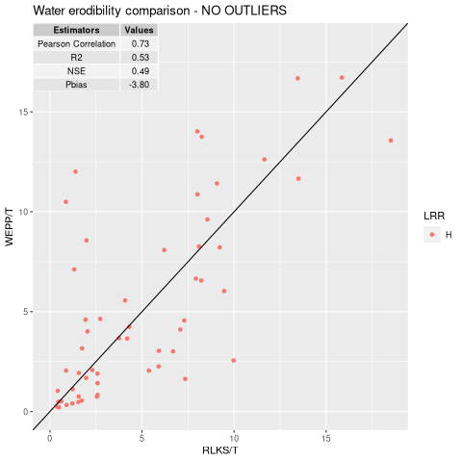
Water Erodibility Comparison - LRR H

Slide 33
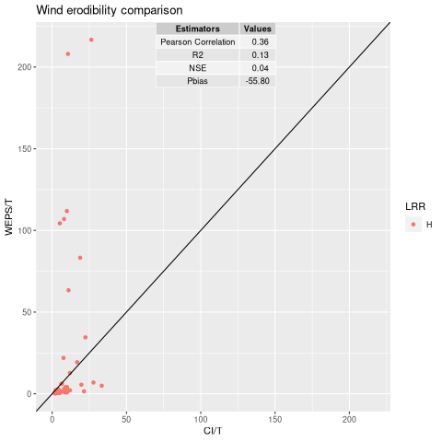
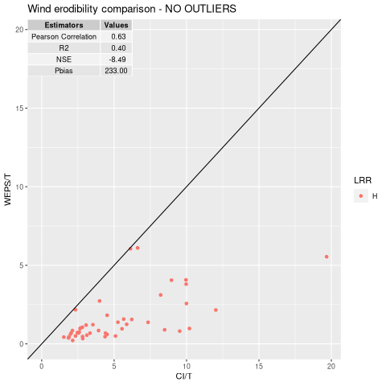
Wind Erodibility Comparison - LRR H

Slide 34
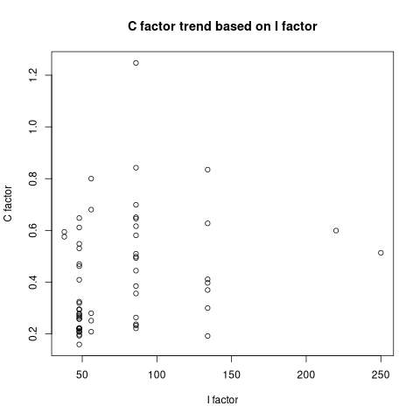
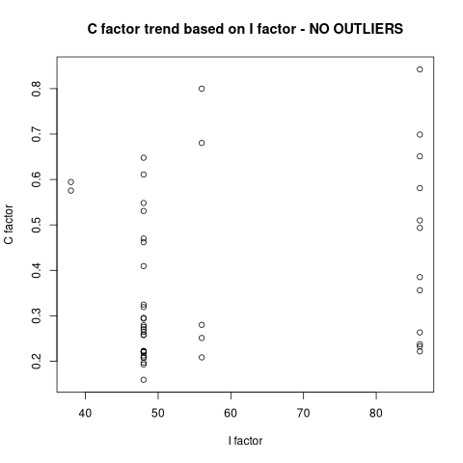
Wind Erodibility C factor, I factor - LRR H

