Slide 1
Preliminary RULSE2 and WEPP Soil Loss Comparisons
Anurag Srivastava
Research Associate
Ryan P. McGehee
Graduate Research Assistant
ABE Dept., Purdue University
National Soil Erosion Research Laboratory
West Lafayette, Indiana

Slide 2
Model Inputs
Simulations were conducted for 99 Iowa counties
WEPP CLIGEN and RUSLE2 inbuilt climate
Unit plot conditions
  22.1 m (72.6 ft) slope length
  9% slope
Dominant soils in each county
Tilled-fallow conditions

Slide 3
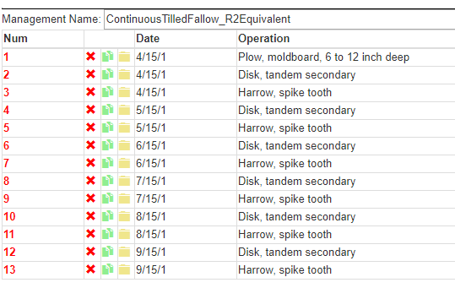
Tilled-fallow management

Slide 4
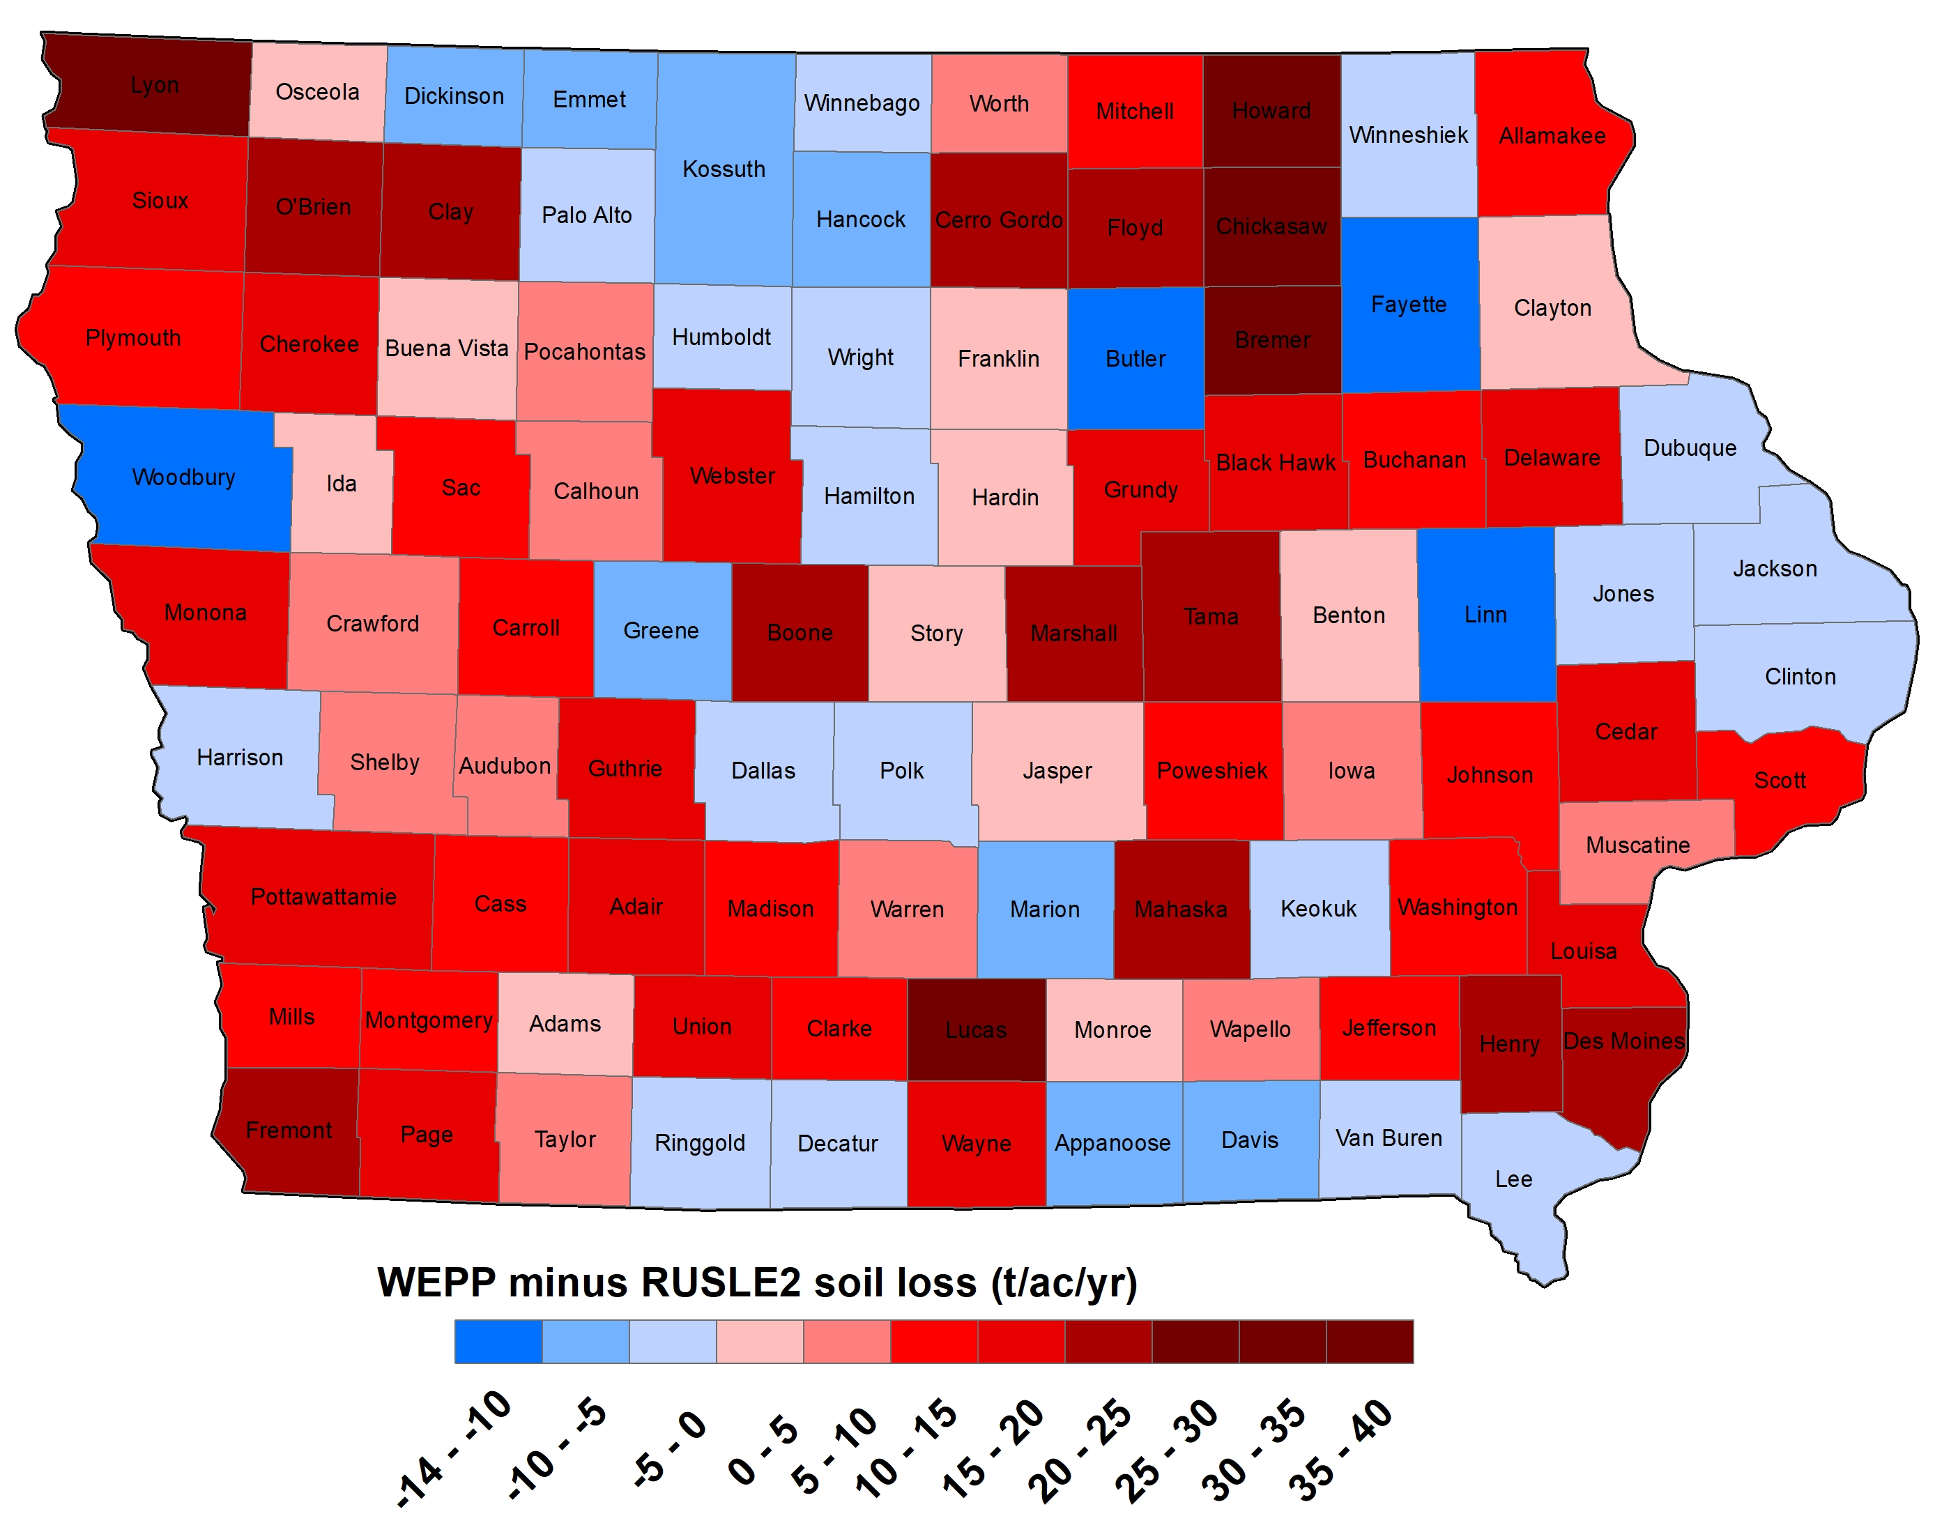
WEPP vs RUSLE2 Soil loss

Slide 5
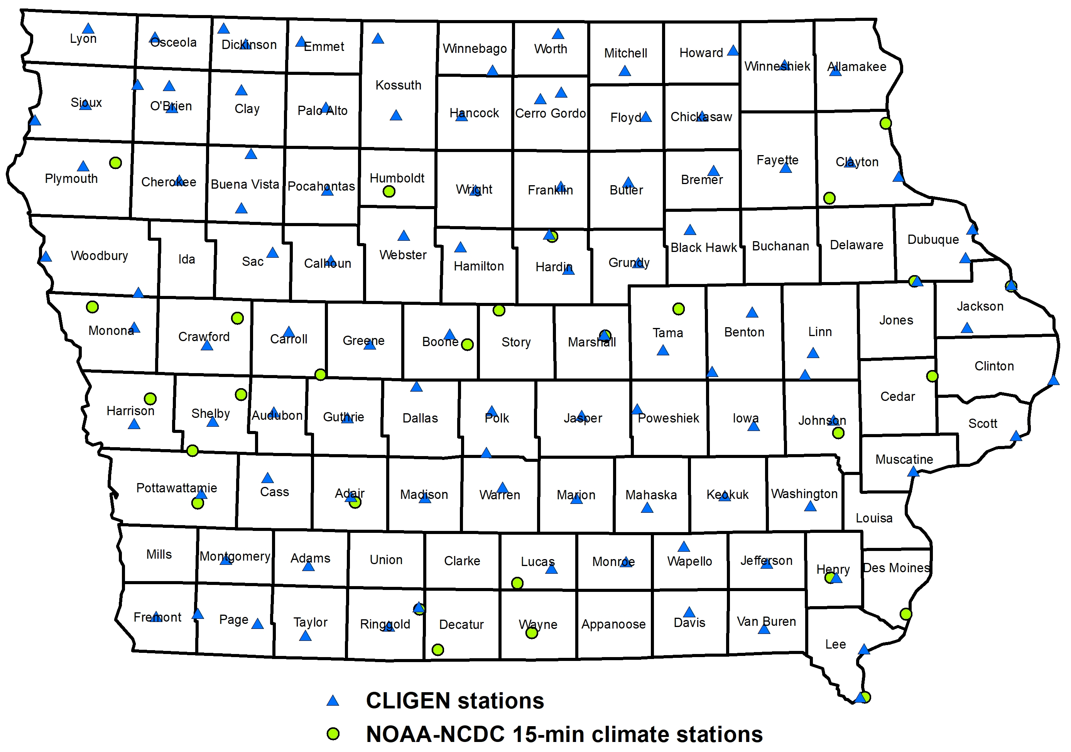
Climate Evaluation

Slide 6
Avg. Ann. Precipitation Comparisons

Slide 7
Soil Loss from WEPP
(CLIGEN vs Observed 15-min data)

Slide 8
Soil Loss (WEPP vs RUSLE2)
CLIGEN vs Observed 15-min data

Slide 9
Proposed Climate Comparison
Observed NOAA land-based station datasets will be used to generate identical climate inputs for WEPP and RUSLE2 using each of their respective methodologies
Potential NOAA datasets include:
  Global daily data (GHCND) 100,000+ stations
  15-minute data (DSI-3260) 3,700+ stations
  1-minute data (ASOS) 900+ stations

Slide 10
Proposed Iowa Comparison
Some progress has already been made using the 15-minute data, since that dataset has already been used with both WEPP and RUSLE2 models
Three screening / quality checking thresholds have yielded minimally, moderately, and strictly screened stations for better understanding spatial patterns and absolute values of Iowa climate
  Minimal: 75 stations, > 3 years, < 50% missing
  Moderate: 53 stations, > 20 years, < 10% missing
  Strict: 28 stations, > 25 years, < 5% missing
Alternative screenings can be used as needed
Suggestions for improvement are welcomed

Slide 11
WEPP Climate Inputs
WEPP requires the following daily climate inputs (depending slightly on the mode of operation):
  Precipitation
  Maximum and Minimum Temperature
  Solar Radiation
  Wind Speed and Direction
  Dew Point Temperature
WEPP can accept precipitation inputs as:
  Daily time-to-peak (T_{p}), peak intensity (I_{p}), depth, and storm duration, OR
  Breakpoints of time and depth since midnight
Daily base CLIGEN precip. outputs (WEPP inputs) are randomly generated and fit to a double-exponential storm shape (single peak) in WEPP. Input breakpoints are used directly.

Slide 12
Generating WEPP Climate Inputs
Using CLIGEN alone (a daily input option)
Using CLIGEN with observed daily precipitation and temperature data (such as from GHCND; another daily input option)
Using WEPP Climate File Formatter (WEPPCLIFF) (a new software for preparing breakpoint inputs for WEPP) from interval precipitation data (intervals of 15 minutes or smaller are recommended)
These options reflect a gradient of less certain to most certain in terms of intensity and weather linkages which are most important for soil loss simulations with WEPP

Slide 13
RUSLE2 Climate Inputs
RUSLE2 requires a relatively long-term climate analysis of individual storm EI values, which is used to derive:
  Average daily EI fraction
  Monthly EI and erosivity density
  Average annual EI (commonly known as R)
This analysis builds on those used in USLE and RUSLE1 (documented in the ‘Ag Handbooks’)
Equivalent R values for snowmelt may also be needed when erosion from snowmelt is significant
Precipitation and temperature are used to fluctuate soil erodibility (K) throughout the year

Slide 14
Generating RUSLE2 Climate Inputs
EI values can be generated from any breakpoint dataset with 15-minute or smaller intervals
This includes all previously listed WEPP climate input generation options, but those of the most interest will be the observed climate datasets
WEPPCLIFF already performs this function, and it is possible (but not currently convenient) for WEPP to provide breakpoints from any run for the creation of event-wise EI values
Subsequent analysis of event-wise EI values can then be used for RUSLE2 runs.

Slide 15
Questions and
Suggestions?

Slide 18
Soil Loss (WEPP vs RUSLE2)
Using Single Soil Throughout IOWA

Slide 19
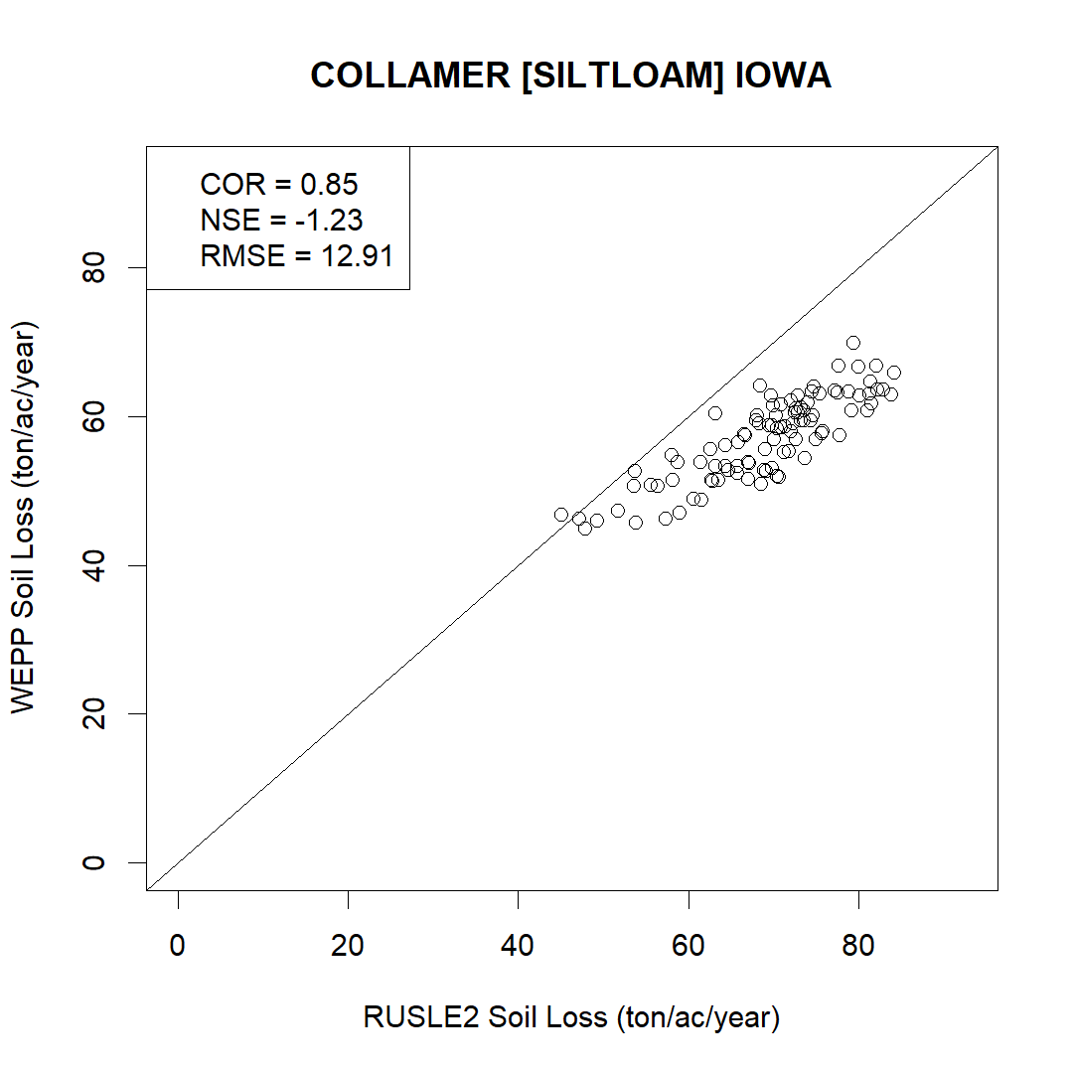
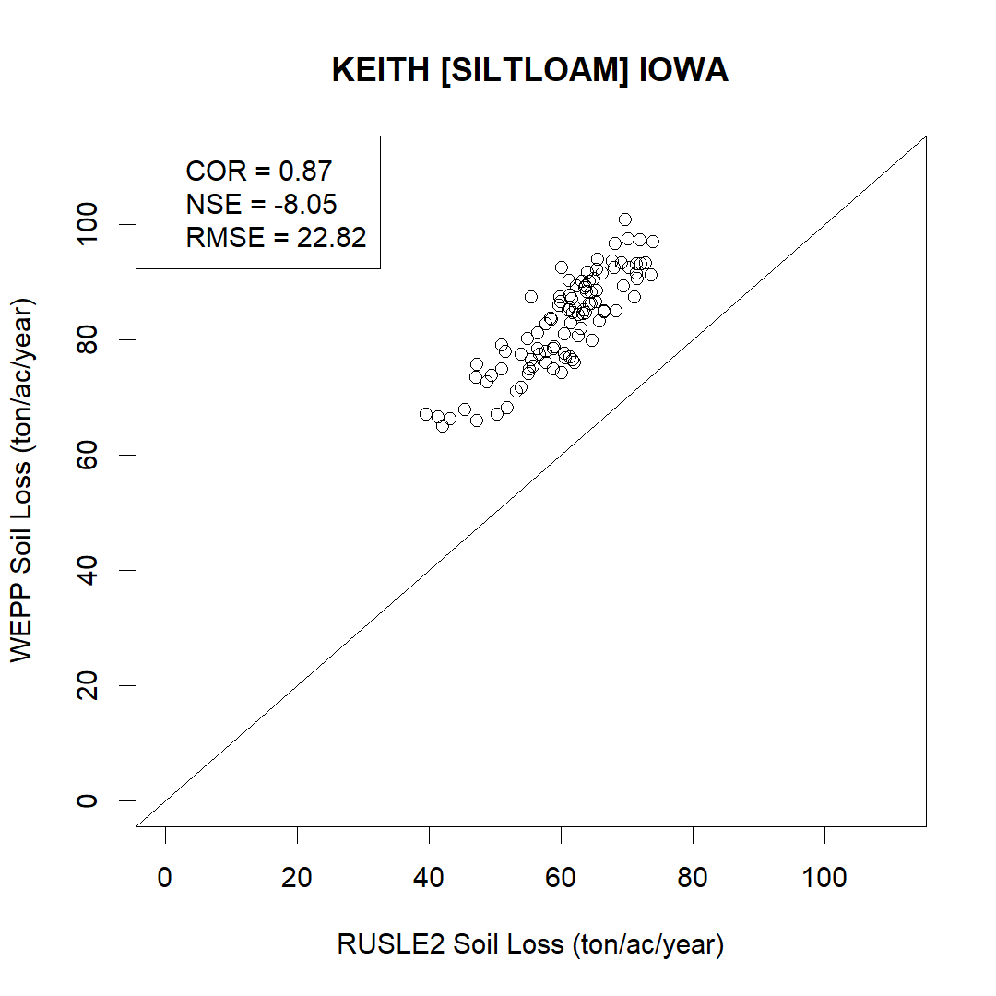
Silt Loam texture

Slide 20
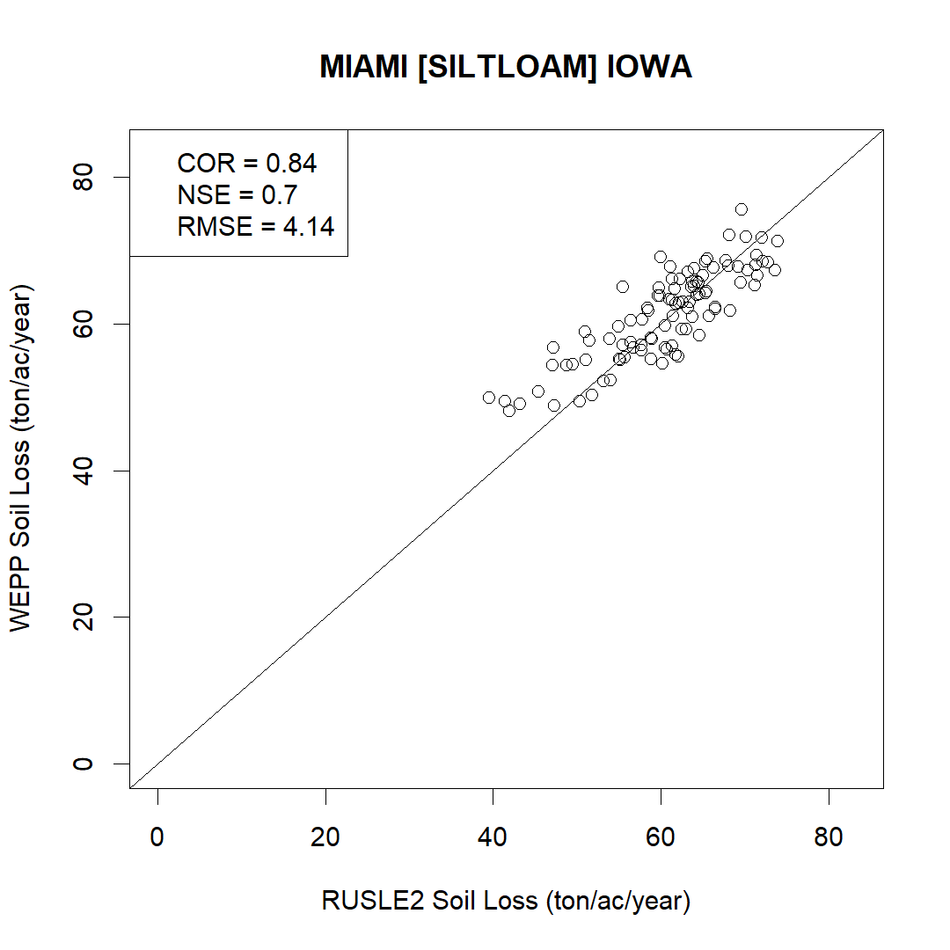
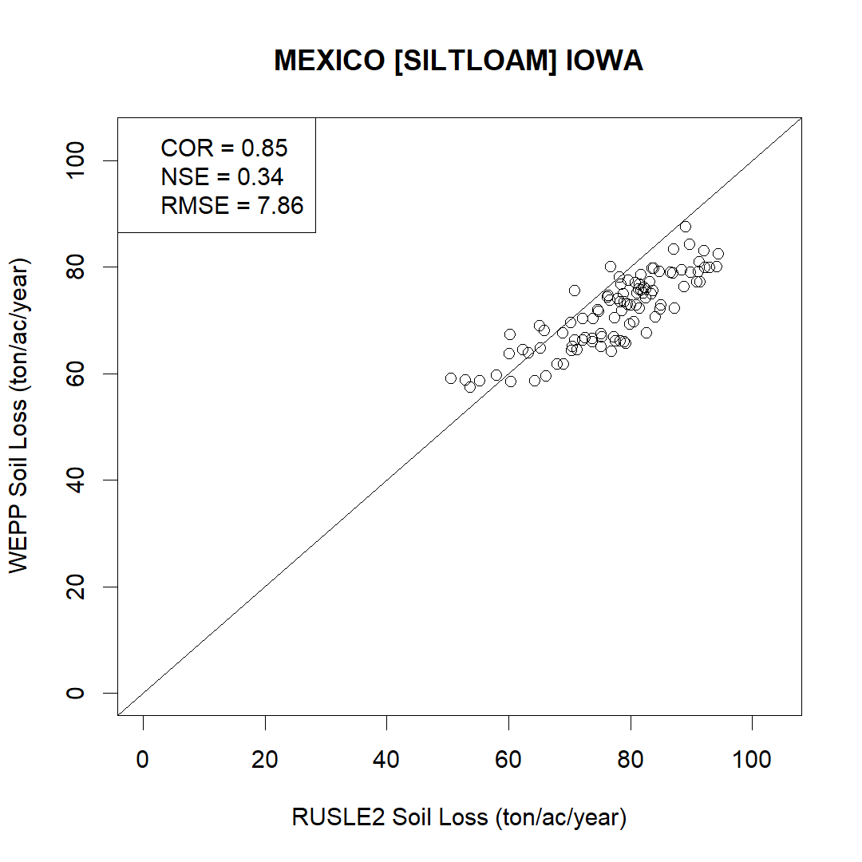
Silt Loam texture

Slide 21
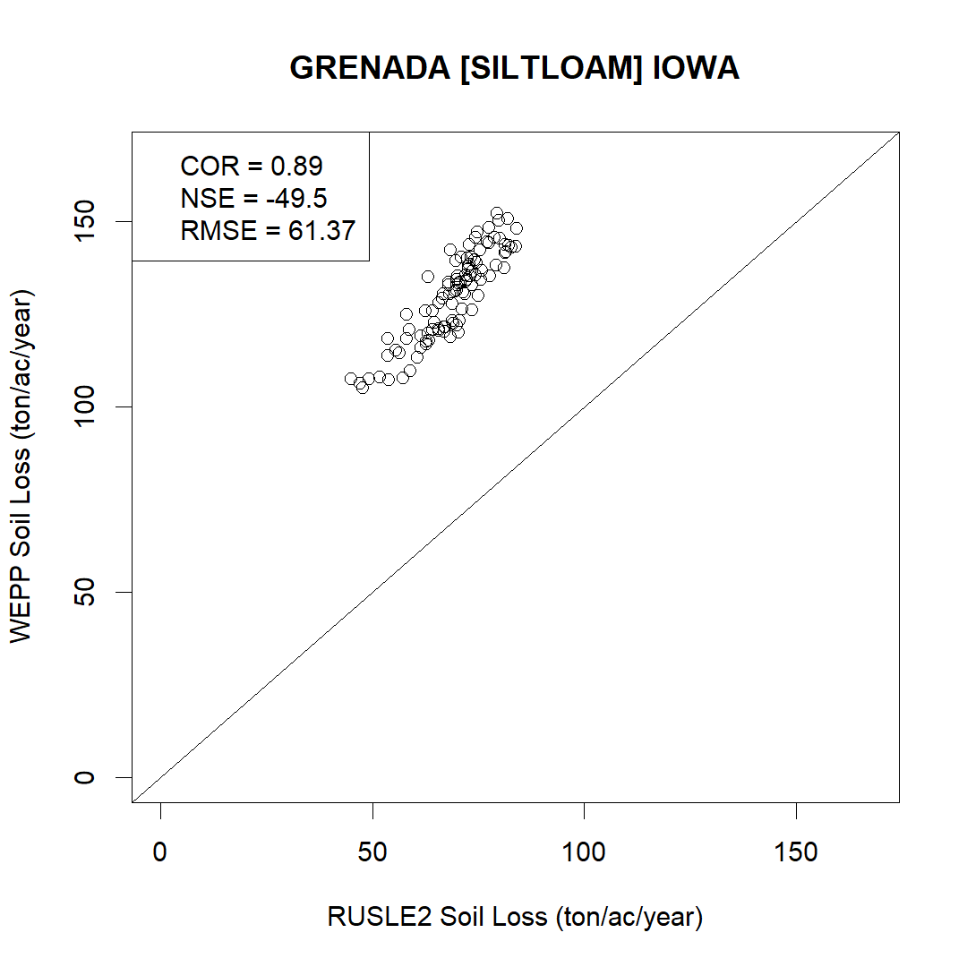
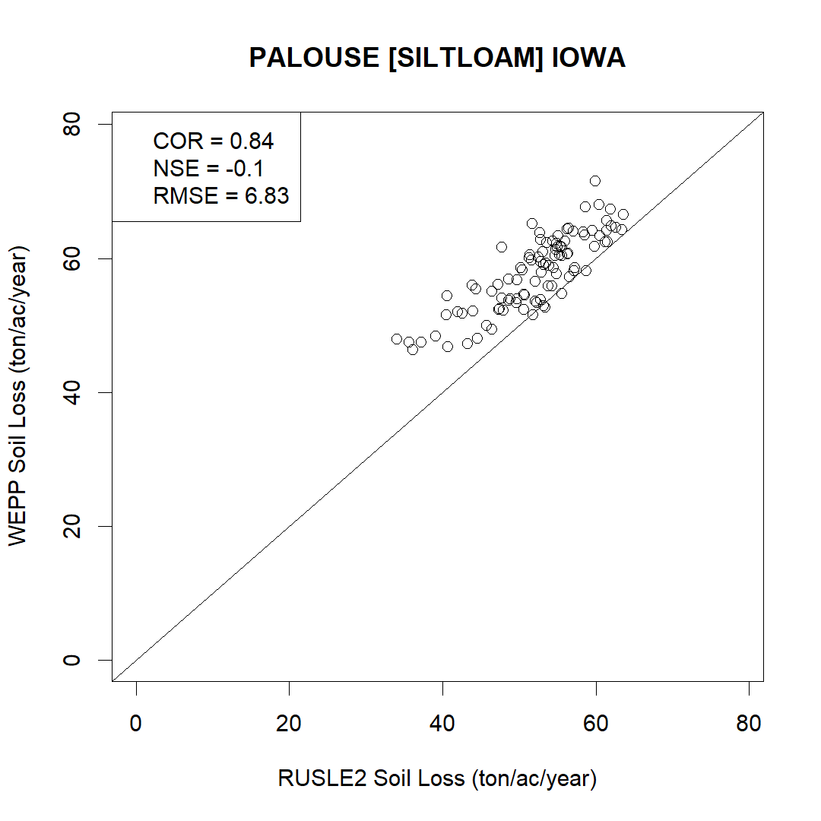
Silt Loam texture

Slide 22
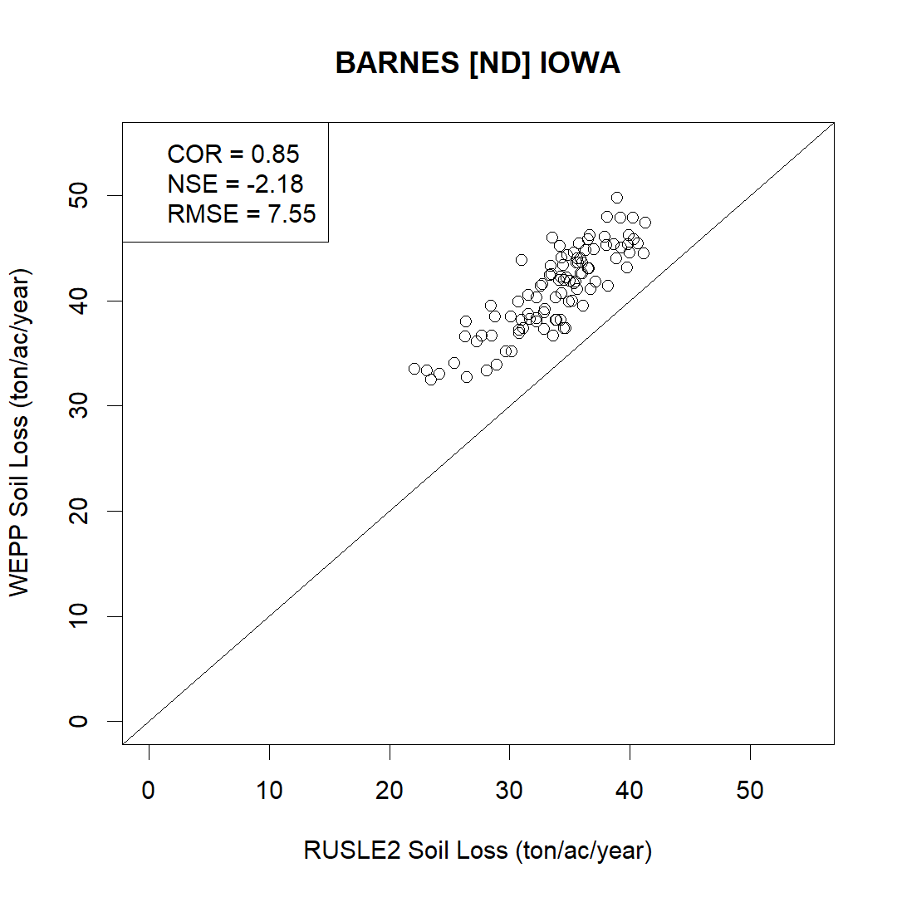

Loam texture

Slide 23
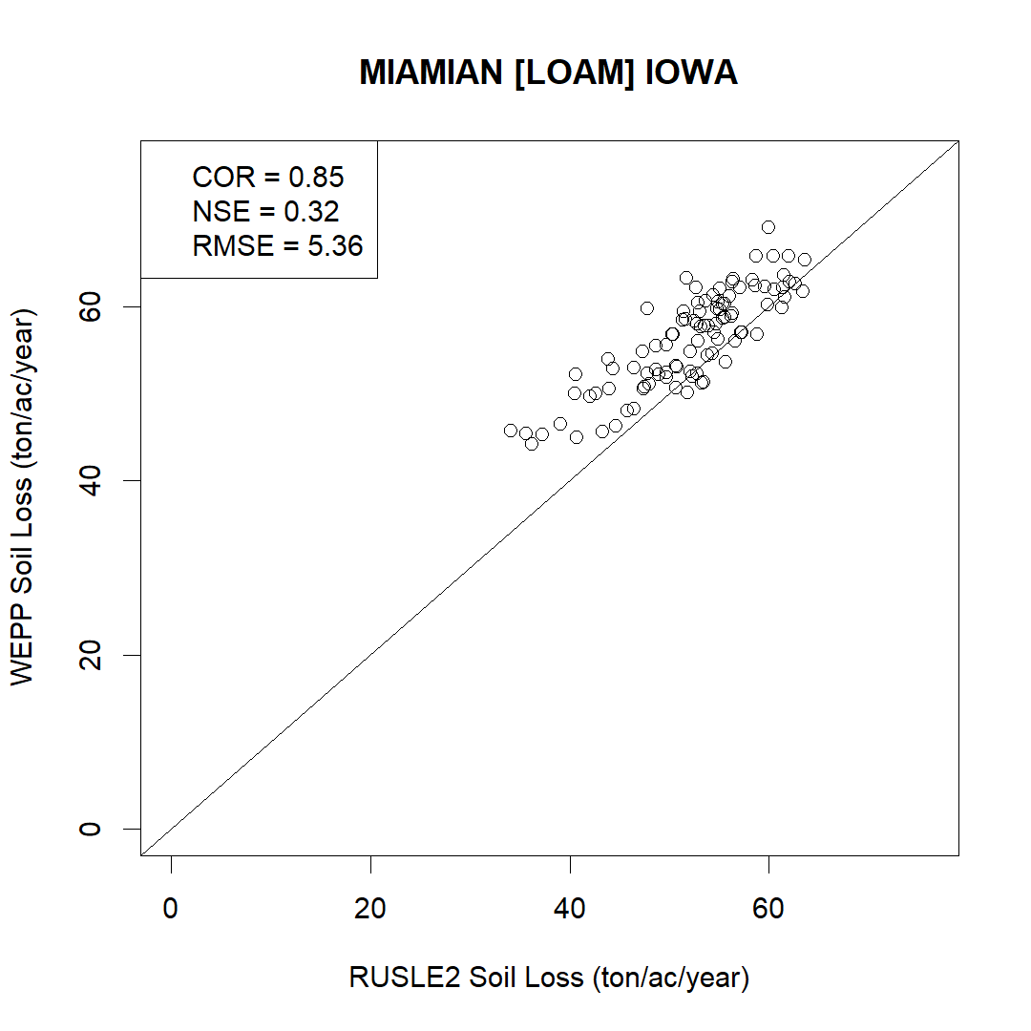

Loam texture

Slide 24
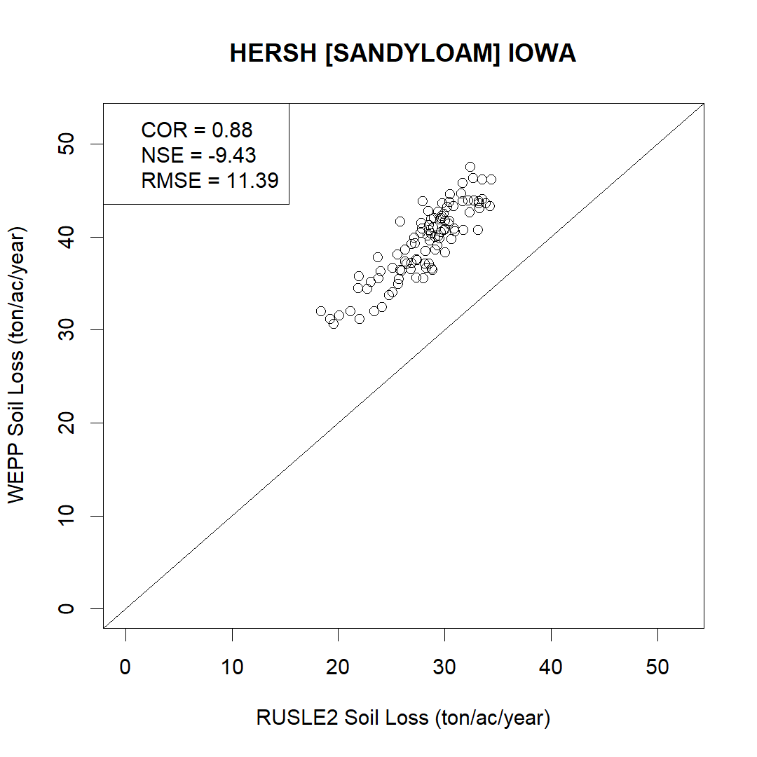
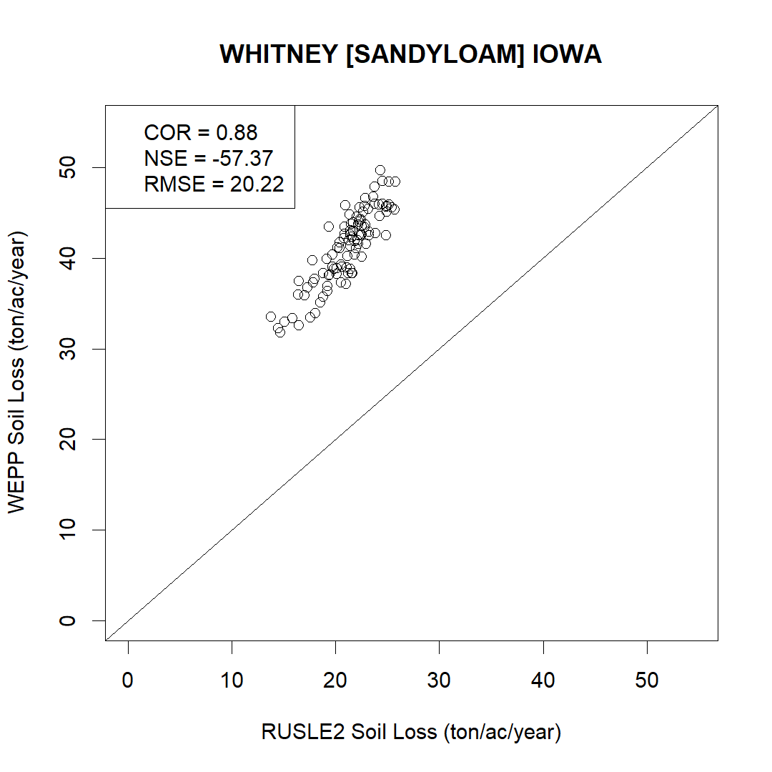
Sandy Loam texture

Slide 25
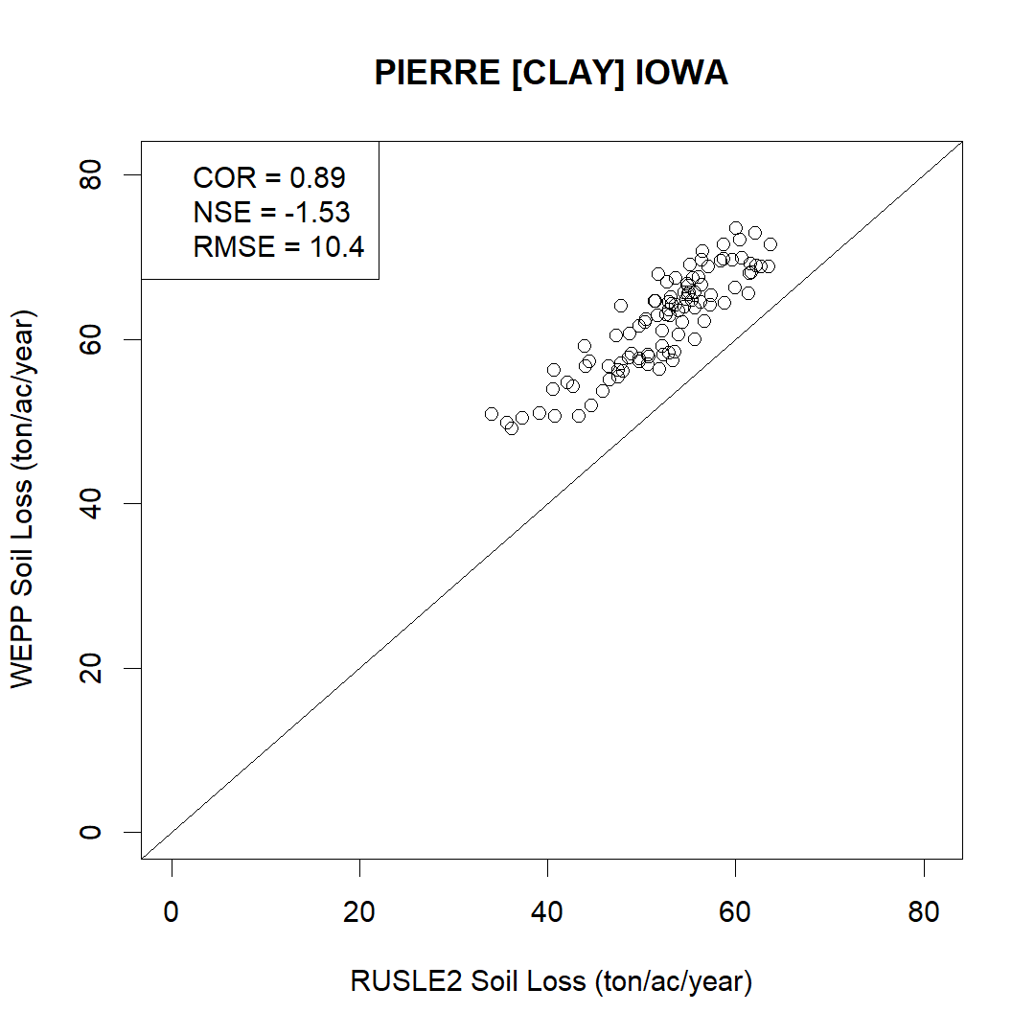
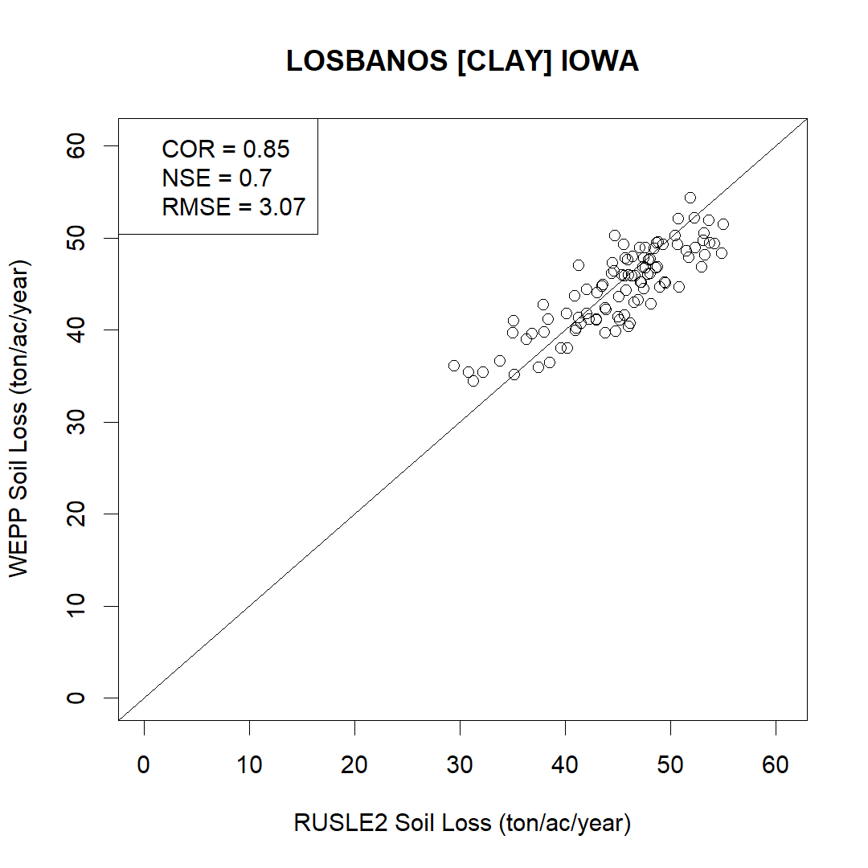
Clay texture

