Slide 1
WEPP Watershed/Field Interface for Spatial Soil Loss
Jim Frankenberger
Olaf David
Dennis Flanagan
March 21, 2019

Slide 2
Goals
Web based application to run WEPP watershed simulations
Web based application to run several hillslope profiles for spatial soil loss
Generate slope profiles from DEM’s
Use existing CSIP services for managements (CRLMOD), soils and climates.
Develop new service for WEPP watershed model
WEPP watershed services run on CSU and NRCS CSIP platform
Use CSU eRAMS/Catena platform for user interface

Slide 3
Status
WEPP watershed model is included with hillslope model currently deployed
Need to develop CSIP service link with WEPP watershed FORTRAN model
Just starting to look at design for software components
Will be able to reuse some code from existing WEPP web watershed project
CSU will be working on User interface and NSERL on WEPP watershed web service – awaiting ARS funds to be transferred to CSU
Initial prototype with limited features scheduled for September 2019

Slide 4
Background
Existing WEPP watershed web interface
CSU eRAMS/Catena platform
Iowa Daily Erosion Project

Slide 5
Existing WEPP watershed web interface
Developed around 2010
Single server, not scaleable
Uses Mapserver, PHP, HTML, javascript for user interface
User selects model inputs. Very limited editing allowed.
Simulations are run on servers. Results are displayed in users web browser window.
Run lengths are limited to provide reasonable response times.
Each user session has a unique area on the server where model inputs and outputs are processed.
http://milford.nserl.purdue.edu/ol/wepp/wepp1.php

Slide 6
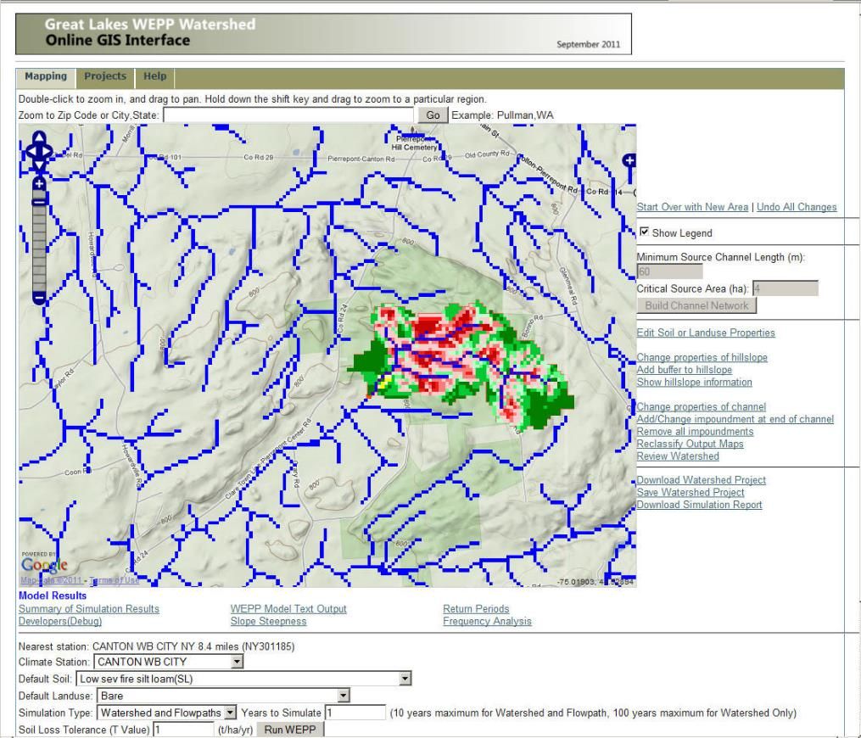
Flowpath erosion output map

Slide 7
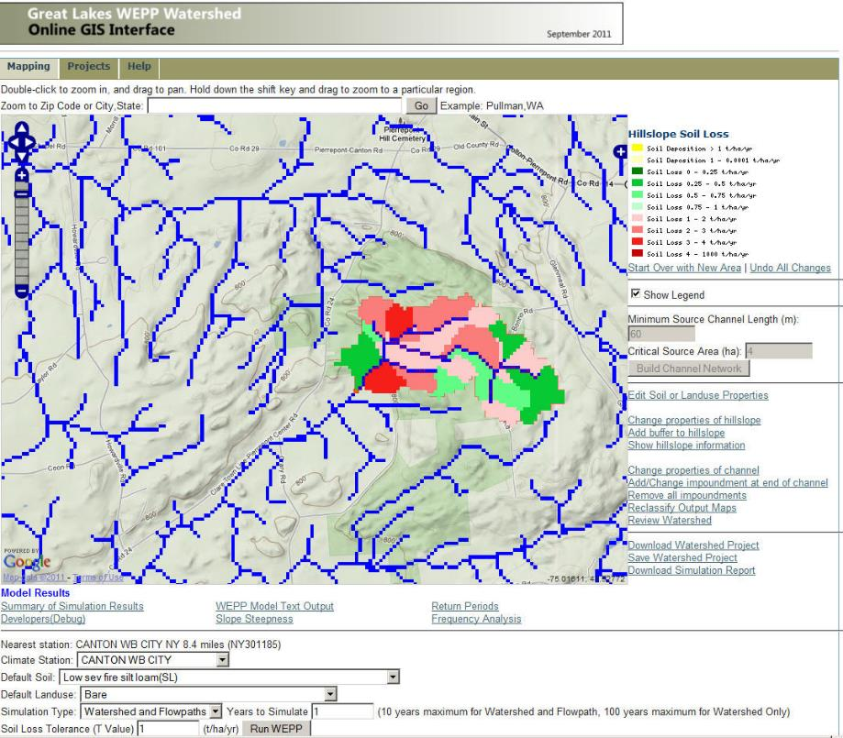
Hillslope erosion output Map

Slide 8
Flowpaths
Watershed
(grid based DEM)
Flowpath
Channel
Slope Profile of flowpath for WEPP run
outlet

Slide 9
WEPP Hillslope Representative Profile
z
l
Determined using all flowpaths in a subcatchment.
Notes:
All flowpaths are processed to have slope points at the same intervals so that lengths become a multiple of the cellsize. This is done by interpolating the the original flowpaths at the intervals may be equal to 1 cell width or the length of a cell diagonal depending on direction of the flowpath through the cell. Before the flowpaths are merged the points are all at equal intervals of 1 cell width.
Before creating a WEPP slope file if the number of slope points is > 20 then the points are reduced to have at most 20 points.
The slope grid used is the FVSLOP grid output from TOPAZ where each cell has a slope value.

Slide 10
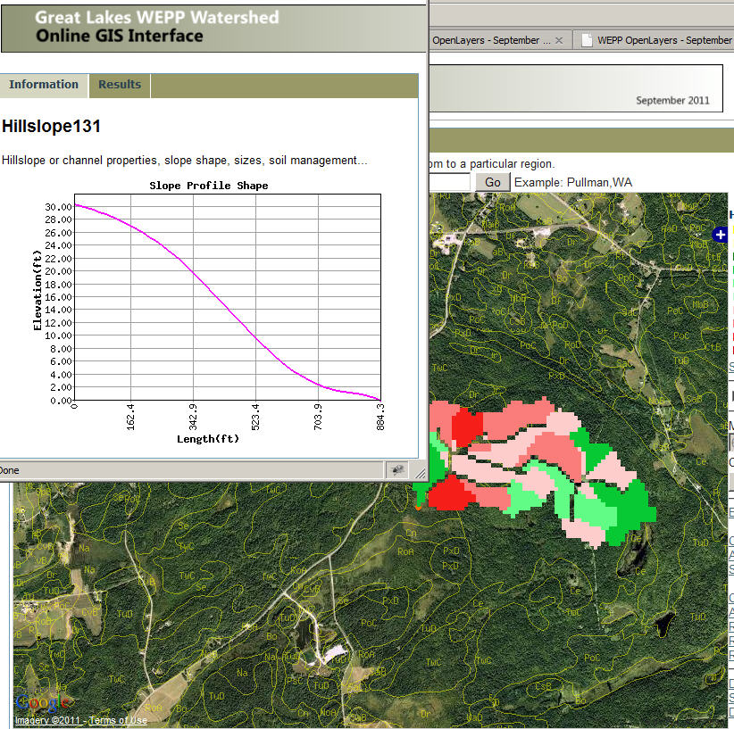
Shape of one representative hillslope

Slide 11
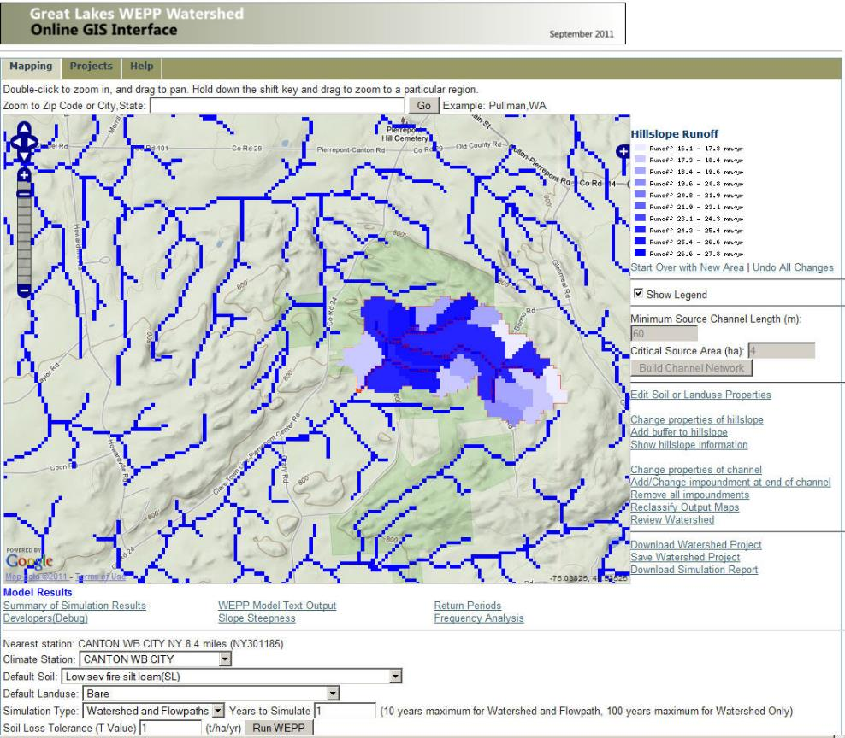
Runoff output Map

Slide 12
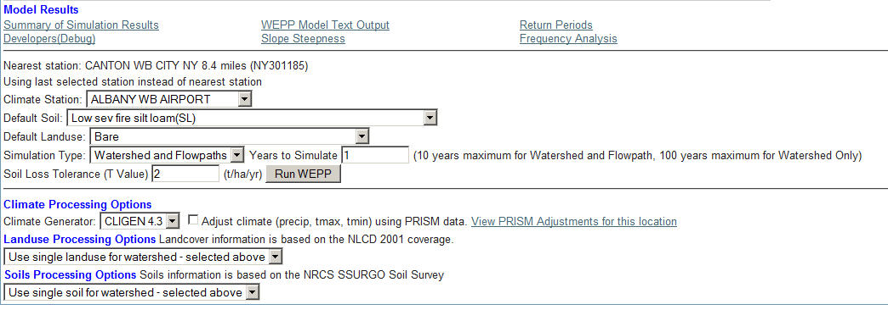
WEPP Model setup options

Slide 13
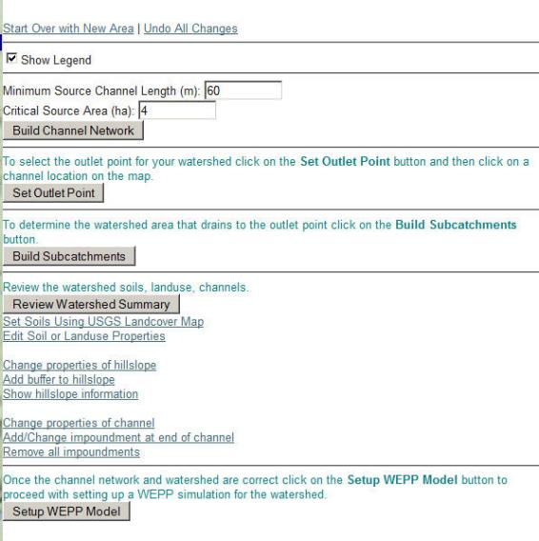
WEPP model setup options

Slide 14
Major software pieces
OpenLayers+Google Images+MapServer – Allows user to locate area of interest, assemble grids, visualize outputs.
GDAL – Geospatial Data Abstraction Library, GIS processing functions.
TOPAZ – Performs DEM analysis, watershed delineation, subcatchments, flow direction, channel network.
Prepwepp – Builds WEPP inputs from grids, runs WEPP model, produces output maps.

Slide 15
eRAMS/Catena UI framework
WEB GIS platform that can integrate with CSIP services.
GIS layers displayed in OpenLayers 4.0 in web browser
Server GIS is a Django application using Mapserver for displaying project layers
Olaf to add slides…

Slide 16
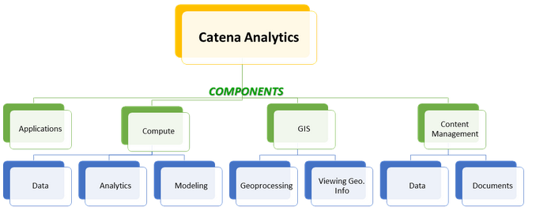
Catena Components

Slide 17
Catena UI Examples
Olaf to add slides…

Slide 18
Iowa Daily Erosion Project
Developed by Iowa State University
https://www.dailyerosion.org/
Modern spatial data and remote sensing makes it possible to generate high-resolution inputs for Water Erosion Prediction Project (WEPP) model
  Use discrete flowpaths from LiDAR-derived DEM
    Overlay on other appropriate data sources
  Use a HUC12 watershed spatial framework with approximately 125 flowpaths per watershed
    2,500 HUC12 watersheds
      Each approximately 100 km²
      Over 280,000 flowpaths modeled daily

Slide 19
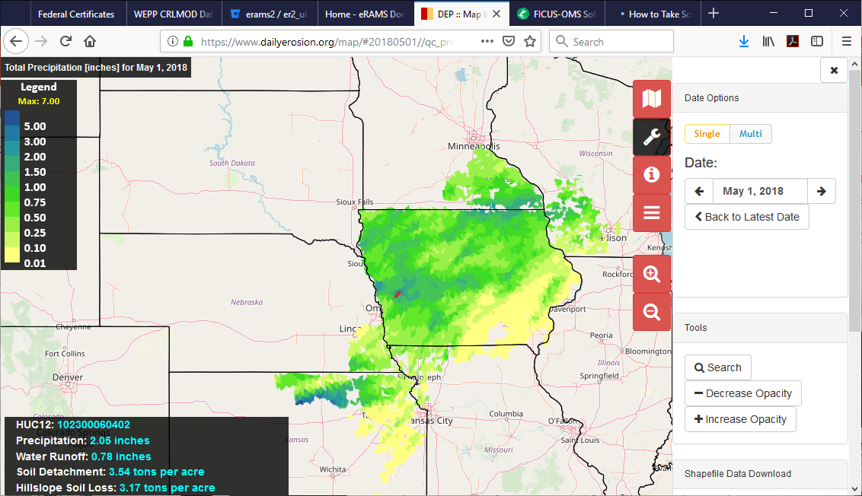

Slide 20
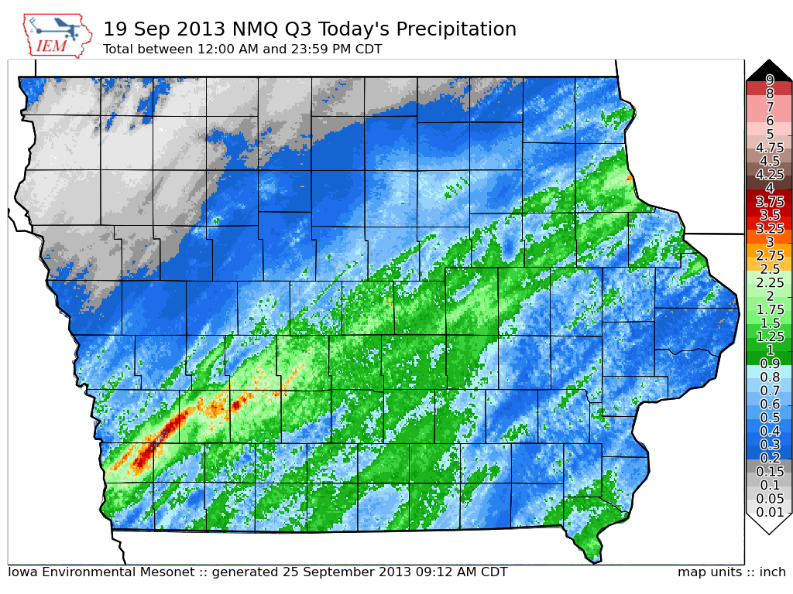
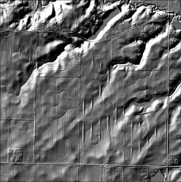
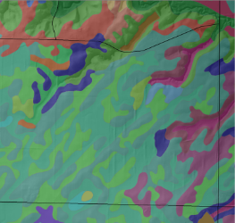
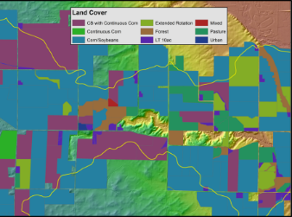
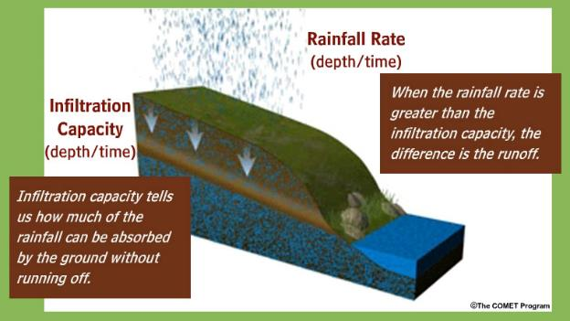
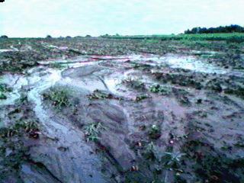
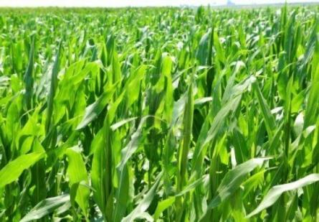
NEXRAD Precipitation
LiDAR Elevation
gSSURGO Soils
Field-scale Land-use & Management
Iowa Daily Erosion Project
WEPP
Runoff
Detachment
Delivery
Soil Moisture

Slide 21
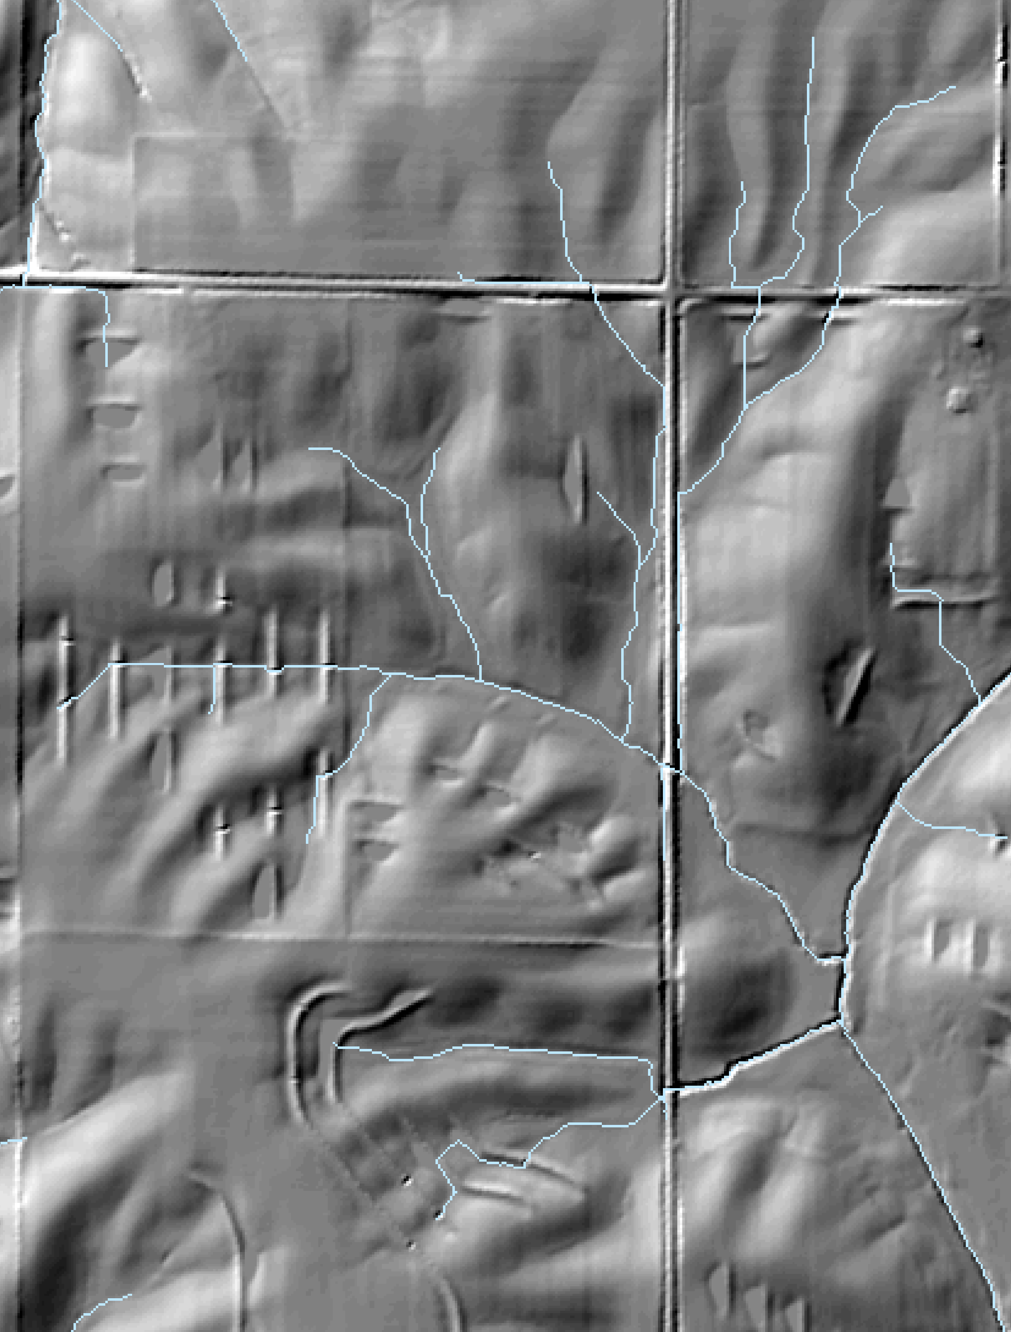
IOWA Daily erosion Project Hillslope Profiles
Hydrologic enforcement cuts across impediments to flow
  Too many flowpaths for WEPP requires random sampling
  Enables stratification of watersheds into subcatchments
    TauDEM Peuker-Douglas method constant drop stream analysis
    125 sub-catchments per HUC12
  Select 1 AG flowpath per sub-catchment
  Stops at impediments to flow; terraces, roads, non-Ag land, concentrated flow

Slide 22
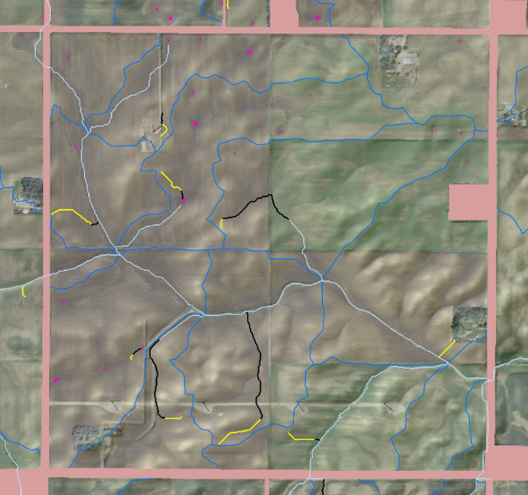
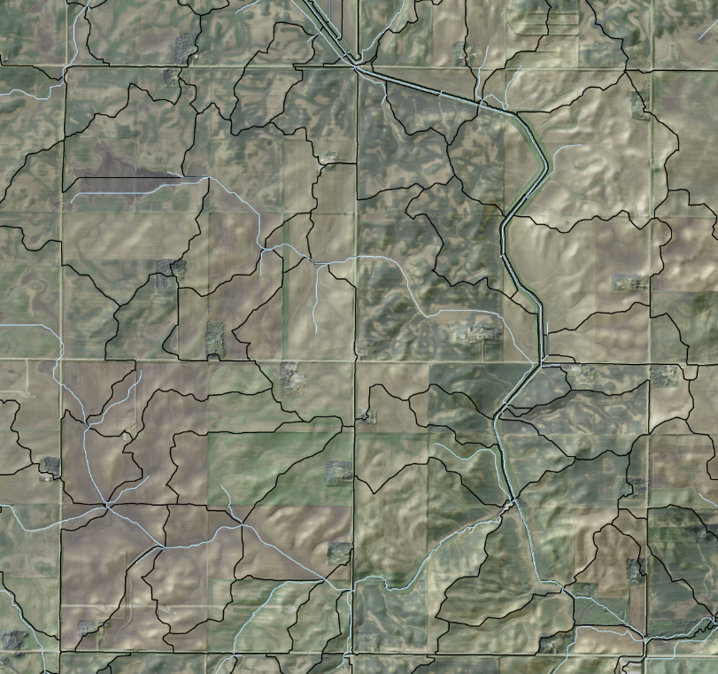
Iowa Daily Erosion Project
Sub-catchments & Flowpaths
Subcatchment Boundary
Flowpath
(Not modeled)
Flowpath
(Modeled)
1 random flowpath per subcatchment
Must be on agricultural land
Approximately 10-100 m long
Only modeled in sheet/rill flow
Notes:
Bottom image – HUC12, Middle Image – Subcatcment Boundaries with channels, Top image Flowpaths leading to channels (Yellow parts of flowpath are Grid Order 4 or less, which is what we model)

Slide 23
Considerations
Should we have Selective sampling of flowpaths similar to the Iowa daily project to provide better response?
Full flowpath simulations on field level for spatial soil loss (non watershed).
Full flowpath simulations for larger areas may not be practical requiring thousands of model runs.
WEPP watershed simulations, representative hillslopes to generate inputs to channels.
Will eventually need Taudem to replace Topaz for watershed delineation.
Appropriate DEM scale to use 10m, 3m Lidar for small areas.
Scope of features

Slide 24
The end
Questions?

