Slide 1
WEPP Watershed/Field Interface for Spatial Soil Loss
Jim Frankenberger
Olaf David
Dennis Flanagan
March 21, 2019

Slide 2
Goals
Web based application to run WEPP watershed simulations
Web based application to run several hillslope profiles for spatial soil loss
Generate slope profiles from DEM’s
Use existing CSIP services for managements (CRLMOD), soils and climates.
Develop new service for WEPP watershed model
WEPP watershed services run on CSU and NRCS CSIP platform
Use CSU eRAMS/Catena platform for user interface

Slide 3
Status
WEPP watershed model is included with hillslope model currently deployed
Need to develop CSIP service link with WEPP watershed FORTRAN model
Just starting to look at design for software components
Will be able to reuse some code from existing WEPP web watershed project
CSU will be working on User interface and NSERL on WEPP watershed web service – awaiting ARS funds to be transferred to CSU
Initial prototype with limited features scheduled for September 2019

Slide 4
Background
Existing WEPP watershed web interface
CSU eRAMS/Catena platform
Iowa Daily Erosion Project

Slide 5
Existing WEPP watershed web interface
Developed around 2010
Single server, not scaleable
Uses Mapserver, PHP, HTML, javascript for user interface
User selects model inputs. Very limited editing allowed.
Simulations are run on servers. Results are displayed in users web browser window.
Run lengths are limited to provide reasonable response times.
Each user session has a unique area on the server where model inputs and outputs are processed.
http://milford.nserl.purdue.edu/ol/wepp/wepp1.php

Slide 6
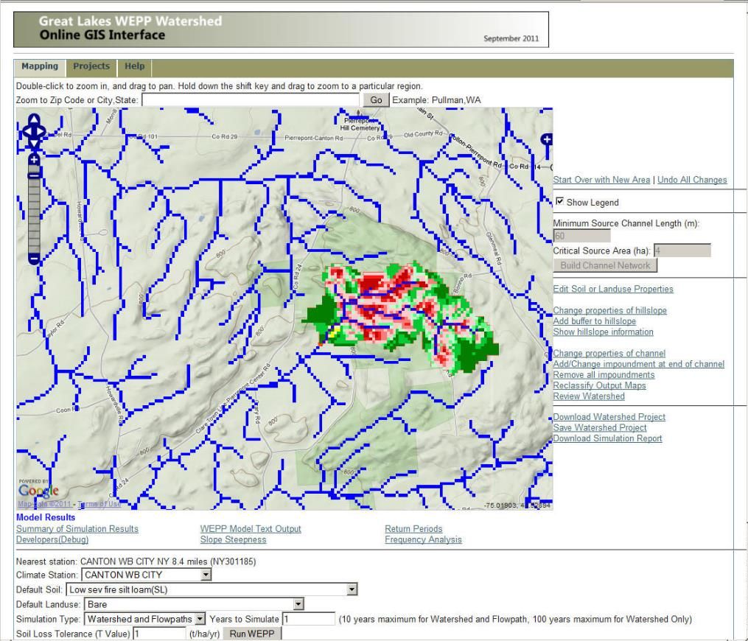
Flowpath erosion output map

Slide 7
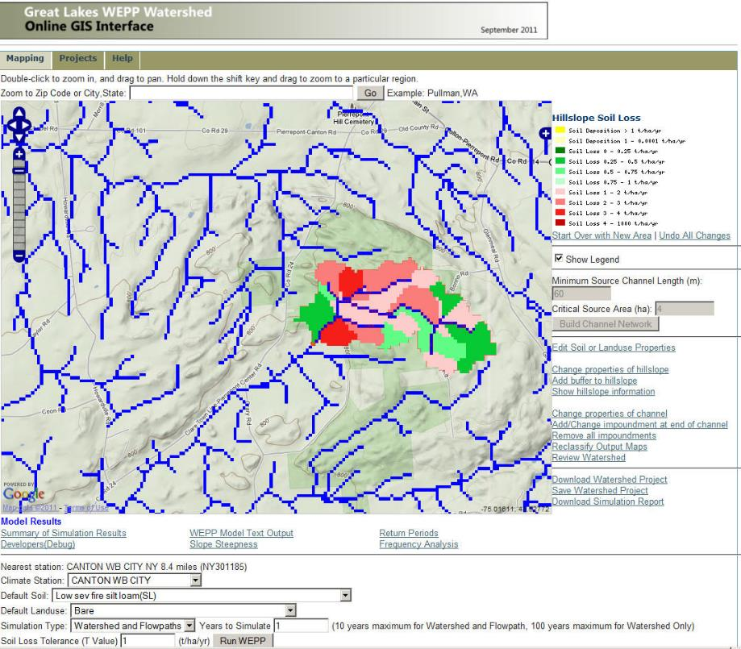
Hillslope erosion output Map

Slide 8
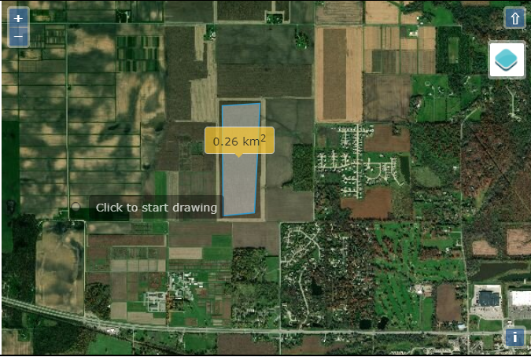
Future – only present for results for area

Slide 9
Flowpaths
Watershed
(grid based DEM)
Flowpath
Channel
Slope Profile of flowpath for WEPP run
outlet

Slide 10
WEPP Hillslope Representative Profile
z
l
Determined using all flowpaths in a subcatchment.
Notes:
All flowpaths are processed to have slope points at the same intervals so that lengths become a multiple of the cellsize. This is done by interpolating the the original flowpaths at the intervals may be equal to 1 cell width or the length of a cell diagonal depending on direction of the flowpath through the cell. Before the flowpaths are merged the points are all at equal intervals of 1 cell width.
Before creating a WEPP slope file if the number of slope points is > 20 then the points are reduced to have at most 20 points.
The slope grid used is the FVSLOP grid output from TOPAZ where each cell has a slope value.

Slide 11
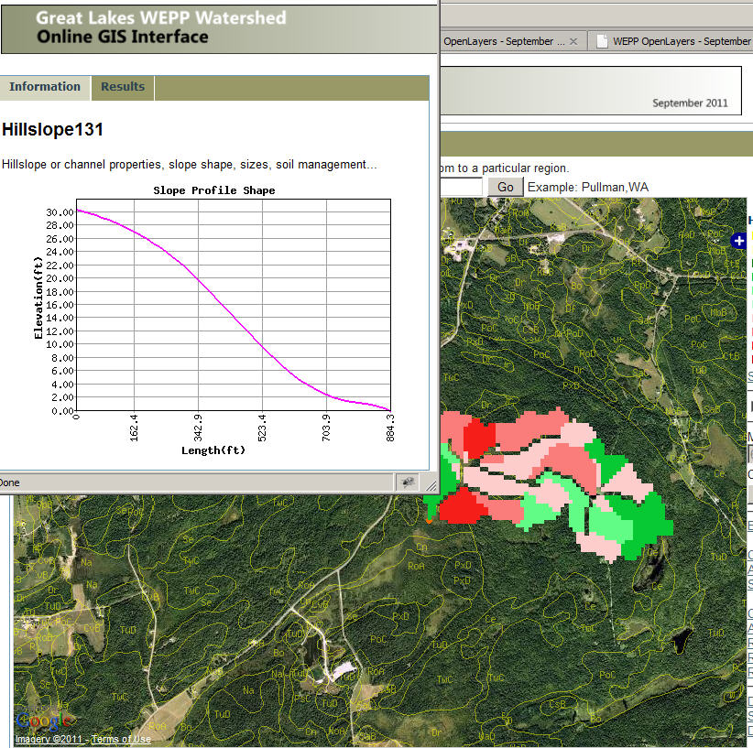
Shape of one representative hillslope

Slide 12
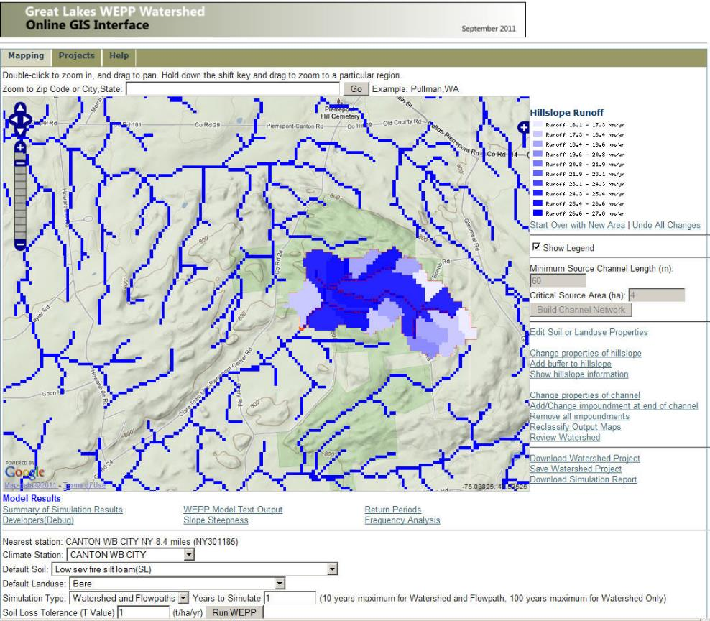
Runoff output Map

Slide 13
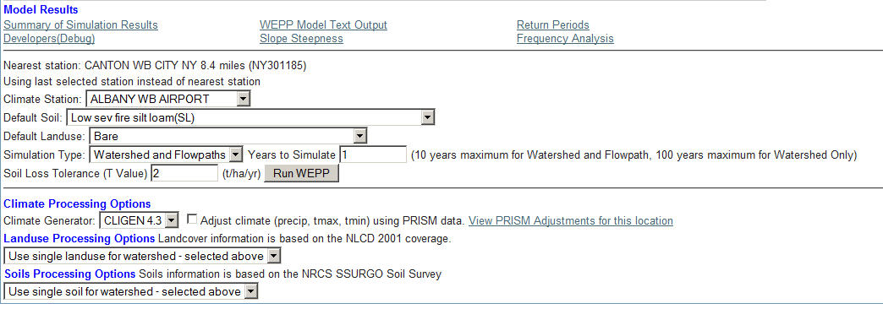
WEPP Model setup options

Slide 14
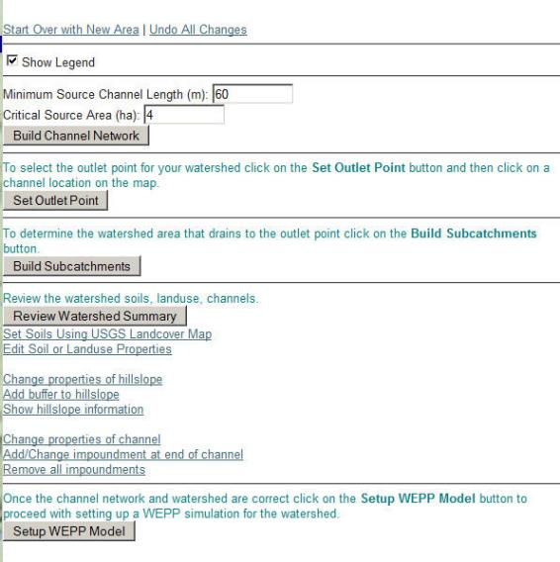
WEPP model setup options

Slide 15
Major software pieces
OpenLayers+Google Images+MapServer – Allows user to locate area of interest, assemble grids, visualize outputs.
GDAL – Geospatial Data Abstraction Library, GIS processing functions.
TOPAZ – Performs DEM analysis, watershed delineation, subcatchments, flow direction, channel network.
Prepwepp – Builds WEPP inputs from grids, runs WEPP model, produces output maps.

Slide 16
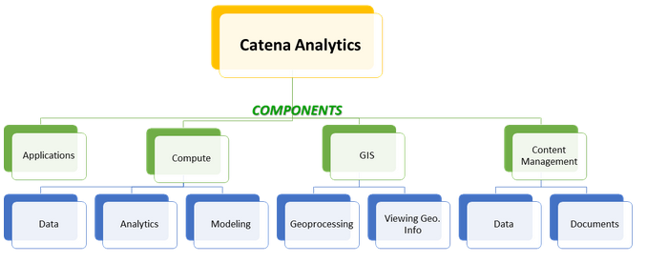
Catena – CSU
Lightweight web-based GIS core platform
Software framework & libraries for geospatial applications
Plugin-based architecture - use as much or as little as you need
Focus on the app, not the framework
Core components
  GIS
  Compute (CSIP)
  Content Management
  Collaboration
Direct data source access
Workflow support
Modular and microservices application approach for core Components, GIS, Data, Models
Horizontal/Vertical scaling
Brushing and Linking
Contemporary Architecture / UI
Notes:
Why not a framework?
frameworks are highly-opinionated, which make application development harder the more custom your application becomes
Why a lightweight core?
needs to be deployed and scaled quickly
need to eliminate bloat, since most apps use only a small subset of features
Plugin-based architecture mimics Wordpress plugin architecture, except more generic.
Plugins can be downloaded from any URL as a mercurial or git repository
Plugins are more comprehensive: include installation and configuration for application dependencies, software libraries, runtimes, etc… via Docker containers
Apps are plugins

Slide 17
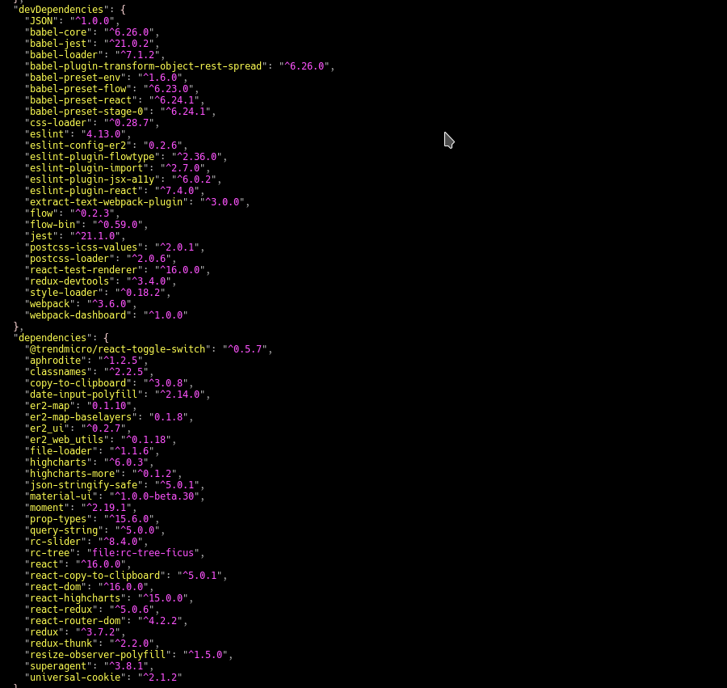
Libraries
Leaflet: 1.2.0
OpenLayers: 4.4.2
Redis: 2.10.5
MongoDB: 3.6
Django
Notes:
Some assets still need bundled, see “Roadmap”

Slide 18
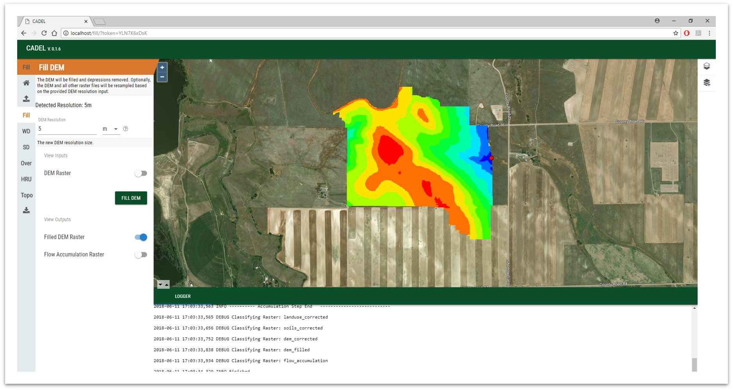
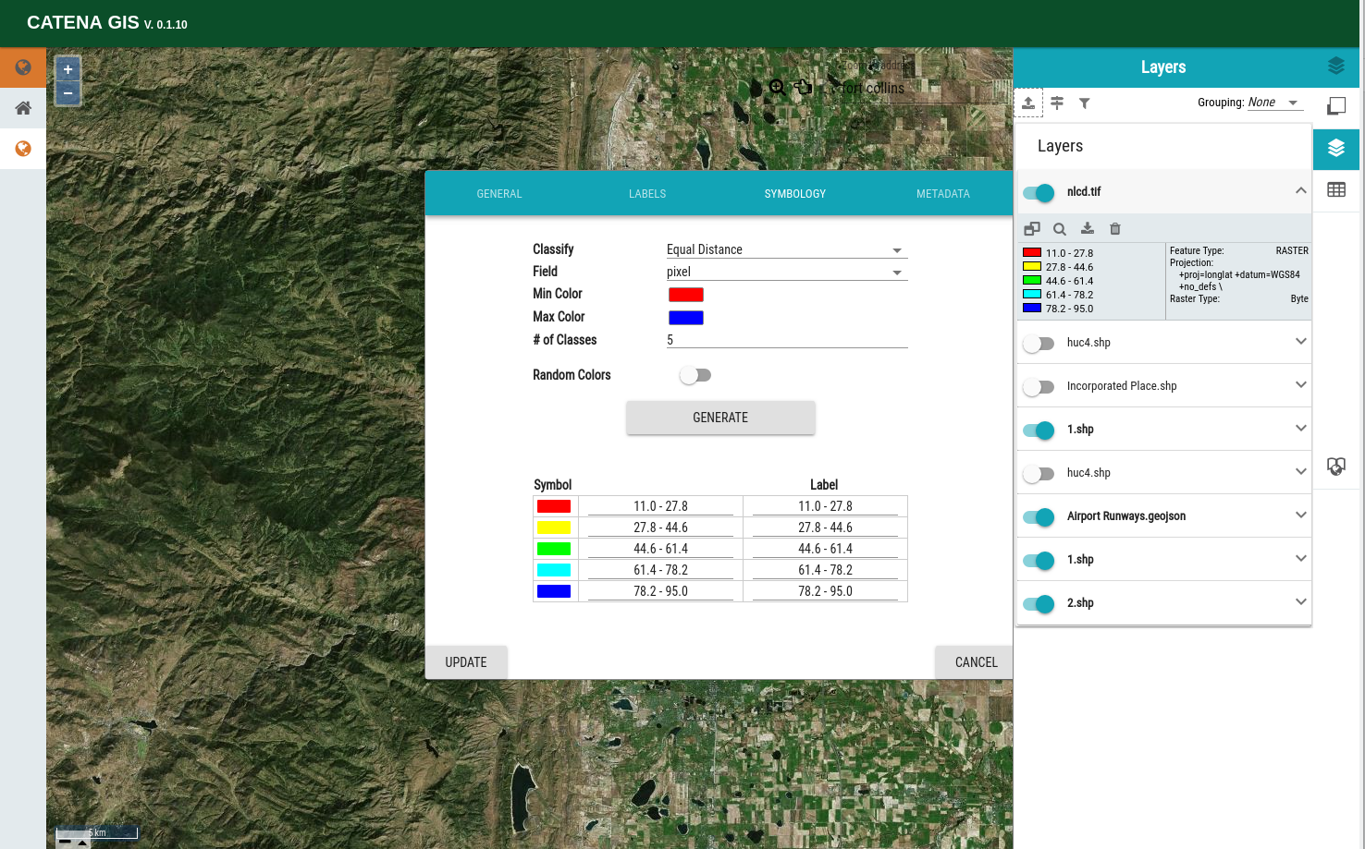
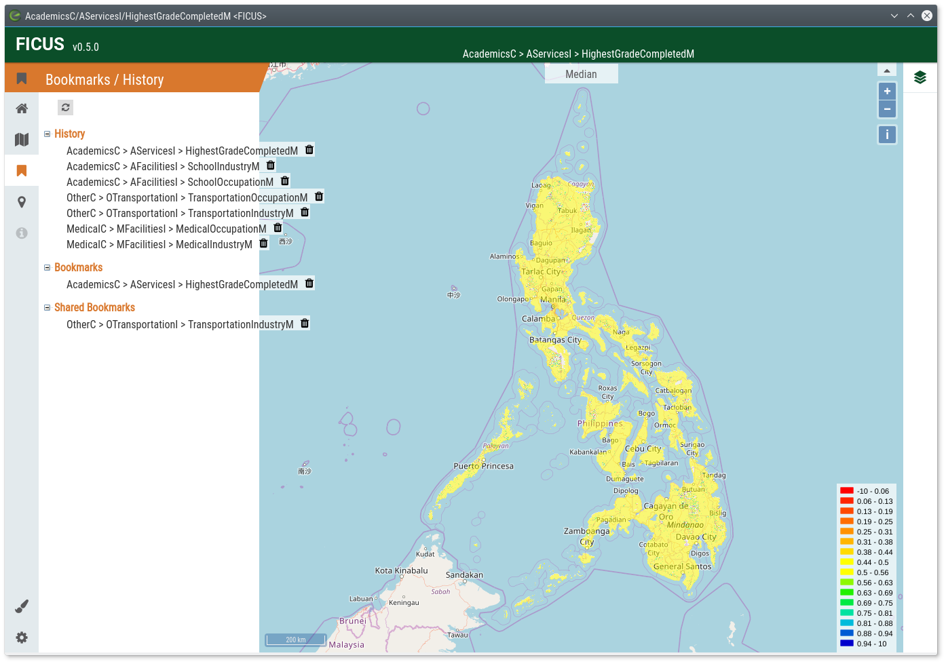
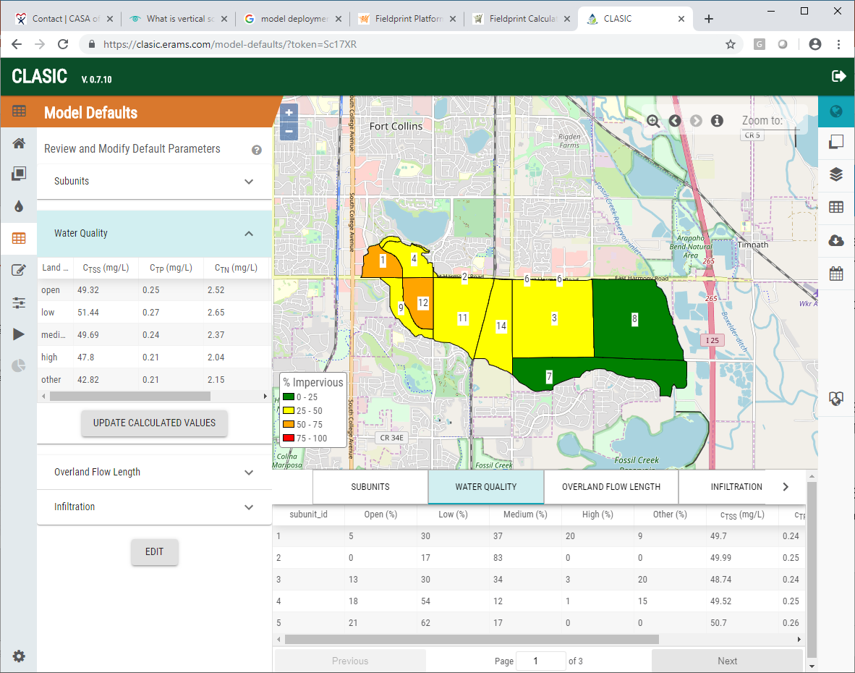
Catena Applications
Catena Platform
Cadel
Catena GIS
FICUS
CLASIC

Slide 19
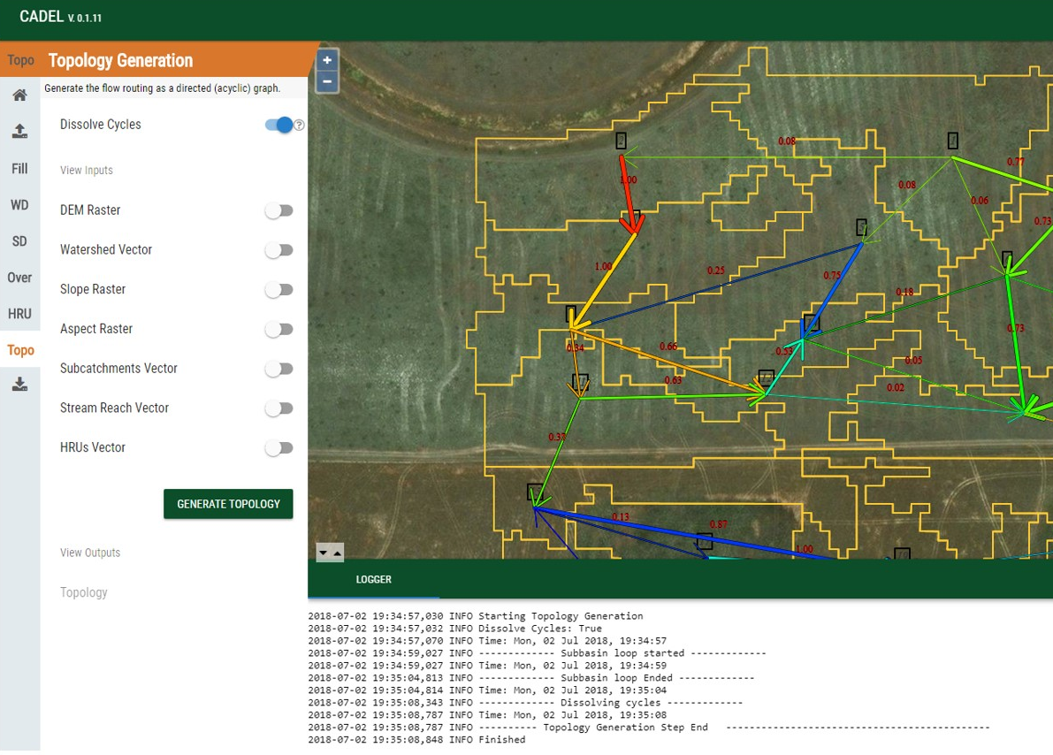
Catchment Delineation - Cadel (ARS)
Purpose
Delineating a watershed’s boundaries and a set of internal response elements or polygons with geospatial attribute tables is an essential part of generating input parameter sets for distributed hydrological models.
Cadel implements a generic methodology of such a delineation process and services workflow. The current version produces specific topology and routing input files for the Agricultural Ecosystem Services (AgES) distributed watershed model. Attributes assigned to each HRU include terrain attributes with optional soil, land use, and hydrogeologic identifiers provides as geospatial input layers.
CSIP services
csip-watershed
  TauDEM Method
    Flow direction
    Flow accumulation
    Stream raster
    Stream network
    Peuker-Douglas
    Gage watershed
    etc.

Slide 20
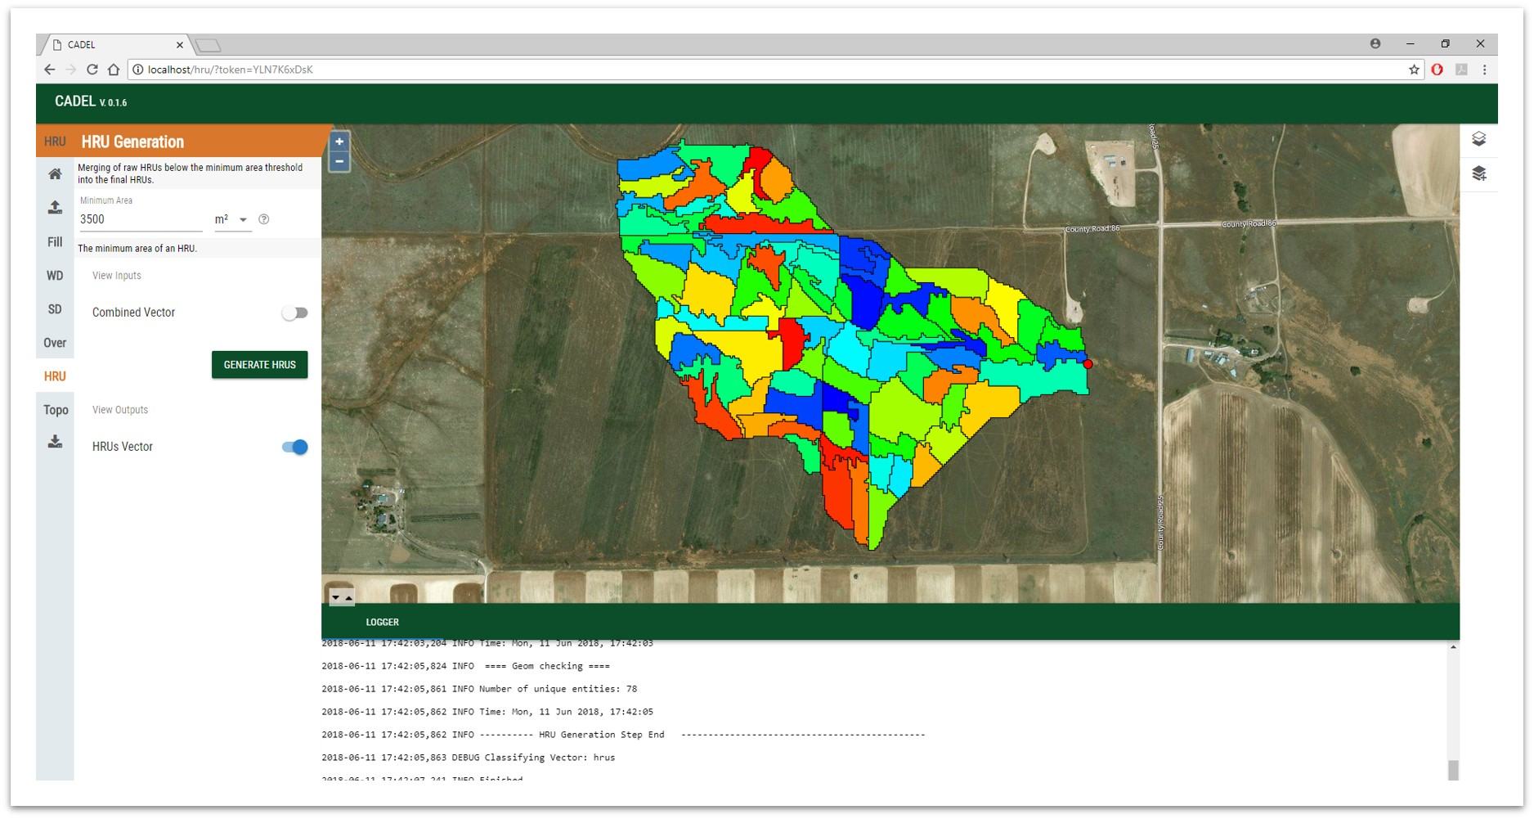
Catchment Delineation CADEL

Slide 21
Catchment Delineation

Slide 22
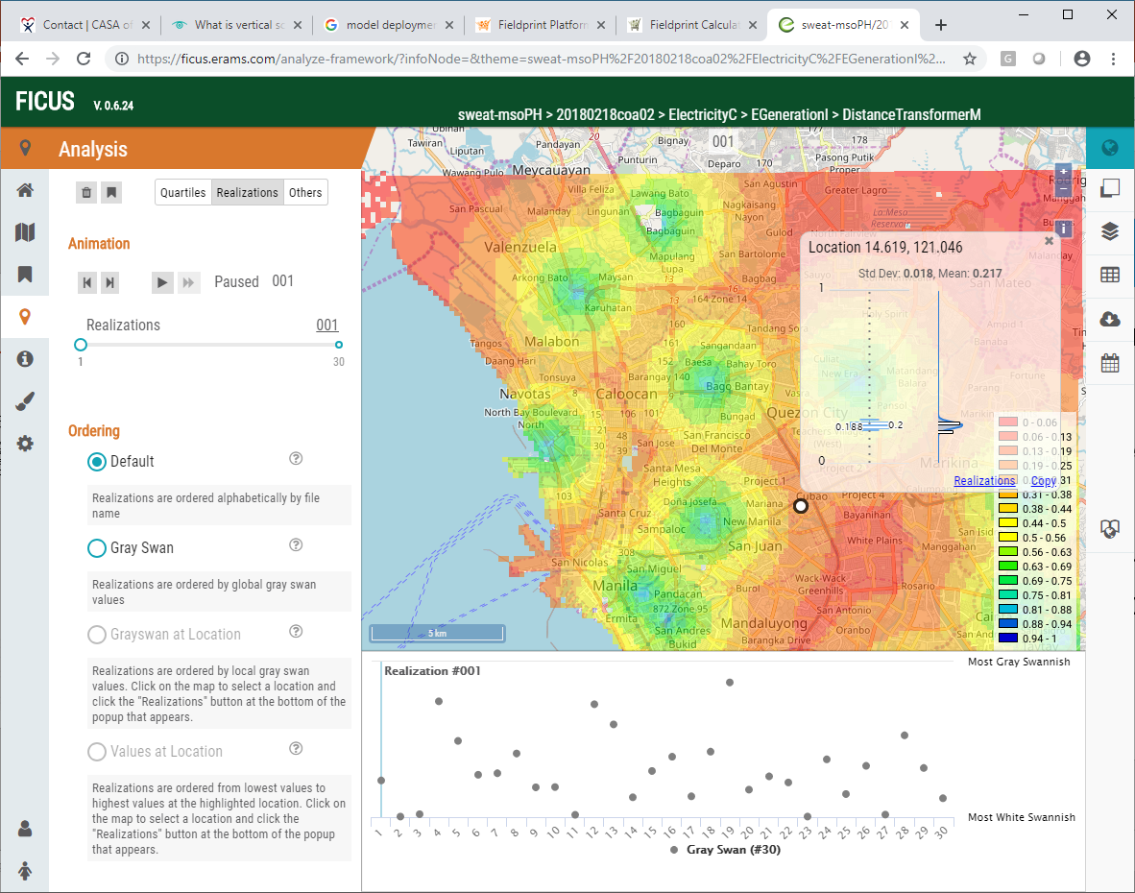
Framework for Integrating Complex Uncertain Systems FICUS (USACE)
Purpose
The “Framework for Integrating Complex Uncertain Systems” (FICUS) is a computational framework to support federated models of complex uncertain systems and enable information support for multiple interconnected social, infrastructural, and environmental models.
FICUS research goals are to develop a neighborhood scale geo-temporal analysis tool quantifying data and application uncertainty and forecasting near future environmental, social, and infrastructural change.
CSIP Services
csip-transims
csip-HISSA

Slide 23
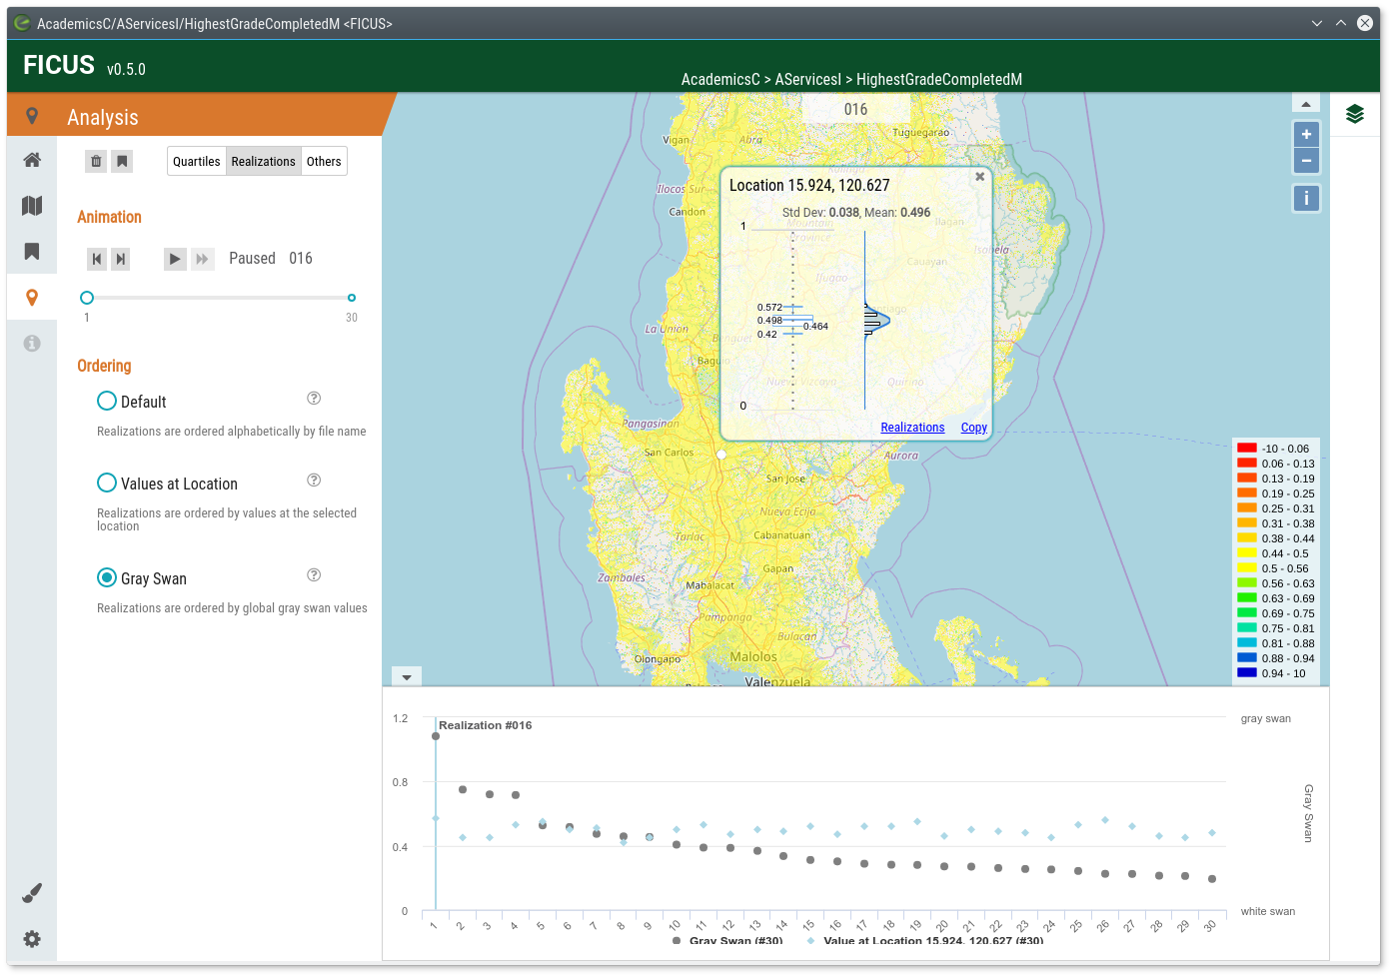
Framework for Integrating the Complexity of Uncertain Systems (FICUS)
Feature Animation
Statistics

Slide 24
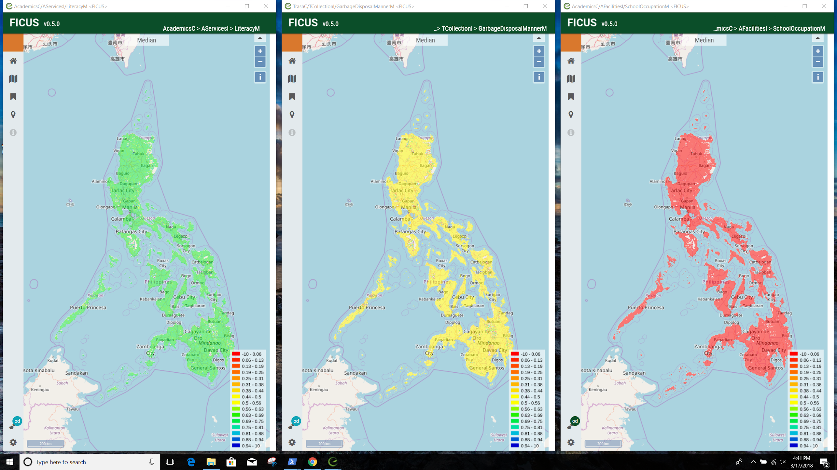
FICUS
Brushing
Mapextend
Feature selection
Analysis (Gray Swan stats)

Slide 25
Community-enabled Lifecycle Analysis of Stormwater Infrastructure Costs (EPA)
Purpose
Community-enabled Lifecycle Analysis of Stormwater Infrastructure Costs (CLASIC) is a screening tool utilizing a lifecycle cost framework to support stormwater infrastructure decisions on extent and combinations of green, hybrid green-gray, and gray infrastructure practices.
Users can create scenarios of stormwater control measures including climate and land use projections to assess lifecycle costs, performance, and co-benefits associated with those scenarios.
CSIP – Services
csip-swmm: Storm Water Management Model

Slide 26
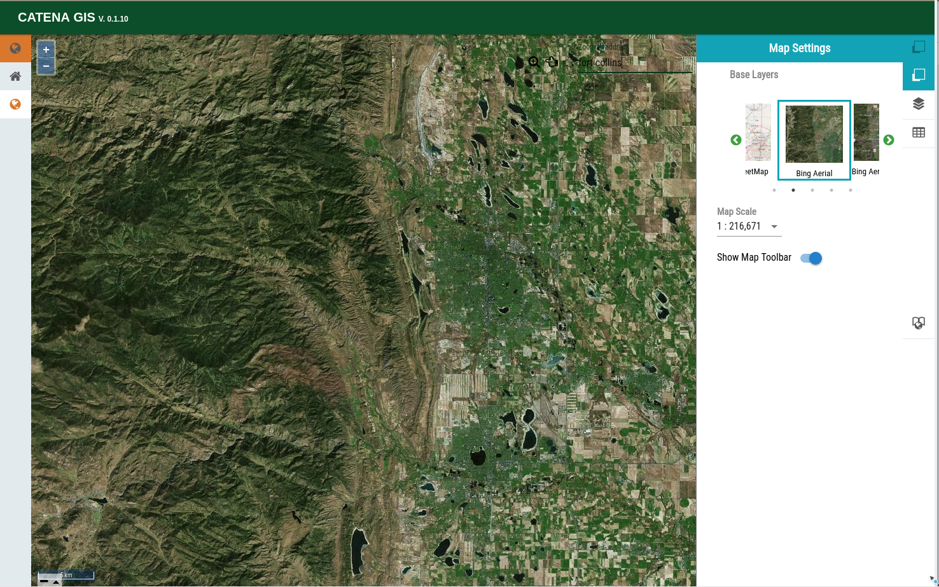
Catena GIS

Slide 27
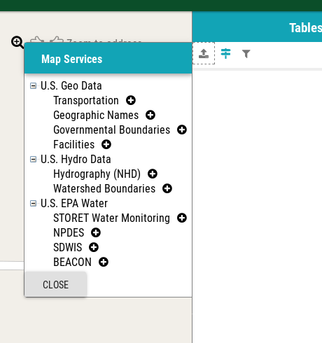
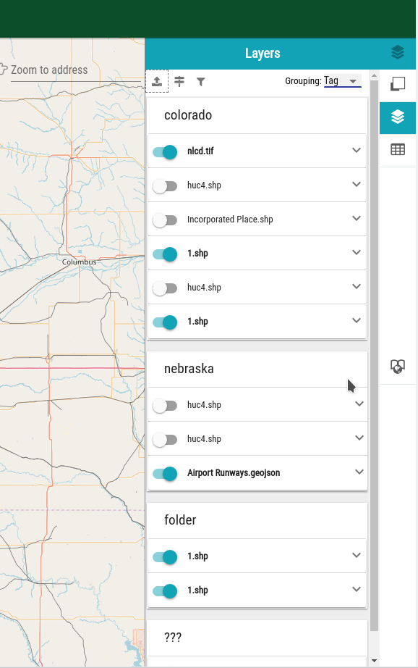
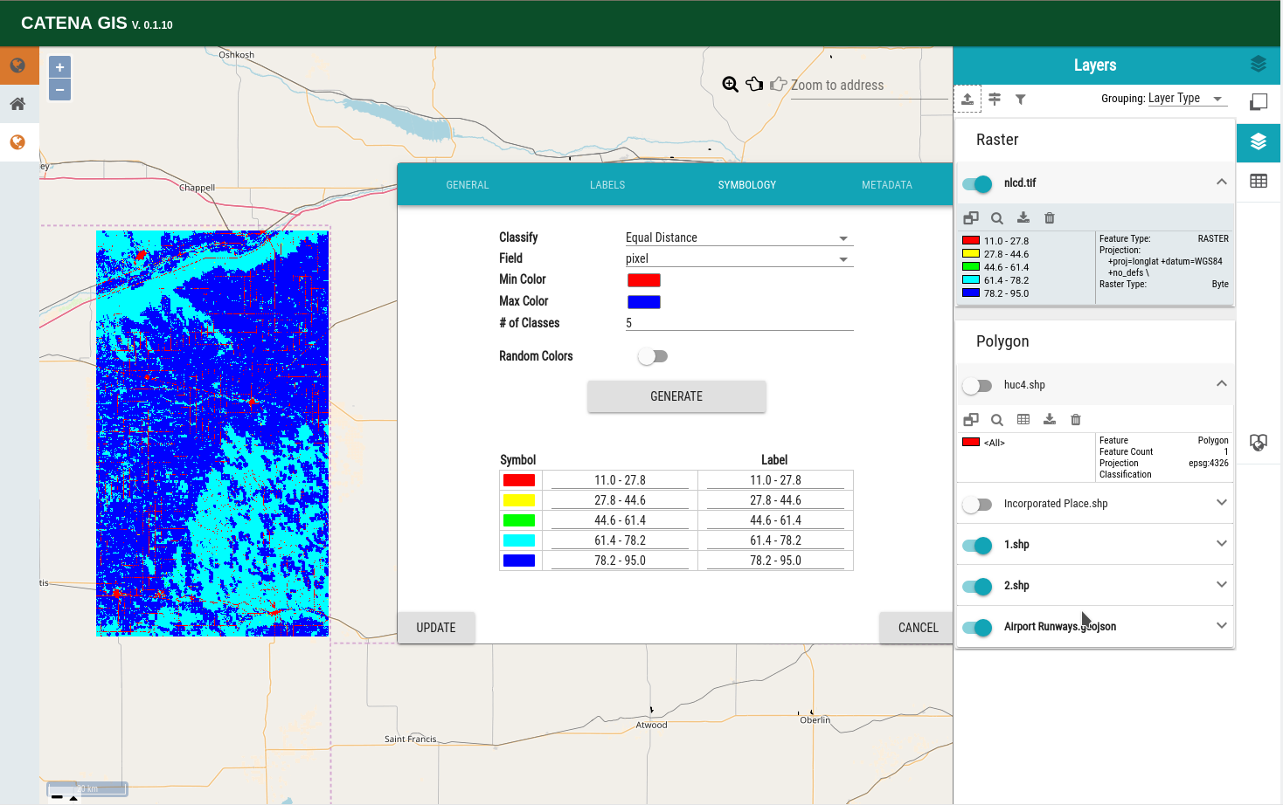
Layer Management
Layer Grouping, Tagging
Meta data
Public Data Sources
Properties
Classification

Slide 28
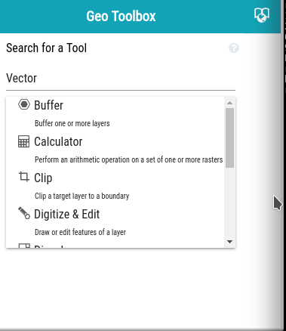
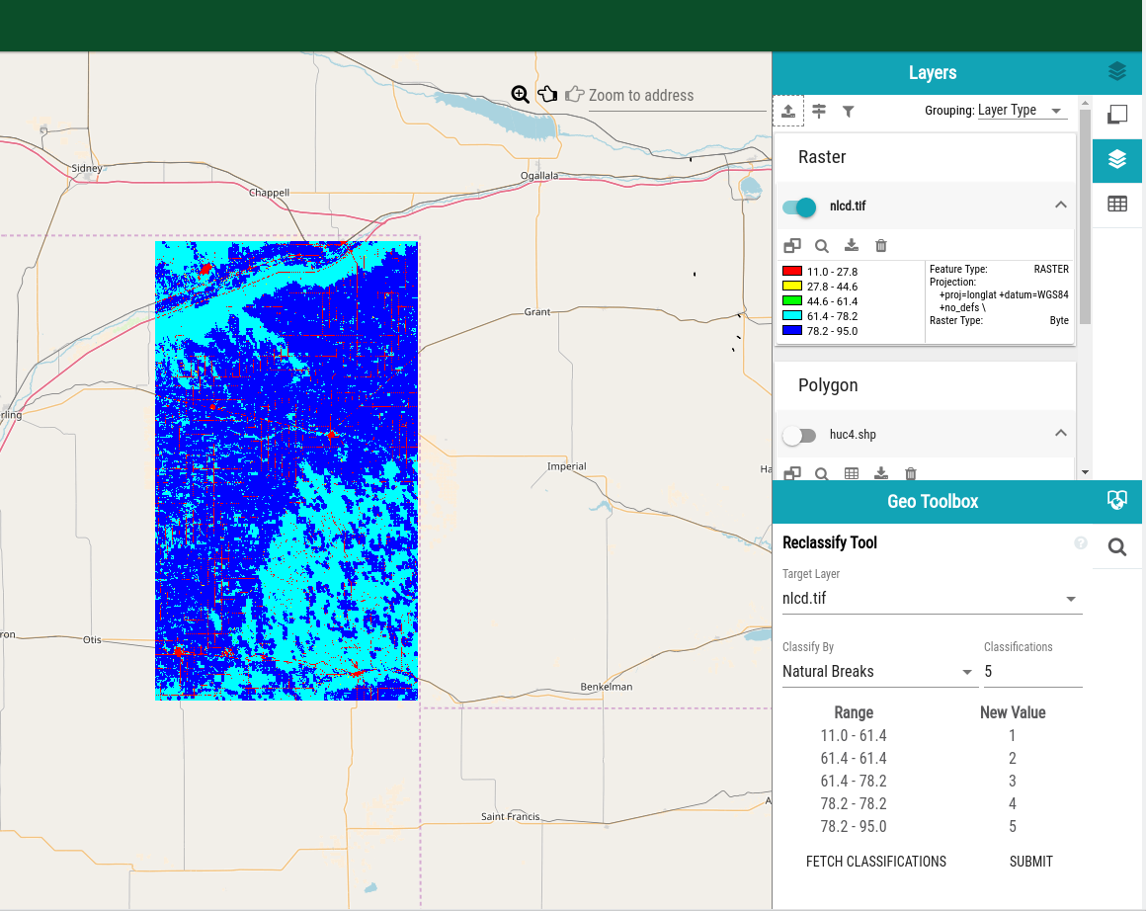
Geoprocessing
Search for a tool

Slide 29
Iowa Daily Erosion Project
Developed by Iowa State University
https://www.dailyerosion.org/
Modern spatial data and remote sensing makes it possible to generate high-resolution inputs for Water Erosion Prediction Project (WEPP) model
  Use discrete flowpaths from LiDAR-derived DEM
    Overlay on other appropriate data sources
  Use a HUC12 watershed spatial framework with approximately 125 flowpaths per watershed
    2,500 HUC12 watersheds
      Each approximately 100 km²
      Over 280,000 flowpaths modeled daily

Slide 30
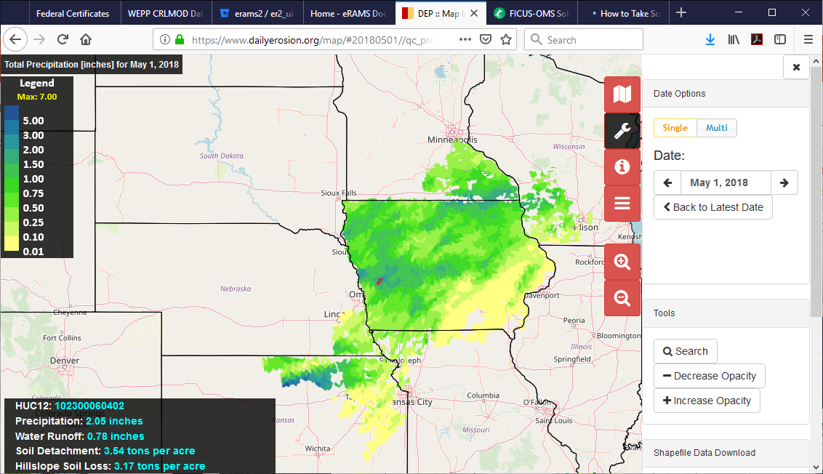

Slide 31
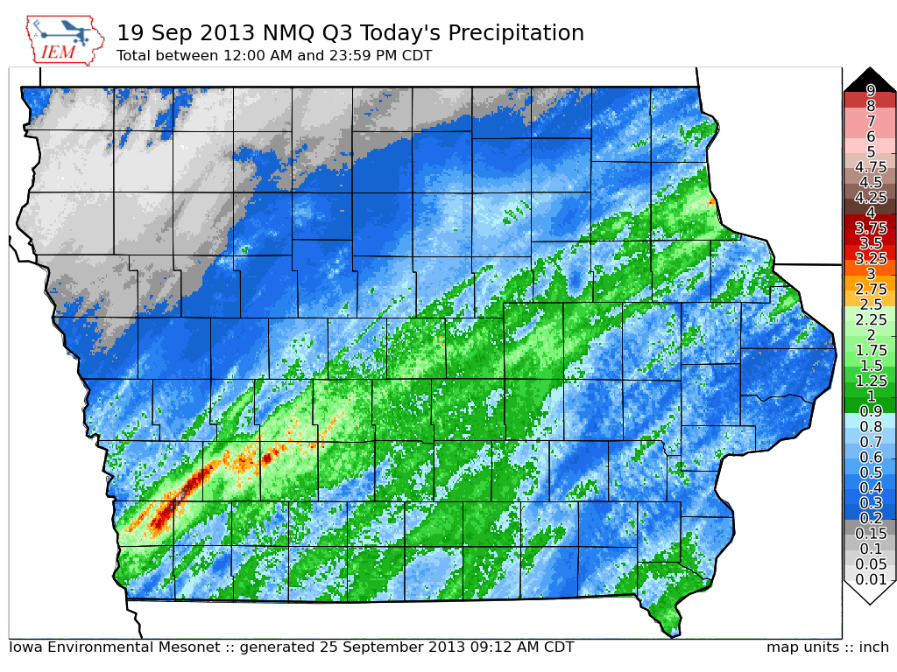
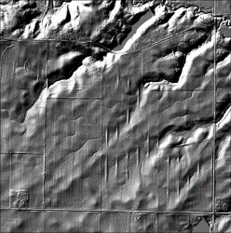
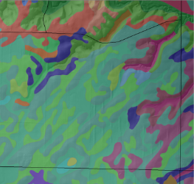
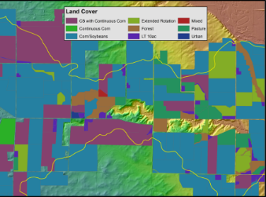
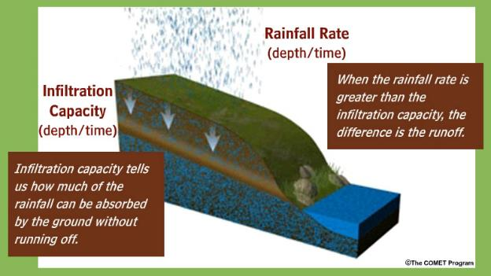
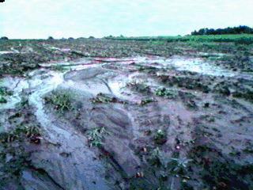
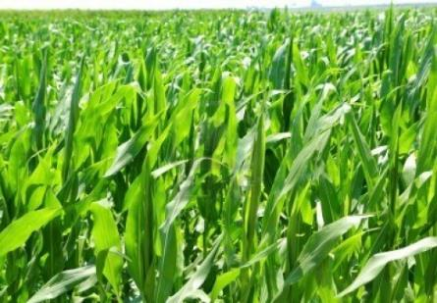
NEXRAD Precipitation
LiDAR Elevation
gSSURGO Soils
Field-scale Land-use & Management
Iowa Daily Erosion Project
WEPP
Runoff
Detachment
Delivery
Soil Moisture

Slide 32
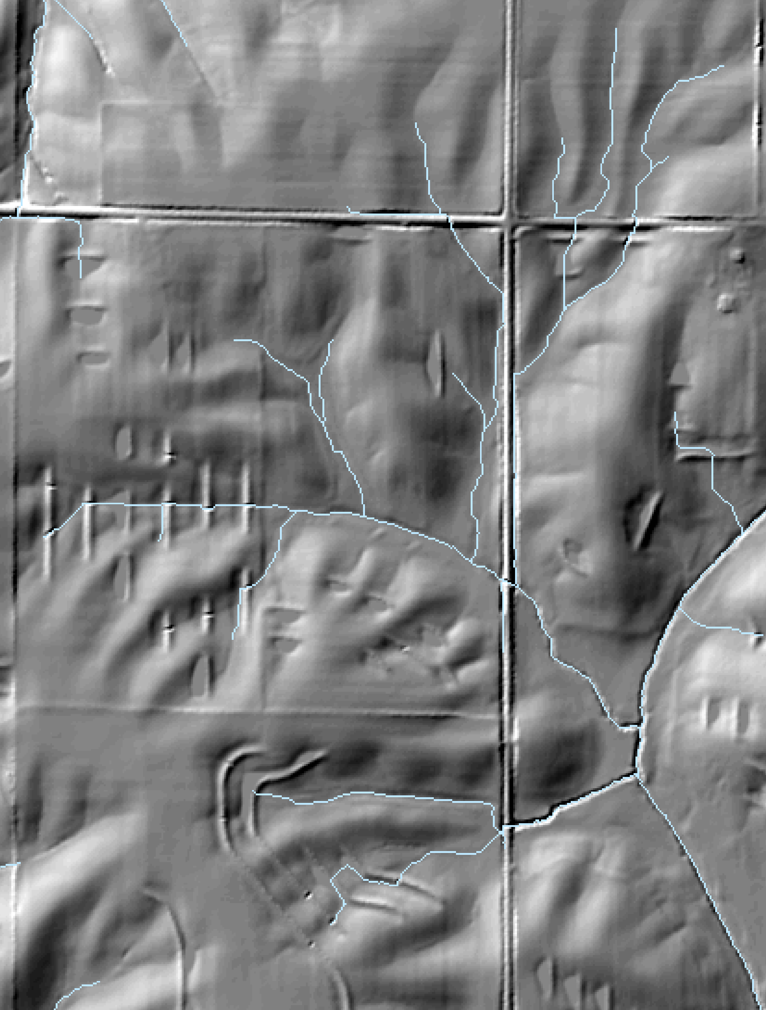
IOWA Daily erosion Project Hillslope Profiles
Hydrologic enforcement cuts across impediments to flow
  Too many flowpaths for WEPP requires random sampling
  Enables stratification of watersheds into subcatchments
    TauDEM Peuker-Douglas method constant drop stream analysis
    125 sub-catchments per HUC12
  Select 1 AG flowpath per sub-catchment
  Stops at impediments to flow; terraces, roads, non-Ag land, concentrated flow

Slide 33
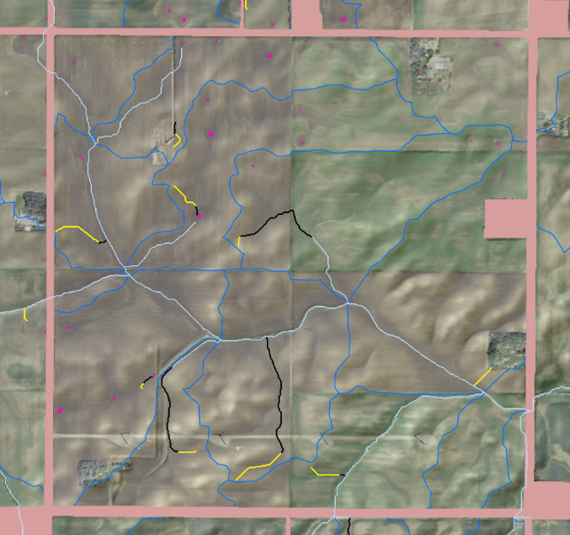
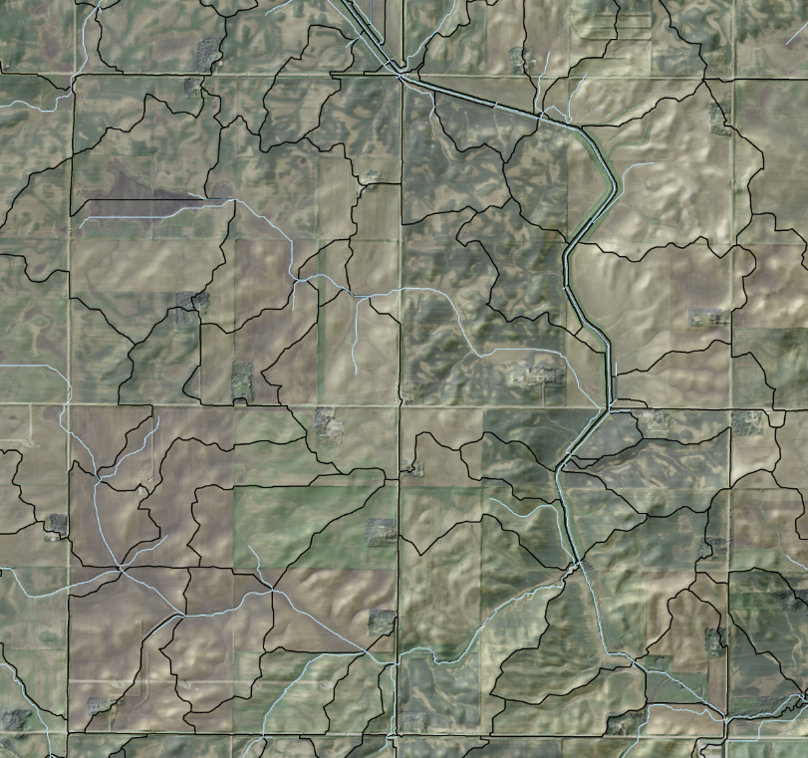
Iowa Daily Erosion Project
Sub-catchments & Flowpaths
Subcatchment Boundary
Flowpath
(Not modeled)
Flowpath
(Modeled)
1 random flowpath per subcatchment
Must be on agricultural land
Approximately 10-100 m long
Only modeled in sheet/rill flow
Notes:
Bottom image – HUC12, Middle Image – Subcatcment Boundaries with channels, Top image Flowpaths leading to channels (Yellow parts of flowpath are Grid Order 4 or less, which is what we model)

Slide 34
Considerations
Should we have Selective sampling of flowpaths similar to the Iowa daily project to provide better response?
Full flowpath simulations on field level for spatial soil loss (non watershed).
Full flowpath simulations for larger areas may not be practical requiring thousands of model runs.
WEPP watershed simulations, representative hillslopes to generate inputs to channels.
Will eventually need Taudem to replace Topaz for watershed delineation.
Appropriate DEM scale to use 10m, 3m Lidar for small areas.
Scope of features

Slide 35
The end
Questions?

