Slide 1
Status of WEPP Hillslope Model – Interfaces and Databases
Jim Frankenberger
March 19, 2019

Slide 2
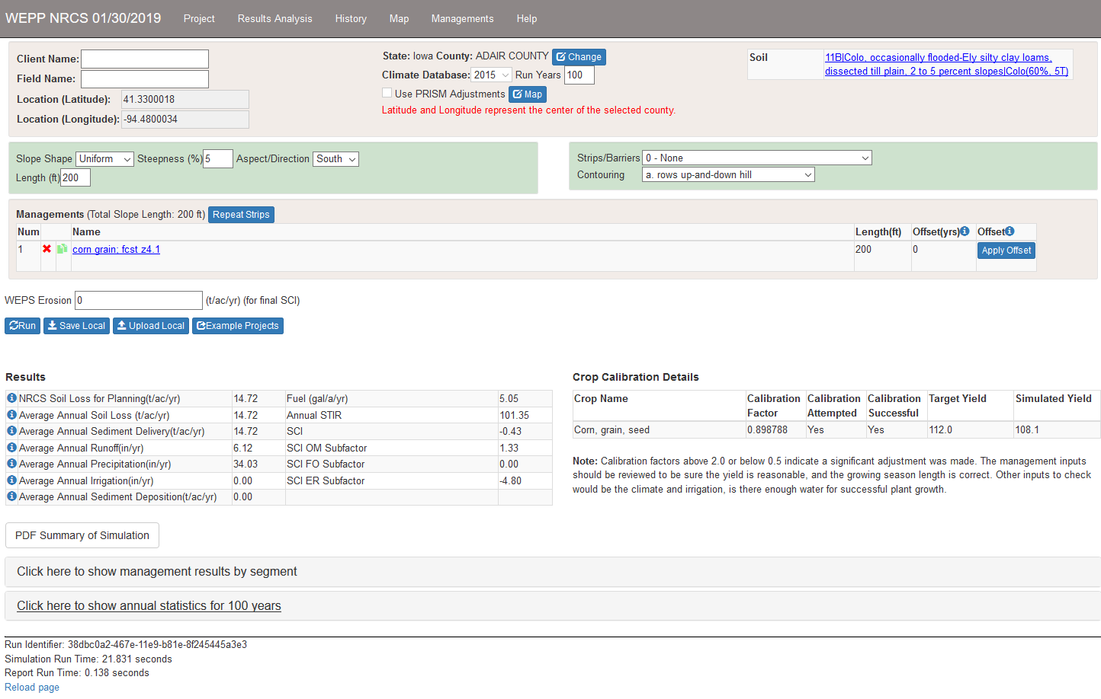
Web User Interface

Slide 3
Web User Interface
Available from NSERL websites:
http://brenton.nserl.purdue.edu/rest/weppcrtest/ - CRLMOD 3.1, all services and model runs are from CSU servers. WEPP 2018
http://brenton.nserl.purdue.edu/rest/nserl/ - local CRLMOD 4+, latest local crop and operation parameters being tested. Model runs and Crop, operation data from NSERL servers. WEPP 2019.
http://brenton.nserl.purdue.edu/rest/r2weppeval/ - Snapshot on DEC 10, 2018 for RUSLE2 and WEPP comparisons.

Slide 4
Status of interface
Need better error reporting if web services are down or partially working
Safari browser – management editor does not allow yield, residue to be entered
Management editor error checking needs improvements
Priority of any changes driven by NRCS

Slide 5
WEPP Databases
Working with CRLMOD as basis, woody vegetations need to be completed
For debugging and testing crop and operation parameter changes local database versions at NSERL are available
For testing there is also the ability to override database crop parameters from a debug window in the web interface
NRCS (Mike K) controls how crop and operations are updated in CRLMOD after local testing
Goes from EXCEL spreadsheets -> Files -> local NSERL test -> CRLMOD/SMA
https://fargo.nserl.purdue.edu/weppcrlmod/ - WEPP Crop and operation Data spreadsheets

Slide 6
WEPP Databases – In process
Crop database – decomposition parameter adjustments, total biomass related to harvest index adjustments.
Woody vegetations – orchards, trees, vineyards – need to be tested in management scenarios.
Operations database – No outstanding items.
Soils database – have preliminary file for organic soils, needs to be tested.
Restricting layer - currently recognize two identifiers for a restricting layer, need to look at making common with WEPS.

Slide 7
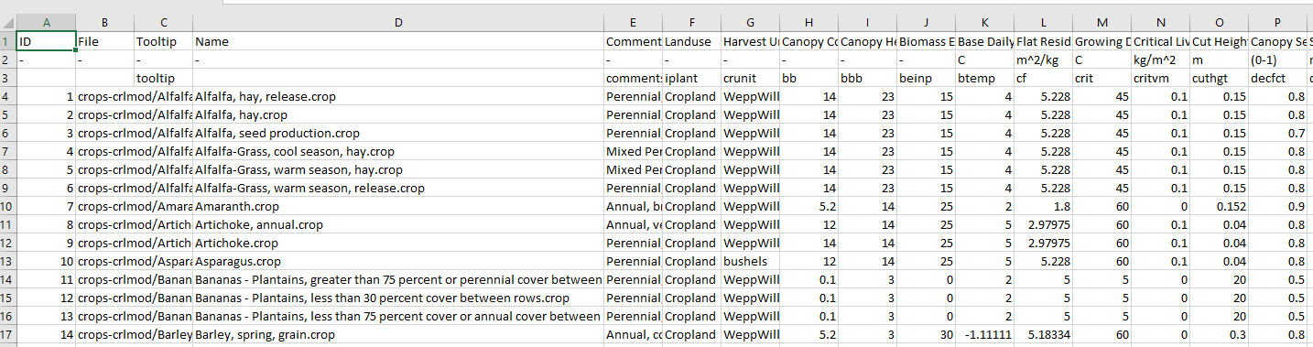
Databases – Crop Parameter Spreadsheet

Slide 8
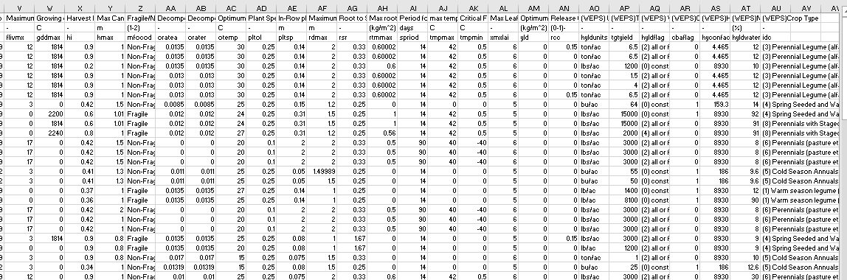
Databases – Crop Parameter Spreadsheet

Slide 9
WEPP Desktop Windows Program
Low priority at present
Latest release is September 2012
Needs extensive updates to management editor
Additions to recognize CRLMOD data
Calibration not included, would need to be updated
Some windows components in the application are obsolete, would need to be replaced
Built with older Microsoft compiler and tools, need to be updated.

Slide 10
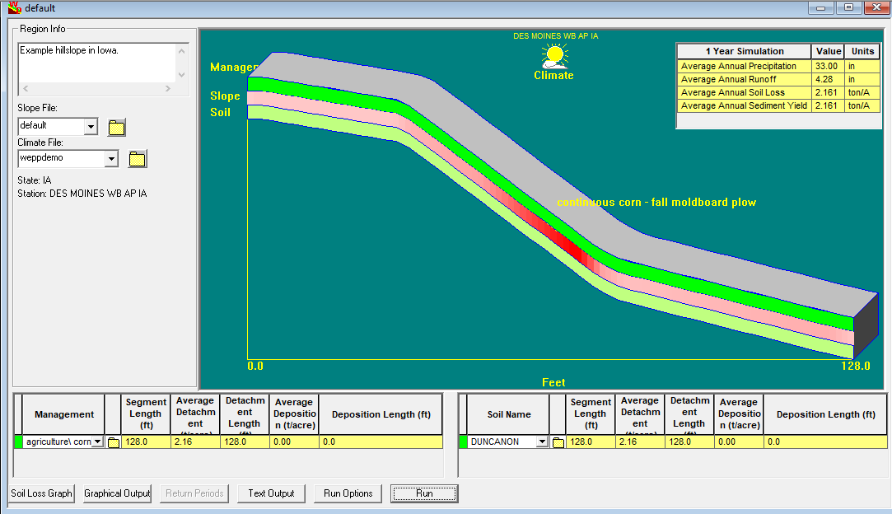
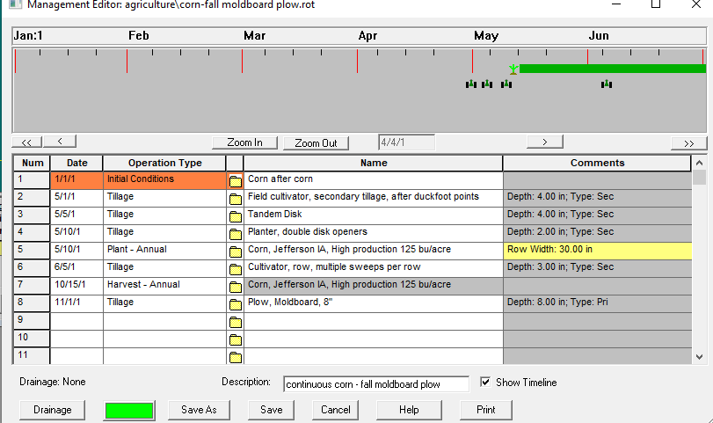
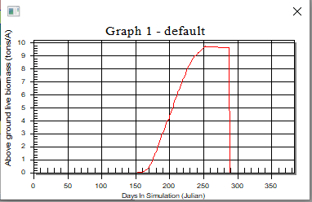
WEPP Desktop Windows Program – 2012

Slide 11
Thank you
Questions?

