Slide 1
RHEM - 2018
Rangeland Hydrology
and
Erosion Model
Mark Nearing
Southwest Watershed Research Center
USDA-Agricultural Research Service
Tucson, AZ, USA
Presented by:

Slide 2
RHEM Research Group
Southwest Watershed Research
Center, USDA-ARS
Tucson, Arizona
Northwest Watershed Research
Center, USDA-ARS
Boise, Idaho
Mark Nearing
C. Jason Williams
Mariano Hernandez
Gerardo Armendariz
Fred Pierson
Central National Technology
Support Center, USDA-NRCS
Dallas, Texas
Great Basin Rangelands
Research, USDA-ARS
Reno, Nevada
Ken Spaeth
George Peacock (retired)
Mark Weltz
Sayjro (Kossi) Nouwakpo
Texas A&M
Kingsville, Texas
Colorado State Univ.
Ft. Collins, CO
Osama Al-Hamdan
Olaf David

Slide 3
What is RHEM?
Rangeland Hydrology and Erosion Model.
RHEM is a dynamic, event-based hillslope-scale infiltration , runoff and erosion model designed specifically for rangelands.

Slide 4
What are rangelands?
“Rangelands are grasslands, shrublands, woodlands, wetlands, and deserts that are grazed by domestic livestock or wild animals.” (Wikipedia)
Rangelands are a sub-set of grazinglands, but generally refer to lands not suitable for agricultural crops.
They do not include pastures that are managed using agronomic practices, such as usually found in humid cropland areas.

Slide 5
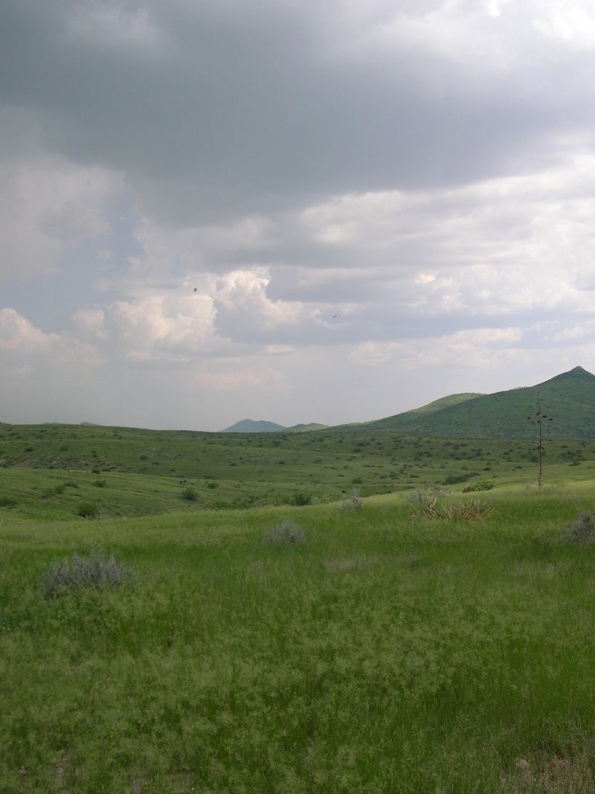
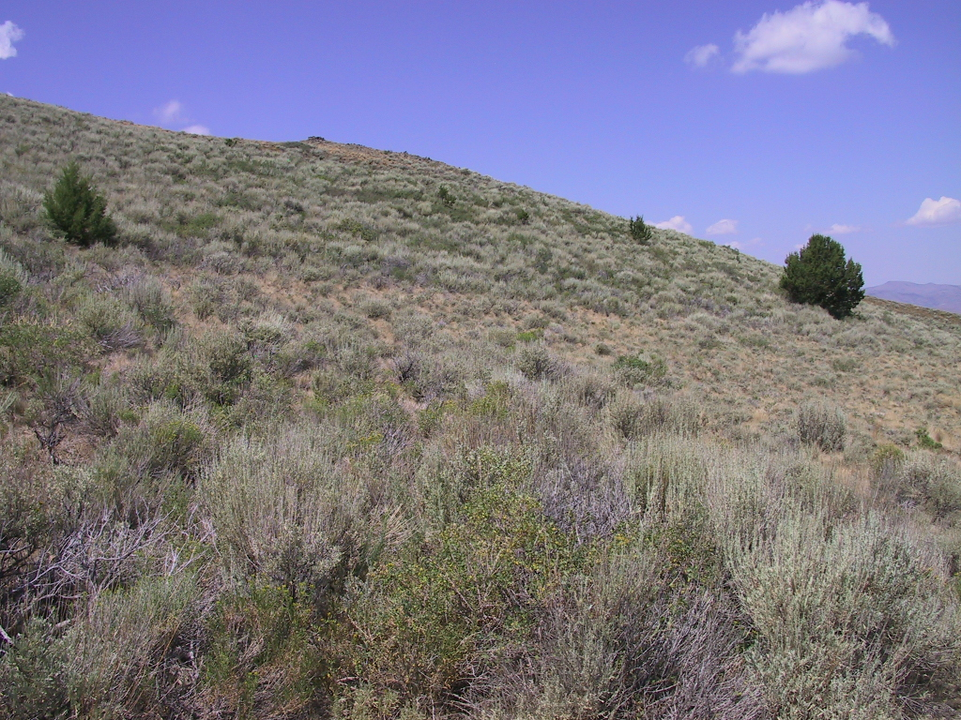
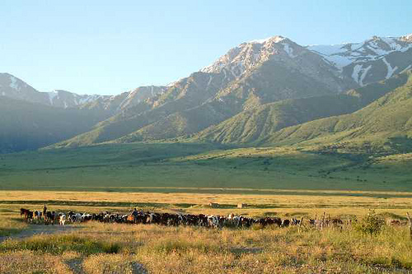
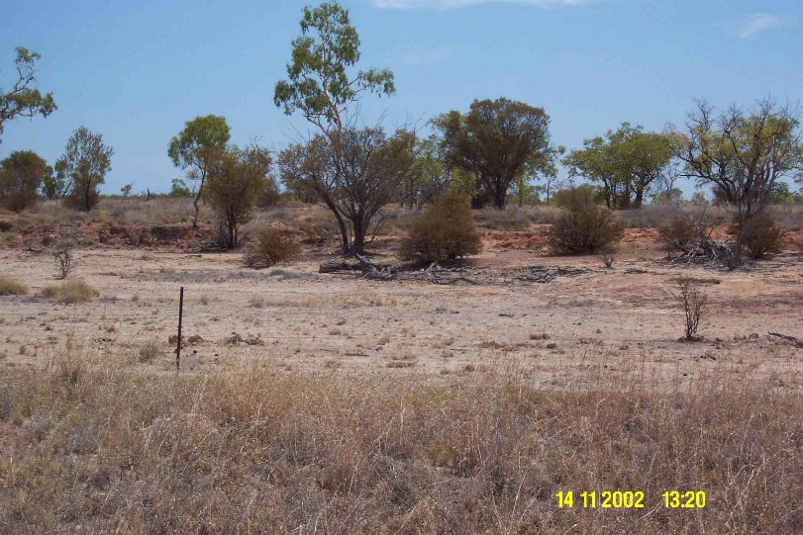
Rangelands
SW Arizona, USA
Great Basin, USA
Kazakhstan
Queensland, Australia

Slide 6
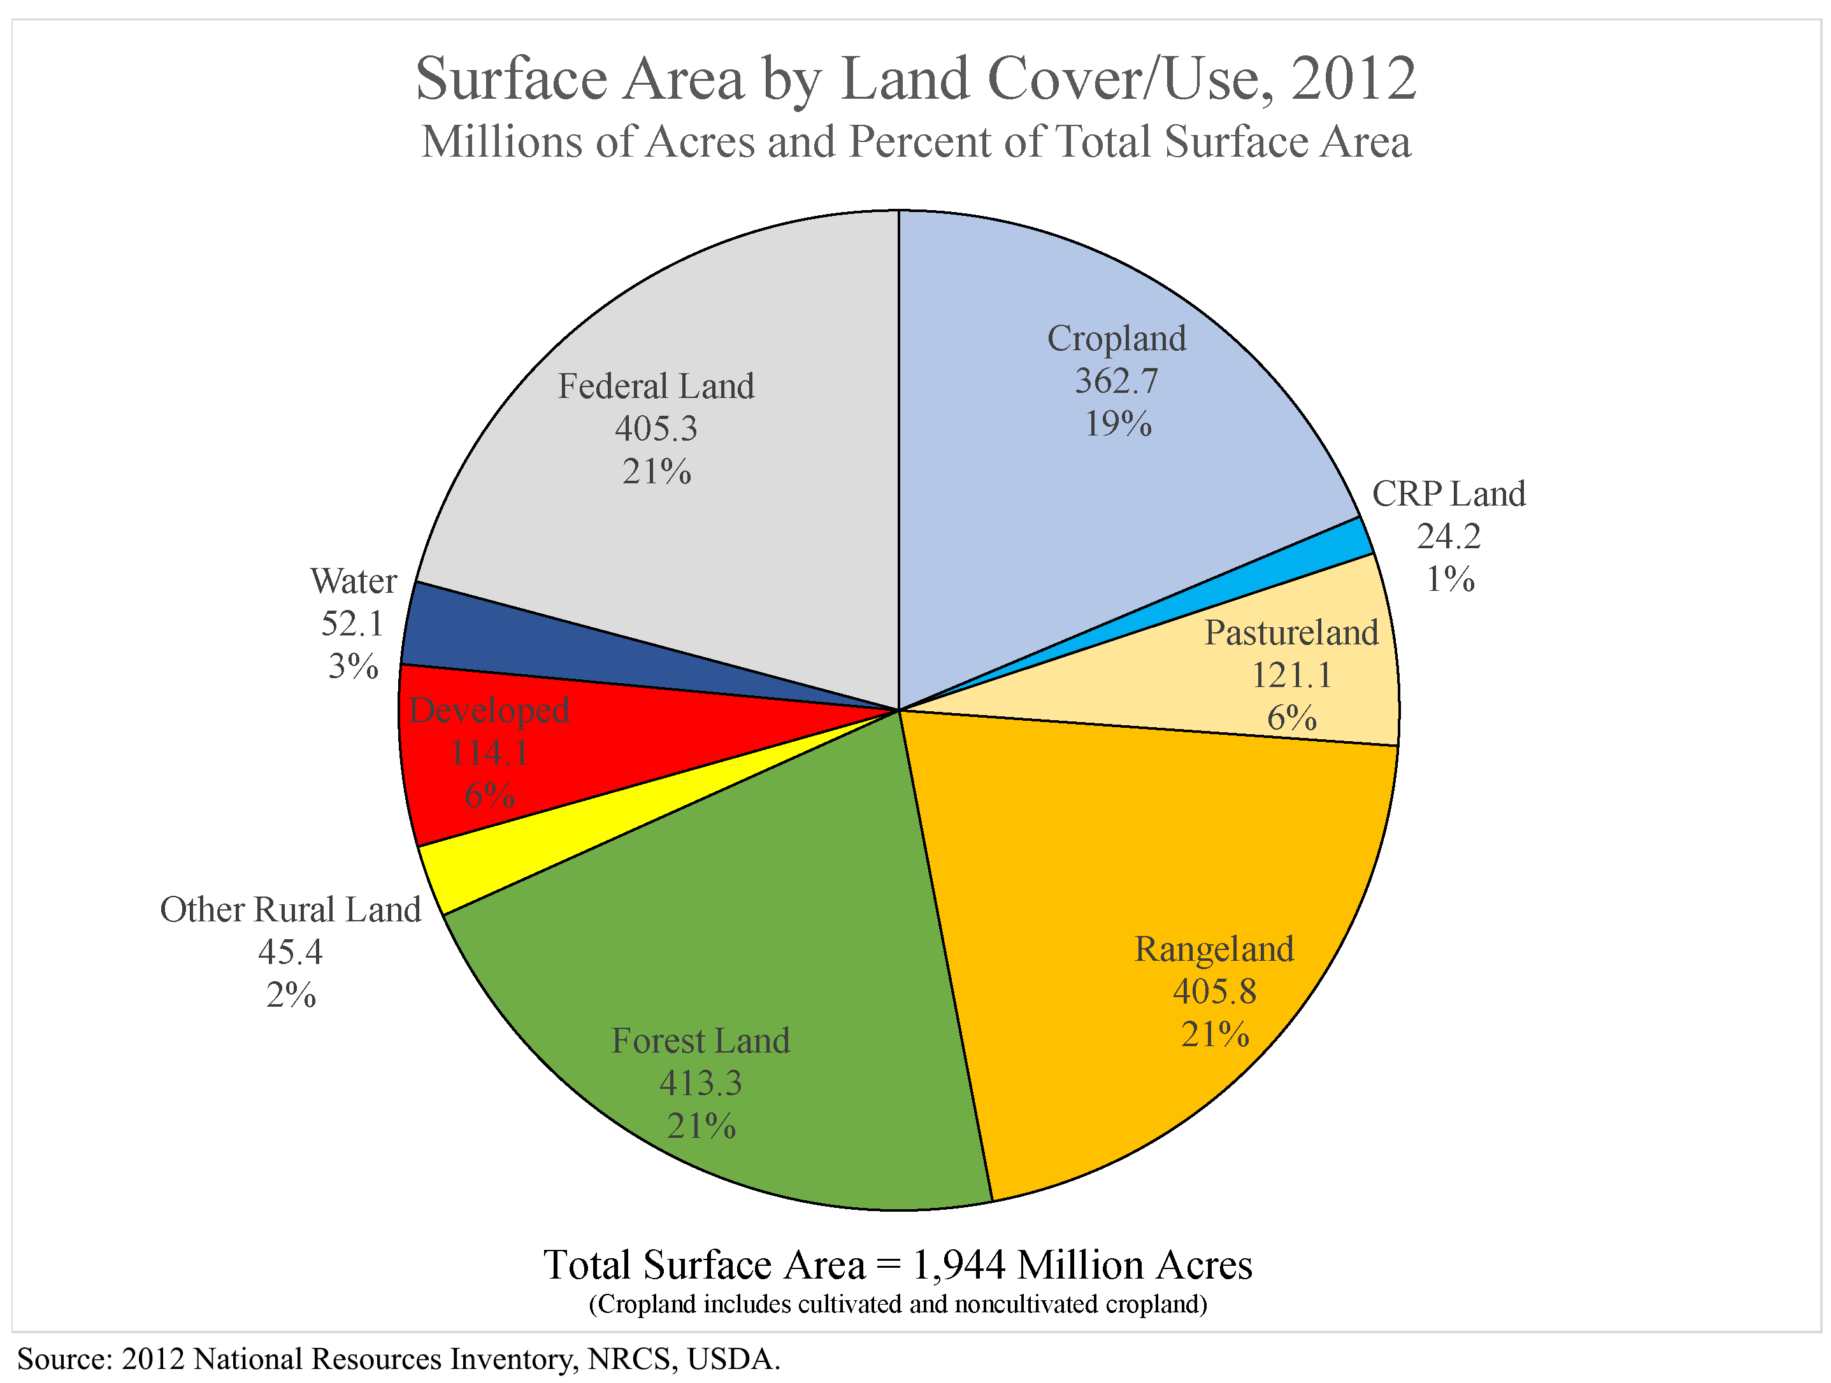
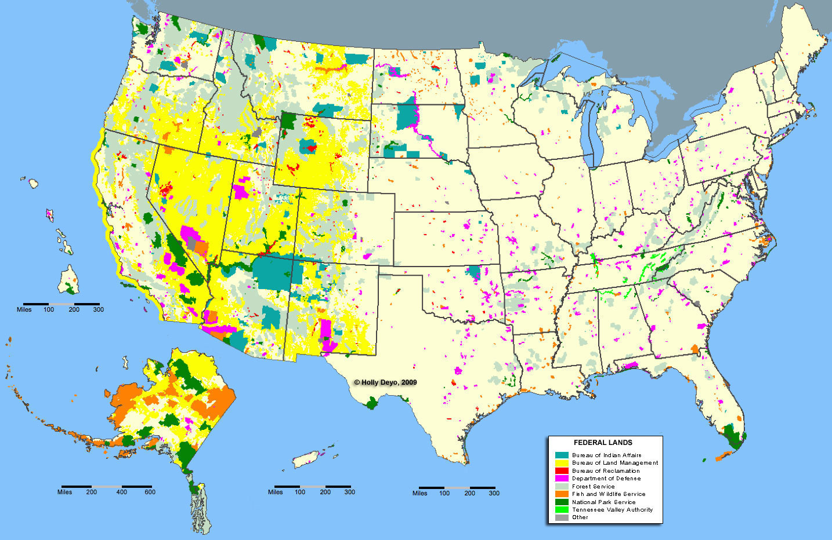
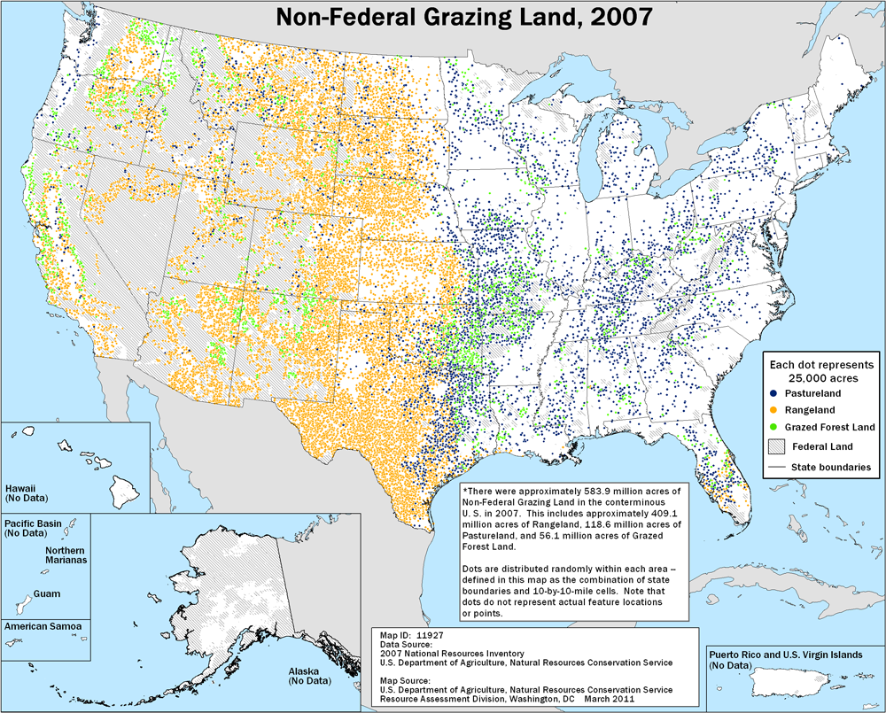
Western US Rangelands

Slide 7
What does RHEM do?
RHEM estimates runoff, erosion, and sediment delivery rates at the spatial scale of the hillslope.
RHEM is designed so to be used as a runoff and erosion calculator, or "engine", within a web-based interface and within other process-based models that apply to the watershed scale, such as AGWA/KINEROS2.
From the research perspective RHEM is a vehicle for incorporating new science from rangeland infiltration, runoff, and erosion research.

Slide 8
RHEM Structure & Function
User Interfaces
Parameter Estimation
Fortran Core Engine
Applications

Slide 9
1. Core Engine
FORTRAN Executable is available for download from the RHEM web site.
Hernandez, Nearing, et al., 2017 WRR

Slide 10
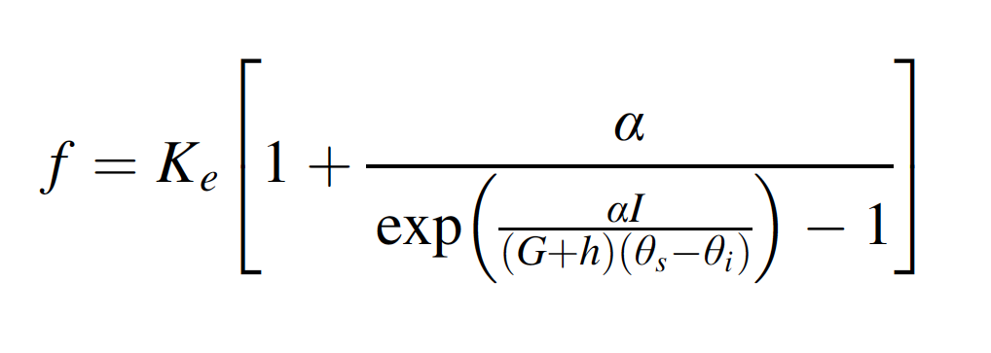
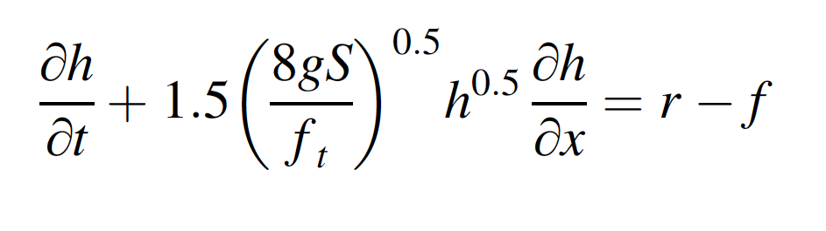
Hydrologic Processes
Smith-Parlange Infiltration
Kinematic Wave Dynamic Runoff Routing
Smith, R. E., D. C. Goodrich, D. A. Woolhiser, and C. L. Unkrich.(1995). “Chapter 20: KINEROS: A kinematic runoff
and erosion model”. In Computer Models of Watershed Hydrology. V. J. Singh, ed. Water Resources Publications.

Slide 11
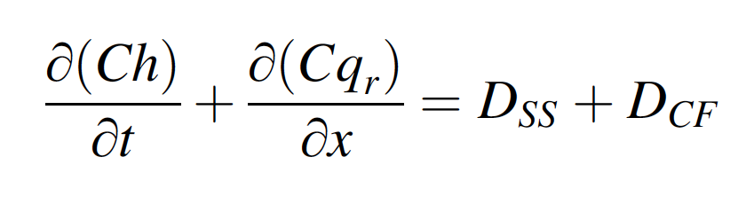
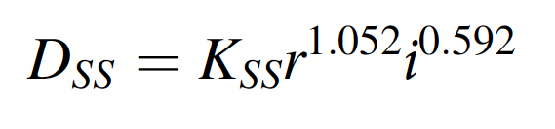
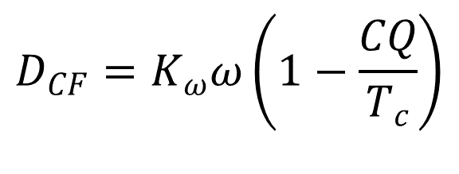
Dynamic Erosion & Sediment Routing
$$D_{CF}=K_{ω}ω\left(1−\frac{CQ}{T_{c}}\right)$$
Splash and Sheet
sediment source term
Concentrated Flow
sediment source term
Bennett, J. P., 1974. Concepts of mathematical modeling of sediment yield. Water Resources Research, 10(3):485-492.
Foster, G.R. 1982. Modeling the erosion process. Chapter In: Hydrologic Modeling of Small Watersheds. ASAE Mono. 5.
Wei, H., M.A. Nearing, et al., 2009. A new splash and sheet erosion equation for rangelands. SSSAJ 73:1386-1392.
Bulygina, N.S. M. A. Nearing, et al., 2007. “DWEPP: A dynamic soil erosion model... ESPL, 32(7):998-1012.
Nearing, M.A., et al., 1997. Hydraulics and erosion in eroding rills. Water Resources Research 33(4):865-876.

Slide 12
2. Parameter Estimation
Translates information
user-knowledge > model parameters.
The model is intended for land managers
Rangeland specialist understands:
Foliar and ground cover
Plant Lifeform
  Soil texture
  Slope steepness
Model Needs:
Erodibility
Effective Conductivity
Hydraulic Roughness
Etc…

Slide 13
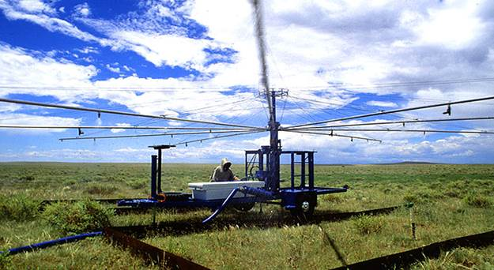
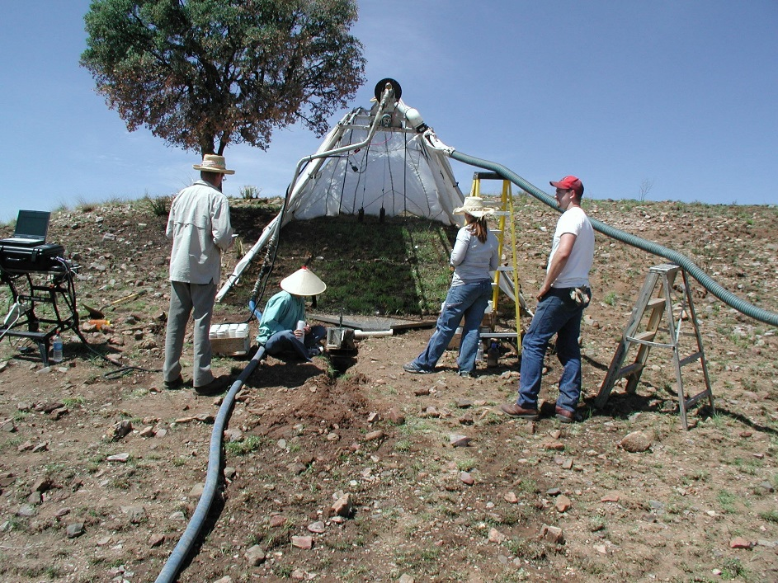
Experimental data
RHEM was first developed based on the WEPP-IRWET dataset 204 plots, 49 sites, 15 western states.
Database is expanded now with new data from Boise, Reno, Tucson

Slide 14
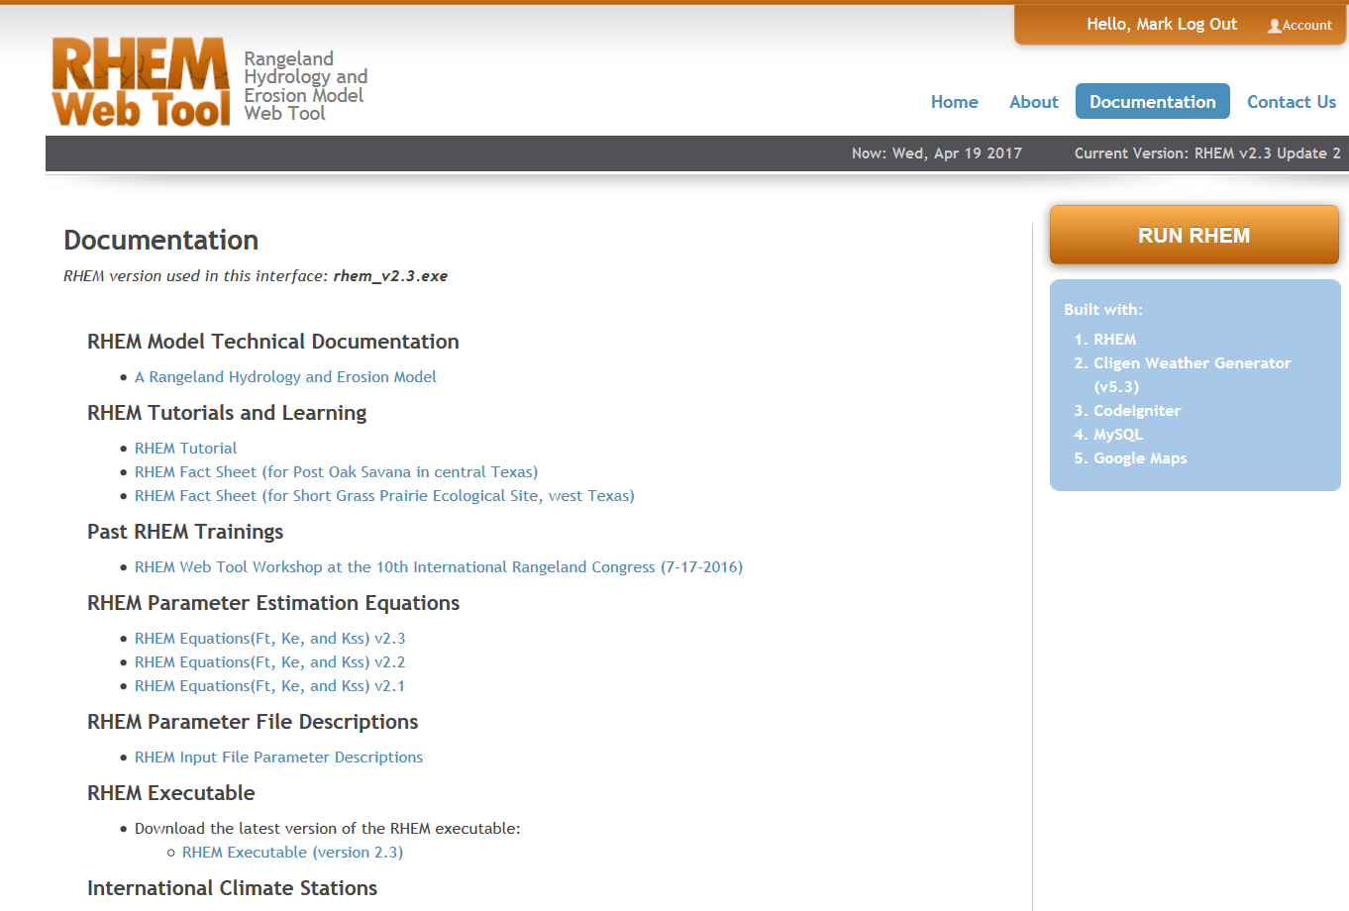
Equations
Hernandez, Nearing, et al., 2017 WRR

Slide 15
3. User Interfaces
Web-based Interface
Stand-alone executable
KINEROS & AGWA watershed/geospatial models (USDA-ARS)

Slide 16
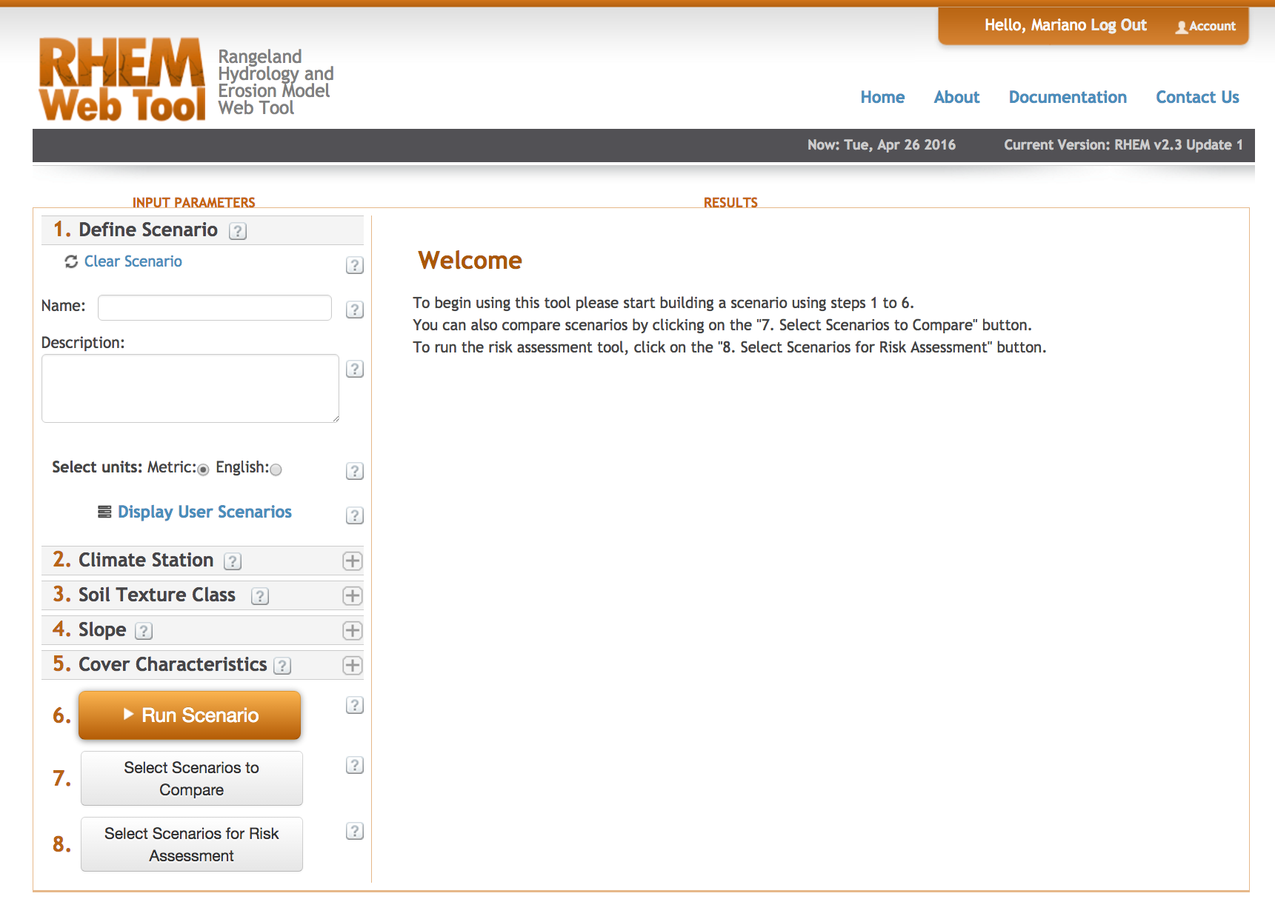
RHEM web-based interface
The RHEM web tool is an online interface that allows users to input site information and review simulation results.
http://apps.tucson.ars.ag.gov/rhem/

Slide 17
Uses information that rangeland specialists understand
9 numbers & 3 dropdown choices
Climate Station
Soil Texture Class
Slope
Steepness %
Shape Class
Foliar Cover
Bunch Grass %
Shrub/Tree %
Annual/Forbs %
Sod Grass %
Ground Cover
Litter %
Rocks %
Basal %
Bio-Crusts %

Slide 18
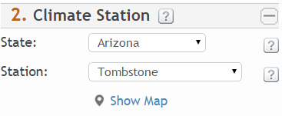
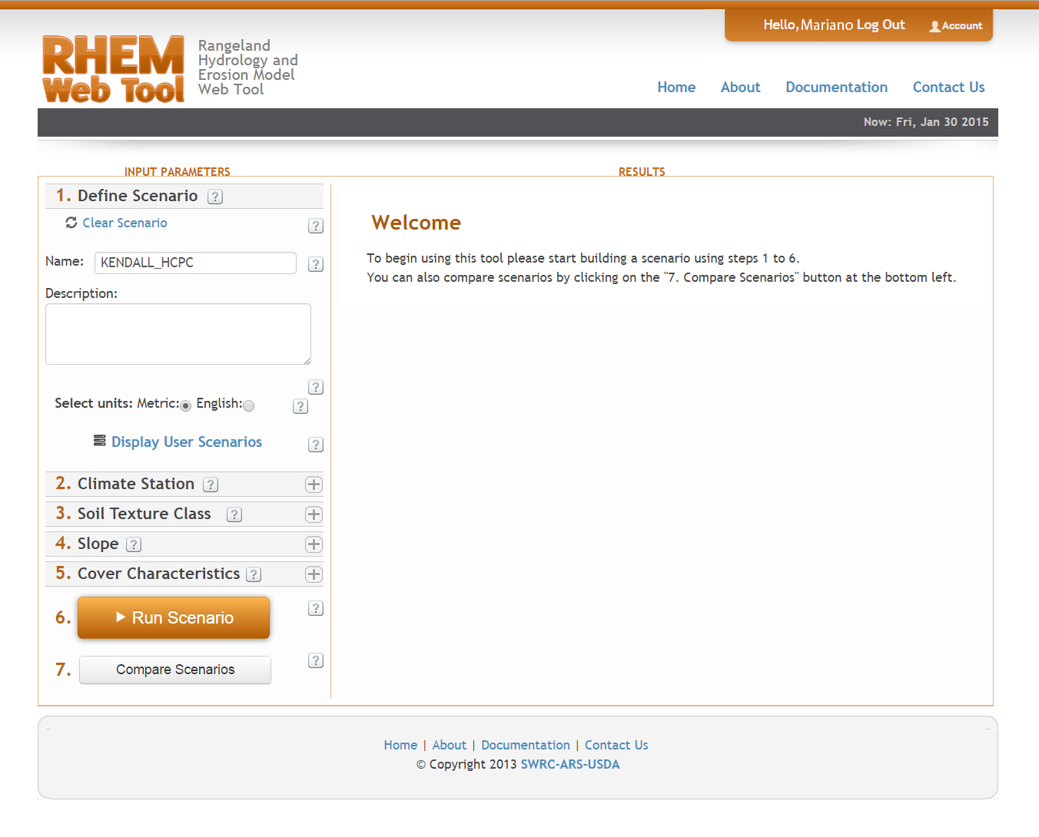
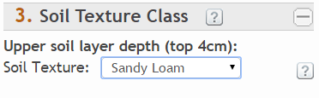
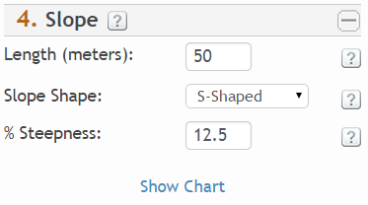
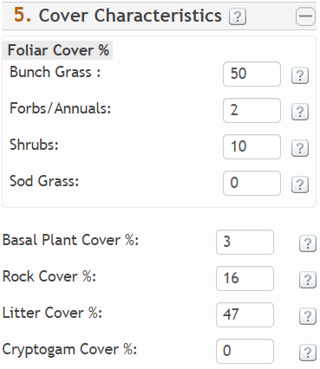
RHEM web tool – Input Summary

Slide 19
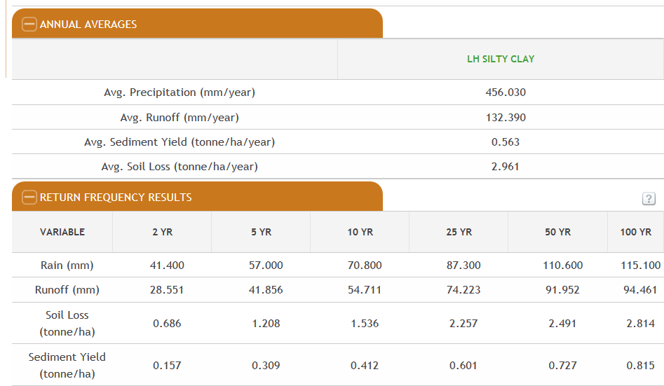
RHEM web tool – Output Summary
For a 300 year representative rainfall sequence

Slide 20
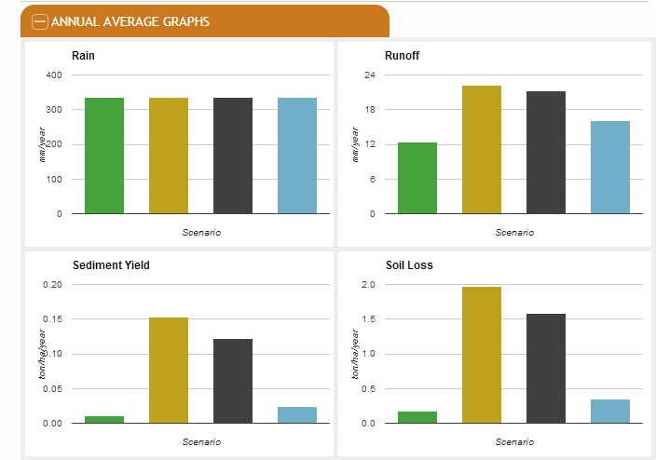
Output – Scenario comparisons

Slide 21
Stand-alone executable

Slide 22
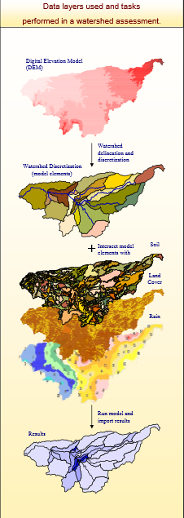
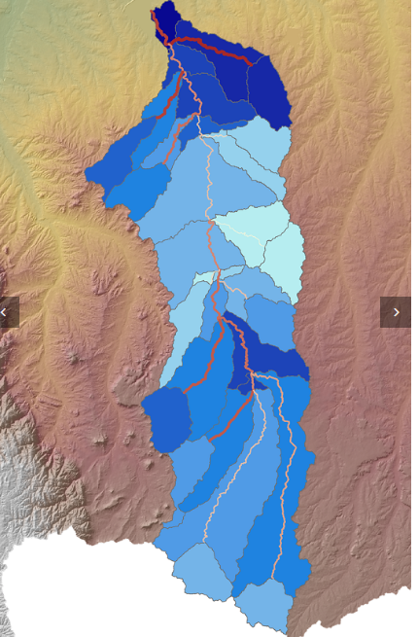
KINEROS and AGWA
RHEM is integrated with KINEROS for watershed management applications
AGWA is the geospatial
interface for KINEROS

Slide 23
4. Applications
How REHM is being used
Informing Ecological Site Descriptions (ESDs) S-T
Land Resource Inventory and Assessment (NRI)
Hillslope-scale engine within watershed models
USDA-NRCS Field Office
Research, teaching, and other applications with the web-based interface
Assessment of conservation practices (CEAP)

Slide 24
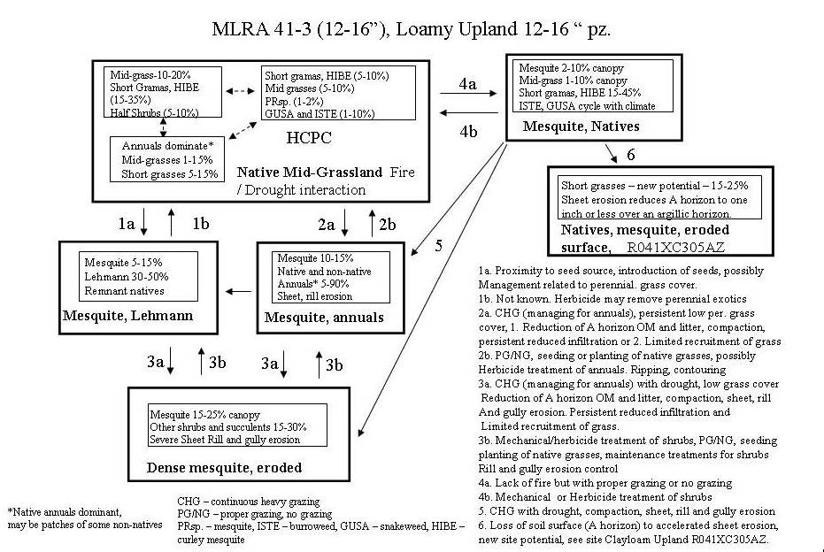
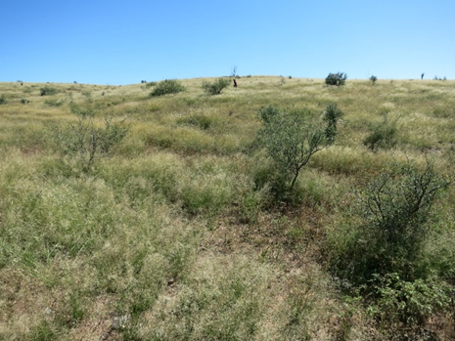
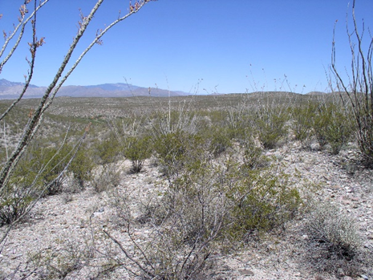
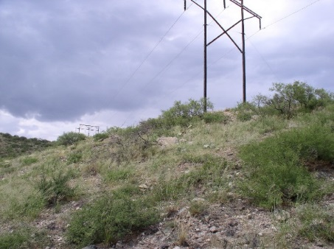
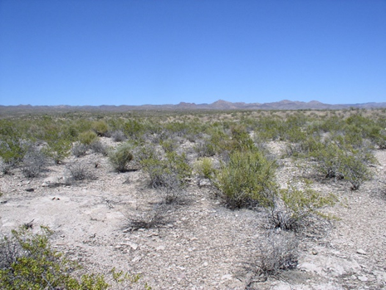
Use 1 - Ecological Site Descriptions
An ecological site is “a distinctive kind of land with specific characteristics that differs from other kinds of land in its ability to produce a distinctive kind and amount of vegetation.”
ESDs are being developed and mapped over the entire US.
Each ESD describes a state-and-transition model, which is a conceptual description of the long-term dynamics of an ecological site

Slide 25
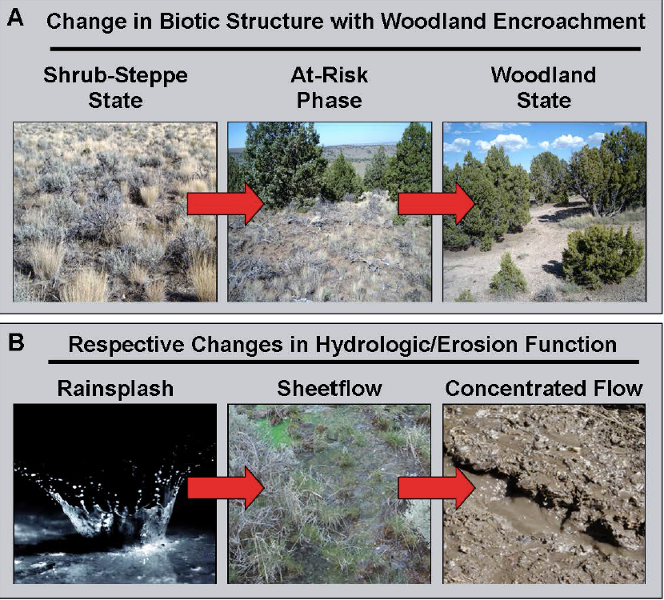
Ecological Site Descriptions - ESDs
ESDs are being developed and mapped by NRCS, BLM, and FS across the entire US.
Methods have been developed to use RHEM to inform hydrologic function for ESDs
Williams, et al., 2016. Rangeland Ecology and Management 69:4-19.

Slide 26
Example
Loamy Upland ESD:
305-406 mm (12-16 inches)

Slide 27
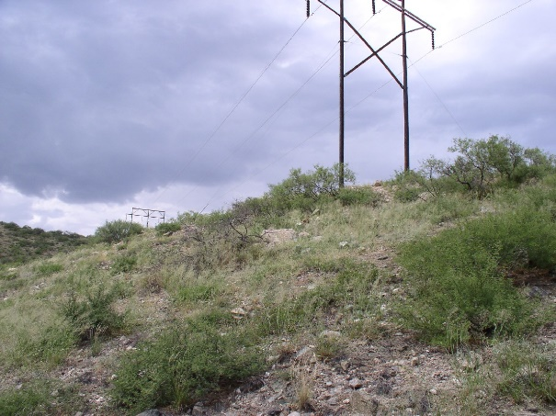
Ecological States within the ESD
Loamy
Upland
Historic Plant Community (HPC)
Exotic perennial grass
Shrub invaded state
Eroded

Slide 28
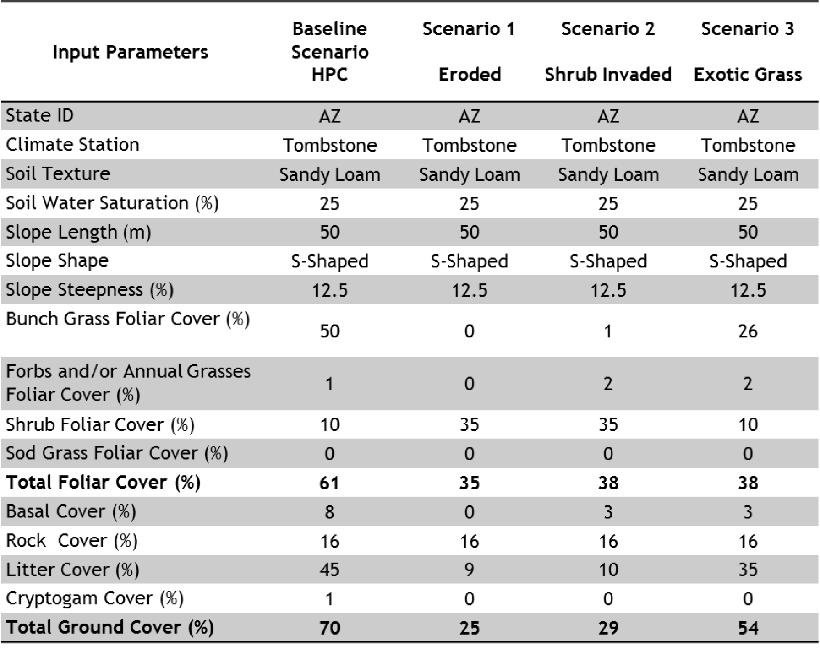
RHEM web tool – Input Information
Input information representing each state in the ESD

Slide 29
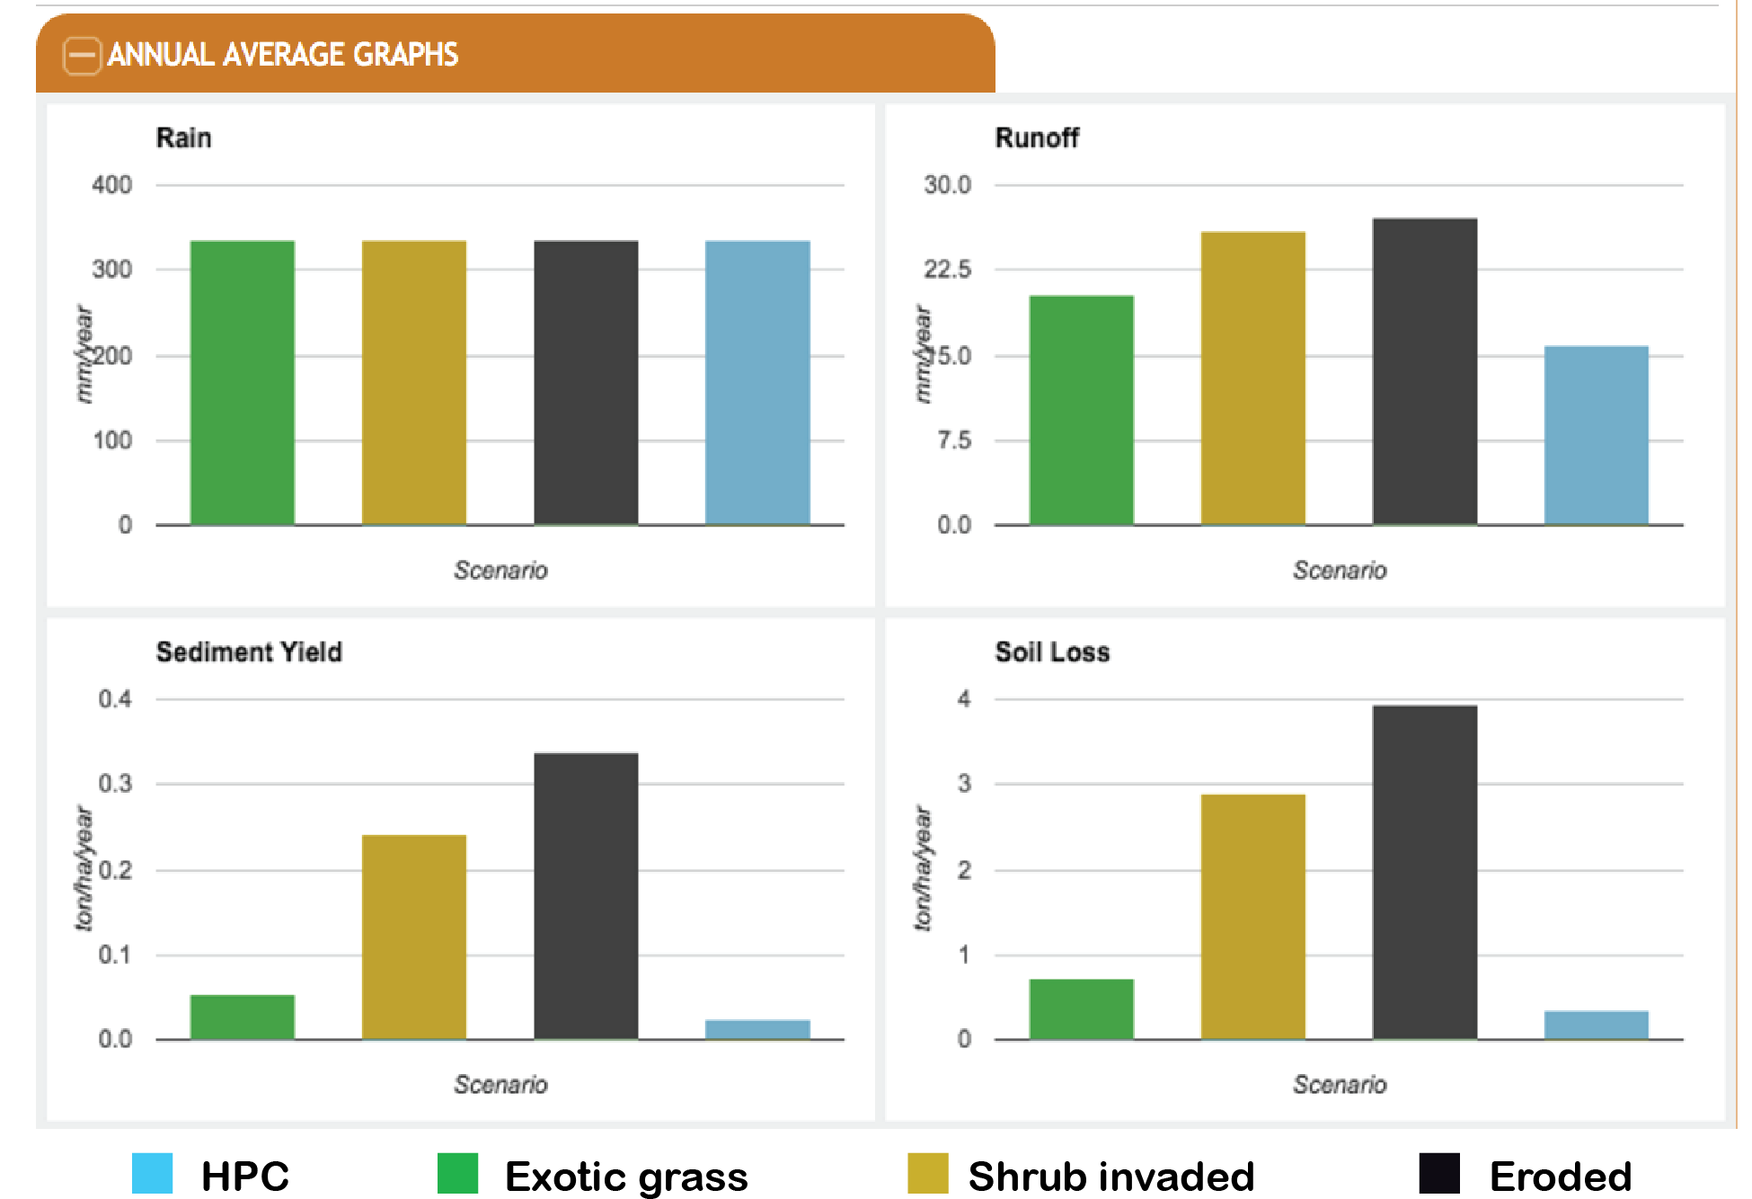
RHEM web tool – Annual Runoff and Soil Erosion Output

Slide 30
Risk Assessment
KEY CONCEPT
Yearly soil loss vulnerability relative to a user-defined baseline (e.g., HPC) - using probability.
User chooses a baseline scenario
Interface then gets yearly erosion values for a 300 year sequence
Determines the probability curves
Sets 4 Probability Groupings
Very High – Greatest 5% of years
To
Low - Least 50% of years
All other states in ESD compared to this baseline distribution of yearly soil loss rankings
pdf
(a)
(b)
Very High
High
Med
Low
cdf
for baseline

Slide 31
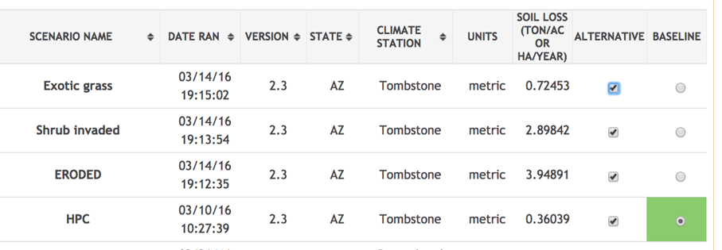
RHEM web tool – Run Risk Assessment
What the user sees and does
HPC Historic Plant Community
chosen as the baseline

Slide 32
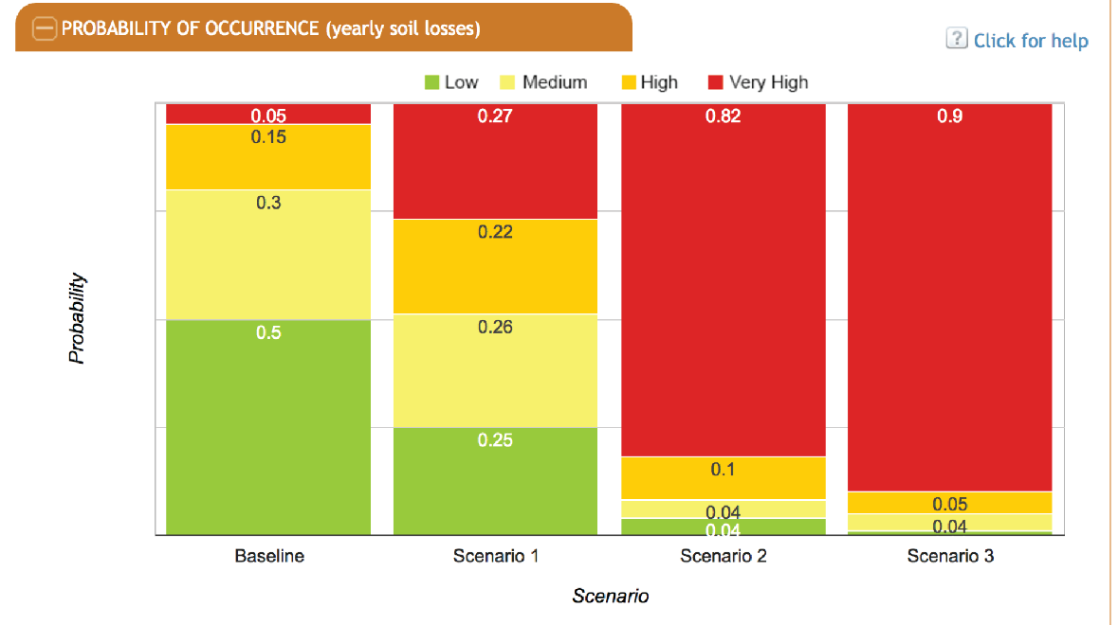
Probability of Occurrence Matrix
1 out of 20 years
9 out of 10 years
Exotic
Grass
Shrub
Invaded
Eroded
HPC

Slide 33
A useful tool for informing ESD development. Model is sensitive to differences in state conditions within the ESD State-and-transition model
The risk approach may have potential to serve as a method for defining Tolerable Soil Losses for Rangelands.

Slide 34
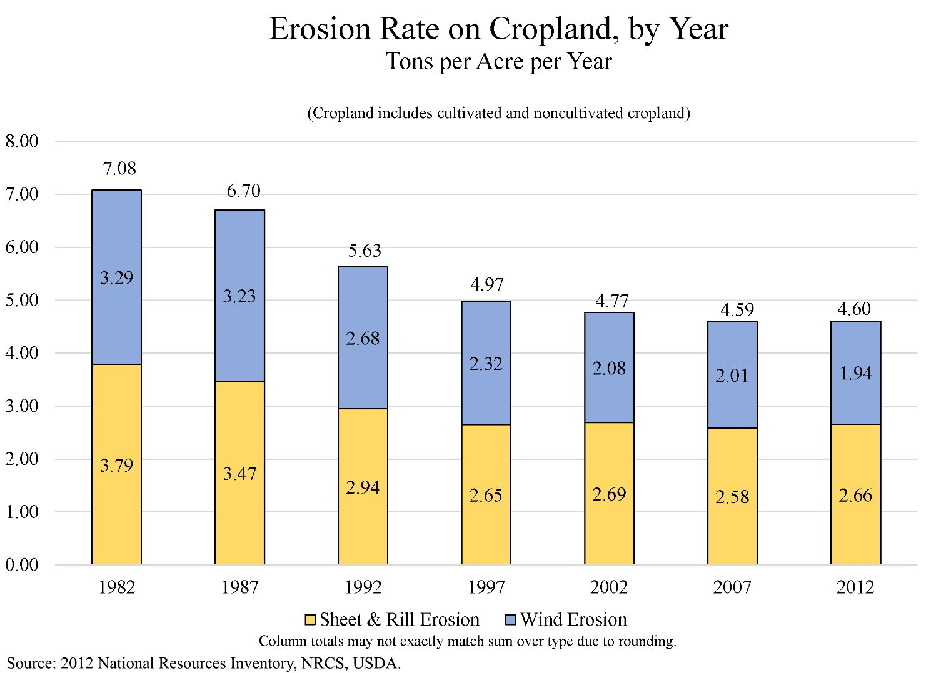
Use 2- National Resource Inventory - NRI
Another Application
National Assessment of private lands, conducted since
the Soil and Water Resources Conservation Act of 1977.
Survey reported each 5 years
Statistical sampling with 800,000 points across the US

Slide 35
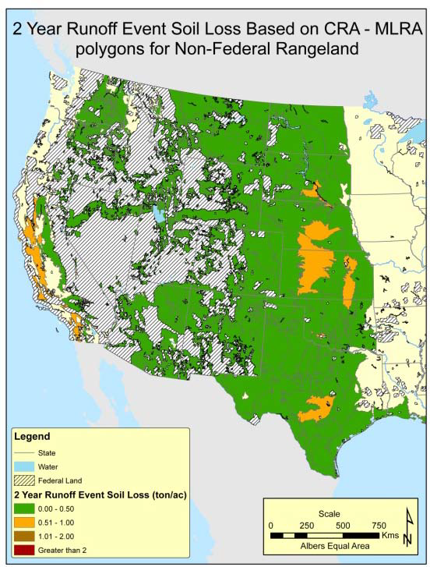
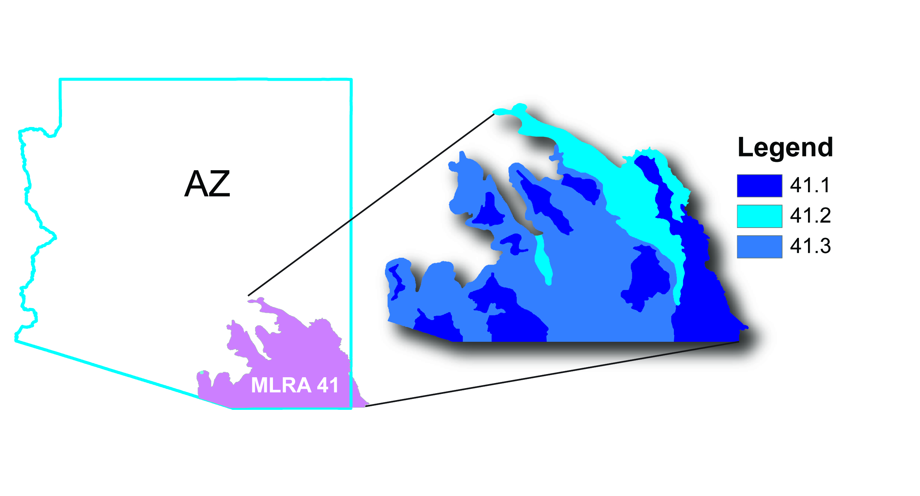
RHEM and the NRI
Methods were developed to use RHEM
to predict erosion for each NRI rangeland point
10,000 data points
w/ on-the-ground
site surveys
Methodology worked out on MLRA 41
Hernandez et al., 2013
2012 report

Slide 36
Future Directions
USDA Handbook and user guide
Chapter in the ESD development handbook
Training Course in rangeland hydrology
Grid-based climate input
International climate data
Disturbance (fire)
Saline soils
Risk and Soil Loss Tolerance for rangeland

Slide 37

http://apps.tucson.ars.ag.gov/rhem/
or go to the
USDA ARS Southwest Watershed Research Center
home page and follow the link to “Model Access”

