Slide 1
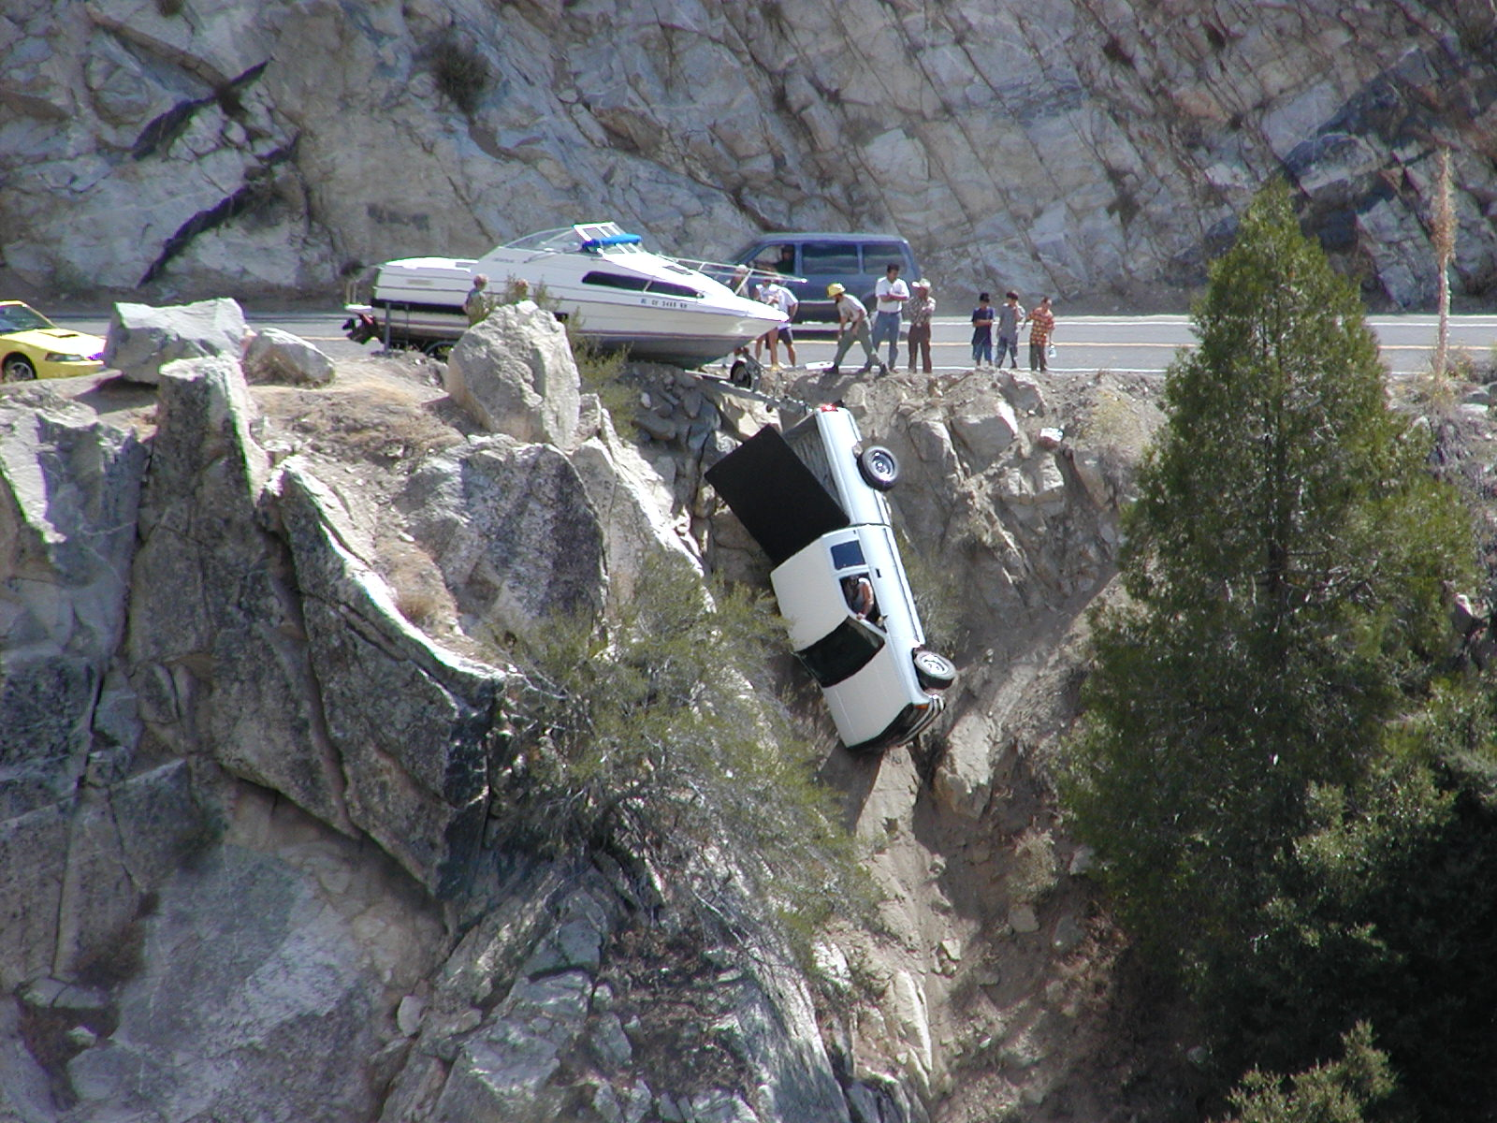

Slide 2
Modeling within field variability in the Wind Erosion Prediction System (WEPS)
Fred Fox
USDA-ARS
Fort Collins, Colorado, U.S.A

Slide 3
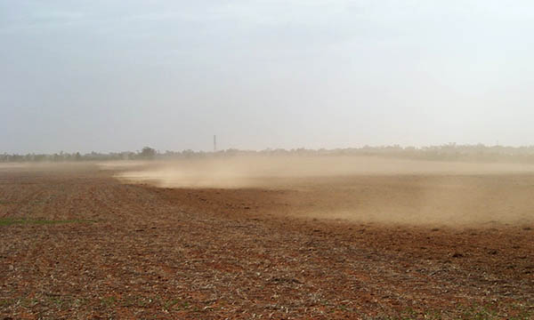

Slide 4
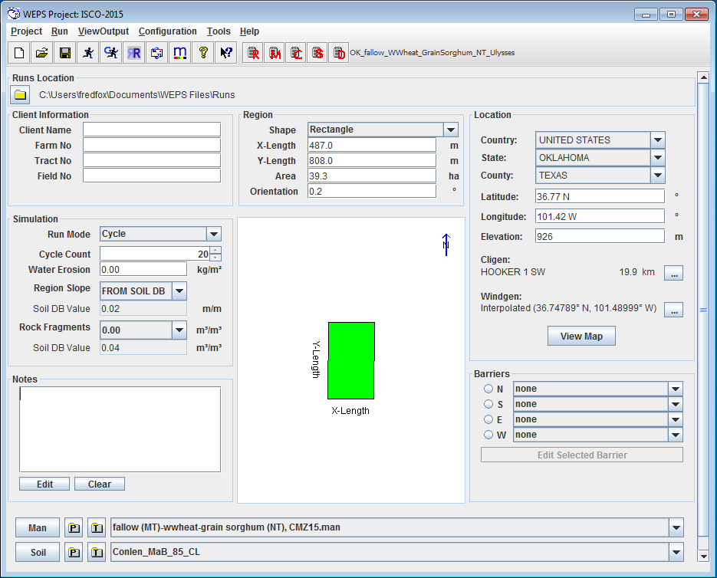
The Wind Erosion Prediction System
Notes:
The first release, 1 soil and 1 management.
Works fine for many fields.
Select most vulnerable soil.
Simulate one strip of a strip cropping scenario.
Summarize the inputs: Field dimensions, climate location, barriers, management, soil

Slide 5
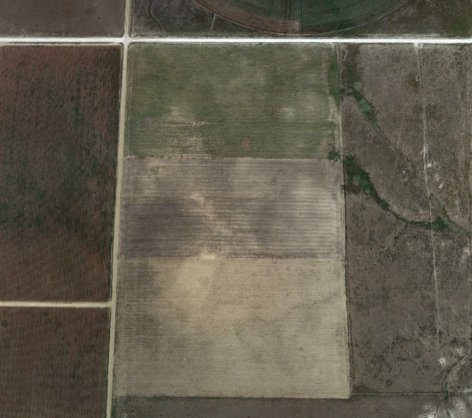
Modeling within field complexity
Notes:
Simulating this field with one soil and one management is a gross simplification.
First, there are what appear to be strips. Does the producer manage these strips separately?
Next, lets look at the soil map.

Slide 6
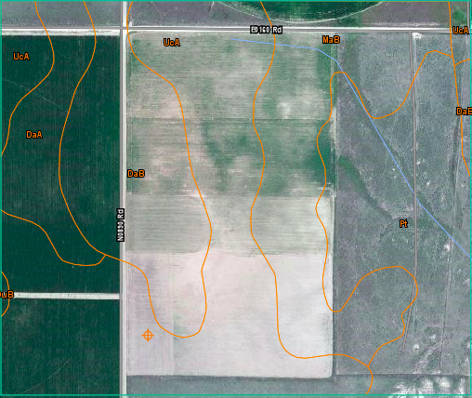
Variable Soils and Management
Notes:
DaB – Dalhart fine sandy loam, 1 to 3 percent slopes
UcA - Ulysses clay loam, 0 to 1 percent slopes
MaB - Conlen clay loam, 0 to 3 percent slopes
Pt - Plack-Rock outcrop complex, 5 to 20 percent slopes
Lets simulate this field with the soils as mapped and 3 strips with a phased shifted 3 year management rotation.

Slide 7
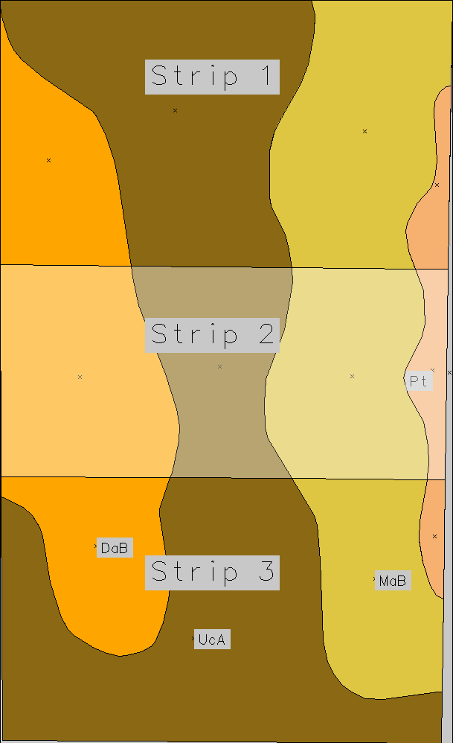
The required inputs
Best rectangle enclosing convex hall defines simulation coordinates
  X,Y dimensions (meters)
  Rotation (degrees from N)
Notes:
Excess area is the part of the enclosing rectangle that is not part of the field to be simulated.
We have not yet programmed the model to skip these areas.
For this simulation, it is set to be 100% rock covered, with no vegetation and no management operations.

Slide 8
The required inputs
Best rectangle enclosing convex hall defines simulation coordinates
  X,Y dimensions (meters)
  Rotation (degrees from N)
Coordinates translated and rotated into simulation coordinates
  Soil polygons
  Strip polygons
  Excess area polygon
Notes:
Excess area is the part of the enclosing rectangle that is not part of the field to be simulated.
We have not yet programmed the model to skip these areas.
For this simulation, it is set to be 100% rock covered, with no vegetation and no management operations.

Slide 9
The required inputs
Best rectangle enclosing convex hall defines simulation coordinates
  X,Y dimensions (meters)
  Rotation (degrees from N)
Coordinates translated and rotated into simulation coordinates
  Soil polygons
  Strip polygons
  Excess area polygon
Barriers – 1.5 meter shrubs surround the field.
Notes:
Excess area is the part of the enclosing rectangle that is not part of the field to be simulated.
We have not yet programmed the model to skip these areas.
For this simulation, it is set to be 100% rock covered, with no vegetation and no management operations.

Slide 10
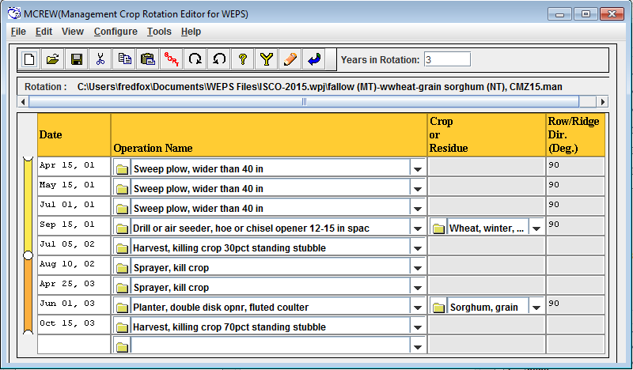

Slide 11
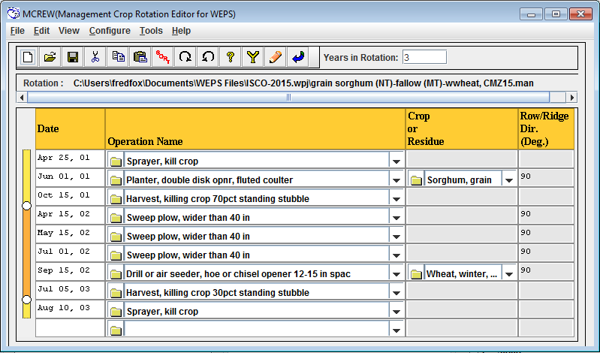

Slide 12
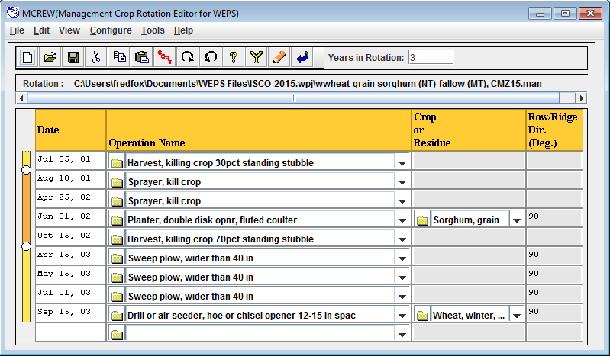

Slide 13
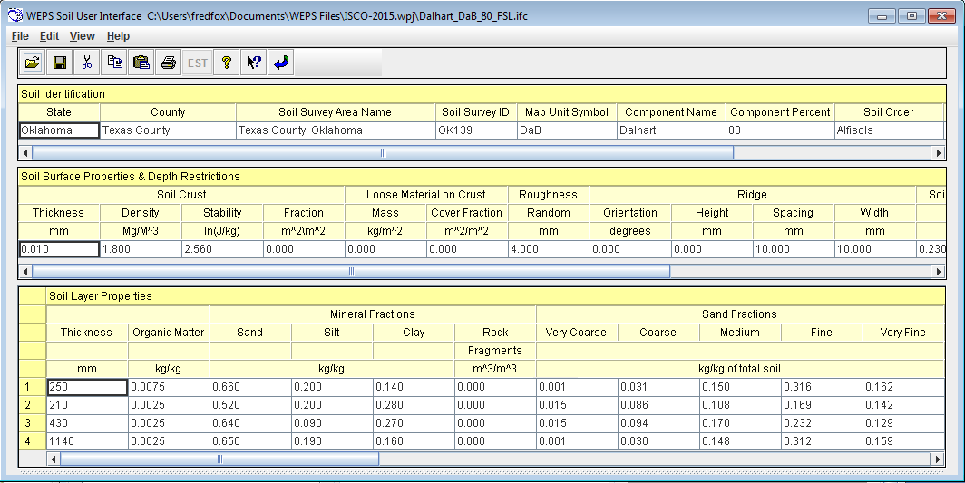

Slide 14
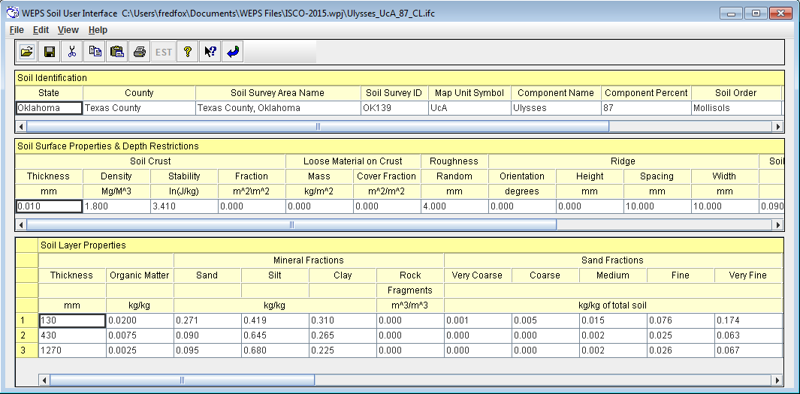

Slide 15


Slide 16
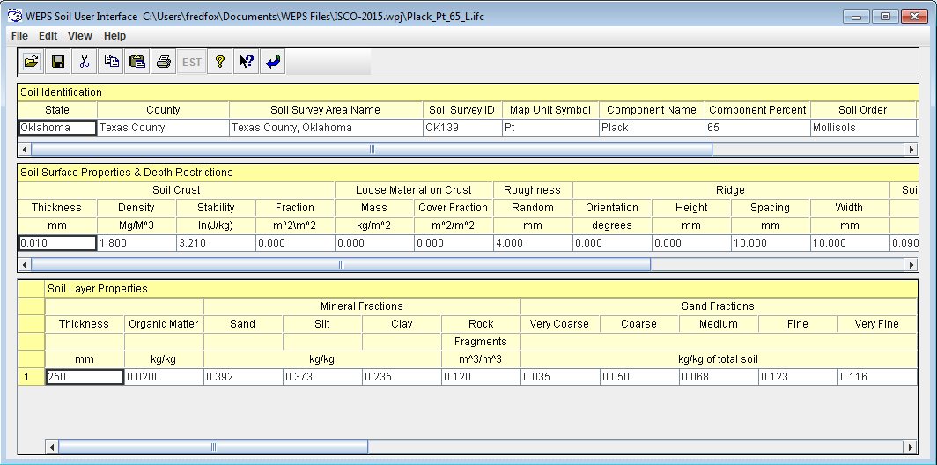

Slide 17
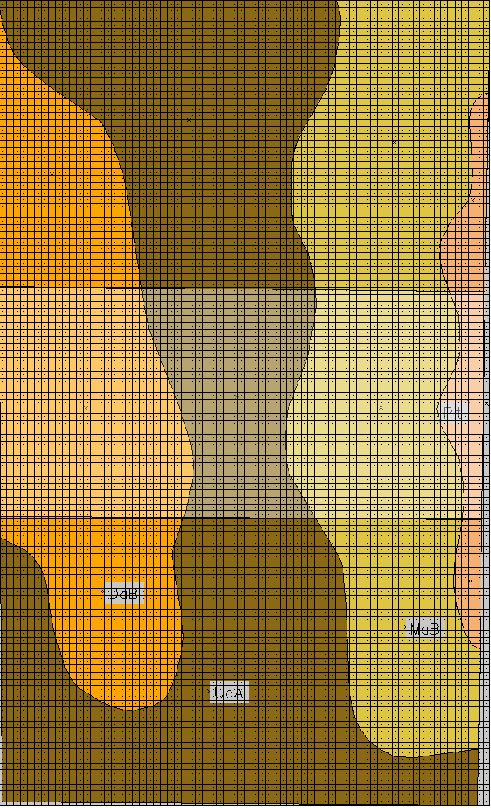
Erosion simulation
70 x 115 grid cells

Slide 18
Erosion simulation
70 x 115 grid cells
Surface conditions vary by grid cell ( 12 distinct soil / management combinations by polygon)

Slide 19
Erosion simulation
70 x 115 grid cells
Surface conditions vary by grid cell ( 12 distinct soil / management combinations by polygon)
Erosion processes
  Detachment
  Transport (creep, saltation, suspension, capacity)
  Deposition
  Surface armoring (depletion of erodible fraction)
  Cell control volume (inflow, outflow)

Slide 20
Single vs. Multiple Soils
 | Single Soil Dalhart | Single Soil Ulysses | Single Soil Conlen | Single Soil Plack | All soils by polygon
Average Annual Erosion (kg/m^2/year) | 0.33 | 0.023 | 0.457 | 0.151 | 0.238
Notes:
Tolerable Soil Loss = 1.12 kg/m^2/yr
Dalhart Sorghum = 67 bushel
Dalhart Wheat = 31 bushel
Ulysses Sorghum = 65 bushel
Ulysses Wheat = 20 bushel
Conlen Sorghum = 76 bushel
Conlen Wheat = 24 bushel
Plack Sorghum = 67 bushel
Plack Wheat = 20 bushel

Slide 21
Single vs. Multiple Soils
 | Single Soil Dalhart | Single Soil Ulysses | Single Soil Conlen | Single Soil Plack | All soils by polygon
Average Annual Erosion (kg/m^2/year) | 0.33 | 0.023 | 0.457 | 0.151 | 0.238
Period with maximum soil loss | Jan 1-14, 02 | Jan 1-14, 02 | Jan 1-14, 02 | Jan 1-14, 02 | Jan 1-14, 02
Soil loss for maximum period (kg/m^2/period) | 0.39 | 0.03 | 0.25 | 0.13 | 0.24
Notes:
Tolerable Soil Loss = 1.12 kg/m^2/yr
Dalhart Sorghum = 67 bushel
Dalhart Wheat = 31 bushel
Ulysses Sorghum = 65 bushel
Ulysses Wheat = 20 bushel
Conlen Sorghum = 76 bushel
Conlen Wheat = 24 bushel
Plack Sorghum = 67 bushel
Plack Wheat = 20 bushel

Slide 22
Single vs. Multiple Soils
 | Single Soil Dalhart | Single Soil Ulysses | Single Soil Conlen | Single Soil Plack | All soils by polygon
Average Annual Erosion (kg/m^2/year) | 0.33 | 0.023 | 0.457 | 0.151 | 0.238
Period with maximum soil loss | Jan 1-14, 02 | Jan 1-14, 02 | Jan 1-14, 02 | Jan 1-14, 02 | Jan 1-14, 02
Soil loss for maximum period (kg/m^2/period) | 0.39 | 0.03 | 0.25 | 0.13 | 0.24
Number of erosion events in 60 years >= 0.001 (kg/m^2/day) | 24 | 18 | 86 | 46 | 74
Notes:
Tolerable Soil Loss = 1.12 kg/m^2/yr
Dalhart Sorghum = 67 bushel
Dalhart Wheat = 31 bushel
Ulysses Sorghum = 65 bushel
Ulysses Wheat = 20 bushel
Conlen Sorghum = 76 bushel
Conlen Wheat = 24 bushel
Plack Sorghum = 67 bushel
Plack Wheat = 20 bushel

Slide 23
Single vs. Multiple Soils
 | Single Soil Dalhart | Single Soil Ulysses | Single Soil Conlen | Single Soil Plack | All soils by polygon
Average Annual Erosion (kg/m^2/year) | 0.33 | 0.023 | 0.457 | 0.151 | 0.238
Period with maximum soil loss | Jan 1-14, 02 | Jan 1-14, 02 | Jan 1-14, 02 | Jan 1-14, 02 | Jan 1-14, 02
Soil loss for maximum period (kg/m^2/period) | 0.39 | 0.03 | 0.25 | 0.13 | 0.24
Number of erosion events in 60 years >= 0.001 (kg/m^2/day) | 24 | 18 | 86 | 46 | 74
Maximum Single Event Erosion (kg/m^2/day) | 1.970 | 0.300 | 0.899 | 0.856 | 1.081
Notes:
Tolerable Soil Loss = 1.12 kg/m^2/yr
Dalhart Sorghum = 67 bushel
Dalhart Wheat = 31 bushel
Ulysses Sorghum = 65 bushel
Ulysses Wheat = 20 bushel
Conlen Sorghum = 76 bushel
Conlen Wheat = 24 bushel
Plack Sorghum = 67 bushel
Plack Wheat = 20 bushel

Slide 24
Single vs. Multiple Soils
 | Single Soil Dalhart | Single Soil Ulysses | Single Soil Conlen | Single Soil Plack | All soils by polygon
Average Annual Erosion (kg/m^2/year) | 0.33 | 0.023 | 0.457 | 0.151 | 0.238
Period with maximum soil loss | Jan 1-14, 02 | Jan 1-14, 02 | Jan 1-14, 02 | Jan 1-14, 02 | Jan 1-14, 02
Soil loss for maximum period (kg/m^2/period) | 0.39 | 0.03 | 0.25 | 0.13 | 0.24
Number of erosion events in 60 years >= 0.001 (kg/m^2/day) | 24 | 18 | 86 | 46 | 74
Maximum Single Event Erosion (kg/m^2/day) | 1.970 | 0.300 | 0.899 | 0.856 | 1.081
Sorghum Yield (Mg/ha) | 3.01-5.81 | 2.75-5.58 | 3.34-6.15 | 2.76-5.70
Wheat Yield (Mg/ha) | 1.16-3.04 | 0.39-2.07 | 0.61-2.28 | 0.47- 2.13
Notes:
Tolerable Soil Loss = 1.12 kg/m^2/yr
Dalhart Sorghum = 67 bushel
Dalhart Wheat = 31 bushel
Ulysses Sorghum = 65 bushel
Ulysses Wheat = 20 bushel
Conlen Sorghum = 76 bushel
Conlen Wheat = 24 bushel
Plack Sorghum = 67 bushel
Plack Wheat = 20 bushel

Slide 25
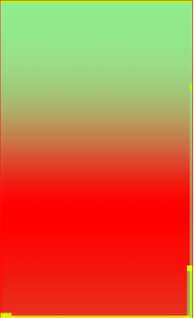

Single vs. Multiple Soils
Notes:
Erosion event Jan 8, 56, maximum erosion from Dalhart soil.
Maximum cell soil loss -8.8 kg/m^2 in both pictures

Slide 26
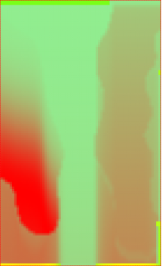

Single vs. Multiple Soils
Notes:
Single Soil - Dalhart
Maximum cell soil loss -8.8 kg/m^2 in both pictures

Slide 27
Property Differences Between Soils
 | Dalhart | Ulysses | Conlen | Plack
Crop Height (m) | 0.017 | 0.019 | 0.020 | 0.018
Stem Area Index (m^2/m^2) | 0.160 | 0.159 | 0.164 | 0.159
Flat biomass cover (m^2/m^2) | 0.197 | 0.200 | 0.214 | 0.203

Slide 28
Property Differences Between Soils
 | Dalhart | Ulysses | Conlen | Plack
Crop Height (m) | 0.017 | 0.019 | 0.020 | 0.018
Stem Area Index (m^2/m^2) | 0.160 | 0.159 | 0.164 | 0.159
Flat biomass cover (m^2/m^2) | 0.197 | 0.200 | 0.214 | 0.203
Soil layer GMD (mm) | 2.342 | 8.663 | 11.300 | 10.778

Slide 29
Property Differences Between Soils
 | Dalhart | Ulysses | Conlen | Plack
Crop Height (m) | 0.017 | 0.019 | 0.020 | 0.018
Stem Area Index (m^2/m^2) | 0.160 | 0.159 | 0.164 | 0.159
Flat biomass cover (m^2/m^2) | 0.197 | 0.200 | 0.214 | 0.203
Soil layer GMD (mm) | 2.342 | 8.663 | 11.300 | 10.778
Surface crust fraction (m^2/m^2) | 0.999 | 0.999 | 0.999 | 0.999
Soil crust stability ln(J/kg) | 2.931 | 3.770 | 3.790 | 3.643
Mass of loose material on crust (kg/m^2) | 0.158 | 0.083 | 1.498 | 0.460

Slide 30
Property Differences Between Soils
 | Dalhart | Ulysses | Conlen | Plack
Crop Height (m) | 0.017 | 0.019 | 0.020 | 0.018
Stem Area Index (m^2/m^2) | 0.160 | 0.159 | 0.164 | 0.159
Flat biomass cover (m^2/m^2) | 0.197 | 0.200 | 0.214 | 0.203
Soil layer GMD (mm) | 2.342 | 8.663 | 11.300 | 10.778
Surface crust fraction (m^2/m^2) | 0.999 | 0.999 | 0.999 | 0.999
Soil crust stability ln(J/kg) | 2.931 | 3.770 | 3.790 | 3.643
Mass of loose material on crust (kg/m^2) | 0.158 | 0.083 | 1.498 | 0.460
Soil layer rock volume (m^3/m^3) | 0 | 0 | 0.04 | 0.12

Slide 31
Property Differences Between Soils
 | Dalhart | Ulysses | Conlen | Plack
Crop Height (m) | 0.017 | 0.019 | 0.020 | 0.018
Stem Area Index (m^2/m^2) | 0.160 | 0.159 | 0.164 | 0.159
Flat biomass cover (m^2/m^2) | 0.197 | 0.200 | 0.214 | 0.203
Soil layer GMD (mm) | 2.342 | 8.663 | 11.300 | 10.778
Surface crust fraction (m^2/m^2) | 0.999 | 0.999 | 0.999 | 0.999
Soil crust stability ln(J/kg) | 2.931 | 3.770 | 3.790 | 3.643
Mass of loose material on crust (kg/m^2) | 0.158 | 0.083 | 1.498 | 0.460
Soil layer rock volume (m^3/m^3) | 0 | 0 | 0.04 | 0.12
Soil layer sand content (Mg/Mg) | 0.660 | 0.271 | 0.371 | 0.392
Soil Layer very fine sand (Mg/Mg) | 0.162 | 0.174 | 0.111 | 0.116

Slide 32
Property Differences Between Soils
 | Dalhart | Ulysses | Conlen | Plack
Crop Height (m) | 0.017 | 0.019 | 0.020 | 0.018
Stem Area Index (m^2/m^2) | 0.160 | 0.159 | 0.164 | 0.159
Flat biomass cover (m^2/m^2) | 0.197 | 0.200 | 0.214 | 0.203
Soil layer GMD (mm) | 2.342 | 8.663 | 11.300 | 10.778
Surface crust fraction (m^2/m^2) | 0.999 | 0.999 | 0.999 | 0.999
Soil crust stability ln(J/kg) | 2.931 | 3.770 | 3.790 | 3.643
Mass of loose material on crust (kg/m^2) | 0.158 | 0.083 | 1.498 | 0.460
Soil layer rock volume (m^3/m^3) | 0 | 0 | 0.04 | 0.12
Soil layer sand content (Mg/Mg) | 0.660 | 0.271 | 0.371 | 0.392
Soil Layer very fine sand (Mg/Mg) | 0.162 | 0.174 | 0.111 | 0.116
Allmaras random roughness (mm) | 3.678 | 5.313 | 5.226 | 5.406

Slide 33
Notes:
Excess area is the part of the enclosing rectangle that is not part of the field to be simulated.
We have not yet programmed the model to skip these areas.
For this simulation, it is set to be 100% rock covered, with no vegetation and no management operations.

Slide 34
Single vs. Multiple Strips
 | Whole Field Conlen | Single Strip Conlen | Whole Field All Soils | Whole Field 3 strips
Average Annual Erosion (kg/m^2/year) | 0.457 | 0.446 | 0.238 | 0.162
Notes:
Tolerable Soil Loss = 1.12 kg/m^2/yr
Dalhart Sorghum = 37 bushel
Dalhart Wheat = 15 bushel
Ulysses Sorghum = 37 bushel
Ulysses Wheat = 10 bushel
Conlen Sorghum = 37 bushel
Conlen Wheat = 12 bushel
Plack Sorghum = 37 bushel
Plack Wheat = 10 bushel

Slide 35
Single vs. Multiple Strips
 | Whole Field Conlen | Single Strip Conlen | Whole Field All Soils | Whole Field 3 strips
Average Annual Erosion (kg/m^2/year) | 0.457 | 0.446 | 0.238 | 0.162
Period with maximum soil loss | Jan 1-14, 02 | Jan 1-14, 02 | Jan 1-14, 02 | Jan 1-14, 02 Nov 15-30, 02
Soil loss for maximum period (kg/m^2/period) | 0.25 | 0.22 | 0.24 | 0.05
Notes:
Tolerable Soil Loss = 1.12 kg/m^2/yr
Dalhart Sorghum = 37 bushel
Dalhart Wheat = 15 bushel
Ulysses Sorghum = 37 bushel
Ulysses Wheat = 10 bushel
Conlen Sorghum = 37 bushel
Conlen Wheat = 12 bushel
Plack Sorghum = 37 bushel
Plack Wheat = 10 bushel

Slide 36
Single vs. Multiple Strips
 | Whole Field Conlen | Single Strip Conlen | Whole Field All Soils | Whole Field 3 strips
Average Annual Erosion (kg/m^2/year) | 0.457 | 0.446 | 0.238 | 0.162
Period with maximum soil loss | Jan 1-14, 02 | Jan 1-14, 02 | Jan 1-14, 02 | Jan 1-14, 02 Nov 15-30, 02
Soil loss for maximum period (kg/m^2/period) | 0.25 | 0.22 | 0.24 | 0.05
Number of erosion events in 60 years >= 0.001 (kg/m^2/day) | 86 | 88 | 74 | 96
Notes:
Tolerable Soil Loss = 1.12 kg/m^2/yr
Dalhart Sorghum = 37 bushel
Dalhart Wheat = 15 bushel
Ulysses Sorghum = 37 bushel
Ulysses Wheat = 10 bushel
Conlen Sorghum = 37 bushel
Conlen Wheat = 12 bushel
Plack Sorghum = 37 bushel
Plack Wheat = 10 bushel

Slide 37
Single vs. Multiple Strips
 | Whole Field Conlen | Single Strip Conlen | Whole Field All Soils | Whole Field 3 strips
Average Annual Erosion (kg/m^2/year) | 0.457 | 0.446 | 0.238 | 0.162
Period with maximum soil loss | Jan 1-14, 02 | Jan 1-14, 02 | Jan 1-14, 02 | Jan 1-14, 02 Nov 15-30, 02
Soil loss for maximum period (kg/m^2/period) | 0.25 | 0.22 | 0.24 | 0.05
Number of erosion events in 60 years >= 0.001 (kg/m^2/day) | 86 | 88 | 74 | 96
Maximum Single Event Erosion (kg/m^2/day) | 0.899 | 0.882 | 1.081 | 0.416
Notes:
Tolerable Soil Loss = 1.12 kg/m^2/yr
Dalhart Sorghum = 37 bushel
Dalhart Wheat = 15 bushel
Ulysses Sorghum = 37 bushel
Ulysses Wheat = 10 bushel
Conlen Sorghum = 37 bushel
Conlen Wheat = 12 bushel
Plack Sorghum = 37 bushel
Plack Wheat = 10 bushel

Slide 38


Single vs. Multiple Strips
Notes:
Both strip maximum single cell erosion -2.3 kg/m^2

Slide 39
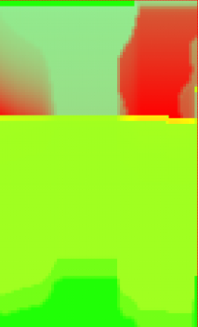

Single vs. Multiple Strips
Notes:
Both strip maximum single cell erosion -2.3 kg/m^2

Slide 40
Notes:
Single Soil - Dalhart
Maximum cell soil loss -8.8 kg/m^2 in both pictures

Slide 41
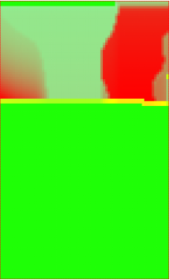

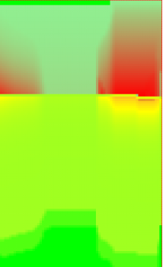

Saltation/creep vs. Suspension

Slide 42


Notes:
Nov 26, 27
Saltation from Conlen starts erosion of Ulysses

Slide 43



Slide 44
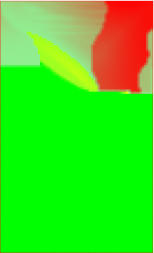


Slide 45
Future Work
Interface for creation of multiple subregion scenarios
Field validation of friction velocity variation across heterogeneous field surfaces
Investigation of terrain effects on surface friction velocity

