Slide 1
Integrated Erosion Tool (IET)
IET is the benchmark example for any application which combines wind and water induced erosion models into one user interface

Slide 2
Integrated Erosion Tool (IET)
IET 1.42.04 currently deployed to NRCS production computing environment;
  version of IET used by planners.
  requires ArcMap 10.3 or 10.5
IET 1.42.04 uses RUSLE2 2.5.2.11 and WEPS
Updating 1.42.04 to use RUSLE2 engine 2.6.11.1 (April 2019)

Slide 3
Integrated Erosion Tool (IET)
IET 2.4.0.9 is current test version for IET2
utilizes WEPS and WEPP model science
IET2 provides a better user experience and enhanced outputs
Anchored to ArcMap; targeting ArcMap 10.6 for IET2 implementation

Slide 4
Integrated Erosion Tool (IET)
IET2 not in Conservation Desktop (CD).
IET2 for meaningful planner and grower alternatives analysis.
IET2 is designed as an addin for ArcMap.
Will need to define and implement a simple Planning Land Unit (PLU) provisioning service to enable ease of use for IET2 - couple of options

Slide 5
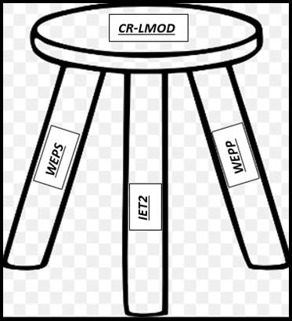
Integrated Erosion Tool (IET)
Logically, IET2 would serve as CRLMOD
testing harness for test cases which
need to test updated CRLMOD objects
in both WEPS and WEPP.

Slide 6
Integrated Erosion Tool (IET)
IET use and application after CART is deployed

Slide 7
Integrated Erosion Tool (IET)
IET is able to document a USDA Customers crop rotation
Conceivably IET rotation file(s) could be securely and electronically passed from a USDA Customer to all USDA Service Center Agencies.
  Enable automation of annual crop reporting
  Modernize methods USDA Customers have to report crops grown
  Primarily applies o annual row crop USDA Customers

