Slide 1




Status of WEPP Hillslope Model
Dennis Flanagan
Jim Frankenberger
USDA-Agricultural Research Service
National Soil Erosion Research Laboratory
West Lafayette, Indiana, USA

Slide 2
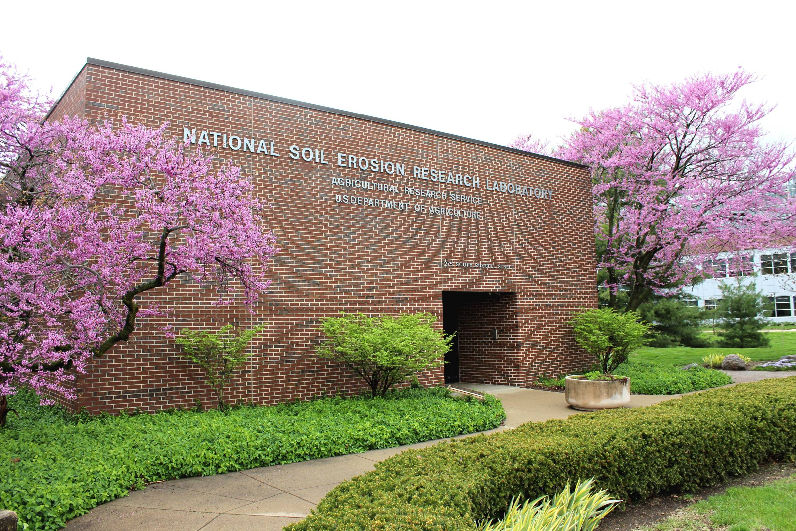
“The NSERL – to provide the knowledge and technology needed by land users to conserve soil and water for future generations.”

Slide 3
WEPP hillslope model
Last public release version was v2012.8, which is now out-of-date.
NRCS-ARS WEPP implementation project (2013-present) has resulted in an updated science model:
  Bug fixes
  Changes to adapt to NRCS requests for WEPP functionality
  Changes to adapt to new NRCS web-based interface
As part of the WEPP implementation project, REST web services have been created that allow inclusion of WEPP technology into any web-based, desktop, or mobile software (including the Integrated Erosion Tool – IET).
Also, a new web-based interface has been developed by ARS-NSERL. (Jim will cover interfaces later)

Slide 4
WEPP Model Changes & Application Procedures since 2013
Automatic yield calibration
Irrigation specification and utilization
Multiple tillage operations on a day.
Contouring simulation
Residue management operations

Slide 5
Automatic Yield Calibration
For most crops, NRCS wish was for the model to produce biomass and crop yield that approximates average observed yield, from user input.
An automatic yield calibration routine was incorporated into the interface and model, that takes an input target yield, and runs multiple 15-yr model simulations to adjust the crop Biomass Energy Ratio (BEINP) parameter.
When the difference between the predicted average annual yield and the target yield is 10% or less, the calibrated BEINP value is used in all subsequent model simulations for that crop. (tolerance can be reduced to lower values – 5% or 1%)

Slide 6
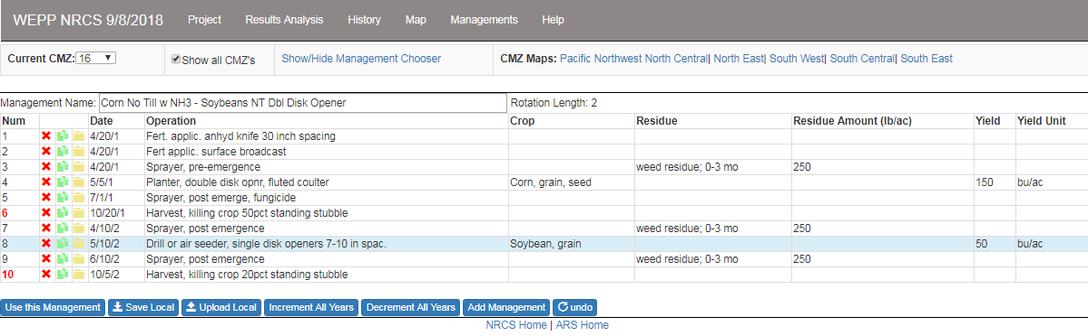
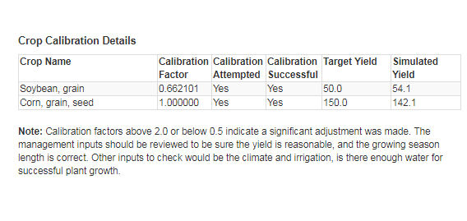
Automatic Yield Calibration

Slide 7
Irrigation Specification & Utilization
WEPP can simulate both sprinkler and furrow irrigation, for either fixed dates or depletion level scheduling.
Users often do not know the amount or rates of irrigation that are applied.
If irrigation is specified by the user with no other information, the new web interface assumes depletion level irrigation scheduling with default irrigation parameters, and very low intensity sprinkler water application.

Slide 8
Updated Contouring Simulation
NRCS set the contour row length to a default of 50 feet (15 m).
Contour ridge height is now equal to the calculated soil ridge height after tillage, which then decays with time (and also is changed after subsequent tillage).
The user provides the uniform contour row slope from a picklist.
Runoff depth and rates, and geometry of the hillslope and contours are used to determine contour failure during a storm.
If contours fail, soil loss in subsequent events is now computed using the up-and-down hill slope topography.
If a tillage operation occurs after failure, contours are reset.
A threshold ridge height of 2” was set by NRCS, and hard-coded into the WEPP model. If the ridge height decays below 2”, then soil loss is computed up-and-down the hill instead of with the contour settings.

Slide 9
Residue & Crop Management
Existing WEPP residue management options were quite limiting, as only a single one could be specified for an entire crop period.
WEPP model code and new interface were revised to allow multiple residue operations within a yearly crop period.
For annual crops these include shredding/cutting, burning, removal & addition of residue; and silage harvesting, herbicide (kill) application, and cutting with or without removal of above ground live biomass.
A “release cover crop” option was added, so that an inter-seeded cover crop such as rye could have its growth better match field conditions the day after harvest of the preceding crop (starts from non-zero canopy and biomass).
“Kill crop” effects have also now been associated with certain tillage operations, so if that tillage is specified by a user it will also kill any current live crop.

Slide 10
Residue & Crop Management (cont.)
For perennial crops, the ability to cut the crop without removing the cut biomass has been added. This is an important improvement for hay crops, where several days may pass between mowing and baling.
Grazing operations that remove a fixed percentage of live biomass on a day have been added. (WEPP already had grazing operations that use grazing time periods, number of animals, etc.).
Tillage operations can now both bury surface residue cover, and re-surface a portion of previously buried crop residues.

Slide 11
Model testing and validation
Considerable recent WEPP model testing has been conducted by NRCS, ARS, and outside scientists.
Testing has included comparisons between WEPP and RUSLE2 predictions in various locations.
NSERL is currently working together with the National Sedimenation Laboratory (NSL) on a new substantial WEPP/RUSLE2 comparison study for Iowa, that will be examining climate, soil, slope length, slope gradient, and management practice effects.
NSERL has also recently redone WEPP model validation studies with v2012.8 and v2018 using natural runoff plot data (USLE plot data).

Slide 12
General testing observations
WEPP and RUSLE2 are different models, and can produce both similar and different erosion estimates.
Some of the components within the 2 models handle things such as soil consolidation somewhat differently. WEPP shows a greater effect of tillage disturbance, but also has a more rapid and greater consolidation effect (so effects of going from tilled systems to no-till systems are greater).
Also, it can be difficult to set up model simulations so that all plant growth, biomass, and residue conditions are identical throughout a simulation period, due in part to database settings as well as how each model accounts for residue partitioning at harvest.

Slide 13
WEPP Validation Overview - 2019
Previously used USLE plot measurements served as the validation dataset
All recorded years from 11 sites:
  Bethany, MO; Castana, IA; Geneva, NY; Guthrie, OK; Holly Springs, MS; Madison, SD; Morris, MN; Pendleton, OR; Presque Isle, ME; Tifton, GA; and Watkinsville, GA
339 plot-years across all managements and sites
Conditions on each plot were uniform
Identical slope, soil, and climate files were used for each treatment at a site (built from measurements at each site)

Slide 14
WEPP Validation Overview
All WEPP runs were uncalibrated, with baseline effective hydraulic conductivity, interrill erodibility, rill erodibility, and critical shear calculated from the parameterization equations.
Model simulation results were determined for runoff and soil loss:
  Average Annual (by site and by management)
  Annual Composite (irrespective of site or management)
  Monthly Composite (irrespective)
  Individual Events (irrespective)
  Log Transformed and Untransformed

Slide 15
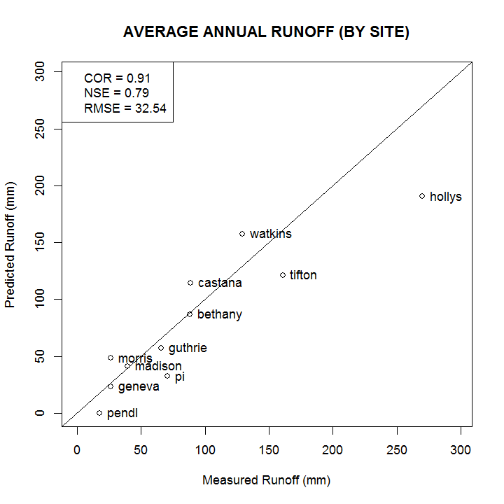
Validation Results (uncalibrated runoff)

Slide 16
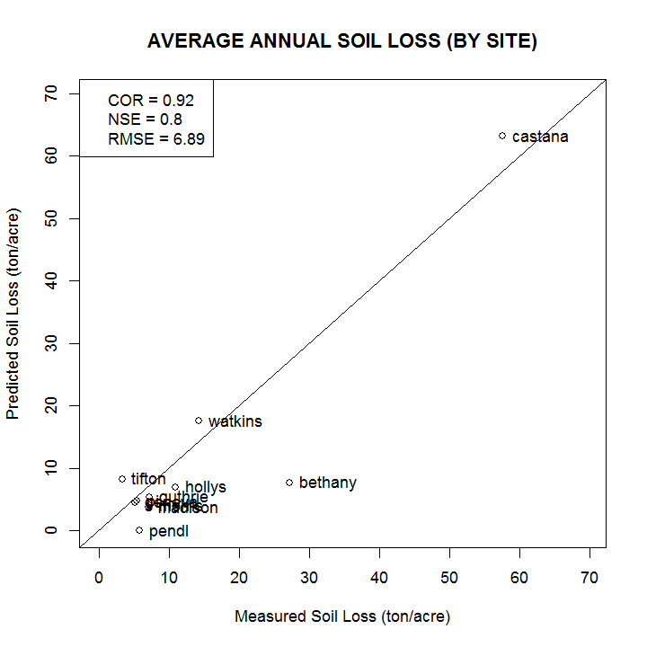
Validation Results (uncalibrated soil loss)

Slide 17
The End

Slide 19
New WEPP web-based interface

Slide 20
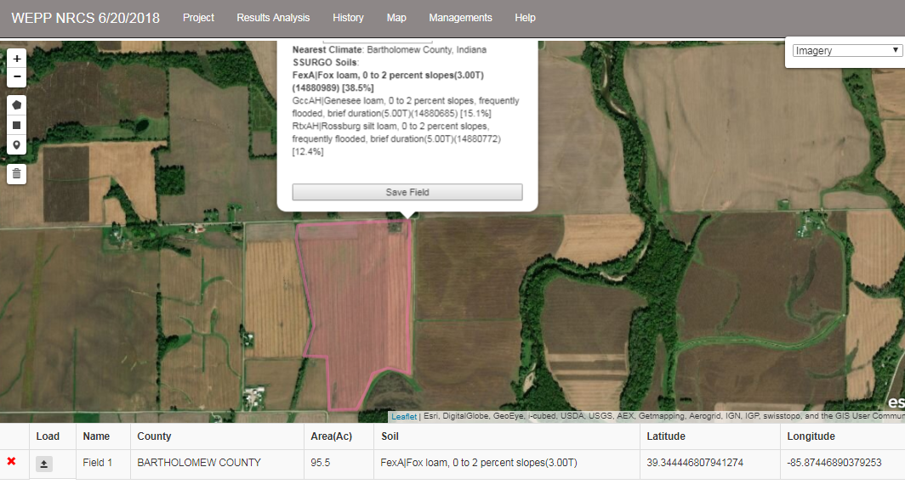
Map function – accesses spatial climate and soils databases.

Slide 21
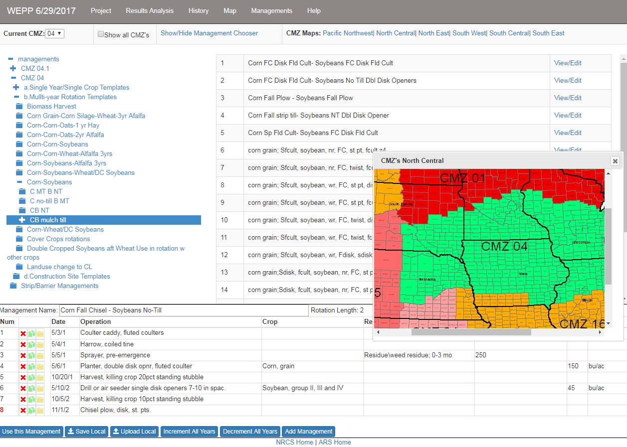
Management editor – accesses NRCS Land Management & Operations Database (LMOD)

Slide 22
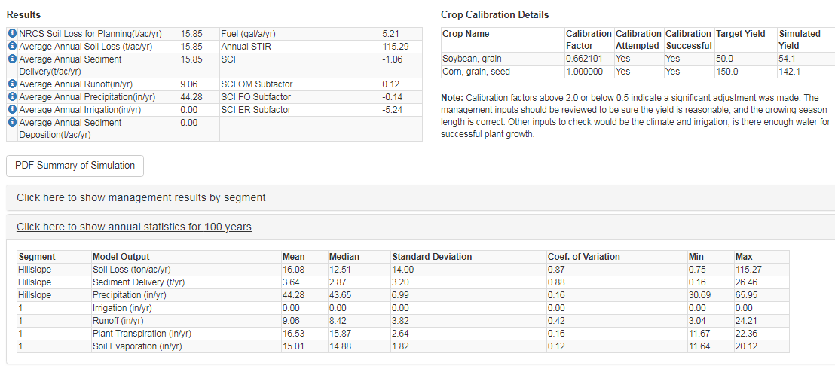
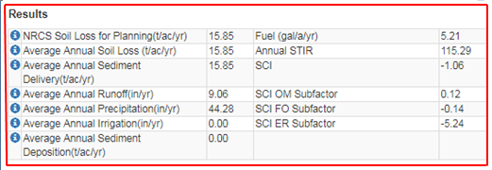
Main Simulation Results

