Slide 1
Cloud Services Integration Platform CSIP
Olaf David, Mazdak Arabi, Jack Carlson, Wesley Lloyd, Ken Rojas,
Charles Ehlschlaeger, Tim Green
Colorado State University
USDA
University of Washington

Slide 2
Outline
Modeling-as-a-Service
Features, Architecture and Implementation at CSU
Application Lifecycle Management
Applications

Slide 3
What is CSIP?
“CSIP is a scalable “Model-as-a-Service” Platform tailored for the delivery of model and data services within the environmental domain.”

Slide 4
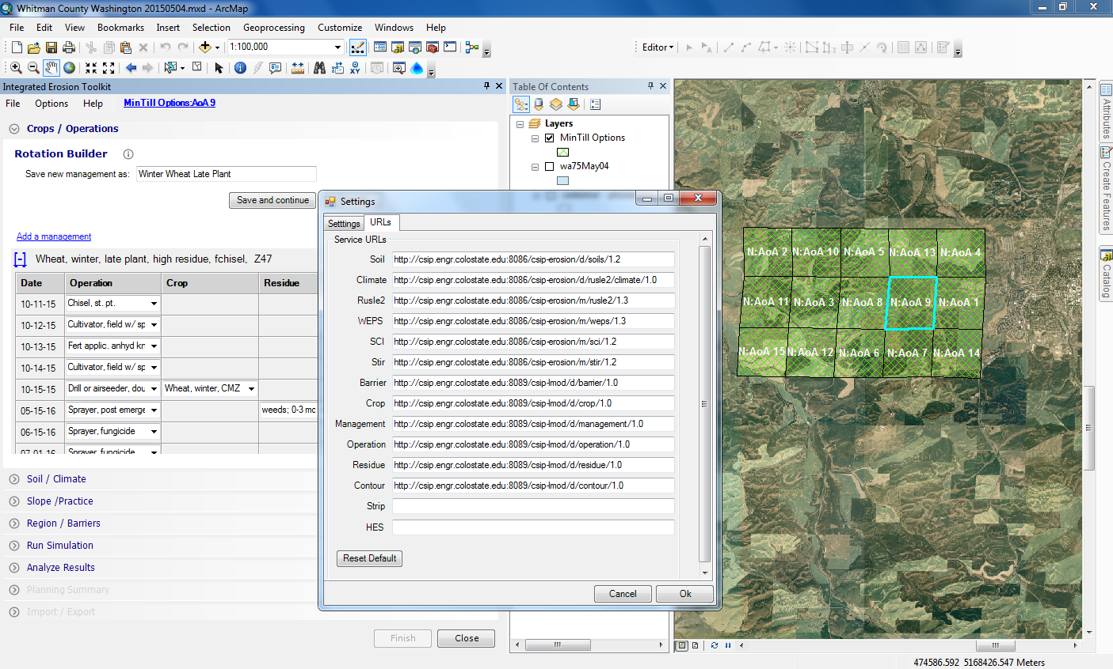
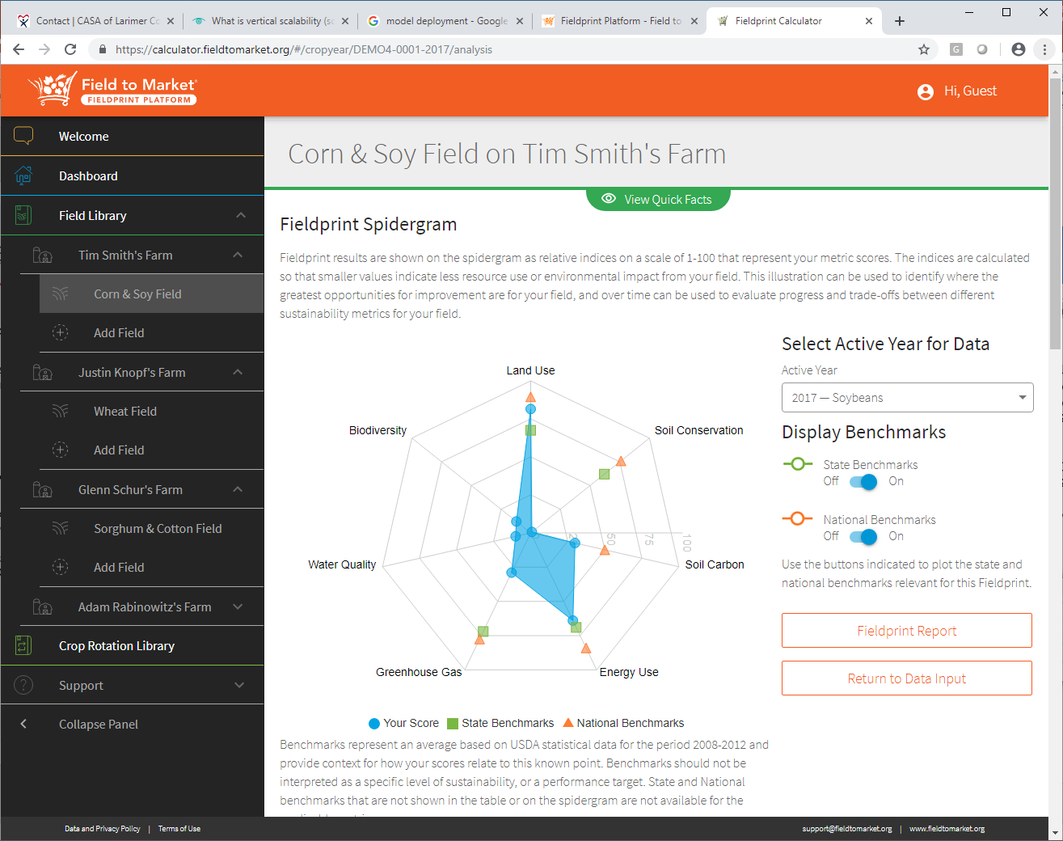
(Environmental) “Model as a Service” addresses …
Model Reuse and Repurpose
Model Deployment, Distribution, and Maintenance
Data Provisioning
Programming Language constraints
Separation of Model UI and Model Engine
Scalability
Web
Model
Service
Data

Slide 5
CSIP Features
Restful Server-Client API, JSON/JAXB
Service Registry, Exploration, and Execution
Cloud/Container agnostic Deployment
Traceability and Archival
Linear horizontal Scalability, Easy vertical Scaling
Synchronous / Asynchronous / Publish-Subscribe Executions
Authenticated Services
Model Ensemble Runs

Slide 6
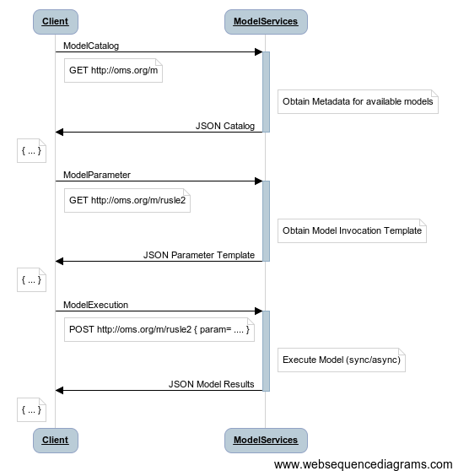
Service Catalog, Exploration and Invocation

Slide 7
Service Server API
Services payloads are in JSON format are mapped to the CSIP API
Service endpoints are versioned. No URL or Query parameter are needed.
Services can be implemented in Java, Python or R, or mapped to existing external executables.
Annotation based.
JSON
Request
service handling, request parsing, file management, workspace + session menagement
CSIP Handling
preProcess()
read, check service parameter, read metainfo values
doProcess()
execute the sevice logic
postProcess()
provide result values and files
report()
optional provide report values and files (optional)
CSIP Handling
error, JSON, workspace and result management.
JSON
Response
https://mvnrepository.com/artifact/edu.colostate.omslab/csip-core

Slide 8
@Name(“Temperature Conversion")
@Description("Example of an simple service")
@Documentation("https://alm.engr.colostate.edu/csip")
@State(PROTOTYPE)
@License(License.GPL3)
@VersionInfo("$Id: 0.1+47 V2_0.java 4657aca8bafb 2018-08-26 od $")
@Author(name = "od", email = "<odavid@colostate.edu>", org = "CSU")
@Category("Climate")
@Path("m/simpleservice/2.0")
public class V2_0 extends csip.ModelDataService {
@Override
protected void doProcess() throws Exception {
double temp = getDoubleParam("temp");
String un = getParamUnit("temp");
if (un.equals("C")) {
putResult("temp", temp * 9 / 5 + 32, "temperature", "F");
return;
}
throw new ServiceException("missing unit.");
}
}
JSON
Request
service handling, request parsing, file management, workspace + session menagement
CSIP Handling
preProcess()
read, check service parameter, read metainfo values
process()
execute the sevice logic
postProcess()
provide result values and files
report()
optional provide report values and files (optional)
CSIP Handling
error, JSON, workspace and result management.
JSON
Response

Slide 9
Service Client API
CSIP has a built-in registry for services, allows for exploration of default service parameter Services are executed via HTTP/POST.
Services payloads are in JSON format. JSON most flexible to populate and consume.
Multipart HTTP/POST requests for input file attachments, Output file queries with HTTP/GET
Java, C#, Python bindings
(https://pypi.org/project/csip)
{
"metainfo": {
"status": "Finished",
"suid":"c6808036-db0b-11e3-84c6-8d184928a57a",
"tstamp": "2014-02-14T02:02:17+0000",
"service_url": "http://csip.engr.colostate.edu:8088/csip-eft/m/efh2/1.0",
"cpu_time": 16,
"expiration_date":"2014-05-14T02:07:17+0000"
},
"parameter": [
{
"name": "precip",
"unit": "inch",
"min": "1",
"max": "15",
"value": 14
},
{
"name": "runoffcurvenumber",
"min": "40",
"max": "95",
"value": 90
...
],
"result": [
{
"name": "runoff",
"value": 12.75
…

Slide 10


Scalability
CSIP Web services are scalable
Vertically (adding/separating features)
Adding dedicated servers for running session management, archives, proxy, more
Horizontally (duplicating resources)
Adding more compute servers
CSIP “all-in one”
Client
1
Proxy
Compute server
Horizontal scaling
2
Vertical scaling
Session server grid
Archive
server (mongodb)
Logging server

Slide 11


CSIP Kubernetes Deployment at CSU
Kubernetes 1.13 deployment
600+ cores, 600 TB storage
Ceph FS for distributed storage
Other deployments at NRCS (NITC), ARS, RTI (Azure), Noble (AWS)
Service Requests
Model
Application
VM
(CSIP/OMS)
csu_kube 1
csu_kube 1
rDBMS VM
PostGIS
Load Balancer
scalability
(AWS)
Kubernetes Container
Session management VM
Mongo DB
Archive / Logging
MongoDB

Slide 12
Daily Simulations – Erosion Model Web Service
Supporting the Field to Market FPC 2.5 Soil Conservation Metric
342,927 RUSLE2 Service Runs
302,090 WEPS Service Runs
515,200 Soil Service Runs
1,160,217 Total Service Runs

Slide 13
Service Execution Options
request
response
1
Synchronous Execution
Caller blocked until response.
For ad-hoc requests with short runtime.
Asynchronous Execution
Caller not blocked, frequently pulls for status.
For ad-hoc requests with medium runtime.
Publish-Subscribe Execution
Caller not blocked, result delivered via webhook.
For batch requests with medium to long runtime
Client
Service
2
request
… polls …
response
Client
Service
3
request + webhook
response
Client
Service
webhook
HTTP/POST
Any service can be executed in any execution mode.

Slide 14
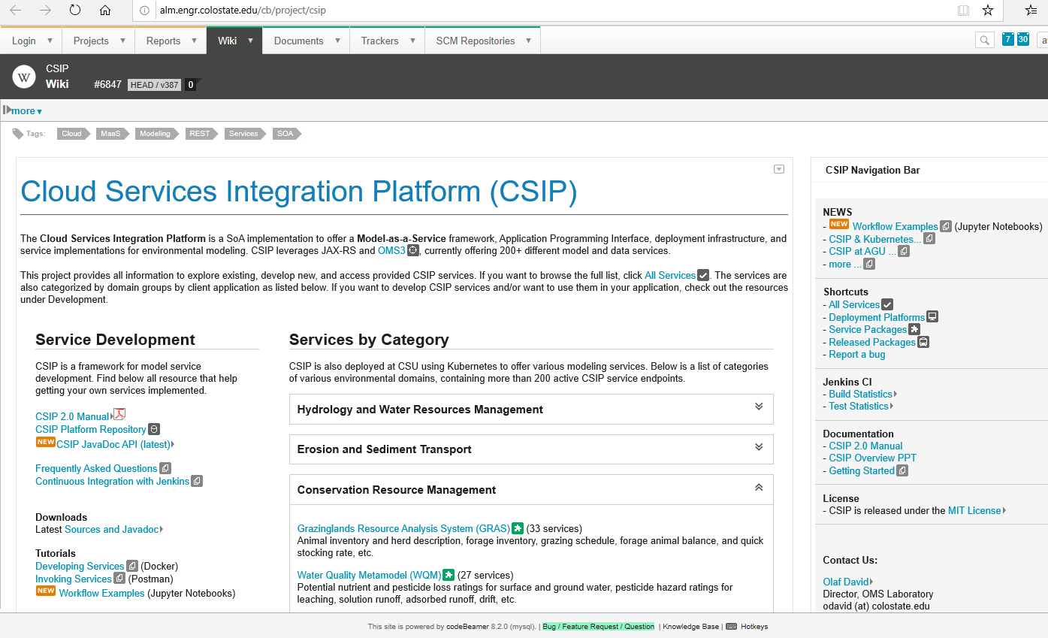

Application Lifecycle Management
Git and Mercurial Repositories for collaborative service development
Jenkins automated builds for service packages, service testing, and deployment
Bug and Feature tracking for CSIP core development service
Resource Download for CSIP sources, manual, examples, tutorials, etc.
http://alm.engr.colostate.edu/cb/project/csip

Slide 15
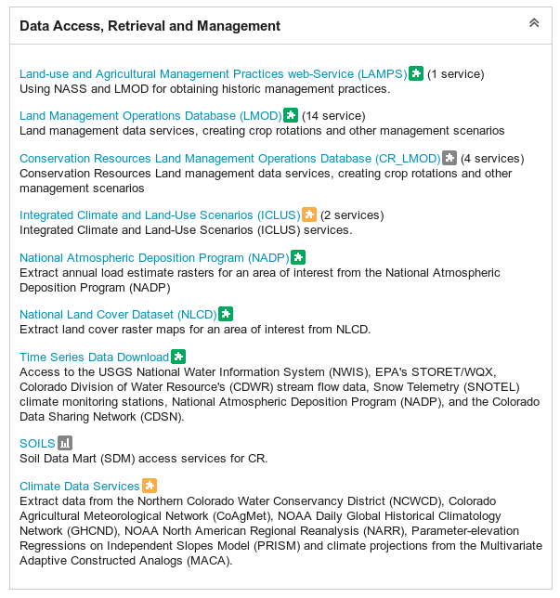
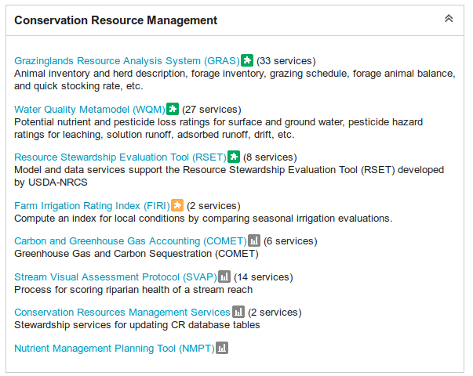
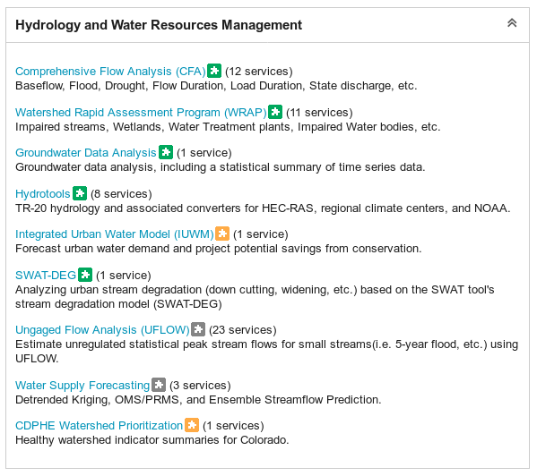
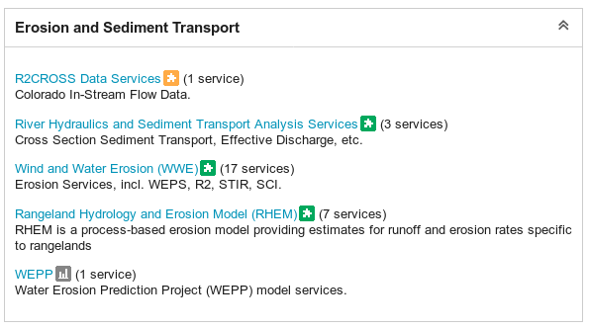
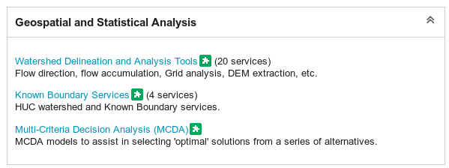
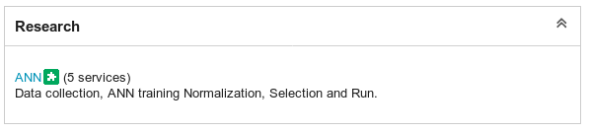
Available Services (alm.engr.colostate.edu/cb/project/csip)

Slide 16
History
2012 - Explored cloud options for running environmental models, Eucalyptus, AWS, NRCS driven
2013 – Implemented first CSIP prototype by extending the OMS3 framework
2014 – Focus CSIP erosion model and data services for various applications, IET1 and IET2, NRCS CDSI
2015 – 19 - 250+ Model & Data services for 10+ (Research) Projects
Applications / Collaborations since then …

Slide 17
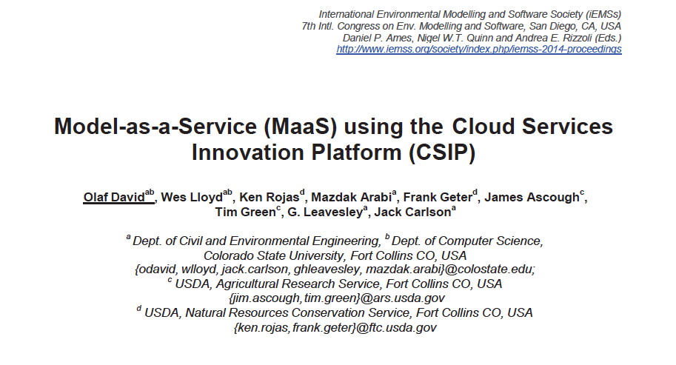
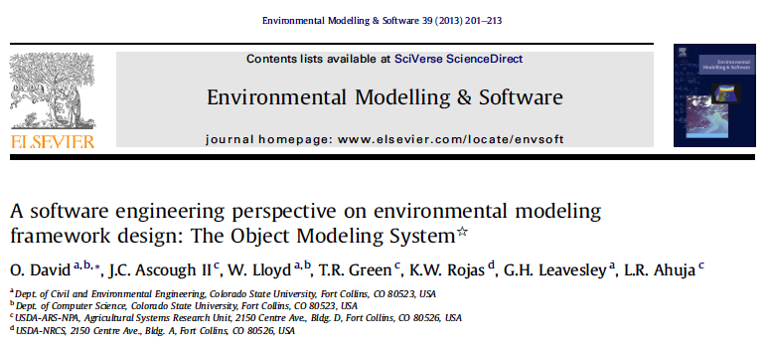
David, O., Arabi, M., Carlson, J., Traff, K., Lloyd, W., Rojas, K., 2016. Supporting collaborative model and data service development and deployment with DevOps, American Geophysical Union (AGU) Fall Meeting, December 12-16, 2016
David, O., Lloyd, W., Rojas, K., Arabi, M., Geter, F., Ascough II, J., Green, T., Leavesley, G., Carlson, J., 2014. Model-as-a-Service (MaaS) using the Cloud Services Innovation Platform (CSIP), International Environmental Modelling and Software Society (iEMSs) 7th International Congress on Env. Modelling and Software, San Diego, CA, USA, Daniel P. Ames, Nigel W.T. Quinn, and Andrea E. Rizzoli (Eds.)
David, O., Ascough II, J., Lloyd, W., Green, T., Rojas, K., Leavesley, G., and L. Ahuja (2013), A software engineering perspective on environmental modeling framework design: The Object Modeling System, Environmental Modelling & Software 39 (2013) 201-213.
Lloyd, W., Pallickara, S., David, O., Lyon, J., Arabi, M. and K. Rojas (2013), Performance implications of multi-tier application deployments on infrastructure-as-a-service clouds: towards performance modeling, Future Generation Computer Systems 29(5):1254-1264.
Lloyd, W., David, O., Ascough II, J., Rojas, K., Carlson, J., Leavesley, G., Krause, P., Green, T., and L. Ahuja (2011), Environmental modeling framework invasiveness: analysis and implications, Environmental Modelling & Software, 26(10), 1240-1250.
David, O., Ascough II, J., Leavesley, G., and L. Ahuja (2010), Rethinking modeling framework design: Object Modeling System 3.0. IEMSS 2010 International Congress on Environmental Modeling and Software – Modeling for Environment’s Sake, Fifth Biennial Meeting, July 5-8, 2010, Ottawa, Canada.

Slide 18
Applications / Collaborations

Slide 19



















Institutions using or leveraging the CSIP Platform and Services

Slide 20
Integrated Erosion Tool (NRCS)
Purpose
Resource Assessment Tool to estimate wind and water erosion, soil condition trend, farming operation fuel consumption, and PM10 particulates at the field scale.
CSIP Services
csip-wepp: Water Erosion Prediction Project model
csip-weps: Wind Erosion Prediction System model
csip-rusle2: Revised Universal Soil Loss Equation model
csip-sci: compute Soil Conditioning Index
csip-stir: compute Soil Tillage Intensity Rating
csip-soils: fetch soil data for UI display and model inputs
csip-climate: fetch climate data for UI display and model input
  Cligen – Climate Generation model
  Windgen – Wind Generation model
csip-crlmod: fetch crop rotation data for UI display and model input

Slide 21
Fieldprint Platform 3.0 (Field-to-Market)
Purpose
Assessment framework for farmers, retailers, and suppliers to measure the environmental impacts of commodity crop production and identify opportunities for continuous improvement. Soil Conservation, Soil Carbon, Greenhouse Gas, and Energy Use metrics rely on CSIP services.
CSIP Services
csip-wepp: Water Erosion Prediction Project model
csip-weps: Wind Erosion Prediction System model
csip-sci: compute Soil Conditioning Index
csip-soils: fetch soil data for UI display and model inputs
csip-climate: fetch climate data for model input
  Cligen – Climate Generation model
  Windgen – Wind Generation model
csip-crlmod: fetch crop rotation data for UI display and model input

Slide 22
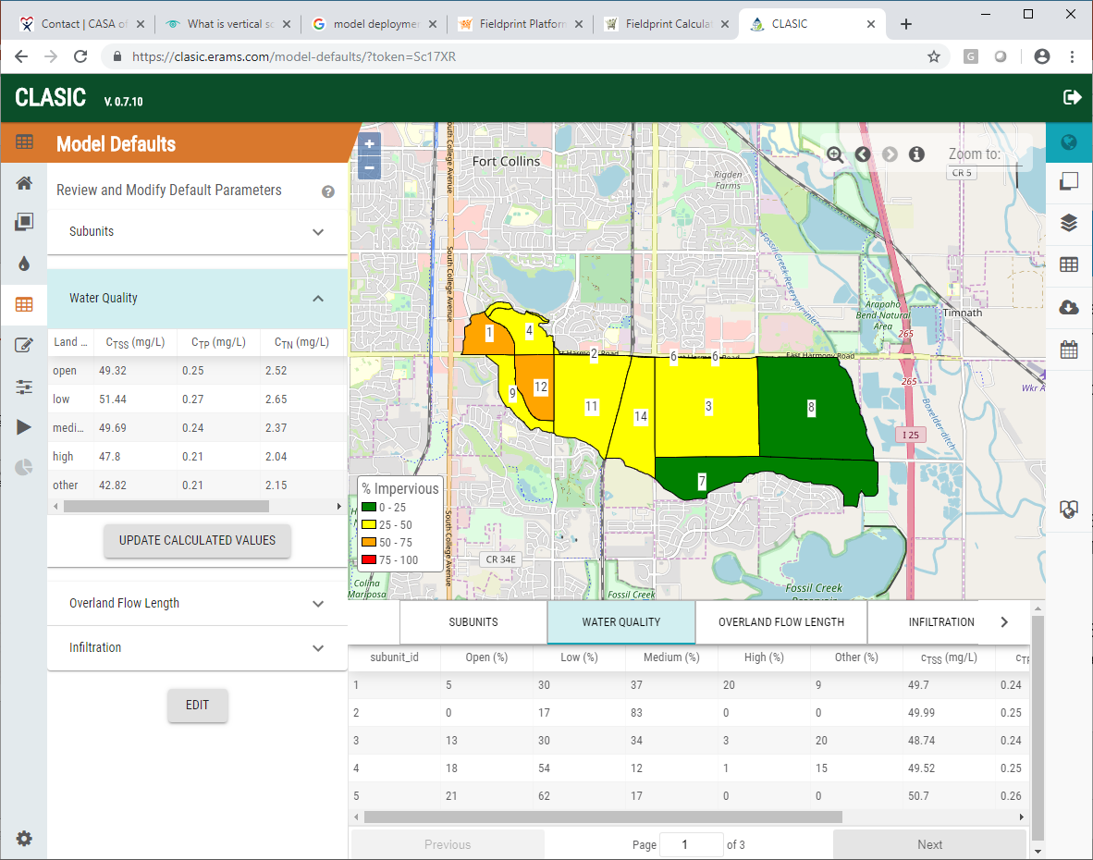
Community-enabled Lifecycle Analysis of Stormwater Infrastructure Costs (EPA)
Purpose
Community-enabled Lifecycle Analysis of Stormwater Infrastructure Costs (CLASIC) is a screening tool utilizing a lifecycle cost framework to support stormwater infrastructure decisions on extent and combinations of green, hybrid green-gray, and gray infrastructure practices.
Users can create scenarios of stormwater control measures including climate and land use projections to assess lifecycle costs, performance, and co-benefits associated with those scenarios.
CSIP – Services
csip-swmm: Storm Water Management Model

Slide 23
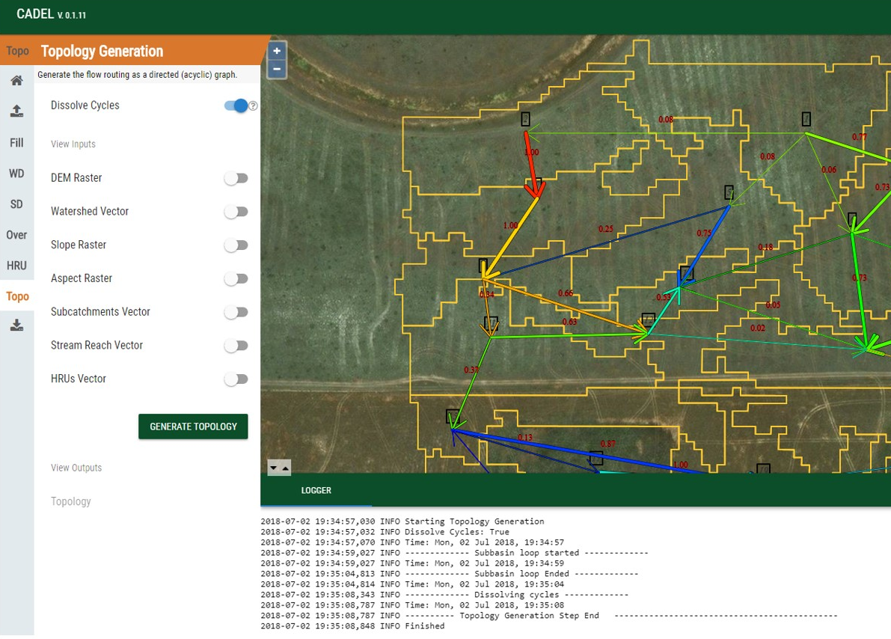
Catchment Delineation - Cadel (ARS)
Purpose
Delineating a watershed’s boundaries and a set of internal response elements or polygons with geospatial attribute tables is an essential part of generating input parameter sets for distributed hydrological models.
Cadel implements a generic methodology of such a delineation process and services workflow. The current version produces specific topology and routing input files for the Agricultural Ecosystem Services (AgES) distributed watershed model. Attributes assigned to each HRU include terrain attributes with optional soil, land use, and hydrogeologic identifiers provides as geospatial input layers.
CSIP services
csip-watershed
  TauDEM Method
    Flow direction
    Flow accumulation
    Stream raster
    Stream network
    Peuker-Douglas
    Gage watershed
    etc.

Slide 24
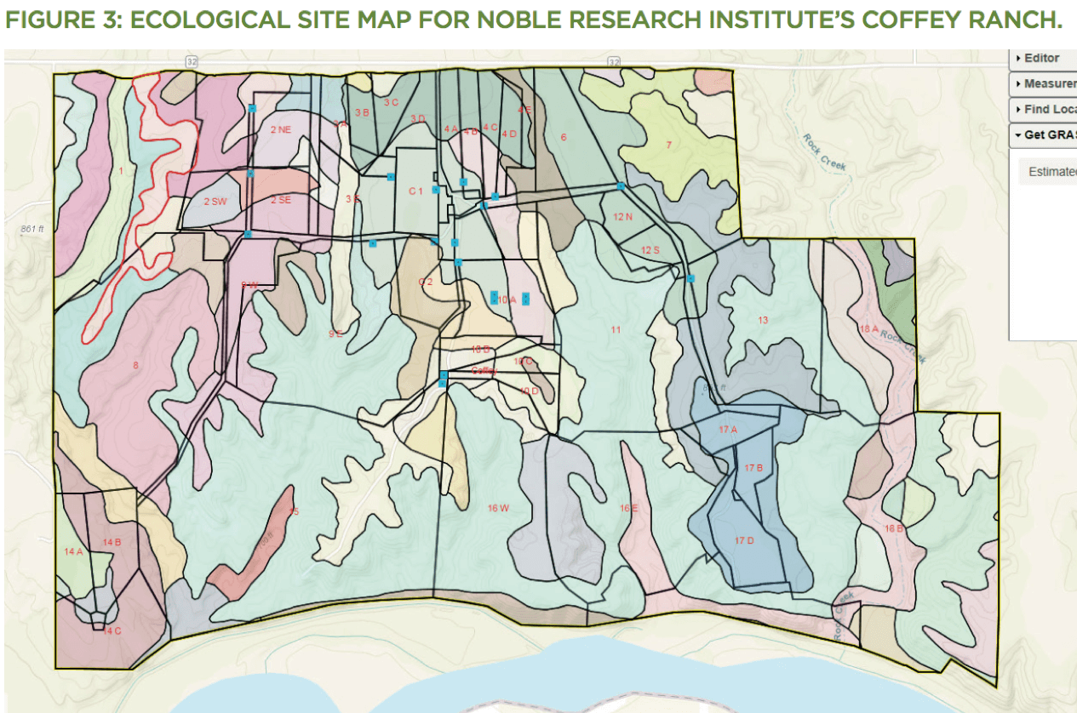
Quick Stocking Rate Calculator (Noble Research Institute)
Purpose
Inform users on stocking rates, forage suitability groups, soils and many more aspects of grazing land management; more quickly and accurately calculate initial stocking rates.
Previously, this process would take numerous hours to complete due to data and information being spread out over many locations. However, with the workflows developed through GRAS, this process can now be easily completed in a few minutes, and stakeholders in the consulting process will have more time to focus on conversations around planning.
CSIP Services
csip-gras: Grazingland Analysis System
Fetch Ecological Site Descriptions for area of interest
Calculate reference forage production
Compute Quick Stocking Rate

Slide 25
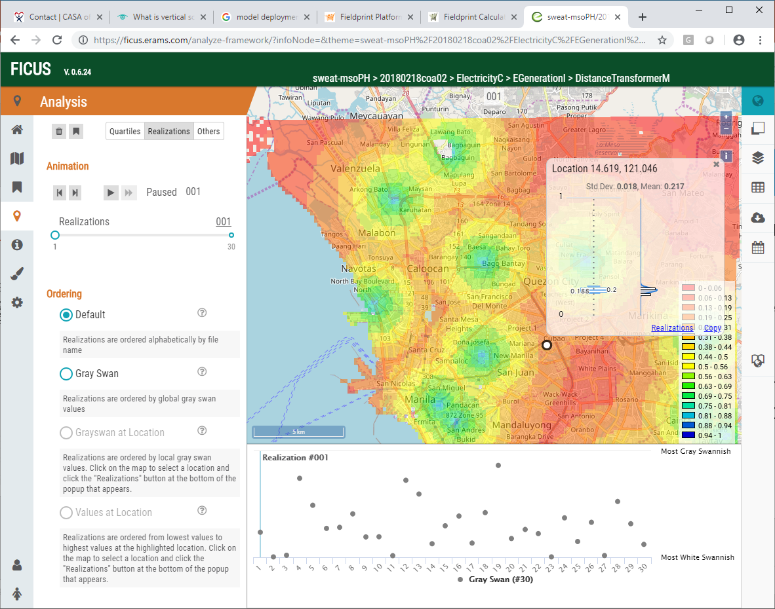
Framework for Integrating Complex Uncertain Systems FICUS (USACE)
Purpose
The “Framework for Integrating Complex Uncertain Systems” (FICUS) is a computational framework to support federated models of complex uncertain systems and enable information support for multiple interconnected social, infrastructural, and environmental models.
FICUS research goals are to develop a neighborhood scale geo-temporal analysis tool quantifying data and application uncertainty and forecasting near future environmental, social, and infrastructural change.
CSIP Services
csip-transims
csip-HISSA

