Slide 1
Compatible WEPS and WEPP management File Transfer
Fred Fox
Jim Frankenberger
March 20, 2019

Slide 2
Goals
Be able to Export a management file created in the WEPS management editor so it can be imported into WEPP.
Preserves dates, operations, crops, residue amounts, yields and yield units when the file is imported into WEPP.
Be able to Export a management file created in the WEPP management editor so it can be imported into WEPS.
Preserves dates, operations, crops, residue amounts, yields and yield units when the file is imported into WEPS. Assumes default row direction, crop calibration based on setting in crop database record.

Slide 3
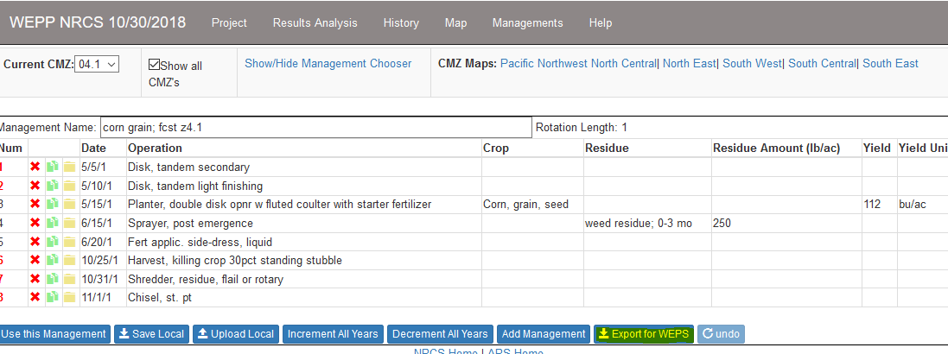
WEPP interface Updates

Slide 4
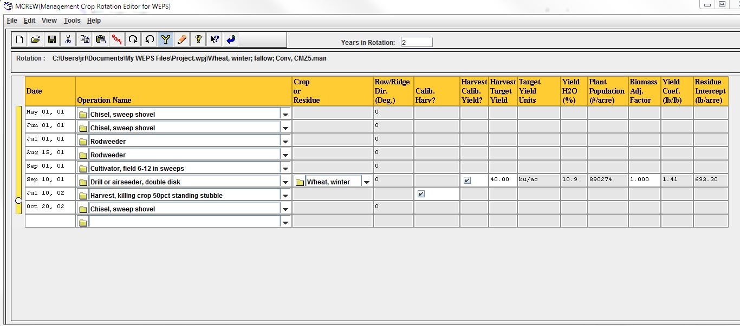
WEPS Interface Updates
The Export to WEPP would be found under the File menu

Slide 5
File Format Options
Each model interface exports the native format the other can easily load.
A common format is selected and both model interfaces agree to import and export using this format. Several alternatives:
  Modified “skel” XML format to include yield and residue amounts (used by WEPS)
  CRLMOD4 JSON format (used by IET)
  Abbreviated R2 JSON (original CRLMOD format) (used by WEPP)

Slide 6
Other considerations?
Are we overlooking anything?

