Slide 1


Common web interfaces for WEPP and WEPS
How do they work and can they be compatible?
Jim Frankenberger
Fred A. Fox
United States Department of Agriculture
Agricultural Research Service
National Soil Erosion Laboratory
West Lafayette, Indiana
and
Agricultural Systems Research Unit
Ft. Collins, Colorado

Slide 2
Outline
Review current user interfaces
Common areas and differences
Look at “how” they work
How much compatibility?
Web interface considerations
Notes:
Wind Erosion Prediction System
Process based ,
Continuous,
Daily time-step,
Wind Erosion Model

Slide 3
Current application installation/interfaces
Windows Desktop
    Current desktop WEPS 1.5.52 release
    WEPP older (2012 version)
Web Browser Interface
    New NRCS WEPP interface
Java WebStart Application
    WEPS interface/application
ArcGIS (ArcMap) Add-In
    IET1 and IET2 (requires ArcGIS be installed)
Notes:
Wind Erosion Prediction System
Process based ,
Continuous,
Daily time-step,
Wind Erosion Model

Slide 4
Windows Desktop
WEPS Windows MSI Installation
  Historical Windows application install option
  Written in Java programming language
  Application installed and runs locally on the computer
  More complex to mass install/update on multiple machines
        Installation/maintenance/updates more difficult to manage
  Can be configured to access data remotely
  Can be designed to run application(s) “in the cloud” by connecting to web services (CSIP)
        Both options require internet access though
Notes:
Wind Erosion Prediction System
Process based ,
Continuous,
Daily time-step,
Wind Erosion Model

Slide 5
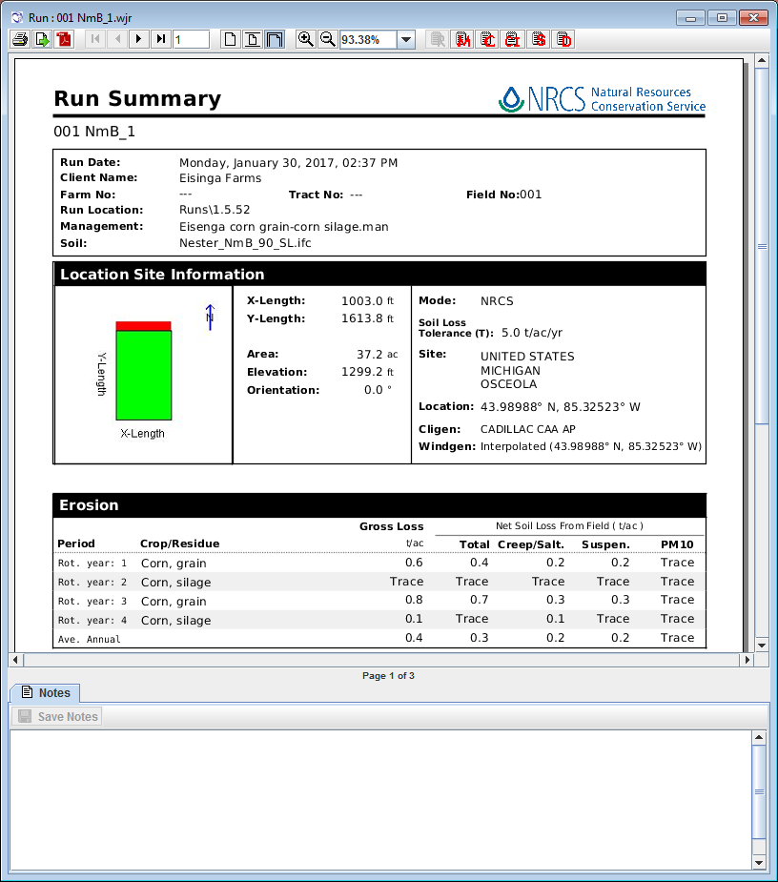
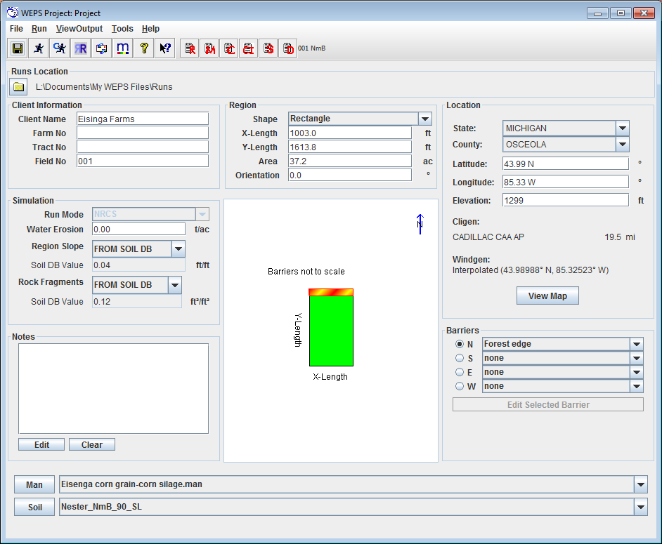
WEPS MSI Builds
WEPS 1.5.52 (Released in December 2016)
    Public (full) release
    NRCS release
Notes:
Wind Erosion Prediction System
Process based ,
Continuous,
Daily time-step,
Wind Erosion Model

Slide 6
Web Browser Interface
  Written in JavaScript, HTML, CSS.
  No local installation/updates (they occur on the server)
        easier to manage application
  Application interface runs within a web browser
        no local computer application installation, etc.
        must be coded to run within a browser (javascript, etc)
  Remote (server) execution of application
        reduces local computer “power” required to run application
  Data required is accessed by the server not local computer
        no data requirements for local computer
  Requires internet access to run application
        Input data and results passed between server and browser interface
  Able to run on many devices and operating systems
        tablet, laptop, phone, Windows, IOS, Android
  Small subset of WEPP functions available in interface
Notes:
Wind Erosion Prediction System
Process based ,
Continuous,
Daily time-step,
Wind Erosion Model

Slide 7
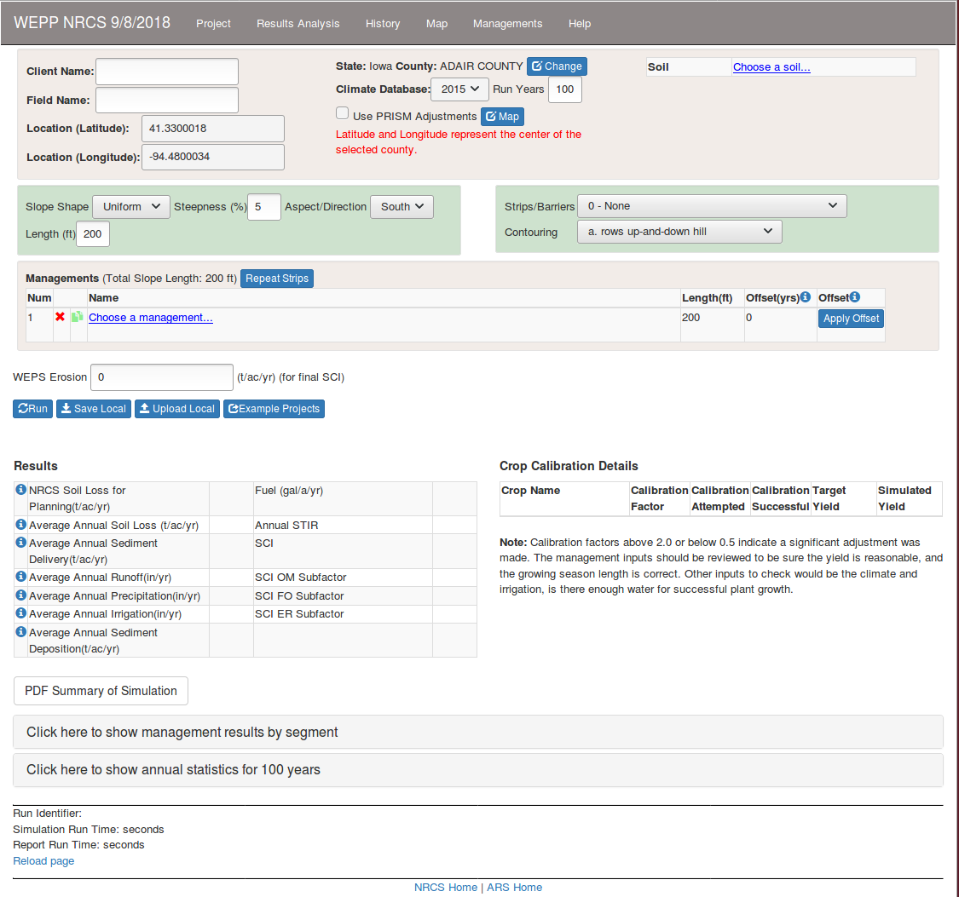
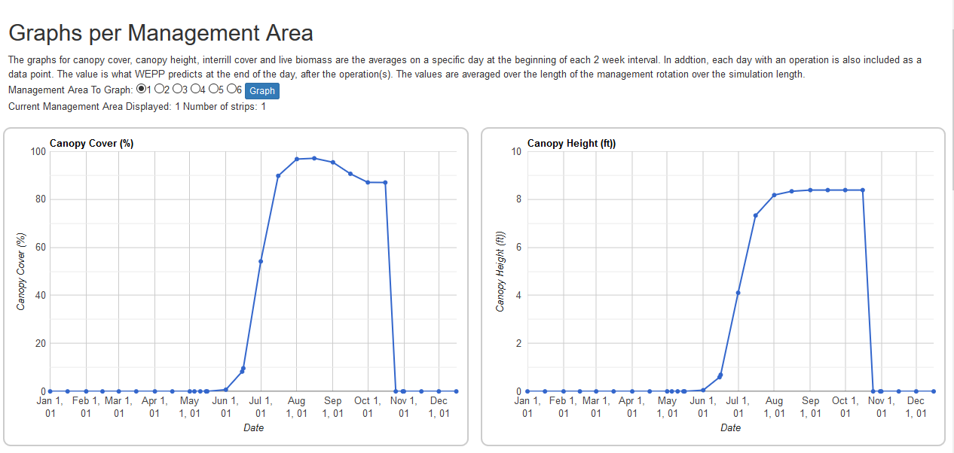
WEPP NRCS Browser Application
Notes:
Wind Erosion Prediction System
Process based ,
Continuous,
Daily time-step,
Wind Erosion Model

Slide 8
WEPS Java WebStart Application
Java WebStart Application
  Replaces conventional “MSI” installations
        done from a web link (URL)
    Application interface still runs locally on the computer
        application can still be run without internet access (offline)
  Provides automated updating features
    Reduces management of installation/updating applications
  Provides additional security
    Requires code to be signed with certificate to install/run
  Can provide remote access to data
  Can provide remote (server) execution of executables
        requires internet access for both options though
Notes:
Wind Erosion Prediction System
Process based ,
Continuous,
Daily time-step,
Wind Erosion Model

Slide 9
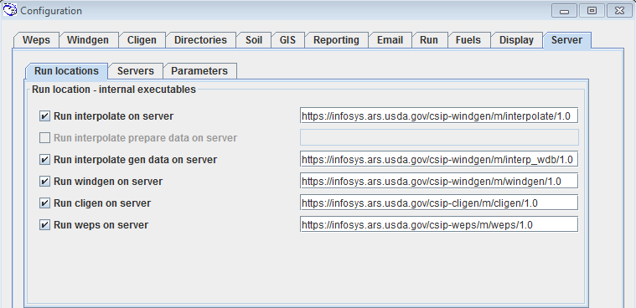
Java WebStart WEPS
Allows access to WEPS application via a web browser link
  Optional desktop icon and/or Start Menu links
    Currently blocked by NRCS IT though
Provides remote and/or local access to data
Provides local and/or remote (server) execution of WEPS runs
Retains all current (full) WEPS interface functionality
  Can be configured for level/type of user and/or Agency (NRCS) mandated restrictions
Provides automated updates to WEPS users
Can still be run locally (offline) if no remote (data) access required
Notes:
Wind Erosion Prediction System
Process based ,
Continuous,
Daily time-step,
Wind Erosion Model

Slide 10
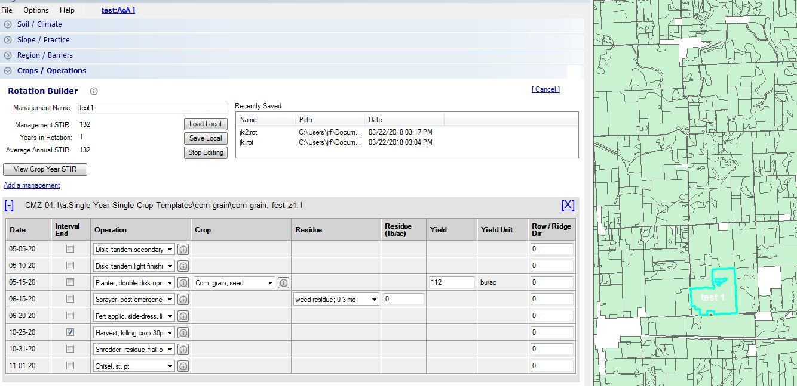
IET ArcGIS (ArcMap) Add-In
Uses ArcGIS (ArcMap) system as basis for user interface
User is able to select a specific area of interest
  gets climate and soil information automatically based upon the selected area
Written in C# programming language
Uses ArcGIS software libraries
Configure runs for both WEPS and WEPP
Notes:
Wind Erosion Prediction System
Process based ,
Continuous,
Daily time-step,
Wind Erosion Model

Slide 11
Application commonality
All use CSIP web services to get data and setup model runs.
Provide management editors, PDF reports, graphs
Same source database for soils – SSURGO
Same source database for climate – CLIGEN + PRISM (optional)
Same source database for management – CRLMOD
  Detail crop and operation parameters are different for WEPP and WEPS
Application differences
*Different programming languages (Java, C#, JavaScript/HTML)
*Different software libraries and development environments
Different levels of model features available in each interface
  WEPS, full access, configurable for level of user, similar to desktop version
  WEPP browser interface and IET, subset of model features based on user requirements
* Would require extensive rewrite to switch between platforms
Notes:
Wind Erosion Prediction System
Process based ,
Continuous,
Daily time-step,
Wind Erosion Model

Slide 12
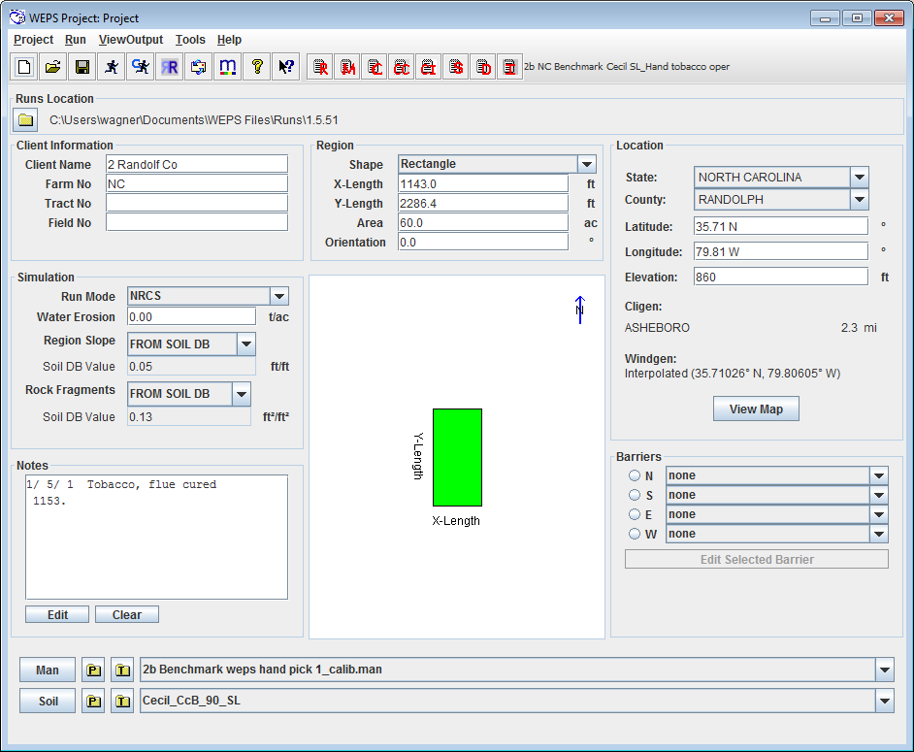
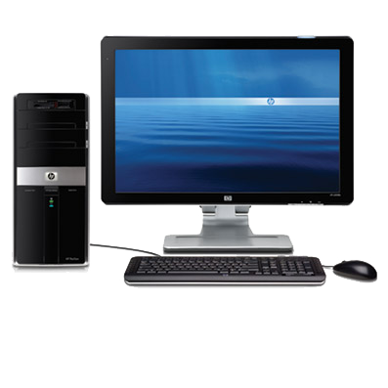
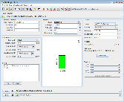
How do they work?
WEPS Java WebStart
After initial download completes -
Java WebStart will bring up application “WebStart WEPS” on the local computer
(has same features as full desktop version)
Notes:
Wind Erosion Prediction System
Process based ,
Continuous,
Daily time-step,
Wind Erosion Model

Slide 13
Java WebStart - How it works
Provides internet browser access to WEPS
    No “Administrator” install required
Provides automated updating services
    User is always running the latest WEPS release
Can be run offline
    Data and model are present on client computer
Access (cloud) “services” for:
    Remote data access (CRLMOD)
    Remote execution of science model, generators, etc.
    WEPS Services:
      Cligen and Windgen weather data and generation
      Operation, Crop and Management template records
      WEPS science model execution
Notes:
Wind Erosion Prediction System
Process based ,
Continuous,
Daily time-step,
Wind Erosion Model

Slide 14
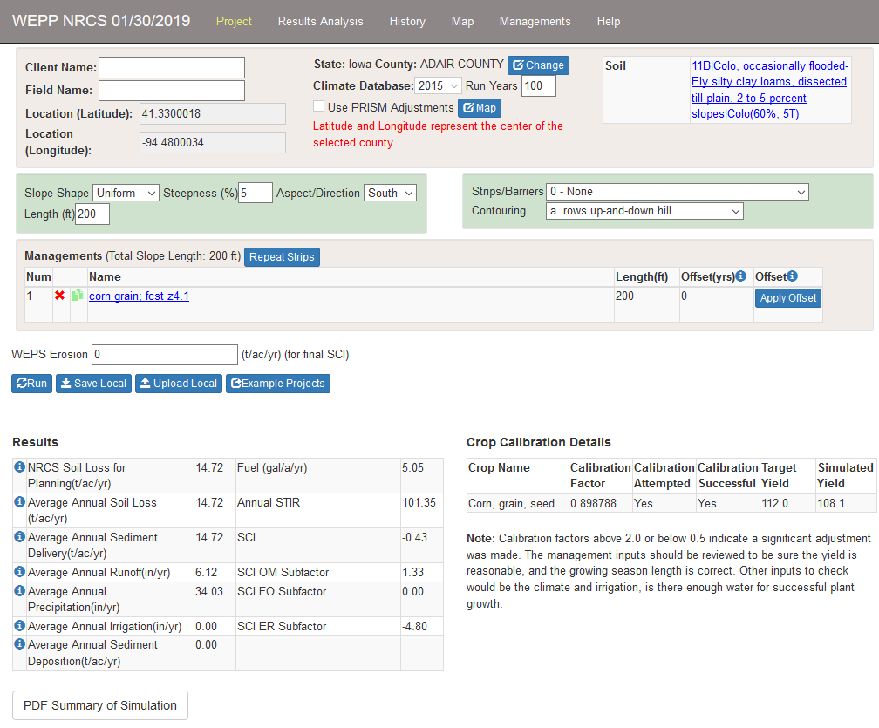
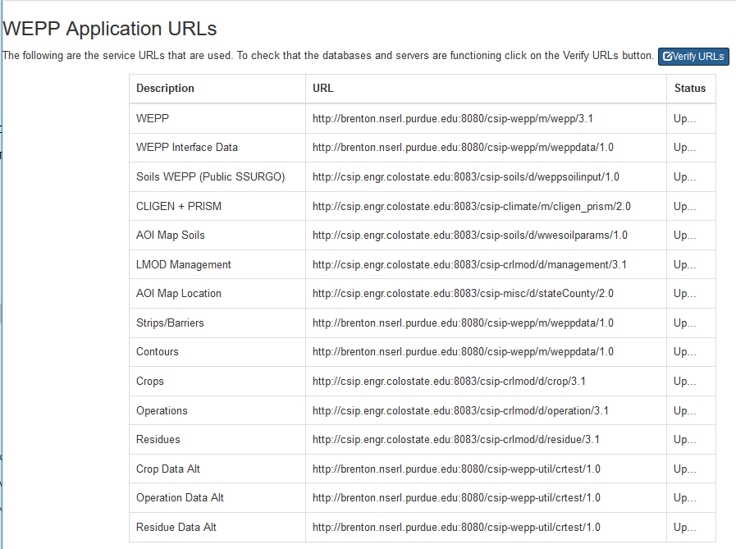
How do they work?
WEPP NRCS Browser Application
When visiting the main page all data for the interface is read from web services.
Notes:
Wind Erosion Prediction System
Process based ,
Continuous,
Daily time-step,
Wind Erosion Model

Slide 15
Web Browser Application – How it works
Support on major browsers, across devices
All data and WEPP model runs use CSIP web services. Data is not stored locally.
Internet access is required.
User has to save projects by downloading to local computer, and uploading to restore.
Written in JavaScript, HTML, CSS, uses Knockout JavaScript framework, Leaflet for mapping.

Slide 16
How much compatibility?
Assume a browser based web application (HTML + JavaScript)
Could have the same mapping interface to delineate area of interest for climate and soils
Could have the same SSURGO soil selection
Could have the same manual climate selection
Could have the same CRLMOD management selection
Notes:
Wind Erosion Prediction System
Process based ,
Continuous,
Daily time-step,
Wind Erosion Model

Slide 17
How much compatibility?
Would require updated management editor to include row direction
Would require adding field barrier choices
Would require adding request for a WEPS run
Add parsing of WEPS run output
Add formatted WEPS PDF reports
  (if not provided by web service)
Add table and graph outputs from WEPS runs
Notes:
Wind Erosion Prediction System
Process based ,
Continuous,
Daily time-step,
Wind Erosion Model

Slide 18
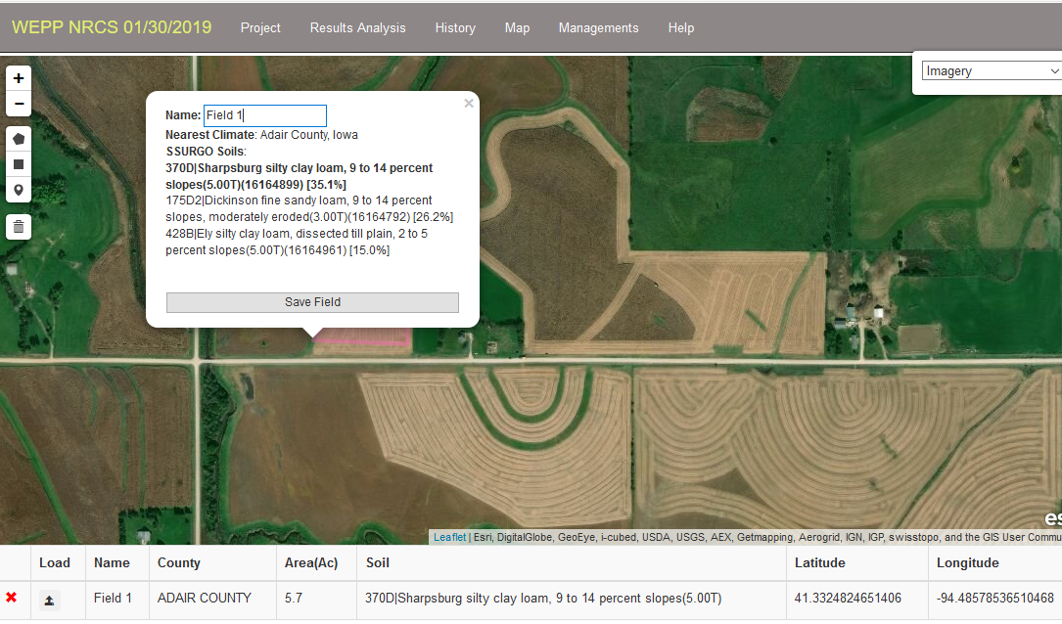
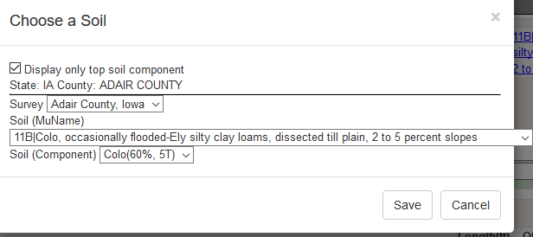
Web interface elements that could be shared
Web map to select area of interest and automatically determine climate and soil
Alternative is to manually select soil from online SSURGO

Slide 19
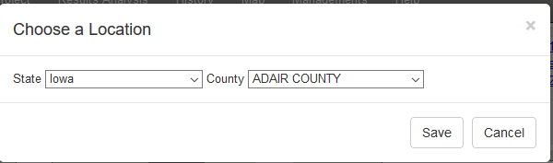
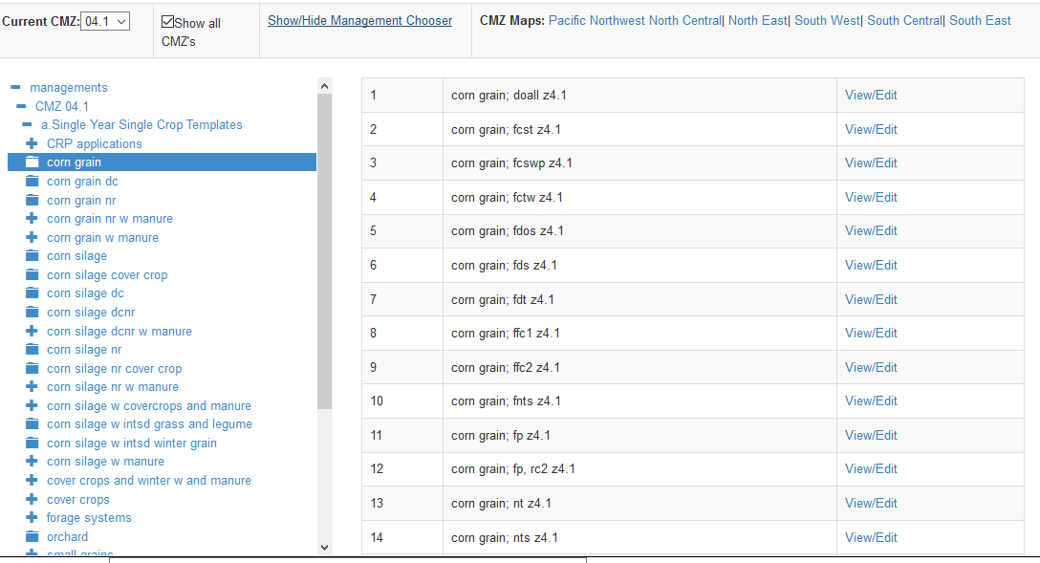
Web interface elements that could be shared
Option to manually select climate location by county
Select CRLMOD template to edit

Slide 20
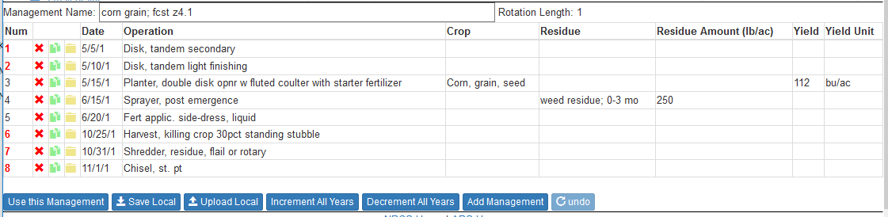
Web interface elements that could be shared
Would require adding row direction column.
To view detail operation and crop parameters would require WEPS specific windows.
Does not have all features of WEPS management editor.

Slide 21
Web Interface Considerations
If WEPS moves to a HTML5/JavaScript platform
  would require rewriting the application user interface
Scope of features!!!
  Is a subset of the model features enough?
  What is most important?
Can WEPP and WEPS be mostly separate web interfaces, not combined like IET?
Software framework for development – many choices – React (Facebook), AngularJS (Google), JQuery, Bootstrap, etc. Depends on developer expertise
Notes:
Wind Erosion Prediction System
Process based ,
Continuous,
Daily time-step,
Wind Erosion Model

Slide 22
Questions?
Thank You
Notes:
Wind Erosion Prediction System
Process based ,
Continuous,
Daily time-step,
Wind Erosion Model

Slide 23


What is a Java WebStart application?
In computing, Java Web Start
(also known as JavaWS, javaws or JAWS)
is a framework developed by
Sun Microsystems (now Oracle) that:
allows users to start application software
for the Java Platform
directly from the Internet using a web browser
Notes:
Wind Erosion Prediction System
Process based ,
Continuous,
Daily time-step,
Wind Erosion Model

Slide 24

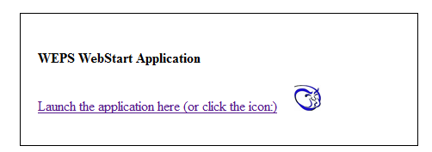
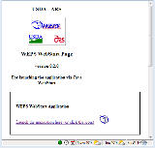
How WEPS Java WebStart application works
After clicking on the URL link for the first time in a browser, it will download the Java WebStart application (WebStart WEPS) and cache a copy on the local computer
Notes:
Wind Erosion Prediction System
Process based ,
Continuous,
Daily time-step,
Wind Erosion Model

Slide 25
How the WEPS Java WebStart application works
=?
Subsequent clicks on the URL link in a browser, will cause Java WebStart to check if the cached copy of the application (WebStart WEPS) is consistent with (same as) the copy on the server.
Notes:
Wind Erosion Prediction System
Process based ,
Continuous,
Daily time-step,
Wind Erosion Model

Slide 26
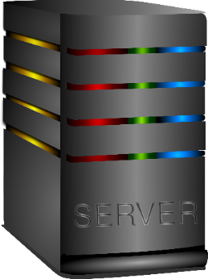
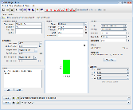
How the WEPS Java WebStart application works
=
If so, it will then bring up the application (WebStart WEPS) from the cached copy on the local computer
Notes:
Wind Erosion Prediction System
Process based ,
Continuous,
Daily time-step,
Wind Erosion Model

Slide 27

How the WEPS Java WebStart application works
If not, it will download another copy from the server to replace the current cached copy on the local computer prior to starting up WebStart WEPS
Notes:
Wind Erosion Prediction System
Process based ,
Continuous,
Daily time-step,
Wind Erosion Model

Slide 28
WEPS Java WebStart release will also
Access (cloud) “services” for:
    Remote data access (LMOD)
    Remote execution of science model, generators, etc.
    WEPS Services:
      Cligen and Windgen weather data and generation
      Operation, Crop and Management template records
      WEPS science model execution
Include new WEPS features:
    Multi-subregion science code (single subr only)
    MCREW - NRCS “Crop Interval” mode
    Access an updated Cligen database
Notes:
Wind Erosion Prediction System
Process based ,
Continuous,
Daily time-step,
Wind Erosion Model

Slide 29
WEPS Java WebStart release
For offline access of WEPS on laptops
    Automated detection of internet access
      Internet access, connect to remote WEPS services
      No internet access, work in local offline mode
    Automated download of required WEPS data
    Automated updating of all cached WEPS data
    User selection of local soil data for offline use
Notes:
Wind Erosion Prediction System
Process based ,
Continuous,
Daily time-step,
Wind Erosion Model

