Slide 1


A Conservation Ontology and Knowledge Base to Support Delivery of Technical Assistance to Agricultural Producers in the United States
J. Carlsonª, D. Butler^{b}, O. Davidª, K. Rojas^{b}, J. Ascough II^{c},
G. Leavesleyª, W. Oaks^{b}, L. Price^{b}, and L. Ahuja^{c}
ªColorado State University, ^{b}USDA-NRCS, ^{c}USDA-ARS
Fort Collins, Colorado and Raleigh, North Carolina, USA

Slide 2
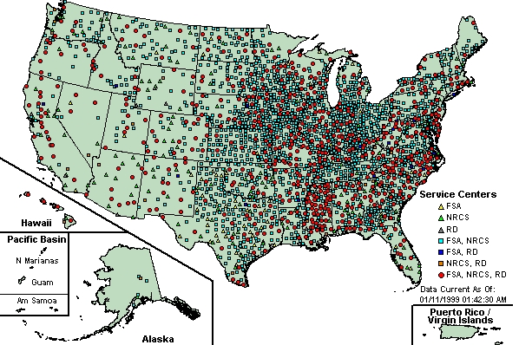
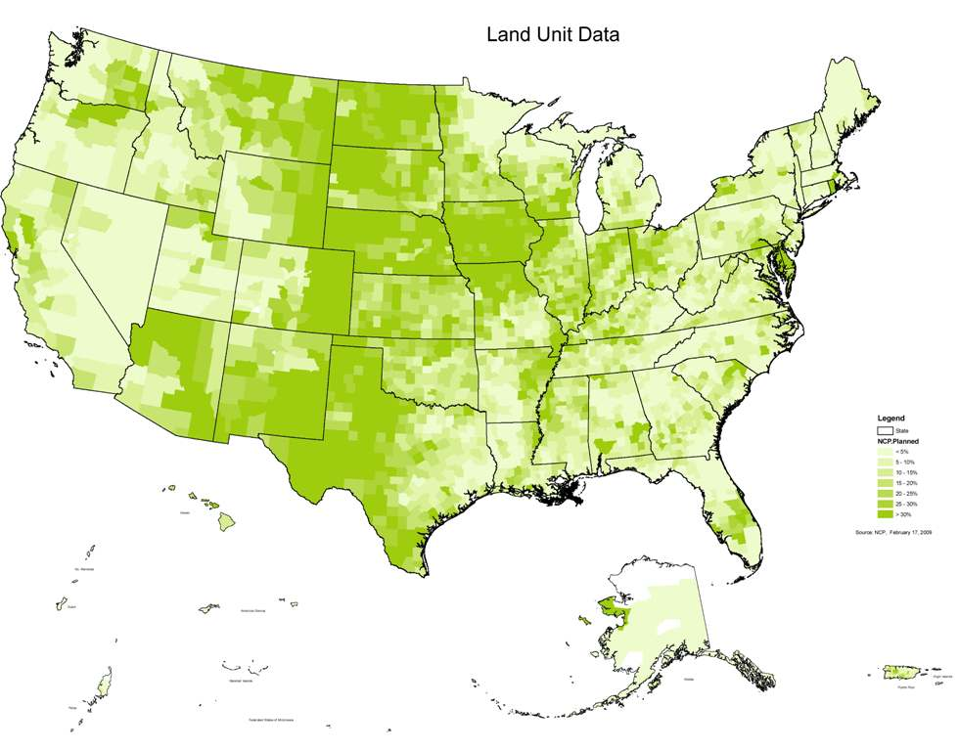
USDA delivers conservation programs through a network of 3,000 county-level offices. Field conservationists interact with between 5-25 thousand farmers each working day.
Conservation technical and financial assistance are delivered through the farmer’s conservation plan. At present there are more than 1 million conservation plans on 120 million hectares of working lands.

Slide 3
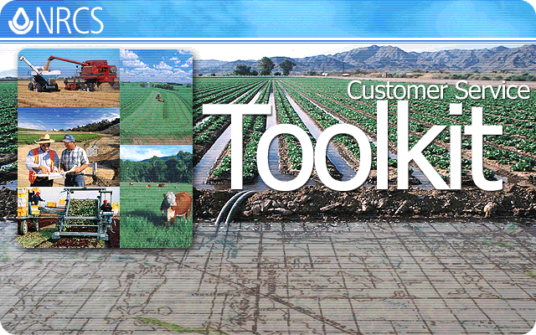
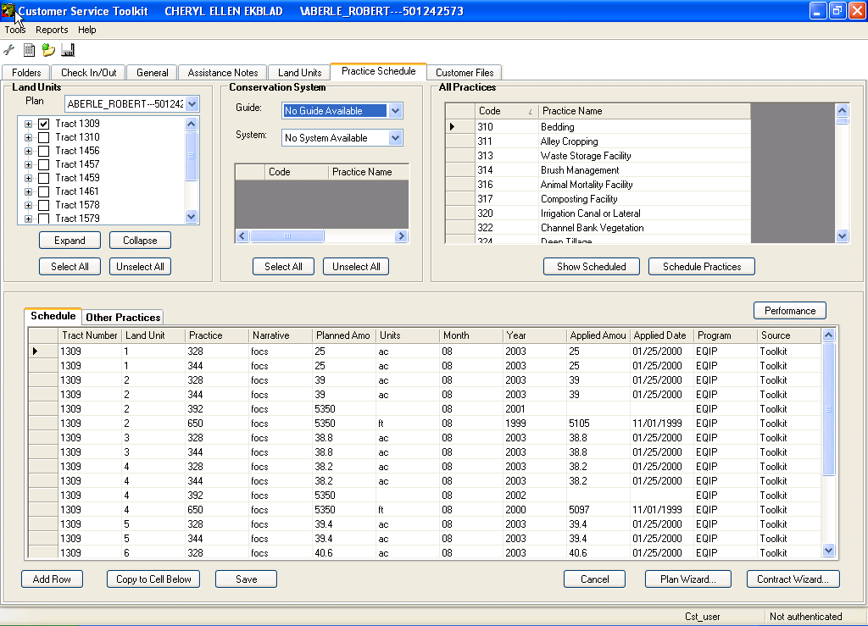
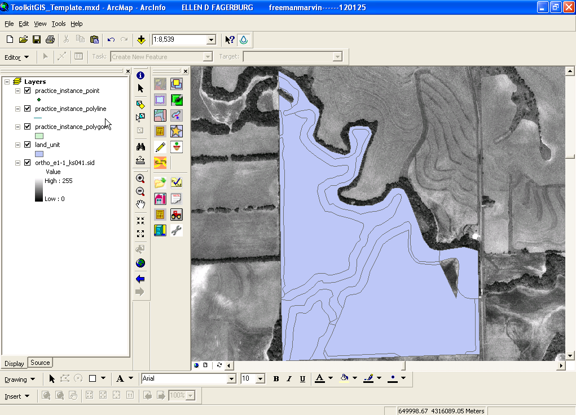
Conservation Plans have been managed in a corporate application/database system since 1985 through 4 system lifecycles, with the 5th lifecycle underway.

Slide 4
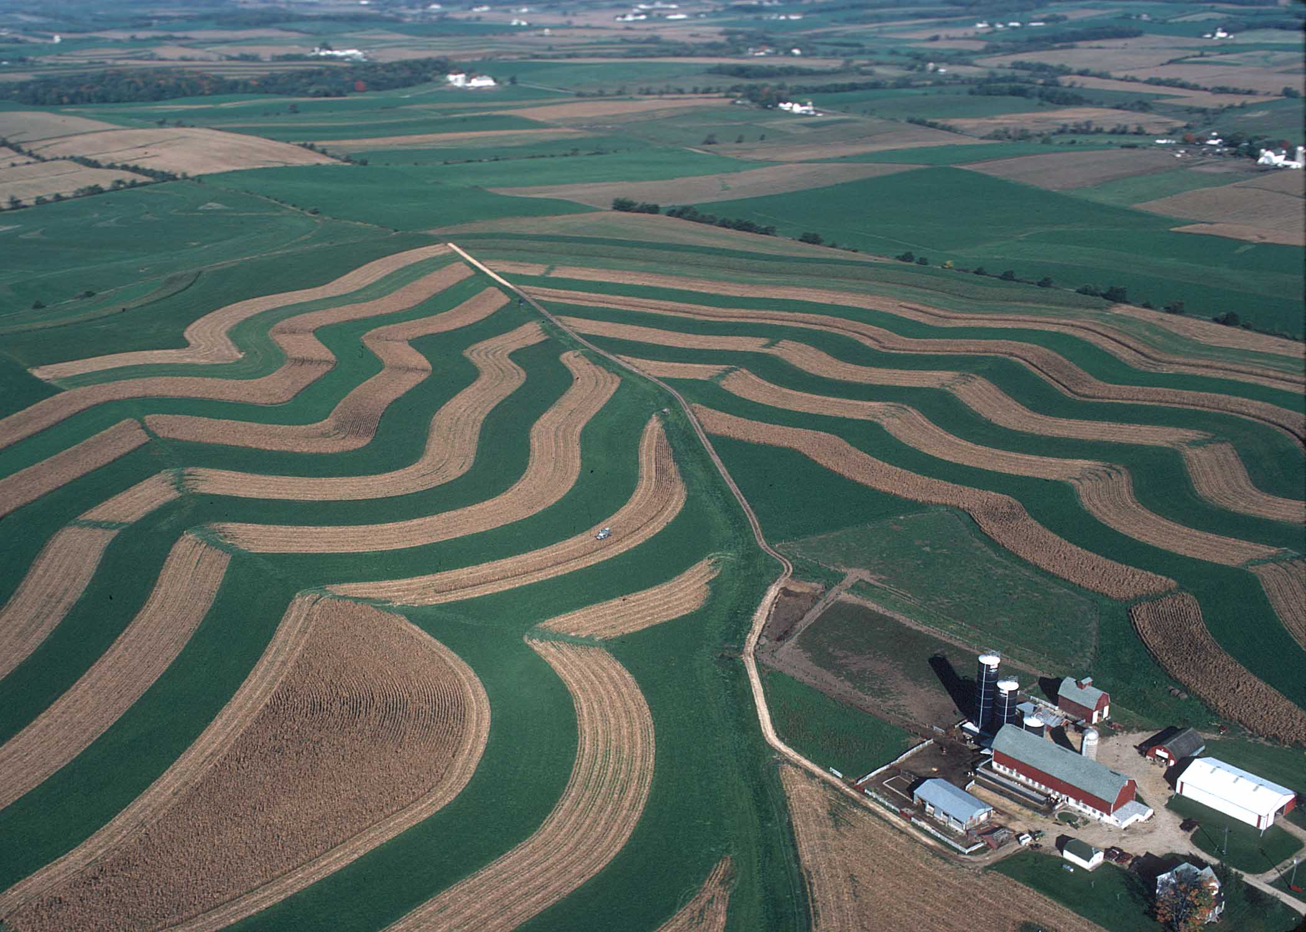
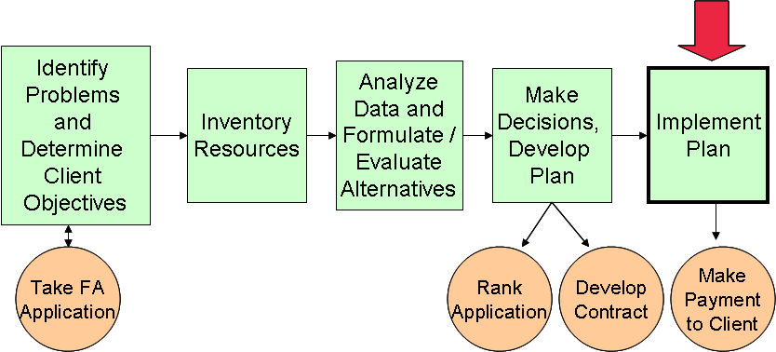
Conservation Programs provide technical and financial assistance to agricultural producers to fix resource problems and promote sustainable farming
Technical
Assistance
(TA)
Take Application
Rank Application
Develop Contract
Make Payment
Financial
Assistance
(FA)

Slide 5
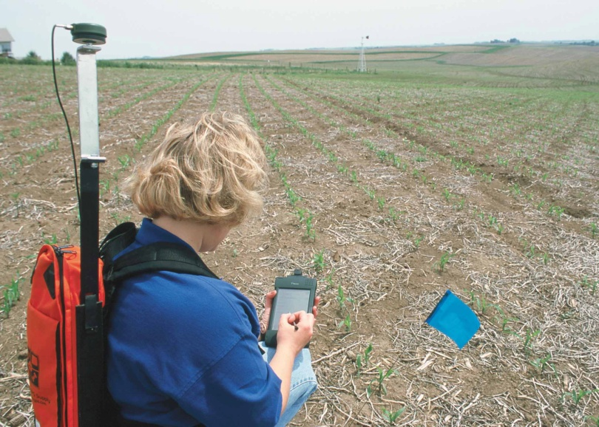
A Conservation Delivery Streamlining Initiative (CDSI) initiated in 2009 will increase time spent on Technical Assistance and increase the use of agro-environmental models for resource analysis and problem solving.
Technical
Assistance
(TA)
Take Application
Rank Application
Develop Contract
Make Payment
Financial
Assistance
(FA)
Many-fold increase in use of
agro-environmental models

Slide 6
Agro-Environmental Models for Improved Conservation Delivery
Watershed Scale
  Soil and Water Assessment Tool (SWAT) – calculates conservation effects for multiple resource concerns, for analyzing problem areas to allocate program resources, and analyzing program effectiveness
  Agro-Ecosystem Watershed Model (AgES-WS) – similar in scope to SWAT, containing updated science
  Precipitation and Runoff Modeling System (PRMS) – for water supply forecasting in the western U.S.
Farm/Ranch/Field Scale
  Agricultural Policy/Environmental Extender (APEX) – calculates conservation effects for multiple resource concerns, for farm/field level conservation planning and application

Slide 7
Agro-Environmental Models for Improved Conservation Delivery
Farm/Ranch/Field Scale (cont’d)
  Revised Universal Soil Loss Equation (RUSLE2) – calculates sheet/rill erosion
  Wind Erosion Prediction System (WEPS) – calculates wind erosion
  Simulation and Production of Rangelands (SPUR2) – calculates conservation effects for multiple resource concerns on grazing lands; can also be used at watershed scale
  Carbon Model (CENTURY) – calculates conservation effects for soil and air quality resource concerns; can also be used at regional scales

Slide 8
Resource Concern | Applicable Models
Soil Erosion
Sheet/Rill, Wind, Irrigation | RUSLE2, WEPS, APEX, SWAT, AgES-WS
Gully
Streambank, Shoreline
Roadbank, Construction Site | RUSLE2
Soil Quality
Organic Matter Depletion | APEX, SWAT, CENTURY
Organic Matter Oxidation | APEX, SWAT, CENTURY
Salinity / Contaminants | APEX
Nutrient Cycling | APEX, SWAT, CENTURY
Compaction
Water Quantity
Excess Water | APEX, SWAT, AgES-WS, PRMS, SPUR2
Insufficient Water | APEX, SWAT, AgES-WS, PRMS, SPUR2
Inefficient Use | APEX, SWAT, AgES-WS, SPUR2
Water Quality
Sediment | APEX, SWAT, AgES-WS, RUSLE2
Nutrients | APEX, SWAT, AgES-WS
Pesticides | APEX, SWAT
Pathogens | APEX, SWAT
Salinity | APEX
Air Quality
Airborne Soil Particulates | WEPS, APEX
Greenhouse gases and ozone | CENTURY
Chemical Spray Drift
Odors
Plants
Quantity, Diversity, Health, Vigor | APEX, SWAT, AgES-WS, SPUR2
Declining Populations (Threatened/Endangered)
Animal
Domestic Livestock – Food, Cover, Water | SPUR2, APEX
Terrestrial Wildlife – Food, Connectivity, Cover, Water | SPUR2
Aquatic Wildlife – Structure, Food, Water, Temperature
Declining Populations (Threatened/Endangered)
Energy
Conservation | APEX
Object Modeling System (OMS)
Models
Model Services
Science from other Models
Expert Knowledge
GAPS

Slide 9
Area of Interest (AOI)
For models deployed as services to interoperate efficiently in business application workflows, they should operate with a…
Controlled Vocabulary
Common E-R Model
…and be part of an:
Institutional Knowledge Base
bounds
0..*
Physiographic Area containing Natural Resource Data
intersects
1..*
IsBoundedBy
Assessment Area
hasConcern
1..*
Resource Concern
hasMgtArea
1..*
0..*
isMgtAreaOf
Management Unit
Conservation Management Unit
hasResponseArea
0..*
Response Unit
1
IsResponseAreaOf
hasSystem
1
hasEffect
1
0..*
isEffectOf
Management Effect
Conservation Effect
CPPE Score
0..*
isSystemOf
Management System
Active/Planned
Other
hasPractice
0..*
isPracticeOf
Conservation Practice
1
Core Classes of the
Conservation Ontology
hasPeriod
1
hasUse
Land Use
1..*
isPeriodOf
Management Period
hasCover
Land Cover
hasOperation
1
isOperationOf
Management Operation
0..*

Slide 10
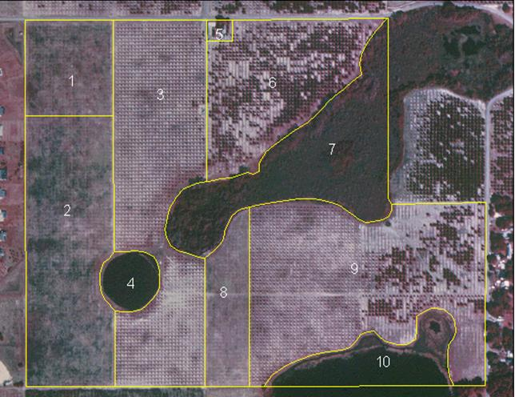
Conservation Ontology – Class “Area of Interest”
Area of Interest
(bounding box)

Slide 11
Conservation Ontology – Class “Assessment Area”
Area of Interest
(bounding box)
Assessment Area
(e.g. farm)
Resource Concern
(e.g. nutrients in surface water)

Slide 12
Conservation Ontology – Class “Management Unit”
Management Unit
(Fields 1 and 2, bahiagrass pasture managed the same)

Slide 13
Rules for delineating “Management Unit”
One or Two
Management Units?
(Fields 1, 2, and 8 managed the same)

Slide 14
Conservation Ontology – Class “Management System”
Management Unit
(Fields 1 and 2 managed the same)
Management System
Conservation Practice
(e.g. nutrient management)
Conservation Practice
(physical, e.g. buffer strip)
Management Period
(e.g. February-October)
Land Use (e.g. pasture)
Land Cover (e.g. bahiagrass)
Management Operation
(e.g. March 15 fertilization)

Slide 15
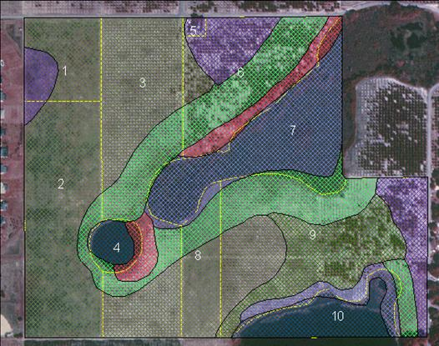
Conservation Ontology – Class “Response Unit”
Management Unit
(Fields 1 and 2 managed the same)
Response Unit
(three responses to management based on soil variation)
Management Effect
(e.g. on soil compaction)
Other Response Units
Hydrologic (surface)
Hydrologic (subsurface)
Wildlife Habitat
Airshed

Slide 16
Area of Interest (AOI)
bounds
0..*
Physiographic Area containing Natural Resource Data
intersects
1..*
IsBoundedBy
Assessment Area
hasConcern
1..*
Resource Concern
hasMgtArea
1..*
0..*
isMgtAreaOf
Management Unit
Conservation Management Unit
hasResponseArea
0..*
Response Unit
1
IsResponseAreaOf
hasSystem
1
hasEffect
1
0..*
isEffectOf
Management Effect
Conservation Effect
CPPE Score
0..*
isSystemOf
Management System
Active/Planned
Other
hasPractice
0..*
isPracticeOf
Conservation Practice
1
Core Classes of the
Conservation Ontology
hasPeriod
1
hasUse
Land Use
1..*
isPeriodOf
Management Period
hasCover
Land Cover
hasOperation
1
isOperationOf
Management Operation
0..*

Slide 17
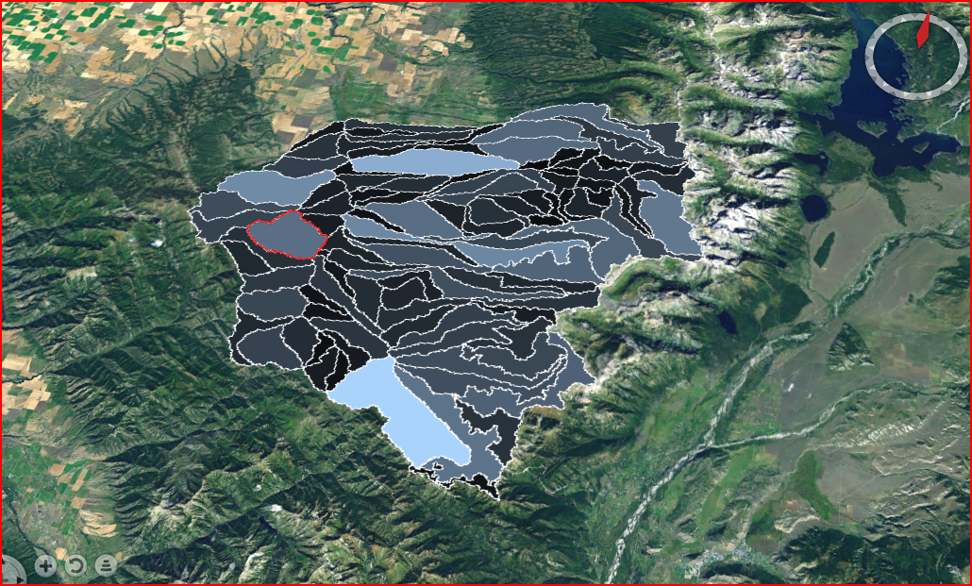
Conservation Ontology – Applies to Watershed Scale
Management Unit / Response Unit
(e.g. HRU)
Assessment Unit
(study area, e.g. forecast basin)
Area of Interest
(bounding box)

Slide 18
Summary and Next Steps
The conservation ontology and knowledge base (COKB) currently resides at http://oms.javaforge.org
It provides the concept model leading to the design of the databases supporting the new CDSI business applications
It provides a basis for re-factoring and integrating agro-environmental models as services in the CDSI architecture
The COKB will be extended to contain landscape classes, e.g. soil, climate, ecological site, vegetation; it also will be extended to guide the model service architecture
As it makes sense and to the extent possible, the COKB will leverage other concept models, e.g. hydrology from CUAHSI
It will enable the integration of information and knowledge found in databases, web sites, and other sources

Slide 19
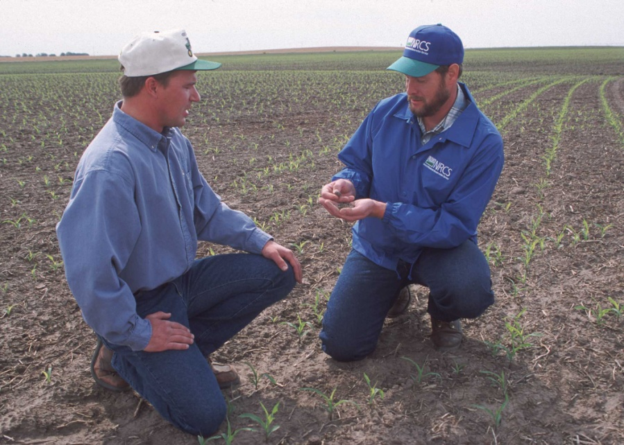
The fundamentally important relationship
Management
The farmer plans and makes decisions to produce crops, livestock, and other products and services with the objective of sustaining the land over the long-term.
Response
The conservationist provides consultation and advice on the natural resource response to management in order to assist the decision-making process.
The conservation ontology (concept model) is rooted in this relationship.
Program $$
Program Rules

Slide 20
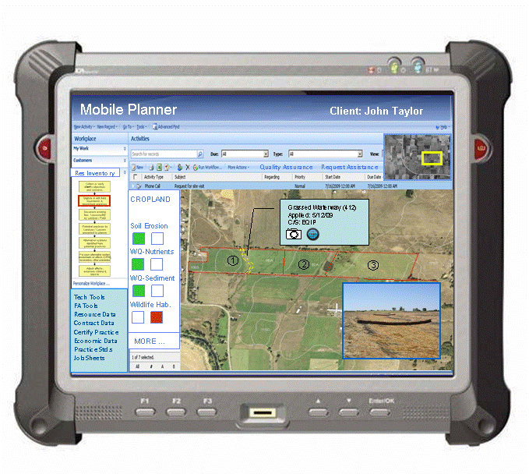
Questions?

