Slide 1


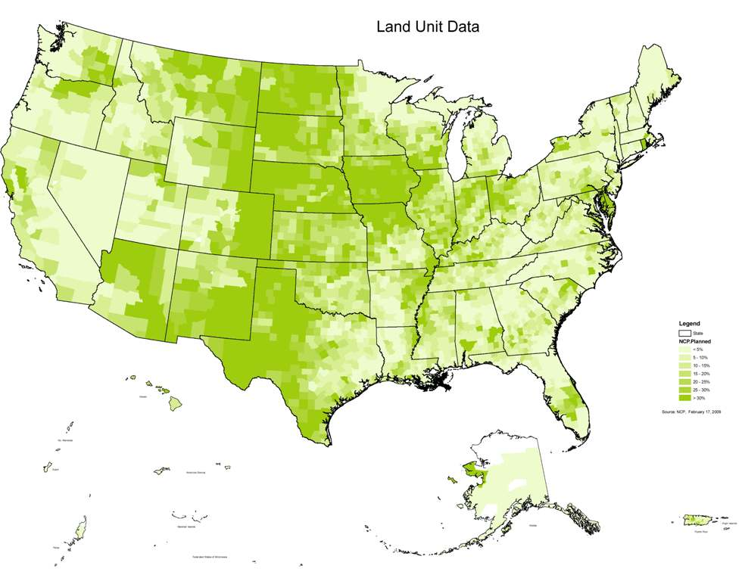
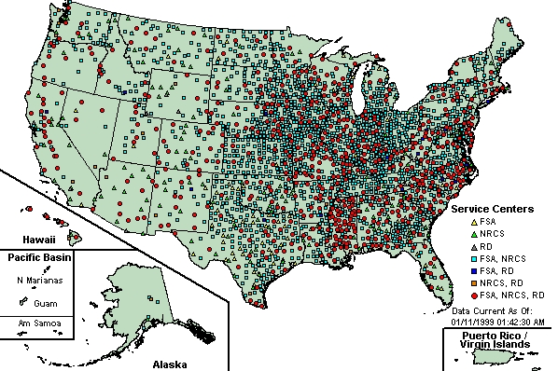
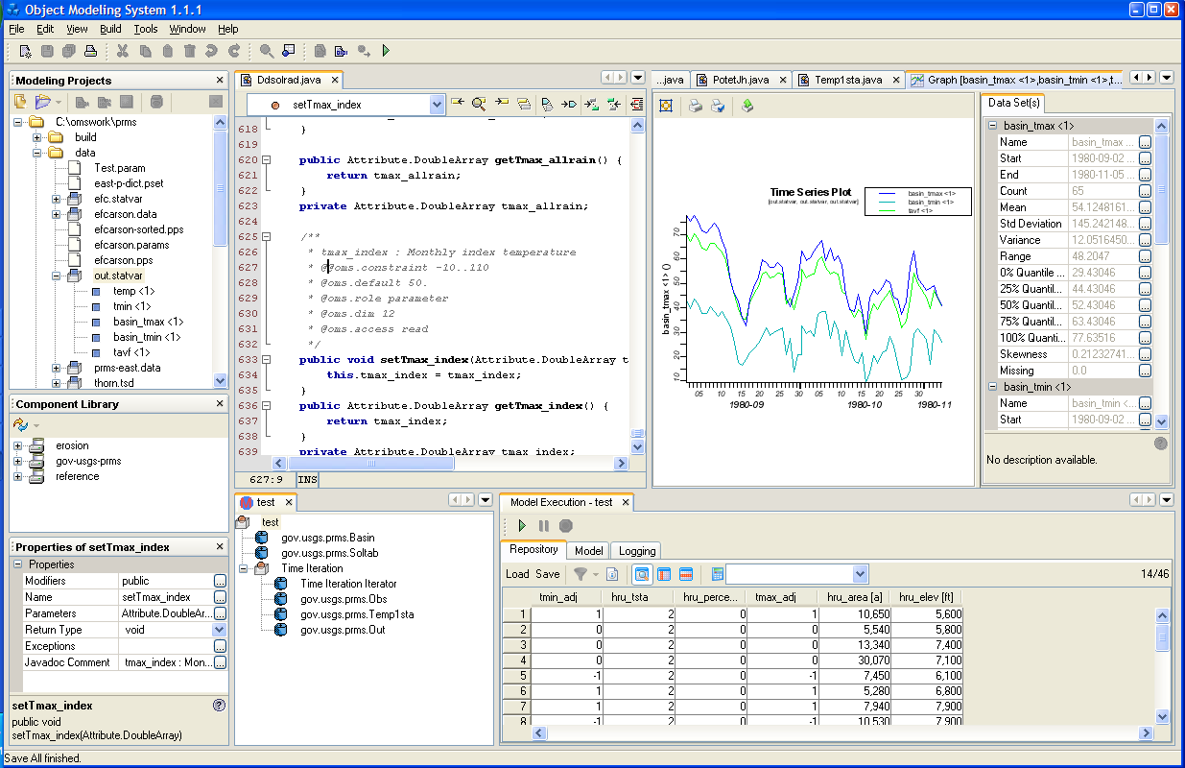
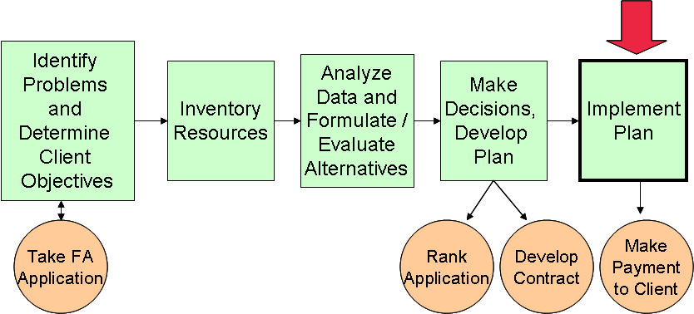
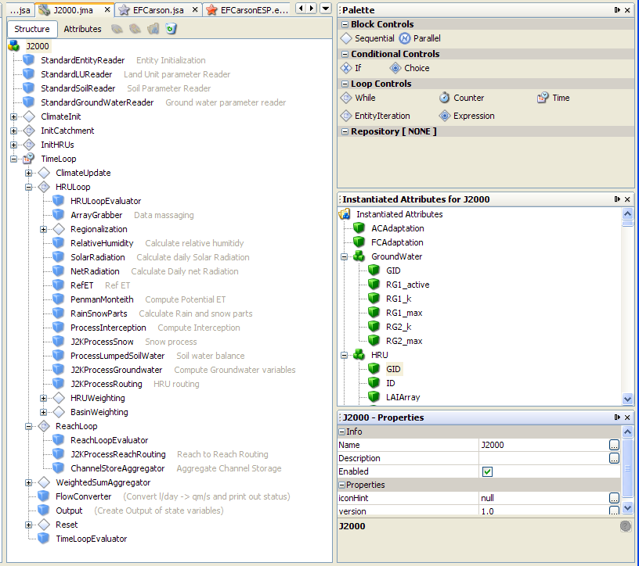
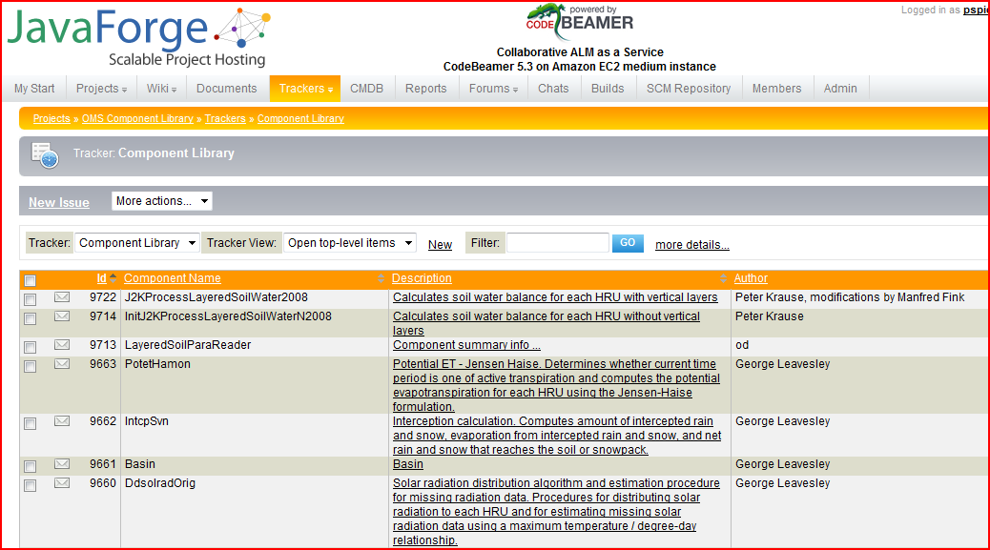
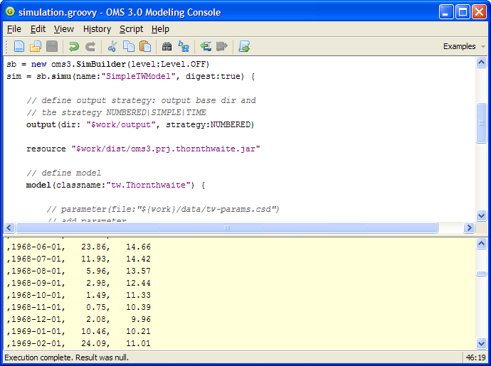
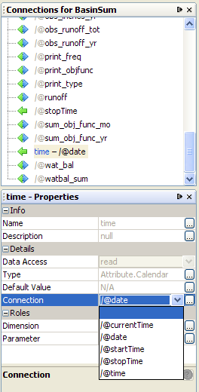
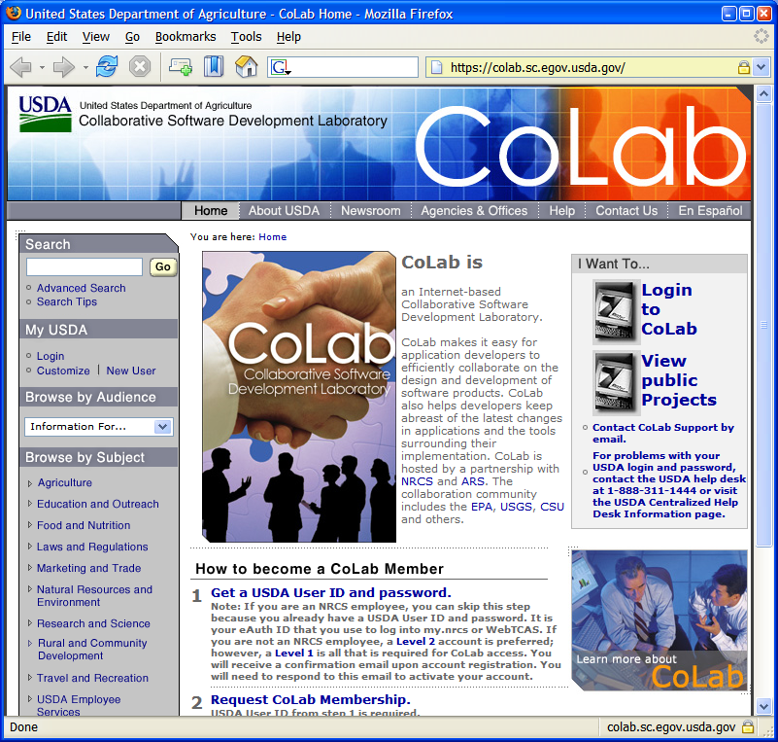
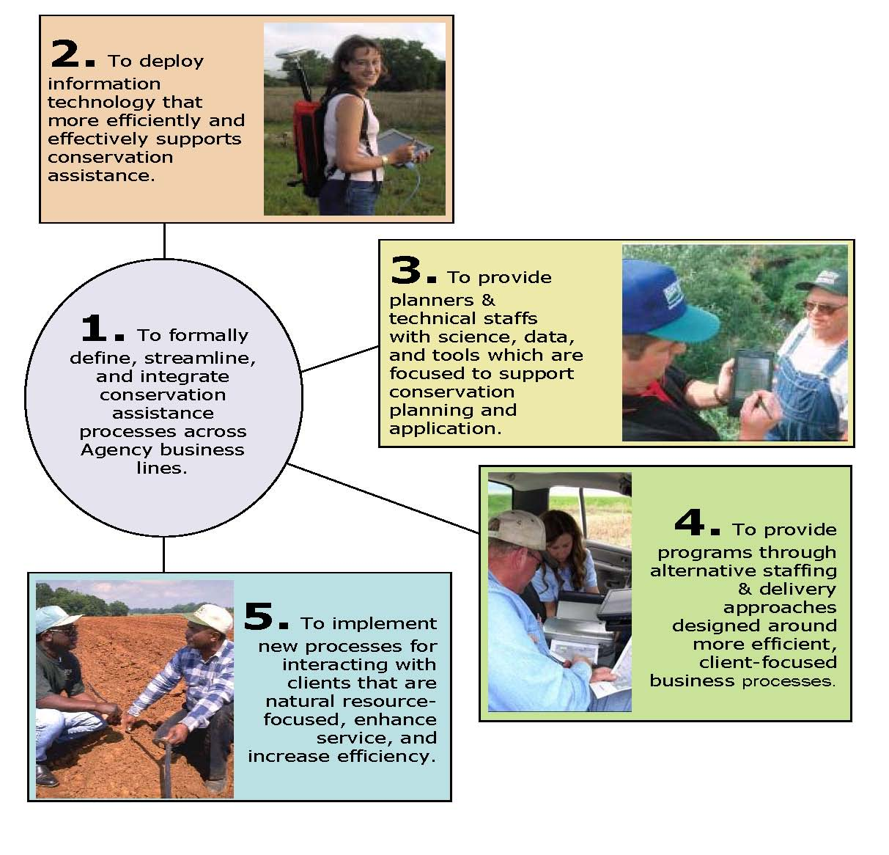
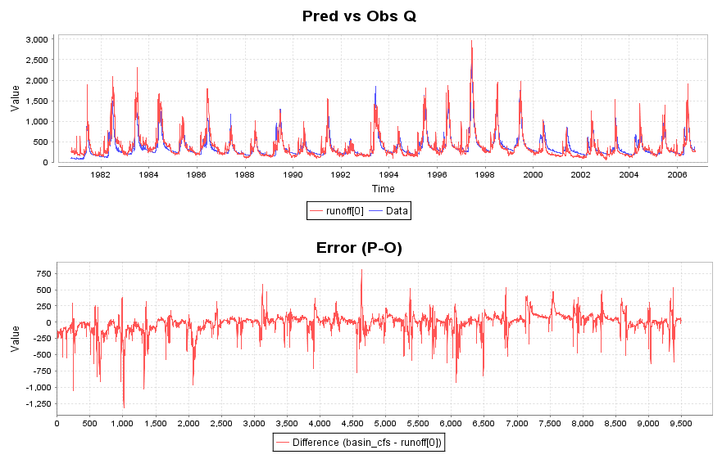
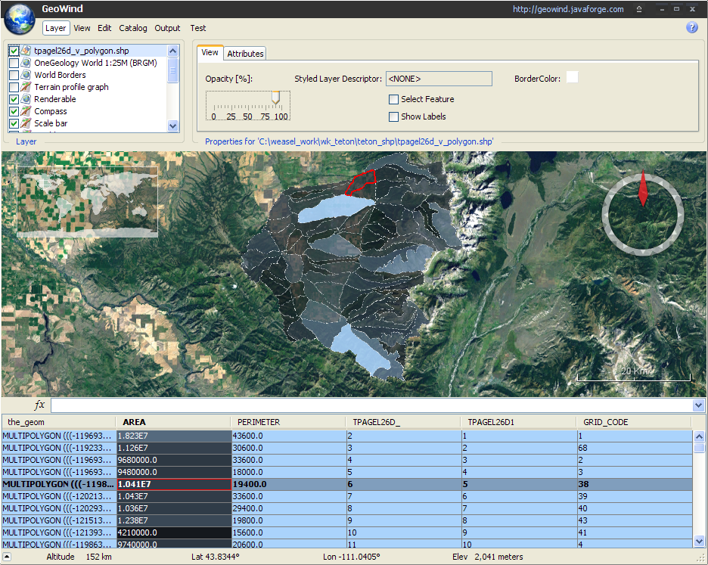
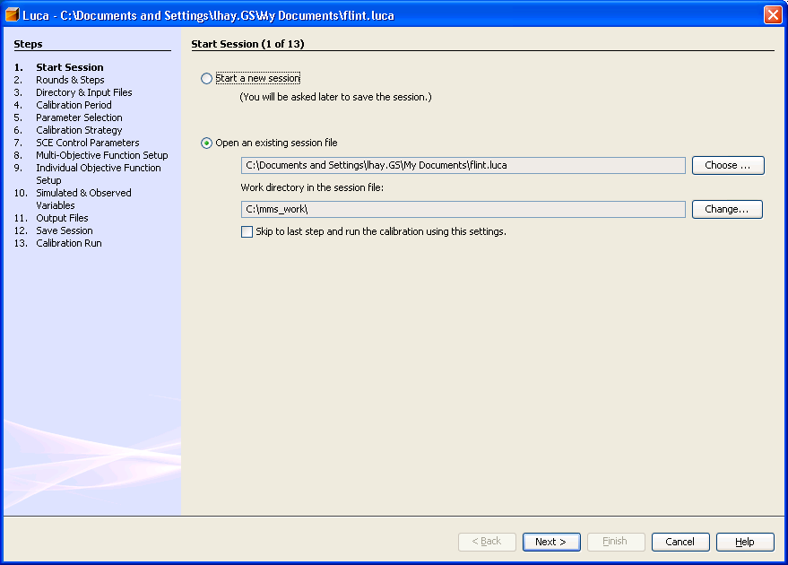
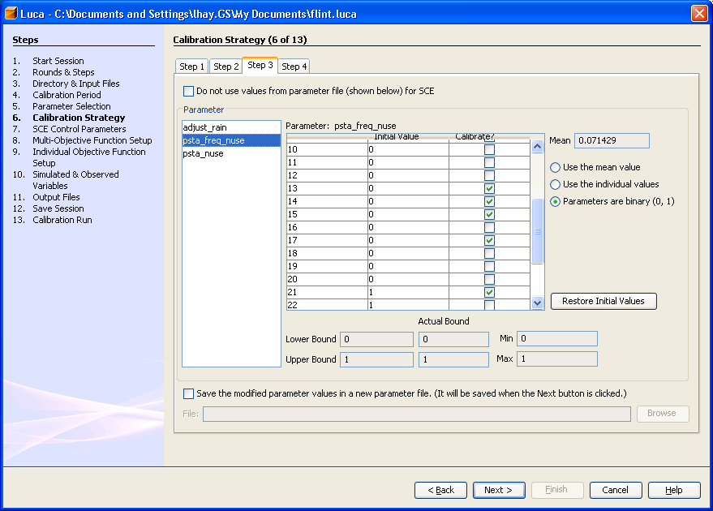
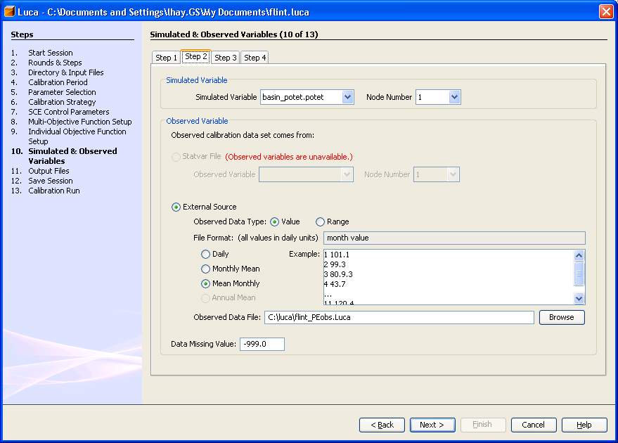
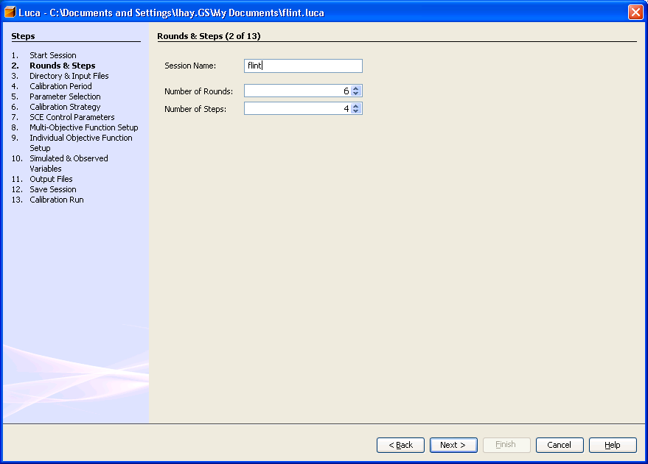
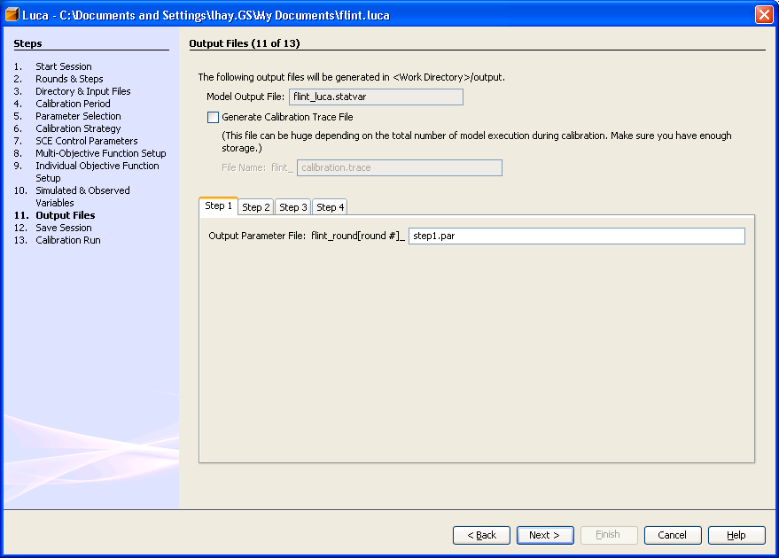
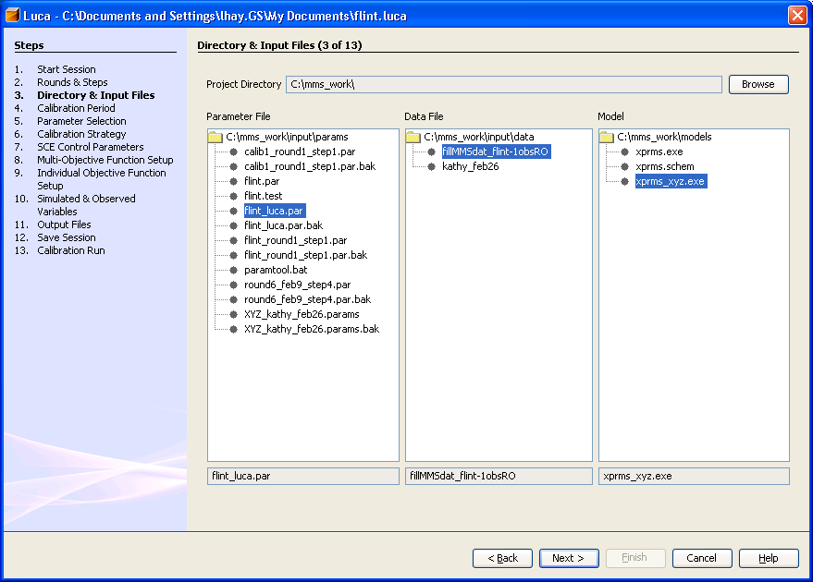
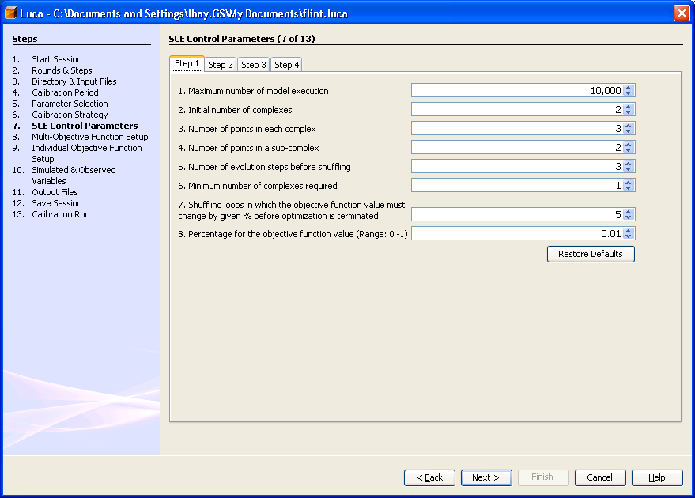
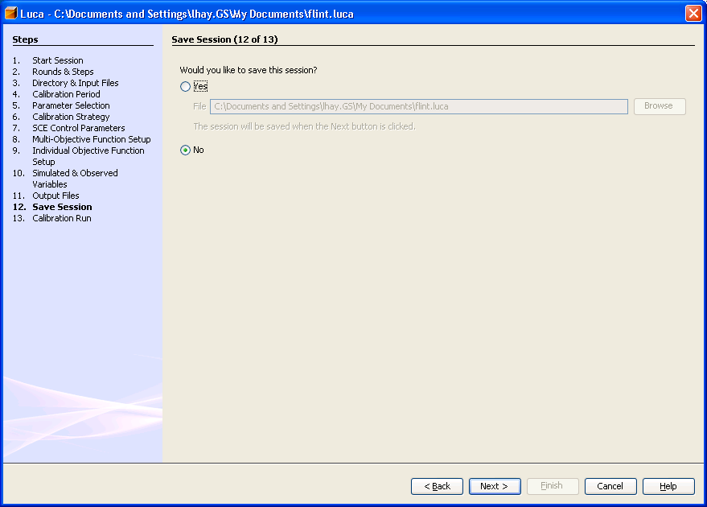
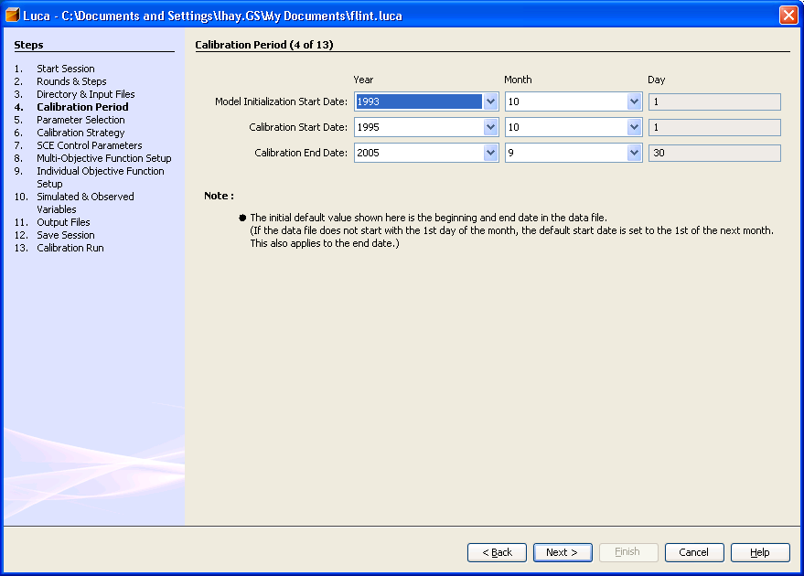
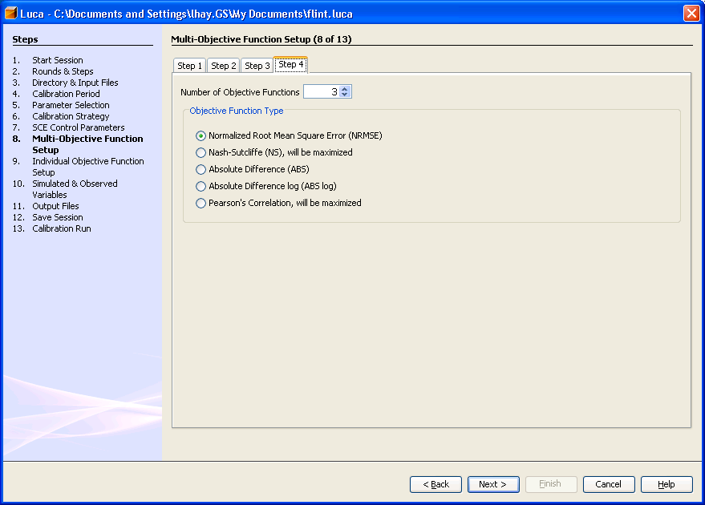
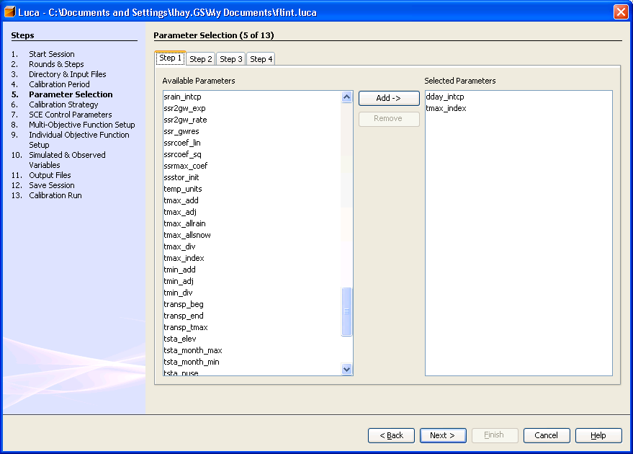
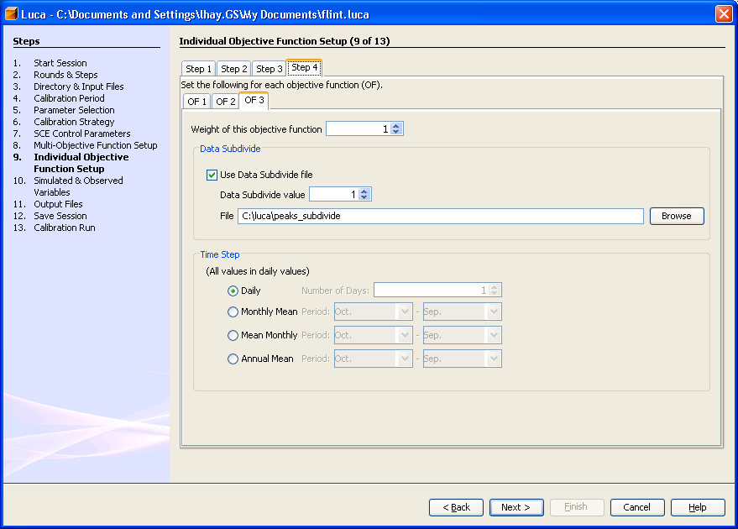
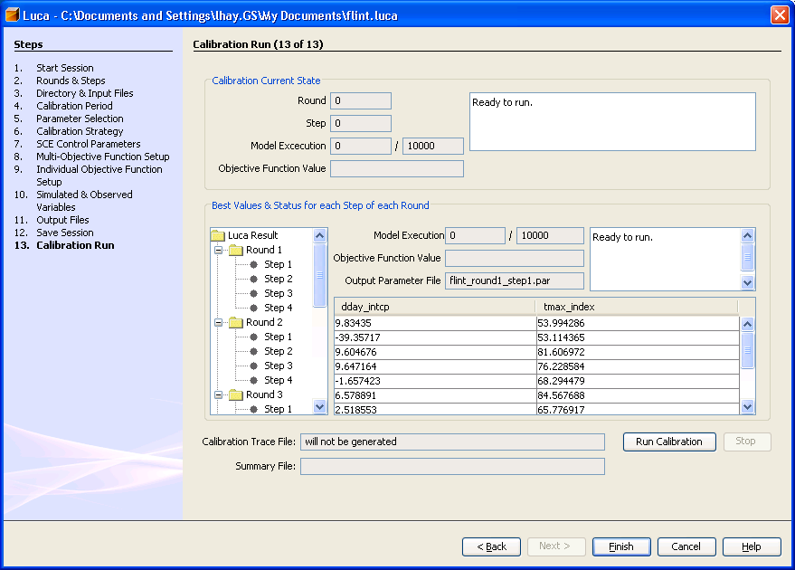
Farming Systems Modeling Using the Object Modeling System (OMS): Overview, Applications, and Future Plans
ABSTRACT
The United States Department of Agriculture (USDA) delivers technical assistance to operators of approximately two million farms and ranches through a network of 2,800 county level field service centers. Technical assistance includes conducting resource inventories and developing alternatives for optimizing the productivity and sustainability of the producer’s operation, as well as the watershed in which it is located. The models and tools to inventory, develop, and analyze solutions currently are not integrated into business processes in an efficient manner. Each tool is used separately with its own data and processing requirements, which limits their use. Furthermore, the additional workload to deliver financial assistance constrains time spent on technical assistance. To re-establish its emphasis on science-based technical assistance, the USDA Natural Resources Conservation Service (NRCS) established the Conservation Delivery Streamlining Initiative (CDSI). The initiative is leveraging the Object Modeling System (OMS) framework to integrate science components as model services into streamlined technical assistance workflows. OMS is a modular component-based framework for model development, data provisioning, testing, validation, and deployment. It contains a library of science, control, and database components (modules), and methods to assemble selected components into a modeling package customized to the problem, data constraints, and scale of application. The framework is supported by utility modules that provide a variety of data management, land unit delineation and parameterization, sensitivity analysis, calibration, statistical analysis, and visualization capabilities. OMS uses an open source software approach to enable several modelers across locations to collaboratively work on the model base supporting CDSI.
The Object Modeling System (OMS)
Natural Resource Model Base
http://oms.javaforge.com
OMS supports the concept of a model base, containing instances of models validated for the regions where it will be used, provisioned with data, and deployed as services available to customer business applications. Currently OMS contains two model bases, one for NRCS water supply forecasting, and one for conservation effects assessment.
OMS is a framework for ago-environmental model development, data provisioning, testing, validation, and deployment. It provides a bridge for transferring technology from the research organization to the program delivery agency. The framework provides a consistent and efficient way to create science components, build models, calibrate and test them, modify as the science advances, and re-purpose for emerging customer business requirements. OMS contains four platforms: (1) model development and validation, (2) data provisioning, (3) model services deployment, and (4) knowledge base and metadata management. OMS was released in 2004 and integrated into the NRCS technical architecture in 2008. With OMS 3.0, framework invasiveness has been removed, improving portability. Components typically represent a unique concept in a model like a physical process, a management practice, or a specific data input. Component attributes are fundamental data objects which a component reads input from and/or writes output to. Attributes are data elements in a model and provide communication among components. Components can be implemented in Java, FORTRAN, C, and C++.
The figures to the right show the location of USDA field offices and the extent of conservation plan acreage. Programs delivered through the 2008 Farm Bill requires the best science as the foundation for decision making and delivery of program benefits. With CDSI, NRCS deploys a farm/field scale model base to support resource inventory, the development of conservation alternatives, and the application of conservation plans. The model services within the model base
Modeling Projects
Component
Editor
Output
Analysis
Component-Based Modeling
Snowmelt
Attribute
Model
enable the analysis of treatment effects on soil erosion, soil quality, water quantity, water quality, plant/crop health and diversity, animal health and diversity, air quality, and energy conservation. Model services are validated by region, provisioned with data, and deployed in a service oriented architecture (SOA) to accommodate peak demand by field users.
Component Library
Component
Component
OMS Features
Snow
Soil
The CDSI farming system model base requires an explicit understanding of core concepts, such as area of interest, problem area, management concern, treatment unit, management system, conservation practice, crop/plant cover, management period and operation, response unit, and management effect. These entities will be managed in a knowledge base to facilitate interaction of model services with agency business applications, among model bases, and across agency business applications. Currently, the knowledge base is being built with Protégé 4.0.
CDSI Business Drivers
Passage of 2008 Farm Bill
Financial systems accountability
Strategic plan update
Human capital management
Emerging environmental issues (e.g. energy)
Transparency and accountability for outcomes
Conservation Delivery Streamlining Initiative
Assembled Model
Parameter Editor
USDA NRCS currently delivers technical assistance to producers through 1.4 million conservation plans on 250 million acres. USDA and partner field consultants must understand the producer’s farming system, and the technical assistance they provide usually involves proposed enhancements to the existing farming system.
Model Building and Component Connectivity
Modelers may use a common Integrated Development Environment to create components, and a simple OMS Domain Scripting Language (DSL) to assemble components into models and create simulations. Components are managed according to their data flow requirements, and attributes linkages among components are established. OMS provides a standard for annotating components and models to facilitate interoperability and re-use. A set of control components are available to support a variety of component linking strategies. Components can be local, or explored and retrieved from a remote repository. Collaborative model development is supported by the USDA Collaborative Software Development Laboratory (CoLab).
CDSI Technology Drivers
Service oriented architecture/CRM
GIS integration as “services” concept
Computing hardware & tools
Availability of geospatial data & natural resource models
Business process modeling technology
The planner and producer work through the process shown on the right to develop and apply a plan that conserves resources and optimizes the sustainability of the operation. The workflow involves both technical assistance (green) and financial
assistance (orange). Natural resource models are used to inventory resources, analyze data, formulate and evaluate plan alternatives. Tools include the Revised Universal Soil Loss Equation, Wind Erosion Equation, Nutrition Balance Analyzer, Soil Quality Index, Pesticide Screening Tool, Phosphorus Indexes, Energy Estimators, Wildlife Habitat Indexes, and Cost and Returns Estimator. More comprehensive models, such as the Agricultural Policy Extender (APEX) and Agricultural Nonpoint Source (annAGNPS), will be leveraged for on-farm system analysis.
Model Builder
The planner and producer will use a CDSI application that accesses model services of the farming system model base to output estimated effects of management on one or more of the following concerns: crop or plant yield, cost and returns, sheet/rill erosion, wind erosion, gully erosion, streambank erosion, soil compaction, soil organic matter, soil carbon, soil contaminants, soil nutrient cycling, surface runoff, groundwater, water yield, irrigation use efficiency, sediment yield, nutrients in runoff, pesticides in runoff, pathogens in water, salinity in water, ecological site diversity, threatened/endangered plants, livestock food/cover/water, terrestrial wildlife food/cover/connectivity/water, aquatic wildlife structure/food/water temperature, airborne particulates, greenhouse and ozone gases, chemical spray drift, odors, and energy conservation. The effects are analyzed and adjustments are made to the farming system, reflected in the producer’s conservation plan.
Model Component
Repository
The tools currently are used each in a stand alone mode, with their own data provisioning, user interface, and unique processing requirements. They are not integrated in a common conservation delivery workflow and therefore they are not used to their full potential.
The NRCS Conservation Delivery Streamlining Initiative (CDSI), chartered in 2008, is focused on restoring an emphasis on technical assistance, improving workflows, and integrating science into the agency delivery system in a more seamless manner. The five CDSI strategies are displayed in the figure to the left.
Model Simulation Console
Collaboration
Platform
Future Plans
Model Support and Analysis Components
The CDSI model base will be deployed as model services in a computing cloud and leverage cluster technology from Terracotta. The platform has been successfully prototyped in Amazon’s Elastic Computing Cloud (EC2). The model base must be able to accommodate 10,000 users and a peak load of 1,000 concurrent user sessions.
Another requirement is for a CDSI business application to be able to run model services on a notebook or tablet computer disconnected from the network. Work is in progress on the design of this feature.
Data provisioning involves the development of data access services and the coordination of available data sources, including soil (SSURGO), climate (ACIS and PRISM), crop/plant (PLANTS), ecological site (ESIS), management operations (LMOD), USDA common land unit (CLU), ortho-imagery, digital elevation (DEM), and research results (STEWARDS).
OMS will contain component, model, and simulation traceability to enable audit trails required in many agency program delivery initiatives.
CDSI currently is one of five envisioned model bases: farm/field resource analysis, watershed scale analysis, forecasting, practice design, and environmental credit determinations.
A variety of components are available to support the creation, visualization, and analysis of model input and model simulation results. These include graphical and statistical analysis tools, the USGS LUCA multiple-objective step-wise parameter calibration, Ensemble Streamflow Prediction (ESP), Shuffled Complex Evolution (SCE), Multi-objective Complex Evolution (MOCOM), Generalized Likelihood Uncertainty Estimation (GLUE), Dynamic Dimensioned Search (DDS), and Relative Sensitivity. Visualization of spatially distributed basin characteristics, model parameters, and input variables, as well as the visualization and animation of spatially distributed model output are provided by the GeoWind tool.
CDSI is leveraging the USDA Object Modeling System (OMS), developed by USDA-ARS, NRCS, US Geologic Survey, and Colorado State University, to integrate natural resource science into a common model base to support farm/field scale conservation planning. OMS can provide headless model instances with no user interface deployed as services to be used in the streamlined workflows of CDSI applications.
Graphical Tools
Soil Erosion
Conservation Delivery Model Base
Soil Quality 1
Nutrient Fate 1
Wildlife Habitat
Energy Conservation
Jack R. Carlson, USDA-ARS-ASRU¹ jack.carlson@ars.usda.gov
James C. Ascough II, USDA-ARS-ASRU¹ jim.ascough@ars.usda.gov
Olaf David, Colorado State University¹ odavid@colostate.edu
Lane C. Price, USDA-NRCS-CDSI² lane.price@nc.usda.gov
Timothy R. Green, USDA-ARS-ASRU¹ tim.green@ars.usda.gov
Ken Rojas, USDA-NRCS-ITC¹ ken.rojas@ftc.usda.gov
Lajpat R. Ahuja, USDA-ARS-ASRU¹ laj.ahuja@ars.usda.gov
W. Frank Geter, USDA-NRCS-ITC¹ frank.geter@ftc.usda.gov
¹ Fort Collins, Colorado; ² Raleigh, North Carolina
Enterprise Service Bus (OpenESB)
Air Quality
Soil Quality 2
Nutrient Fate 2
Web Service
Registry
CDSI Application
CDSI Application
CDSI Application
GeoWind
Analysis Tools (LUCA, ESP, SCE, MOCOM, GLUE, DDS)

