Slide 1

OMS 3.0
O. David, J. Carlson, J. Ascough II, K. Rojas, F. Geter, W. Lloyd
USDA - ARS - Agricultural Systems Research Unit
USDA – NRCS - Information Technology Center
Colorado State University

Slide 2
Environmental Modeling Frameworks
Support the development & application of environmental models
  Coupling, Execution management
  Analysis, Statistics, Visualization
  Spatial/Temporal relationships and management
  Calibration/Parameter Estimation/Uncertainty Analysis/Solver/…
  Data Access, …
Goals
  Eliminate redundancy
  Improve efficiency
  Simplify complicated tasks
Examples (NASA, DoE, EPA, USDA …)
  Earth System Modeling Framework, Common Component Architecture, Object Modeling System, OpenMI, Frames, and probably 10 more; MOU MIMS WG 1

Slide 3
System Components
Principal Architecture
Science Components
Component Based Model
Data IO
Temporal
Erosion
Spatial
Time
ETP
Plant Growth
Plant
growth
Irrigation
Space
Inter-
ception
Groundwater
Erosion
Water Quality
Control
Snow
Surface
RO
Stream RO
Statistics
Surface
water use
ET
Soil-
water
SS RO
Ground
water use
....
Ground-
water
GW Flow
ModelBuilder
Runtime
Projects
Calibration
Analysis
Component
Library

Slide 4
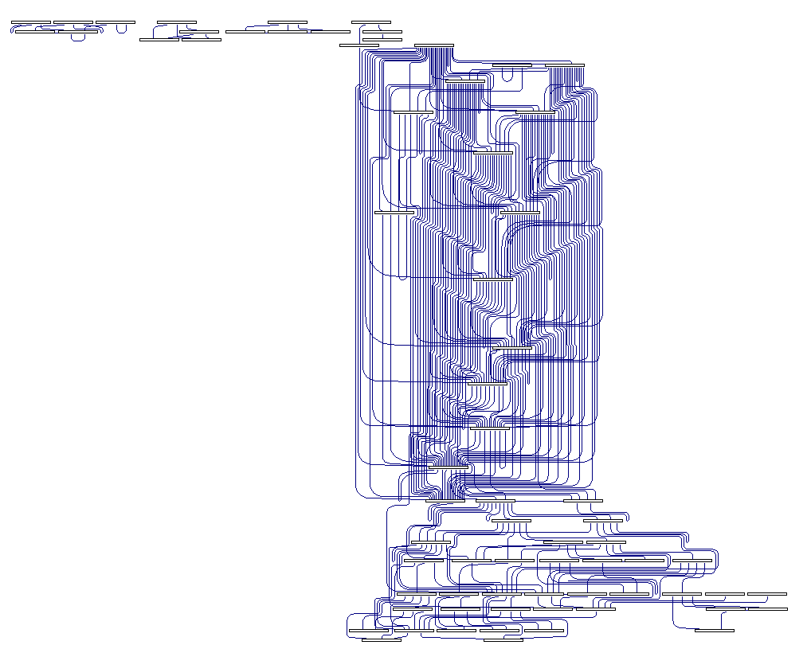
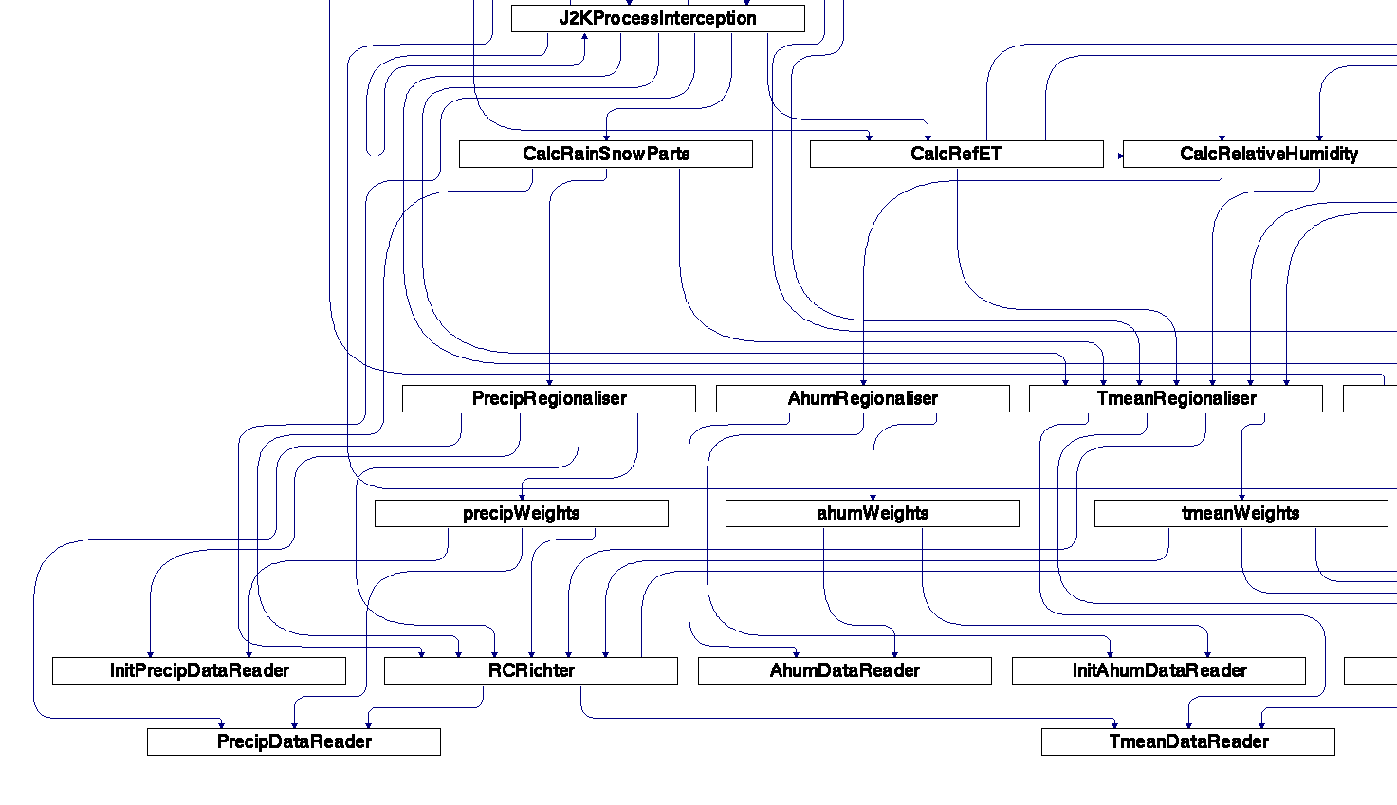
CEAP-SN Component interaction

Slide 5
OMS 2.2
Component-based Environmental modeling framework
Complex, single GUI for component development and integration, application and analysis
Application Programming Interface
Applications
  CEAP
  Water Supply Forecasting at NRCS NWCC (USGS – PRMS)
  Range Livestock Model (ASRU)
  Thornthwaite (with USGS)
  [WWEM (Prototype)]

Slide 6
OMS 3.0 Enhancements 2009
Support of multiple Integrated Development Environments (IDEs) to build models
Full language interoperability for FORTRAN/C/C++/Java, 32/64 bit, all major compiler and OS
Implicit parallelization of component execution to utilize today’s common computing resources
Model Scalability notebook -> desktop -> cluster -> cloud (EC2)
No specific “Application Programming Interface” to learn, use of code annotations that minimize framework API dependency in model component code (non-invasive)

Slide 7
OMS 3.0 Enhancements (cont.)
Calibration – Luca (Shuffled Complex Evolution), Dynamically Dimensional Search (DDS), NSGA, …
Sensitivity Analysis – Morris Screening, Extended FAST, Sobol
Uncertainty Analysis – GLUE, Bayesian Monte Carlo
Forecasting - ESP
OMS Component Library QA/QC (currently ~200 components)
Support tools for parameter delineation, visualization, and editing, Geospatial Tools – GeoWind integration
Relate models/components to Ontologies
Whole model integration possible

Slide 8
Example: GeoWind
GeoWind integrates NASA World Wind and GeoTools to
  delineate response units and performing other set-up for OMS model runs
  facilitate the model calibration process
  visualize model results
Introduced at AGU 2008
http://geowind.javaforge.com

Slide 9
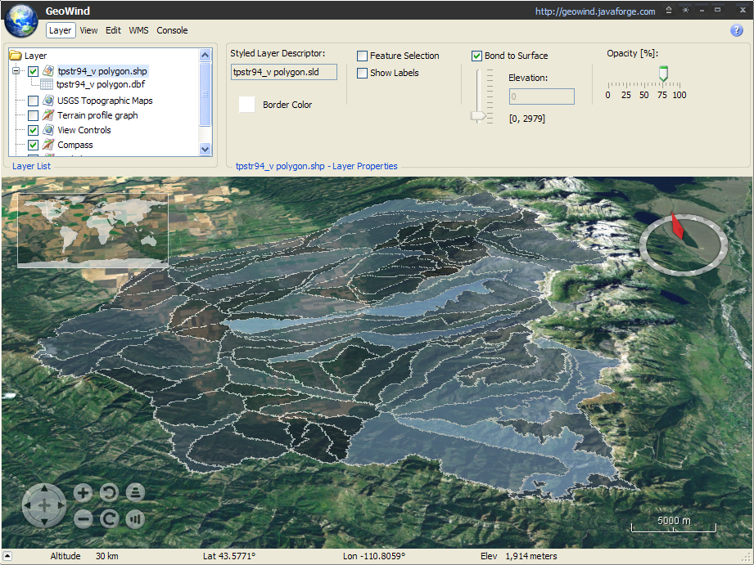

Slide 10
OMS 3.0 – Summary of Objectives and Features
Improve the process for modelers to develop and re-use science components
  Build science components as plain objects - POJOs
  Full Language interoperability
  Manage component and model metadata in a knowledge base
  Add geospatial interface
Improve accessibility and interoperability for agencies and organizations
  Establish data provisioning infrastructure
  Organize models into model bases
  Deploy and advertise model services in an elastic computing cloud
  Framework interoperability

Slide 11
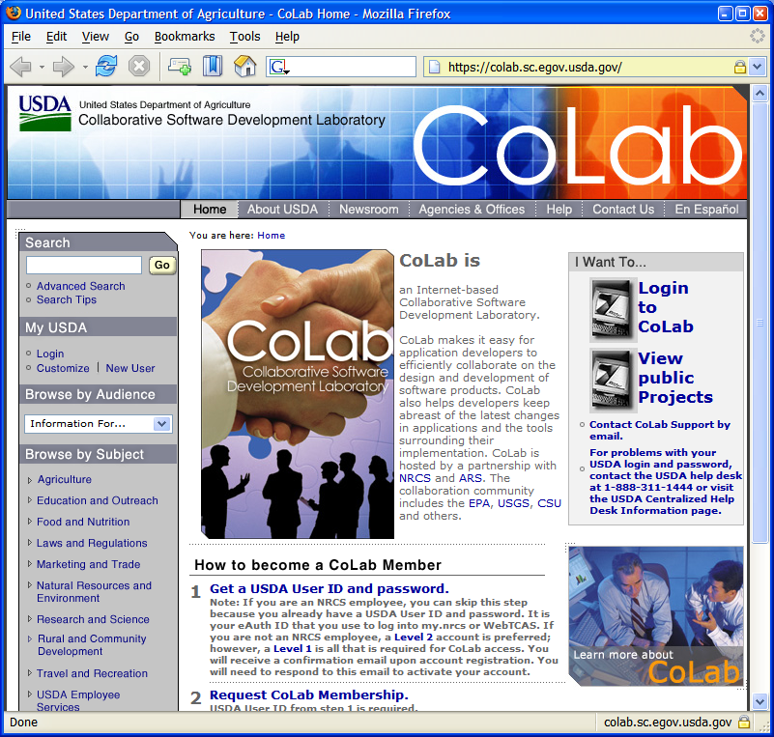
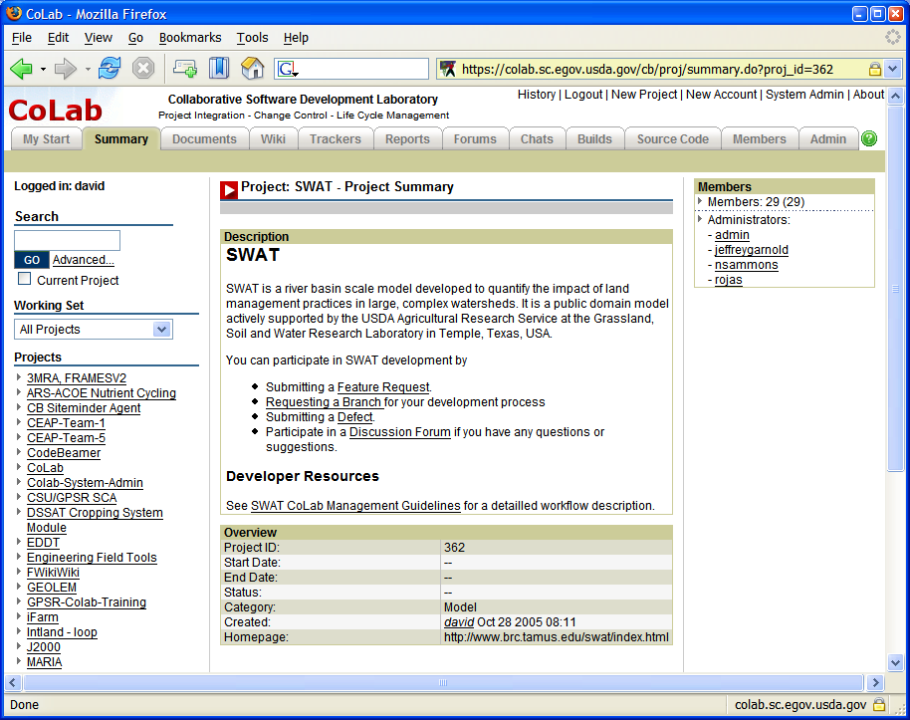
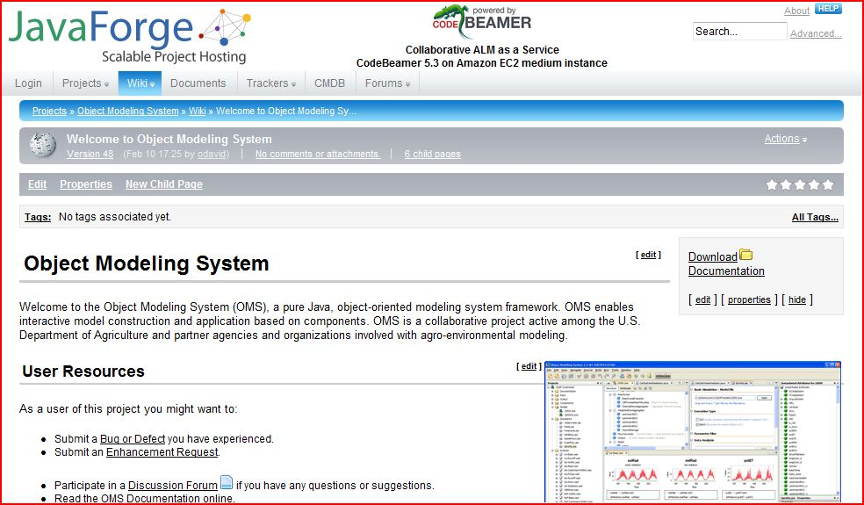
oms.javaforge.com

Slide 13
Key Concepts
Science Component
Model
Model Base
Model Service
Modeling Framework
Utility/Cloud Computing
Ontology / Knowledge Base
Self contained software unit representing a (bio-) physical process (e.g. Interception, ET, ..)
A component can consist of two or more components, in which case it is a compound component (e.g. Erosion, …)
A component can be tested, validated, certified, deployed, archived, and documented
input(s)
output(s)
processing

Slide 14
Key Concepts
Science Component
Model
Model Base
Model Service
Modeling Framework
Utility/Cloud Computing
Ontology / Knowledge Base
A model aggregates components
A model contains science components ((bio-)physical processes) plus system components (e.g. temporal or spatial operations, input/output).
A model is validated and certified.

Slide 15
Key Concepts
Science Component
Model
Model Base
Model Service
Modeling Framework
Utility/Cloud Computing
Ontology / Knowledge Base
A model base contains one or more model instances to satisfy the requirements of a primary business need.
Model instances are created as necessary for regions within the area of intended use.
The model base is calibrated for regions within the area of intended use.
Data is provisioned to the model base for regions within the area of intended use.

Slide 16
Key Concepts
A calibrated model base is packaged and deployed as one or more model services to a run-time platform.
Model services contain the data required to run the model instances within the model base.
Model services are deployed to a Service Oriented Architecture (SOA) as web services.
Agency/organization business applications call and run model services in a business workflow.
Science Component
Model
Model Base
Model Service
Modeling Framework
Utility/Cloud Computing
Ontology / Knowledge Base

Slide 17
Model Services for Business Applications
Business Application
Business
Workflow
Step 1
Step 2
Step 3
Step 4
Step 5
Step…
OMS Run-Time Platform
Model Base
Model
Services
Erosion
Runoff
Crop
Growth
N Fate/
Transport
P Fate/
Transport
Data
Services
OMS Data Mart (Soil, Climate, Plant, etc)

Slide 18
Key Concepts (continued)
A modeling framework supplies the system components, tools, and platforms necessary to build, validate, deploy, and support a model base.
Without a modeling framework, the modeling team must fill this void from scratch on an ad hoc basis.
Science Component
Model
Model Base
Model Service
Modeling Framework
Utility/Cloud Computing
Ontology / Knowledge Base
The Object Modeling System (OMS) is the USDA approved framework, currently the de facto standard.

Slide 19
Key Concepts
Model services are deployed to a utility computing platform that scales to user load.
Model services can be multi-threaded to increase performance under heavy user load.
Access to model services is mediated through interconnectivity agreements.
Science Component
Model
Model Base
Model Service
Modeling Framework
Utility/Cloud Computing
Ontology / Knowledge Base

Slide 20
Key Concepts
Science Component
Model
Model Base
Model Service
Modeling Framework
Utility/Cloud Computing
Ontology / Knowledge Base
Science components and models are stored in the modeling framework repository.
Science components and models contain metadata that facilitate their proper use and integration.
To reduce confusion, metadata are best managed using an ontology and knowledge base
Knowledge often is conceptual and non-computational.
A model can contain both computational components and those that run against a knowledge base.

Slide 21
The Object Modeling System (OMS)
OMS is a modeling framework, currently the only framework used within USDA; modeling frameworks are used by EPA, USGS, and agencies in Europe and Australia.
Modeling projects use OMS to build, validate, and deploy science components for agency business applications.
Through OMS, science components are aggregated into models, deployed as services, provisioned with data, and made available to agency business applications.
Users run agency applications containing a business workflow with processes that call OMS model services, such as erosion estimation, computing a forage balance, calculating runoff, etc.

Slide 22
OMS Contains…
System Components
  Data Input/Output
  Time
  Statistics
  Geospatial Interface
Modeling Project Management
Component Development Standard
Model Builder
Test Harness
Calibration Tools
Analysis Tools
Geospatial Tools
Visualization Tools
Science Component Library
Model / Component
Development and
Validation Platform
Model
Run-Time Platform
Data Provisioning
Platform
Knowledge Base
Platform

Slide 23
OMS Contains…
Model / Component
Development and
Validation Platform
Amazon Elastic Computing Cloud (EC2)
  Virtual service instances
  Virtual data storage
  Capacity adjusted to user load
Enterprise Service Bus (ESB) – Glassfish Enterprise Server
Multi-threading – Terracotta
Registered and advertized SOA-compliant web services
OMS operations team
Models also can be run within the OMS application on a desktop or notebook computer
Model
Run-Time Platform
Data Provisioning
Platform
Knowledge Base
Platform

Slide 24
OMS Contains…
Model / Component
Development and
Validation Platform
Data provisioning standard
Data mart for each model base
Operational data marts deployed to the run-time platform
Data access web services available to model bases
Data stewards for each model base
Data stewards are organized into data provisioning teams serving the respective areas of use.
Data marts fed by agency data warehouses through ETL process
Model
Run-Time Platform
Data Provisioning
Platform
Knowledge Base
Platform

Slide 25
OMS Contains…
Model / Component
Development and
Validation Platform
Ontology and knowledge base accounting for (among other entities):
  Science component/model
  Land unit
  Management system
  Conservation practice
  Resource concern
  Soil mapunit
  Ecological site
  Climate station
  Common resource area
  Plant/crop
  NRI sample unit
Model
Run-Time Platform
Data Provisioning
Platform
Knowledge Base
Platform

Slide 26
Model Development and Delivery Workflow
Review Team
Certify
Model
Modeling
Team
Build
Components
Build
Model
Validate
Model
Modeling Framework
OMS Model Base
OMS Model Base
OMS
API
OMS
Component
Library
OMS Knowledge Base
OMS Model Base
OMS Knowledge Base
OMS
Model
Base
Object Modeling System (OMS)
Data to Calibrate
and Run Model
OMS Model Services in Computing Cloud
OMS Operations Team
Deploy and Operate Model
Model Support Team
Provision
Data
Calibrate Certified Model
for Region of Use

