Slide 1
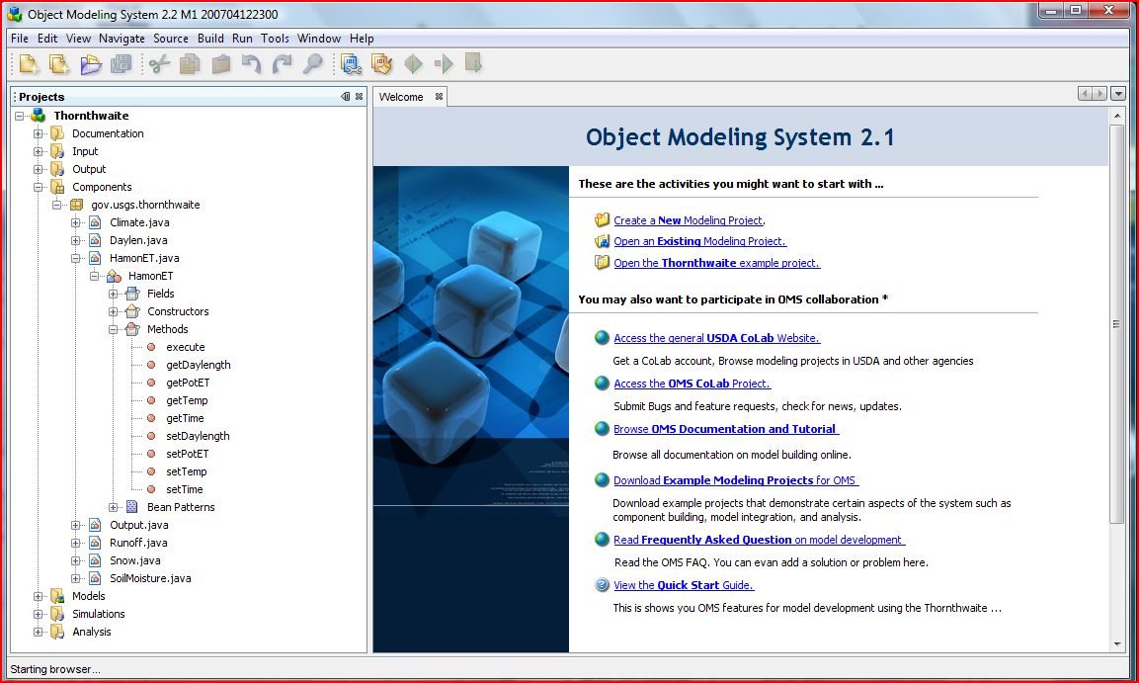

Delivery of Science Components to NRCS Business Applications
USDA - ARS - Agricultural Systems Research Unit
USDA – NRCS - Information Technology Center
Colorado State University – Civil Engineering and Computer Science

Slide 2
Key Concepts
Science Component
Model
Model Base
Model Service
Modeling Framework
Utility/Cloud Computing
Ontology / Knowledge Base

Slide 3
Key Concepts
Science Component
Model
Model Base
Model Service
Modeling Framework
Utility/Cloud Computing
Ontology / Knowledge Base
Self contained software unit representing a (bio-) physical process (e.g. interception, evapotranspiration, …)
A component can consist of two or more components, in which case it is a compound component (e.g. erosion, …)
A component can be tested, validated, certified, deployed, archived, and documented
input(s)
output(s)
processing

Slide 4
Key Concepts
Science Component
Model
Model Base
Model Service
Modeling Framework
Utility/Cloud Computing
Ontology / Knowledge Base
A model aggregates components.
A model contains science components ((bio-)physical processes) plus system components (e.g. temporal or spatial operations, input/output).
A model can be considered a compound component.
A model is validated and certified.

Slide 5
Key Concepts
Science Component
Model
Model Base
Model Service
Modeling Framework
Utility/Cloud Computing
Ontology / Knowledge Base
A model base contains one or more model instances to satisfy the requirements of a primary business need.
Model instances are created as necessary for regions within the area of intended use.
The model base is calibrated for regions within the area of intended use.
Data is provisioned to the model base for regions within the area of intended use.

Slide 6
Key Concepts
A calibrated model base is packaged and deployed as one or more model services to a run-time platform.
Model services contain the data required to run the model instances within the model base.
Model services are deployed to a Service Oriented Architecture (SOA) as web services.
Agency/organization business applications call and run model services in a business workflow.
Science Component
Model
Model Base
Model Service
Modeling Framework
Utility/Cloud Computing
Ontology / Knowledge Base

Slide 7
Model Services for Business Applications
Business Application
Business
Workflow
Step 1
Step 2
Step 3
Step 4
Step 5
Step…
OMS Run-Time Platform
Model Base
Model
Services
Erosion
Runoff
Crop
Growth
N Fate/
Transport
P Fate/
Transport
Data
Services
OMS Data Mart (Soil, Climate, Plant, etc)

Slide 8
Key Concepts (continued)
A modeling framework supplies the system components, tools, and platforms necessary to build, validate, deploy, and support a model base.
Without a modeling framework, the modeling team must fill this void from scratch on an ad hoc basis.
Science Component
Model
Model Base
Model Service
Modeling Framework
Utility/Cloud Computing
Ontology / Knowledge Base
The Object Modeling System (OMS) is the USDA approved framework, currently the de facto standard.

Slide 9
Key Concepts
Model services are deployed to a utility computing platform that scales to user load.
Model services can be multi-threaded to increase performance under heavy user load.
Access to model services is mediated through interconnectivity agreements.
Science Component
Model
Model Base
Model Service
Modeling Framework
Utility/Cloud Computing
Ontology / Knowledge Base

Slide 10
Key Concepts
Science Component
Model
Model Base
Model Service
Modeling Framework
Utility/Cloud Computing
Ontology / Knowledge Base
Science components and models are stored in the modeling framework repository.
Science components and models contain metadata that facilitate their proper use and integration.
To reduce confusion, metadata are best managed using an ontology and knowledge base
Knowledge often is conceptual and non-computational.
A model can contain both computational components and those that run against a knowledge base.

Slide 11
The Object Modeling System (OMS)
OMS is a modeling framework, currently the only framework used within USDA; modeling frameworks are used by EPA, USGS, and agencies in Europe and Australia.
Modeling projects use OMS to build, validate, and deploy science components for agency business applications.
Through OMS, science components are aggregated into models, deployed as services, provisioned with data, and made available to agency business applications.
Users run agency applications containing a business workflow with processes that call OMS model services, such as erosion estimation, computing a forage balance, calculating runoff, etc.

Slide 12
OMS Contains…
System Components
  Data Input/Output
  Time
  Statistics
  Geospatial Interface
Modeling Project Management
Component Development Standard
Model Builder
Test Harness
Calibration Tools
Analysis Tools
Geospatial Tools
Visualization Tools
Science Component Library
Model / Component
Development and
Validation Platform
Model
Run-Time Platform
Data Provisioning
Platform
Knowledge Base
Platform

Slide 13
OMS Contains…
Model / Component
Development and
Validation Platform
Amazon Elastic Computing Cloud (EC2)
  Virtual service instances
  Virtual data storage
  Capacity adjusted to user load
Enterprise Service Bus (ESB) – Glassfish Enterprise Server
Multi-threading – Terracotta
Registered and advertized SOA-compliant web services
OMS operations team
Models also can be run within the OMS application on a desktop or notebook computer
Model
Run-Time Platform
Data Provisioning
Platform
Knowledge Base
Platform

Slide 14
OMS Contains…
Model / Component
Development and
Validation Platform
Data provisioning standard
Data mart for each model base
Operational data marts deployed to the run-time platform
Data access web services available to model bases
Data stewards for each model base
Data stewards are organized into data provisioning teams serving the respective areas of use.
Data marts fed by agency data warehouses through ETL process
Model
Run-Time Platform
Data Provisioning
Platform
Knowledge Base
Platform

Slide 15
OMS Contains…
Model / Component
Development and
Validation Platform
Ontology and knowledge base accounting for (among other entities):
  Science component/model
  Land unit
  Management system
  Conservation practice
  Resource concern
  Soil mapunit
  Ecological site
  Climate station
  Common resource area
  Plant/crop
  NRI sample unit
Model
Run-Time Platform
Data Provisioning
Platform
Knowledge Base
Platform

Slide 16
Model Development and Delivery Workflow
Review Team
Certify
Model
Modeling
Team
Build
Components
Build
Model
Validate
Model
Modeling Framework
OMS Model Base
OMS Model Base
OMS
API
OMS
Component
Library
OMS Knowledge Base
OMS Model Base
OMS Knowledge Base
OMS
Model
Base
Object Modeling System (OMS)
Data to Calibrate
and Run Model
OMS Model Services in Computing Cloud
OMS Operations Team
Deploy and Operate Model
Model Support Team
Provision
Data
Calibrate Certified Model
for Region of Use

Slide 17
Proposed Conservation Model Bases
Conservation
Effects
Assessment
CEAP
Rapid Watershed Assessments
Conservation
Planning
Next Generation
Customer Service Toolkit
Conservation
Practice
Design
Engineering, Vegetative Practices
Ecosystem
Services
Carbon, Nitrogen
Ecosystem Health Indicators
Natural
Resource
Forecasting
Water Supply Forecasting
Forage Production

Slide 18
Conservation Program Delivery Workflow
Integrated
Assessment
Model Base
Conservation
Planning
Model Base
Ecosystem Services
Model Base
Practice
Design
Model Base
Model
Base
County
Office Process
Develop System
Evaluate System
Apply
System
Producer
Management Plans
Data Store
Above
County
Process
Focus
Program
Delivery
Build
Technical
Expertise
Determine Program
Activity
Determine Program
Impact
Watershed Assessments
Technical
Guide
Outcomes
Data Stores

